Slide 1
T1D Pathophysiology and Disease Management: What We Currently Know
Michael R. Rickels, MD, MS
Willard and Rhoda Ware Professor in Diabetes and Metabolic Diseases
University of Pennsylvania Perelman School of Medicine
Philadelphia, PA

Slide 2
Disclaimer
The views and opinions expressed in this educational activity are those of the faculty and do not necessarily represent the views of TotalCME, Inc., the CME providers, or the companies providing educational grants. This presentation is not intended to define an exclusive course of patient management; the participant should use their clinical judgment, knowledge, experience, and diagnostic skills in applying or adopting for professional use any of the information provided herein. Any procedures, medications, or other courses of diagnosis or treatment discussed or suggested in this activity should not be used by clinicians without evaluation of their patient's conditions and possible contraindications or dangers in use, review of any applicable manufacturer’s product information, and comparison with recommendations of other authorities. Links to other sites may be provided as additional sources of information.

Slide 3
Type 1 Diabetes
Autoimmune destruction of insulin-producing islet β-cells
1.6 million affected in the United States (US)
Increasing incidence with 5 million affected by 2050
Multidose injection or continuous subcutaneous insulin infusion (pump) therapy is required for survival
Only ~20% of adult patients receiving specialized diabetes care achieve HbA1c <7.0% (53 mmol/mol)¹
More than 7% of adult patients report having experienced severe hypoglycemia resulting in seizure or loss of consciousness in the previous 3 months¹
β-cells can be replaced by transplantation of allogeneic islets isolated from a deceased donor pancreas
Islet transplantation has completed phase 3 investigation in the US for patients with impaired awareness of hypoglycemia experiencing severe hypoglycemia

Slide 4
Type 1 Diabetes
Autoimmune destruction of insulin-producing islet β-cells
1.6 million affected in the United States (US)
Increasing incidence with 5 million affected by 2050
Multidose injection or continuous subcutaneous insulin infusion (pump) therapy is required for survival
Only ~20% of adult patients receiving specialized diabetes care achieve HbA1c <7.0% (53 mmol/mol)¹
More than 7% of adult patients report having experienced severe hypoglycemia resulting in seizure or loss of consciousness in the previous 3 months¹
β-cells can be replaced by transplantation of allogeneic islets isolated from a deceased donor pancreas
Islet transplantation has completed phase 3 investigation in the US for patients with impaired awareness of hypoglycemia experiencing severe hypoglycemia

Slide 5
Type 1 Diabetes
Autoimmune destruction of insulin-producing islet β-cells
1.6 million affected in the United States (US)
Increasing incidence with 5 million affected by 2050
Multidose injection or continuous subcutaneous insulin infusion (pump) therapy is required for survival
Only ~20% of adult patients receiving specialized diabetes care achieve HbA1c <7.0% (53 mmol/mol)¹
More than 7% of adult patients report having experienced severe hypoglycemia resulting in seizure or loss of consciousness in the previous 3 months¹
β-cells can be replaced by transplantation of allogeneic islets isolated from a deceased donor pancreas
Islet transplantation has completed phase 3 investigation in the US for patients with impaired awareness of hypoglycemia experiencing severe hypoglycemia

Slide 6
Type 1 Diabetes
Autoimmune destruction of insulin-producing islet β-cells
1.6 million affected in the United States (US)
Increasing incidence with 5 million affected by 2050
Multidose injection or continuous subcutaneous insulin infusion (pump) therapy is required for survival
Only ~20% of adult patients receiving specialized diabetes care achieve HbA1c <7.0% (53 mmol/mol)¹
More than 7% of adult patients report having experienced severe hypoglycemia resulting in seizure or loss of consciousness in the previous 3 months¹
β-cells can be replaced by transplantation of allogeneic islets isolated from a deceased donor pancreas
Islet transplantation has completed phase 3 investigation in the US for patients with impaired awareness of hypoglycemia experiencing severe hypoglycemia

Slide 7
Type 1 Diabetes
Autoimmune destruction of insulin-producing islet β-cells
1.6 million affected in the United States (US)
Increasing incidence with 5 million affected by 2050
Multidose injection or continuous subcutaneous insulin infusion (pump) therapy is required for survival
Only ~20% of adult patients receiving specialized diabetes care achieve HbA1c <7.0% (53 mmol/mol)¹
More than 7% of adult patients report having experienced severe hypoglycemia resulting in seizure or loss of consciousness in the previous 3 months¹
β-cells can be replaced by transplantation of allogeneic islets isolated from a deceased donor pancreas
Islet transplantation has completed phase 3 investigation in the US for patients with impaired awareness of hypoglycemia experiencing severe hypoglycemia

Slide 8
Type 1 Diabetes
Autoimmune destruction of insulin-producing islet β-cells
1.6 million affected in the United States (US)
Increasing incidence with 5 million affected by 2050
Multidose injection or continuous subcutaneous insulin infusion (pump) therapy is required for survival
Only ~20% of adult patients receiving specialized diabetes care achieve HbA1c <7.0% (53 mmol/mol)¹
More than 7% of adult patients report having experienced severe hypoglycemia resulting in seizure or loss of consciousness in the previous 3 months¹
β-cells can be replaced by transplantation of allogeneic islets isolated from a deceased donor pancreas
Islet transplantation has completed phase 3 investigation in the US for patients with impaired awareness of hypoglycemia experiencing severe hypoglycemia

Slide 9
Type 1 Diabetes
Autoimmune destruction of insulin-producing islet β-cells
1.6 million affected in the United States (US)
Increasing incidence with 5 million affected by 2050
Multidose injection or continuous subcutaneous insulin infusion (pump) therapy is required for survival
Only ~20% of adult patients receiving specialized diabetes care achieve HbA1c <7.0% (53 mmol/mol)¹
More than 7% of adult patients report having experienced severe hypoglycemia resulting in seizure or loss of consciousness in the previous 3 months¹
β-cells can be replaced by transplantation of allogeneic islets isolated from a deceased donor pancreas
Islet transplantation has completed phase 3 investigation in the US for patients with impaired awareness of hypoglycemia experiencing severe hypoglycemia

Slide 10
Type 1 Diabetes
Autoimmune destruction of insulin-producing islet β-cells
1.6 million affected in the United States (US)
Increasing incidence with 5 million affected by 2050
Multidose injection or continuous subcutaneous insulin infusion (pump) therapy is required for survival
Only ~20% of adult patients receiving specialized diabetes care achieve HbA1c <7.0% (53 mmol/mol)¹
More than 7% of adult patients report having experienced severe hypoglycemia resulting in seizure or loss of consciousness in the previous 3 months¹
β-cells can be replaced by transplantation of allogeneic islets isolated from a deceased donor pancreas
Islet transplantation has completed phase 3 investigation in the US for patients with impaired awareness of hypoglycemia experiencing severe hypoglycemia

Slide 11
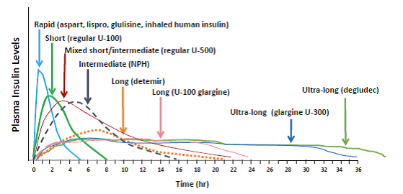
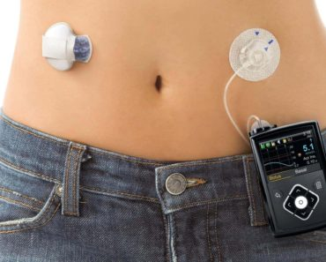

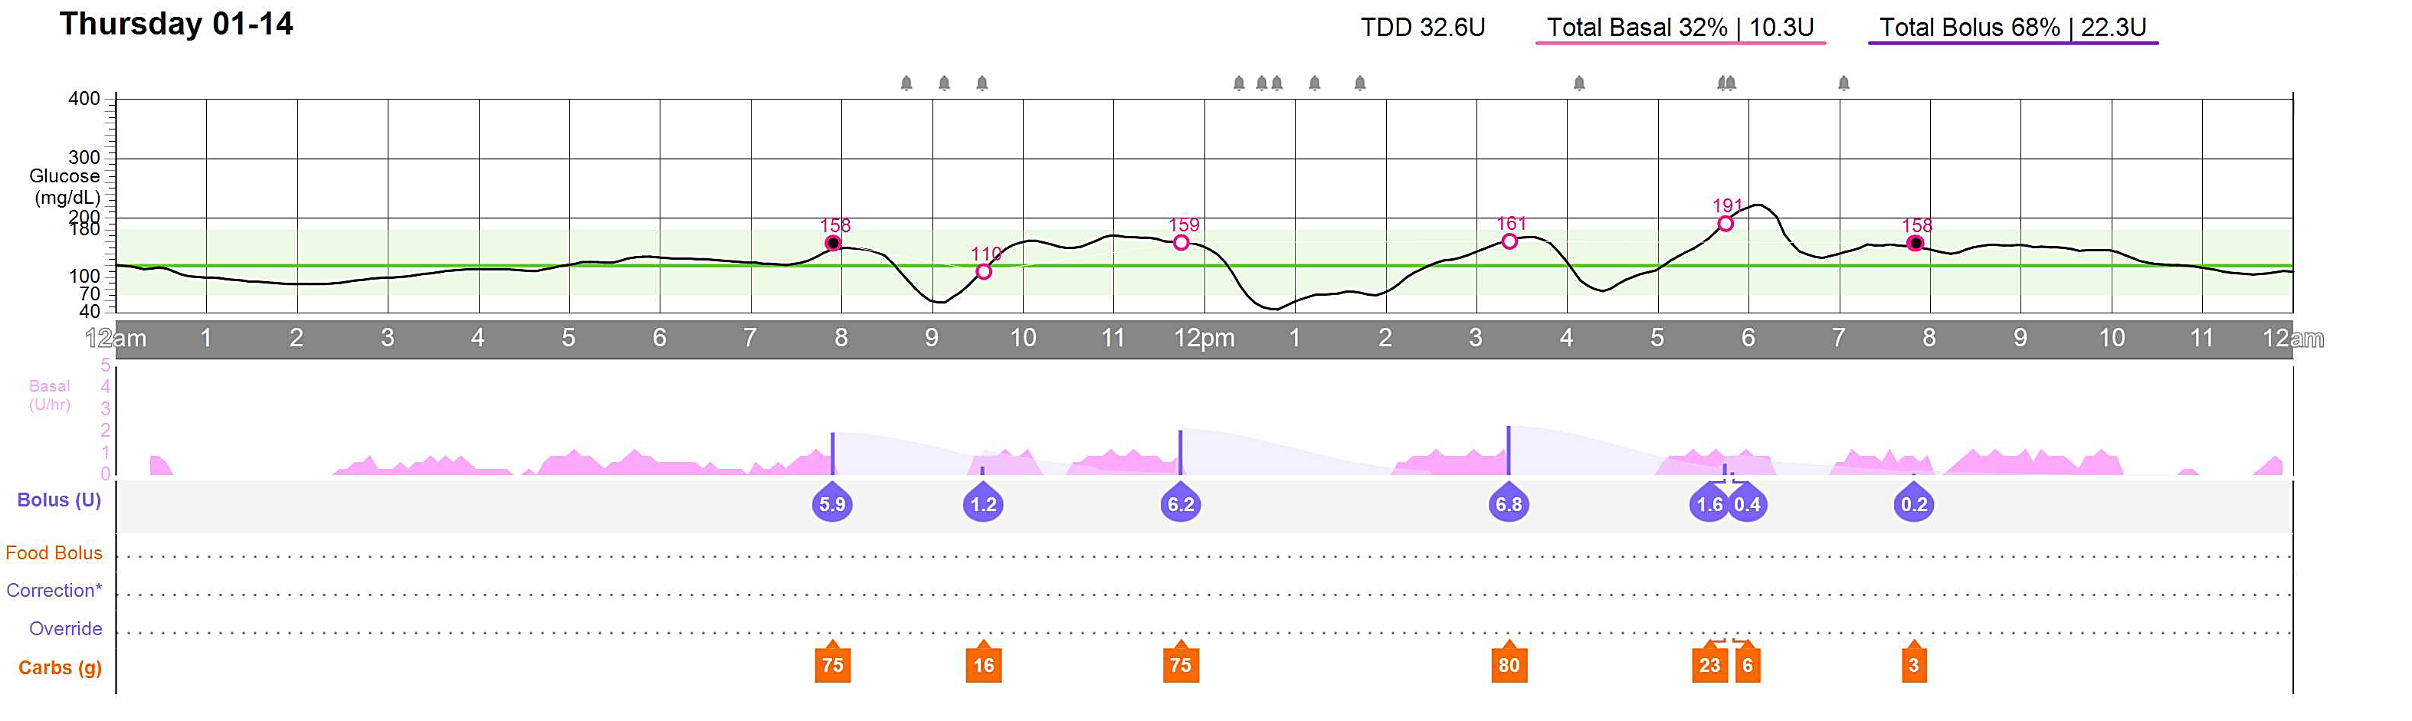
Multidose Injection or Pump Delivery

Slide 12
Severe Hypoglycemia in Type 1 Diabetes
Event Resulting in Seizure or Loss of Consciousness in Last 3 Months

Slide 13
Evolution of Type 1 Diabetes
Stage 1
Stage 2
Stage 3
Genetic
susceptibility
Inciting
event(s)
“Silent” β
cell loss
Diabetes
onset
“Brittle”
diabetes
100%
Islet β-cell
mass
50%
0%
Time (years)

Slide 14
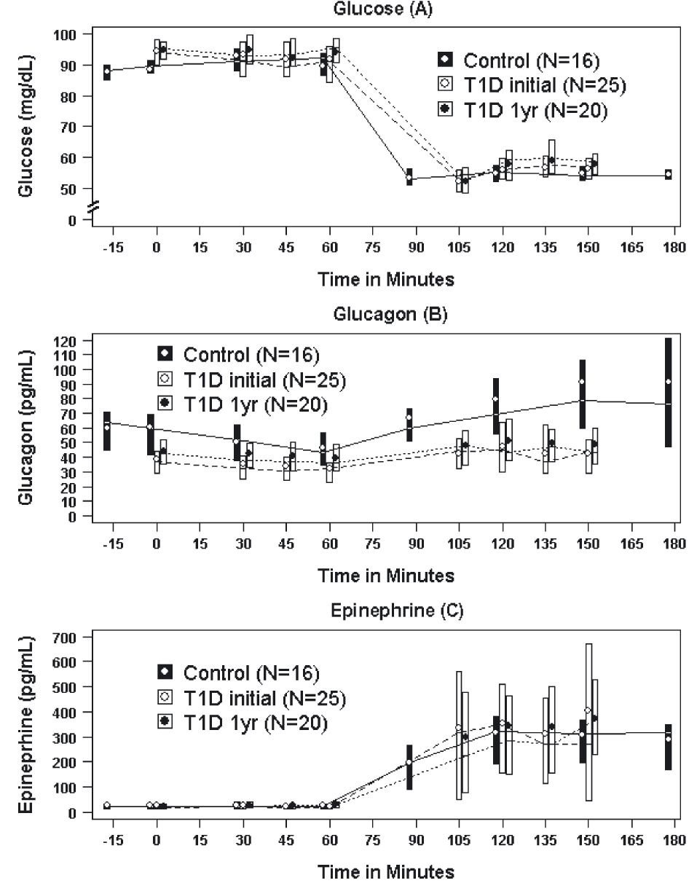
Glucagon Response Markedly Impaired at Diabetes Onset

Slide 15
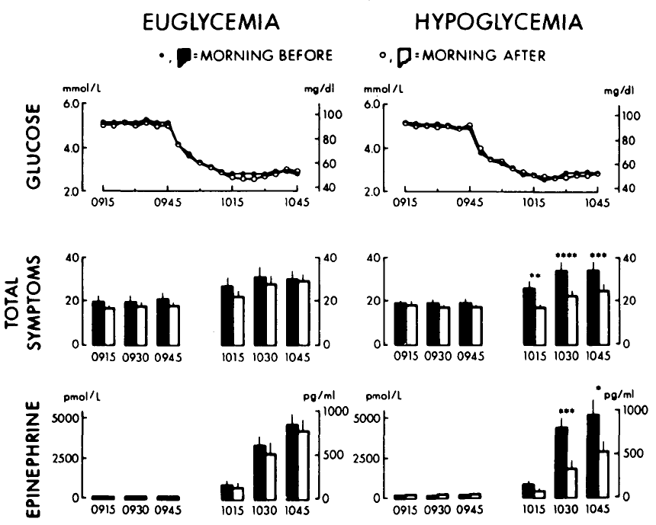
Blunting of Sympathoadrenal Responses to Hypoglycemia by Hypoglycemia
Nondiabetic humans
Type 1 diabetic humans
Dagogo-Jack SE, et al. J Clin Invest. 1993;91(3):819-828. doi:10.1172/JCI116302

Slide 16
Defective Glucose Counterregulation in Diabetes
↓Insulin
secretion
1° Defense
Islet cell
responses
↑Endogenous
glucose
production
↑Glucagon
secretion
↓Plasma
glucose
↓Peripheral
glucose
utilization
↑Plasma
glucose
↑Epinephrine
secretion
2° Defense
Sympathoadrenal
responses
↑Autonomic
symptoms
Food
ingestion

Slide 17
Defective Glucose Counterregulation in Diabetes
Near total β-cell loss
(C-peptide negative)
↓Insulin
secretion
1° Defense
Islet cell
responses
↑Endogenous
glucose
production
↑Glucagon
secretion
↓Plasma
glucose
↓Peripheral
glucose
utilization
↑Plasma
glucose
↑Epinephrine
secretion
2° Defense
Sympathoadrenal
responses
↑Autonomic
symptoms
Food
ingestion

Slide 18
Defective Glucose Counterregulation in Diabetes
Near total β-cell loss
(C-peptide negative)
↓Insulin
secretion
1° Defense
Islet cell
responses
↑Endogenous
glucose
production
↑Glucagon
secretion
↓Plasma
glucose
↓Peripheral
glucose
utilization
↑Plasma
glucose
↑Epinephrine
secretion
2° Defense
Sympathoadrenal
responses
↑Autonomic
symptoms
Food
ingestion

Slide 19
Defective Glucose Counterregulation in Diabetes
Near total β-cell loss
(C-peptide negative)
↓Insulin
secretion
1° Defense
Islet cell
responses
↑Endogenous
glucose
production
↑Glucagon
secretion
↓Plasma
glucose
↓Peripheral
glucose
utilization
↑Plasma
glucose
↑Epinephrine
secretion
2° Defense
Sympathoadrenal
responses
↑Autonomic
symptoms
Food
ingestion
Hypoglycemia-associated
autonomic failure (HAAF)

Slide 20
Defective Glucose Counterregulation in Diabetes
Near total β-cell loss
(C-peptide negative)
↓Insulin
secretion
1° Defense
Islet cell
responses
↑Endogenous
glucose
production
↑Glucagon
secretion
↓Plasma
glucose
↓Peripheral
glucose
utilization
↑Plasma
glucose
↑Epinephrine
secretion
2° Defense
Sympathoadrenal
responses
↑Autonomic
symptoms
Food
ingestion
Hypoglycemia-associated
autonomic failure (HAAF)

Slide 21
Defective Glucose Counterregulation in Diabetes
Near total β-cell loss
(C-peptide negative)
↓Insulin
secretion
1° Defense
Islet cell
responses
↑Glucagon
secretion
↓Plasma
glucose
↓Peripheral
glucose
utilization
↑Plasma
glucose
↑Epinephrine
secretion
2° Defense
Sympathoadrenal
responses
↑Autonomic
symptoms
Food
ingestion
Hypoglycemia-associated
autonomic failure (HAAF)

Slide 22
Summary
Achievement of target glycemic control and avoidance of severe hypoglycemia remain major challenges for most patients living with type 1 diabetes
Absent islet cell responses predispose a cycle of hypoglycemia that begets hypoglycemia, resulting in impaired glucose counterregulation and the syndrome of hypoglycemia-associated autonomic failure (HAAF)

