Slide 1
Psychosocial Considerations in Managing XLH
Anne E. Dawson, PhD
Pediatric Psychologist
Nationwide Children’s Hospital
Columbus, OH

Slide 2
Disclaimer
The views and opinions expressed in this educational activity are those of the faculty and do not necessarily represent the views of TotalCME, Inc., the CME providers, or the companies providing educational grants. This presentation is not intended to define an exclusive course of patient management; the participant should use their clinical judgment, knowledge, experience, and diagnostic skills in applying or adopting for professional use any of the information provided herein. Any procedures, medications, or other courses of diagnosis or treatment discussed or suggested in this activity should not be used by clinicians without evaluation of their patient's conditions and possible contraindications or dangers in use, review of any applicable manufacturer’s product information, and comparison with recommendations of other authorities. Links to other sites may be provided as additional sources of information.

Slide 3
Developmental Considerations
Children
Physical Development
Emotional Development
Social Development
Cognitive Development

Slide 4
Developmental Considerations
Children
Physical Development
More logical/black & white
Tend to follow parents’ views of “right” vs. “wrong”
Emotional Development
Social Development
Cognitive Development

Slide 5
Developmental Considerations
Children
Friendships tend to be same-sex/same-gender
Bonding based on play
Physical Development
More logical/black & white
Tend to follow parents’ views of “right” vs. “wrong”
Emotional Development
Social Development
Cognitive Development

Slide 6
Developmental Considerations
Children
Increasing complexity of emotions
Improved emotion identification
Friendships tend to be same-sex/same-gender
Bonding based on play
Physical Development
More logical/black & white
Tend to follow parents’ views of “right” vs. “wrong”
Emotional Development
Social Development
Cognitive Development

Slide 7
Developmental Considerations
Typical initiation of puberty
Growth spurts common
Strengthening of muscles and bones
Children
Increasing complexity of emotions
Improved emotion identification
Friendships tend to be same-sex/same-gender
Bonding based on play
Physical Development
More logical/black & white
Tend to follow parents’ views of “right” vs. “wrong”
Emotional Development
Social Development
Cognitive Development

Slide 8
Developmental Considerations
Typical initiation of puberty
Growth spurts common
Strengthening of muscles and bones
Children
Increasing complexity of emotions
Improved emotion identification
Friendships tend to be same-sex/same-gender
Bonding based on play
Physical Development
More logical/black & white
Tend to follow parents’ views of “right” vs. “wrong”
Emotional Development
Social Development
Cognitive Development
Increased abstract reasoning
Increased risk-taking
Tend to question parents’ views and seek independence
Active identity development exploration
Adolescents

Slide 9
Developmental Considerations
Typical initiation of puberty
Growth spurts common
Strengthening of muscles and bones
Children
Increasing complexity of emotions
Improved emotion identification
Friendships tend to be same-sex/same-gender
Bonding based on play
Physical Development
More logical/black & white
Tend to follow parents’ views of “right” vs. “wrong”
Emotional Development
Social Development
Cognitive Development
Friendships are more diverse and relationally intimate
Increased interest in dating
Friend values become increasingly important
Increased social comparison
Increased abstract reasoning
Increased risk-taking
Tend to question parents’ views and seek independence
Active identity development exploration
Adolescents

Slide 10
Developmental Considerations
Typical initiation of puberty
Growth spurts common
Strengthening of muscles and bones
Children
Increasing complexity of emotions
Improved emotion identification
Friendships tend to be same-sex/same-gender
Bonding based on play
Physical Development
More logical/black & white
Tend to follow parents’ views of “right” vs. “wrong”
Emotional Development
Social Development
Cognitive Development
Greater emotional extremes
Increased rates of depression/anxiety
Friendships are more diverse and relationally intimate
Increased interest in dating
Friend values become increasingly important
Increased social comparison
Increased abstract reasoning
Increased risk-taking
Tend to question parents’ views and seek independence
Active identity development exploration
Adolescents

Slide 11
Developmental Considerations
Typical initiation of puberty
Growth spurts common
Strengthening of muscles and bones
Children
Increasing complexity of emotions
Improved emotion identification
Friendships tend to be same-sex/same-gender
Bonding based on play
Physical Development
More logical/black & white
Tend to follow parents’ views of “right” vs. “wrong”
Emotional Development
Social Development
Development of secondary sex characteristics
Fully developed reproductive organs
Ongoing growth and muscle development
Cognitive Development
Greater emotional extremes
Increased rates of depression/anxiety
Friendships are more diverse and relationally intimate
Increased interest in dating
Friend values become increasingly important
Increased social comparison
Increased abstract reasoning
Increased risk-taking
Tend to question parents’ views and seek independence
Active identity development exploration
Adolescents

Slide 12
Developmental Considerations
Typical initiation of puberty
Growth spurts common
Strengthening of muscles and bones
Children
Increasing complexity of emotions
Improved emotion identification
Friendships tend to be same-sex/same-gender
Bonding based on play
Physical Development
More logical/black & white
Tend to follow parents’ views of “right” vs. “wrong”
Emotional Development
Changing emphasis on importance of friends, romantic relationships, family relationships, school, hobbies, and future/career
Social Development
Development of secondary sex characteristics
Fully developed reproductive organs
Ongoing growth and muscle development
Cognitive Development
Greater emotional extremes
Increased rates of depression/anxiety
Friendships are more diverse and relationally intimate
Increased interest in dating
Friend values become increasingly important
Increased social comparison
Increased abstract reasoning
Increased risk-taking
Tend to question parents’ views and seek independence
Active identity development exploration
Adolescents

Slide 13
Transitioning
Setting the Stage: initiation of Health Care Transition (HCT) preparation and transition readiness assessment
Moving Forward: ongoing provision of HCT services
Reaching the Goal: transfer to adult-focused providers

Slide 14
Transitioning
Setting the Stage: initiation of Health Care Transition (HCT) preparation and transition readiness assessment
Introduce transition to patients early and often with frequent conversations to present opportunities for questions/information review (e.g., create a routine around transition conversations)
Discuss areas to achieve improved mastery through scaffolding (e.g., understanding health insurance, identifying medications, knowing signs/symptoms of concerns)
Caregivers and providers understand that anxiety about transitioning is expected rather than “bad,” to best support the patient through their distress
Friendship role - start practicing “elevator pitch” so the patient can learn how to explain their health care needs

Slide 15
Transitioning
Setting the Stage: initiation of Health Care Transition (HCT) preparation and transition readiness assessment
Introduce transition to patients early and often with frequent conversations to present opportunities for questions/information review (e.g., create a routine around transition conversations)
Discuss areas to achieve improved mastery through scaffolding (e.g., understanding health insurance, identifying medications, knowing signs/symptoms of concerns)
Caregivers and providers understand that anxiety about transitioning is expected rather than “bad,” to best support the patient through their distress
Friendship role - start practicing “elevator pitch” so the patient can learn how to explain their health care needs

Slide 16
Transitioning
Setting the Stage: initiation of Health Care Transition (HCT) preparation and transition readiness assessment
Introduce transition to patients early and often with frequent conversations to present opportunities for questions/information review (e.g., create a routine around transition conversations)
Discuss areas to achieve improved mastery through scaffolding (e.g., understanding health insurance, identifying medications, knowing signs/symptoms of concerns)
Caregivers and providers understand that anxiety about transitioning is expected rather than “bad,” to best support the patient through their distress
Friendship role - start practicing “elevator pitch” so the patient can learn how to explain their health care needs

Slide 17
Transitioning
Setting the Stage: initiation of Health Care Transition (HCT) preparation and transition readiness assessment
Introduce transition to patients early and often with frequent conversations to present opportunities for questions/information review (e.g., create a routine around transition conversations)
Discuss areas to achieve improved mastery through scaffolding (e.g., understanding health insurance, identifying medications, knowing signs/symptoms of concerns)
Caregivers and providers understand that anxiety about transitioning is expected rather than “bad,” to best support the patient through their distress
Friendship role - start practicing “elevator pitch” so the patient can learn how to explain their health care needs

Slide 18
Transitioning
Moving Forward: ongoing provision of HCT services
Introduce more multidisciplinary team members (e.g., discuss how to ask for social worker support, review how to request referrals to outside services)
Ensure increased responsibility in disease management (e.g., refilling prescriptions, making appointments) and understanding of high-impact health behaviors (e.g., physical activity, sleep, diet)
Scaffolded self-advocacy, planning, organization, and assertiveness during medical appointments
Patient encouraged to ask questions to medical providers
Patient encouraged to schedule their follow-up appointments via phone or electronic record
Patient empowered to self-manage symptoms including pain, as appropriate
Reaching the Goal: transfer to adult-focused providers

Slide 19
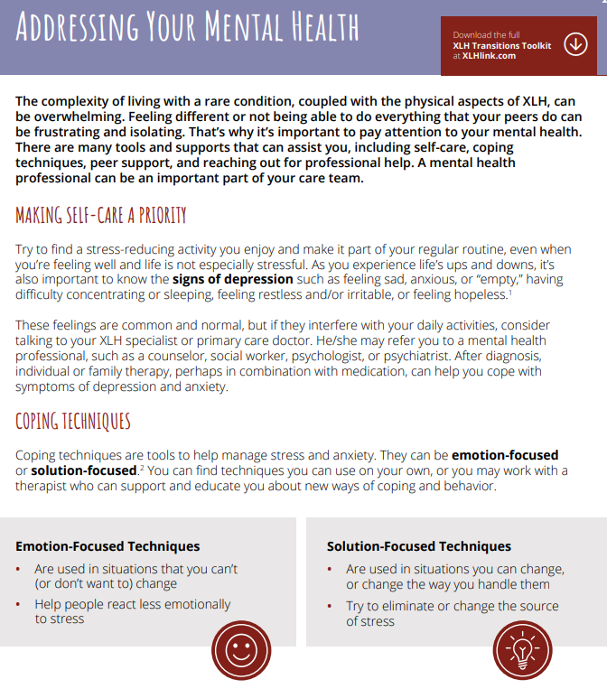
What to Watch
Stress – stressors are relative to developmental stage
Resources – what is available to reduce stress and increase support (e.g., support group)
[Balance of stress and resources]
Values – what are the patient’s needs/ what do they care about (e.g., sports, dating, friends, pain, etc.)
Family – acknowledge effects of XLH on the entire family’s stress levels

Slide 20
What to Watch
Stress – stressors are relative to developmental stage
Resources – what is available to reduce stress and increase support (e.g., support group)
[Balance of stress and resources]
Values – what are the patient’s needs/ what do they care about (e.g., sports, dating, friends, pain, etc.)
Family – acknowledge effects of XLH on the entire family’s stress levels

Slide 21
What to Watch
Stress – stressors are relative to developmental stage
Resources – what is available to reduce stress and increase support (e.g., support group)
[Balance of stress and resources]
Values – what are the patient’s needs/ what do they care about (e.g., sports, dating, friends, pain, etc.)
Family – acknowledge effects of XLH on the entire family’s stress levels

Slide 22
What to Watch
Stress – stressors are relative to developmental stage
Resources – what is available to reduce stress and increase support (e.g., support group)
[Balance of stress and resources]
Values – what are the patient’s needs/ what do they care about (e.g., sports, dating, friends, pain, etc.)
Family – acknowledge effects of XLH on the entire family’s stress levels

Slide 23
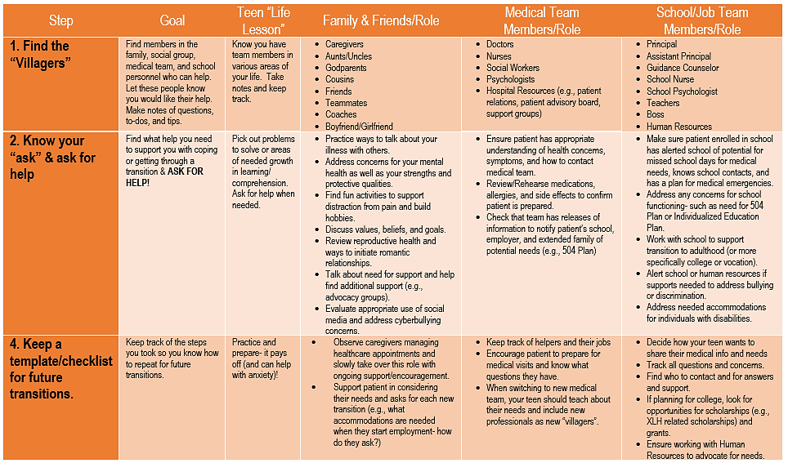
Transition Toolbox for Teens and Families

Slide 24
Transition Toolbox for Teens and Families

Slide 25
Transition Toolbox for Teens and Families

