Slide 1
Healthcare Transition With XLH
Maria E. Díaz-González de Ferris, MD, MPH, PhD
Professor and Director, the UNC Transition Program
The University of North Carolina at Chapel Hill
Chapel Hill, NC

Slide 2
Disclaimer
The views and opinions expressed in this educational activity are those of the faculty and do not necessarily represent the views of TotalCME, Inc., the CME providers, or the companies providing educational grants. This presentation is not intended to define an exclusive course of patient management; the participant should use their clinical judgment, knowledge, experience, and diagnostic skills in applying or adopting for professional use any of the information provided herein. Any procedures, medications, or other courses of diagnosis or treatment discussed or suggested in this activity should not be used by clinicians without evaluation of their patient's conditions and possible contraindications or dangers in use, review of any applicable manufacturer’s product information, and comparison with recommendations of other authorities. Links to other sites may be provided as additional sources of information.

Slide 3

The UNC STARx Program Tools/Interventions Since 2006
Measurement
TR_{x}ANSITION Index™ (provider-administered)
Youth version (pediatric & adult-focused setting)^{1,2}
Parent version³
STARx Questionnaire (self-administered)
AYA version (pediatric & adult-focused setting)^{4,5}
Parent version⁶
Interventions
TR_{x}ANSITION Passport
ALL YOU NEED IS LOVE⁷ Planet-K, Planet-T1D, and The Kidney Guru Apps
Index Cards – Giving youth/caregivers a voice
Countries: Mexico, Colombia, Philippines, S. Korea, Turkey, Japan, China, Canada, India, Russia and the USA

Slide 4
X-Linked Hypophosphatemia
XLH is a rare, chronic multisystem disease that progresses throughout adulthood with worsening musculoskeletal signs and symptoms
Burosumab dose changes in adulthood to bi-monthly
Lifelong multidisciplinary care is needed, involving physicians, physiotherapists, surgeons, psychologists, dentists, and social workers

Slide 5

Healthcare transition is the “process of moving from a child to an adult model of health care with or without a transfer to a new clinician.” It involves adolescents/young adults, their parents, and their healthcare providers.

Slide 6

Healthcare transition is the “process of moving from a child to an adult model of health care with or without a transfer to a new clinician.” It involves adolescents/young adults, their parents, and their healthcare providers.

Slide 7




Unprepared Transferred Adults

Slide 8
Unprepared Transferred Adults
Transplant rejection¹
Death or graft loss²
Higher Hgb A1C³
↑ Disease activity⁴

Slide 9




Barriers for Health Care Transition
Adolescent/Young Adult Barriers
Caregiver barriers
Low literacy
(Jordan 2020, Cantu-Quintanilla 2015, Zhong 2020)
Younger age or younger at Dx
(Lapp 2018, Ferris 2015, Cohen, 2015, Cantu 2015,
Non-White race
(Ferris 2015, Cohen 2015)
No chores at home
Locus of control, Depression
(Nazareth, 2017, Fenton 2007)
(Nazareth, 2017)
and Haarbauer-Krupa 2019)
Single parent household
(Javalkar, 2017)
Low socioeconomic status or
having public insurance
(Javalkar 2017, Phillips,2016)
Non-cohesive family
(Fenton, 2017; Sheng, 2018; Kim, 2019)
Parent role overload
(Hart, 2019)

Slide 10
Healthcare Transition Readiness Questionnaires
Self-report
STAR_{x},TRAQ, RTQ, Good2Go, TRS, and TRANSIT
Parent-proxy
STAR_{x}-Parent ; CRTQ; TRS
Provider confirmed
TR_{x}ANSITION Index
TR_{x}ANSITION Index-P: Parent’s own knowledge of child’s disease plus perception of their child’s healthcare transition readiness

Slide 11
Start Early – At the Time of Diagnosis!
Even in prenatal visits!
Mention that the survival is great even for ESRD patients (Ferris M et al 2006)
Optimize parents’ health
Detect parenting style
Re-educate parents
Educate adolescents!!!

Slide 12
Adolescent Preference to Learn About Health Condition From…
If parents = ↑ Adherence
If providers = ↑ self-efficacy and healthcare transition readiness in all health conditions
(n=160)
Notes:
12

Slide 13
Parents of Patients With Chronic Health Conditions
↑ Authoritarian parenting style = ↑ educational success
(Zahedani Z, 2016; Leung K, 2018)
↑ Parental education = ↑ academic achievement in their child
(Hooper et. al. CJASN 2011)
↑ Maternal education = ↓ Healthcare transition readiness
(Ferris et.al. 2017 and 2018)
↑ Parent mood disorder = ↑ Child mood disorder (various studies)

Slide 14
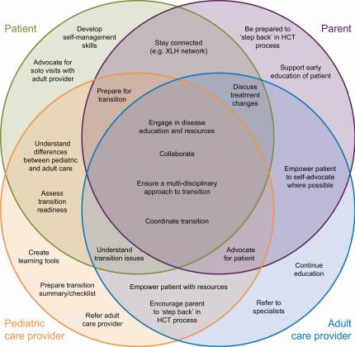
Supporting Healthcare Transition to Adult-focused Services for Patients With XLH (Expert Consensus)

Slide 15
Suggested Healthcare Transition By Age (XLH Expert Consensus)
12-14 years
Readiness
Discussions
17-18 years
Readiness
Transition planning
18-26 years
Readiness
Transfer and post-transfer f/u

Slide 16



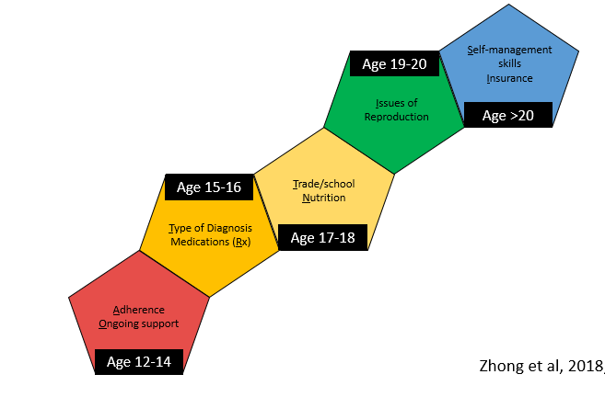


10-Year Longitudinal Total TRxANSITION Score in 862 Adolescents/Young Adults With Different Health Conditions at UNC Chapel Hill

Slide 17


Slide 18
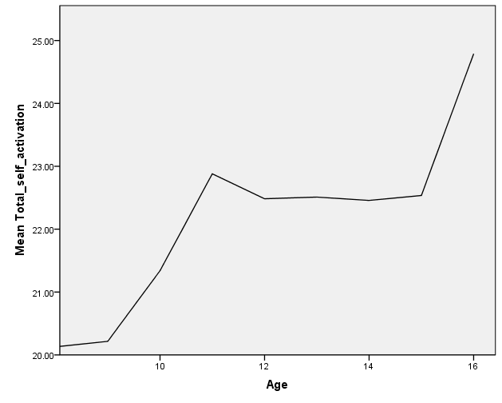
Age Predicts Health Self-management All Conditions: STARx Survey n = 403
Controlling for sex and # of parents in the home
~ Age 15
(β .17, p= .01)
8

Slide 19
Parent and Patient Interactions
Universal literacy level
Use plain language
Speak S L O W L Y !
Teach back method
Have them read you the after visit summary

