Slide 1
Continuing XLH Treatment into Adulthood – Evolving the Treatment Goals
Guido Filler, MD, PhD, FRCPC
Professor of Pediatrics, Medicine, and Pathology & Laboratory Medicine
Schulich School of Medicine and Dentistry
London, Canada

Slide 2
Disclaimer
The views and opinions expressed in this educational activity are those of the faculty and do not necessarily represent the views of TotalCME, Inc., the CME providers, or the companies providing educational grants. This presentation is not intended to define an exclusive course of patient management; the participant should use their clinical judgment, knowledge, experience, and diagnostic skills in applying or adopting for professional use any of the information provided herein. Any procedures, medications, or other courses of diagnosis or treatment discussed or suggested in this activity should not be used by clinicians without evaluation of their patient's conditions and possible contraindications or dangers in use, review of any applicable manufacturer’s product information, and comparison with recommendations of other authorities. Links to other sites may be provided as additional sources of information.

Slide 3
Should We Be Striving To Complete Resolution of Osteomalacia at the Bone Tissue Level?

Slide 4
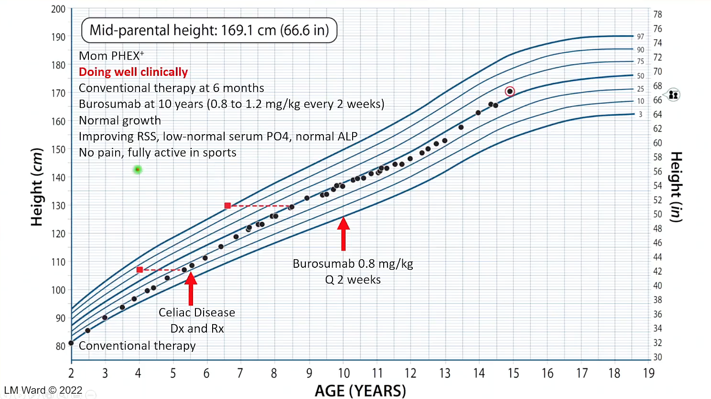

Slide 5
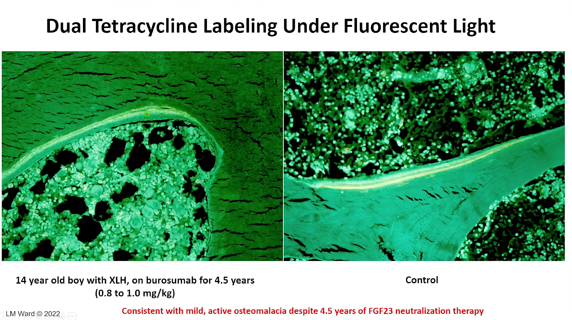

Slide 6
Should We Allow for Higher Alkaline Phosphatase Levels During Puberty, and Do Male Patients Need Higher Doses of Burosemab?

Slide 7
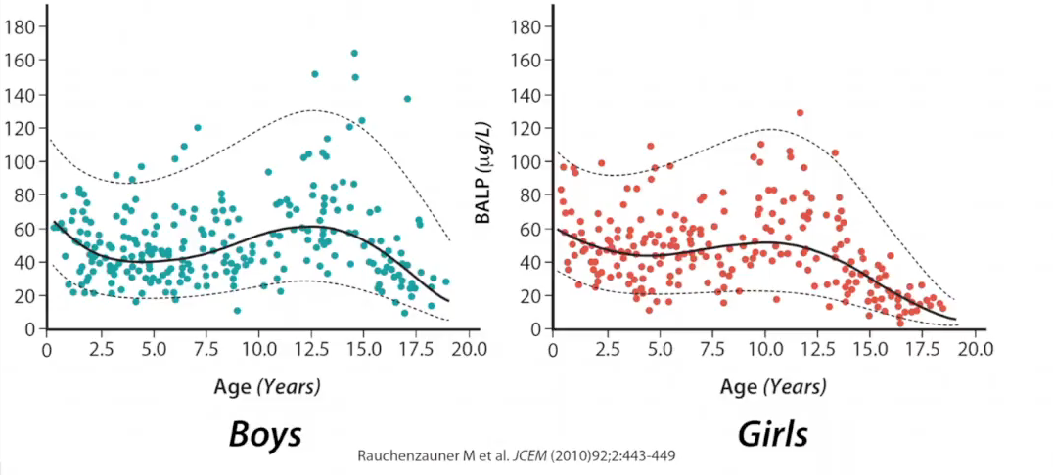
Alkaline Phosphatase Varies With Age and Gender and Mirrors Growth Velocity

Slide 8
Do Patients Achieve
Normal Body Proportions
With Treatment?

Slide 9
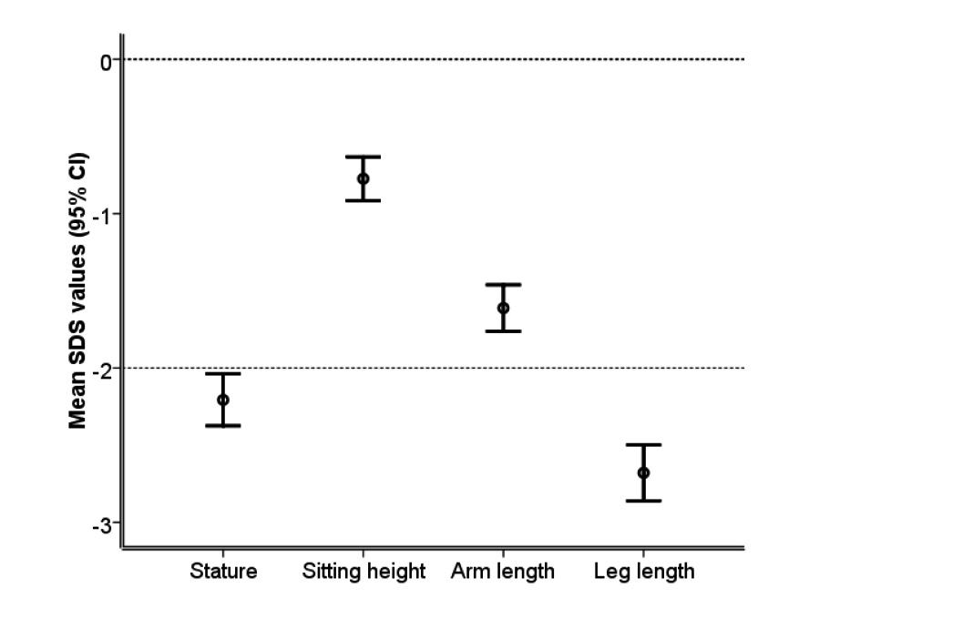
Baseline Anthropometry

Slide 10
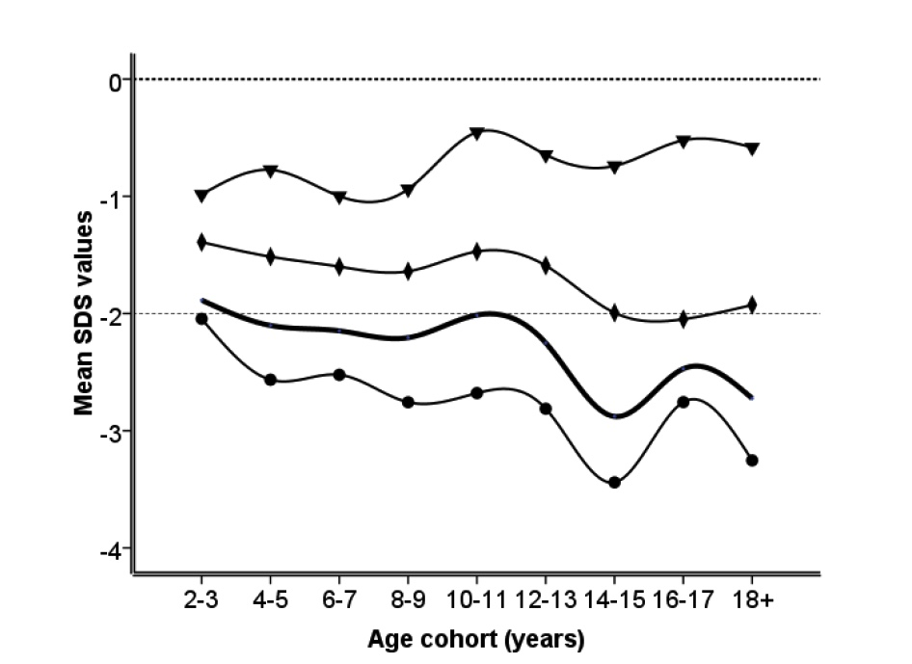
Disproportion Worsens With Age
Mean standard deviation score (SDS) for stature, sitting height, arm and leg length as a
function of age in 76 children with XLH. In order to assess the age-related changes in body
dimensions all measurements per patient were grouped according to age at time of
Examination. Stature: full line; leg length: full line with dots ( ); arm length: full line
with rhombuses ( ); sitting height: full line with triangles ( ).

Slide 11
Dose Reduction at Age 18

Slide 12
Dosing at Age 18
Dosing is 0.8-2.0 mg/kg Q2 weeks in pediatric patients
Dosing drops to 0.8-2.0 mg/kg Q4 weeks in adult patients
Dosing was initially Q4 weeks during development for both adult and pediatric patients
Company is seeing a lot of conversions of adult dosing from Q4 weeks to Q2 weeks

Slide 13
Summary
Patients could be treated with Burosumab from birth or at least six months of age life long
There is uncertainty about how to convert dosing upon transition to adult care
Questions For Future Research:
Normalization of alkaline phosphatase enough, or do we need full normalization of the osteomalacia?
Treatment duration, frequency and age/sex difference

