Slide 1
XLH: An Uncommon But
Treatable Disorder
John D. Mahan, MD
Professor of Pediatrics
The Ohio State University College of Medicine
Columbus, OH

Slide 2
Disclaimer
The views and opinions expressed in this educational activity are those of the faculty and do not necessarily represent the views of TotalCME, Inc., the CME providers, or the companies providing educational grants. This presentation is not intended to define an exclusive course of patient management; the participant should use their clinical judgment, knowledge, experience, and diagnostic skills in applying or adopting for professional use any of the information provided herein. Any procedures, medications, or other courses of diagnosis or treatment discussed or suggested in this activity should not be used by clinicians without evaluation of their patient's conditions and possible contraindications or dangers in use, review of any applicable manufacturer’s product information, and comparison with recommendations of other authorities. Links to other sites may be provided as additional sources of information.

Slide 3
Common Symptoms in an Uncommon Disease:
X-Linked Hypophosphatemia (XLH)

Slide 4
Common Symptoms in an Uncommon Disease:
X-Linked Hypophosphatemia (XLH)
X-linked hypophosphatemia (XLH) is a hereditary, progressive, lifelong disorder of renal phosphate wasting
It is the most common form of heritable hypophosphatemic rickets

Slide 5
Common Symptoms in an Uncommon Disease:
X-Linked Hypophosphatemia (XLH)
X-linked hypophosphatemia (XLH) is a hereditary, progressive, lifelong disorder of renal phosphate wasting
It is the most common form of heritable hypophosphatemic rickets
XLH has also been known by patients and healthcare professionals as:

Slide 6
Common Symptoms in an Uncommon Disease:
X-Linked Hypophosphatemia (XLH)
X-linked hypophosphatemia (XLH) is a hereditary, progressive, lifelong disorder of renal phosphate wasting
It is the most common form of heritable hypophosphatemic rickets
XLH has also been known by patients and healthcare professionals as:
  X-linked hypophosphatemic rickets
  Hereditary hypophosphatemic rickets
  Vitamin D–resistant rickets (VDRR)
  Hypophosphatemic rickets
  X-linked rickets (XLR)z

Slide 7
Common Symptoms in an Uncommon Disease:
X-Linked Hypophosphatemia (XLH)
X-linked hypophosphatemia (XLH) is a hereditary, progressive, lifelong disorder of renal phosphate wasting
It is the most common form of heritable hypophosphatemic rickets
XLH has also been known by patients and healthcare professionals as:
  X-linked hypophosphatemic rickets
  Hereditary hypophosphatemic rickets
  Vitamin D–resistant rickets (VDRR)
  Hypophosphatemic rickets
  X-linked rickets (XLR)z
  X-linked vitamin D–resistant rickets
  Hypophosphatemic vitamin D–resistant rickets
  (HPDR)
  Familial hypophosphatemic rickets
  Familial hypophosphatemia

Slide 8
Common Symptoms in an Uncommon Disease:
X-Linked Hypophosphatemia (XLH)
Estimated prevalence of 1:20,000 to 1:25,000
There are 12,000 to 16,000 XLH patients in the US
Excess FGF23
PHEX Gene Dysfunction
‘Phosphate-regulating endopeptidase homolog X-linked’
Loss of function mutation leading to excess FGF23

Slide 9
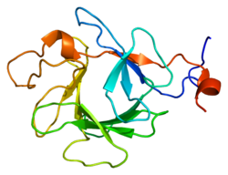
Common Symptoms in an Uncommon Disease:
X-Linked Hypophosphatemia (XLH)
Estimated prevalence of 1:20,000 to 1:25,000
There are 12,000 to 16,000 XLH patients in the US
Excess FGF23
PHEX Gene Dysfunction
‘Phosphate-regulating endopeptidase homolog X-linked’
Loss of function mutation leading to excess FGF23

Slide 10
Common Symptoms in an Uncommon Disease:
X-Linked Hypophosphatemia (XLH)

Slide 11
Common Symptoms in an Uncommon Disease:
X-Linked Hypophosphatemia (XLH)
Children
Symptoms
Delayed walking
Leg pain
Signs
Rickets
Impaired/ disproportionate growth
Craniosynostosis

Slide 12
Common Symptoms in an Uncommon Disease:
X-Linked Hypophosphatemia (XLH)
Children
Adults
Symptoms
Disability impacts work
Signs
Fractures and pseudofractures
Osteoarthritis
Osteophytes
Enthesopathy
Spinal stenosis
Nephrocalcinosis
Hearing loss
Symptoms
Delayed walking
Leg pain
Signs
Rickets
Impaired/ disproportionate growth
Craniosynostosis

Slide 13
Common Symptoms in an Uncommon Disease:
X-Linked Hypophosphatemia (XLH)
Children/Adults
Children
Adults
Symptoms
Gait abnormalities
Bone & joint pain/
stiffness
Muscle pain/weakness
Diminished quality of life
Signs
Short stature
Lower limb deformities
Osteomalacia
Tooth abscesses/caries
Chiari malformation
Frontal bossing
Symptoms
Disability impacts work
Signs
Fractures and pseudofractures
Osteoarthritis
Osteophytes
Enthesopathy
Spinal stenosis
Nephrocalcinosis
Hearing loss
Symptoms
Delayed walking
Leg pain
Signs
Rickets
Impaired/ disproportionate growth
Craniosynostosis

Slide 14
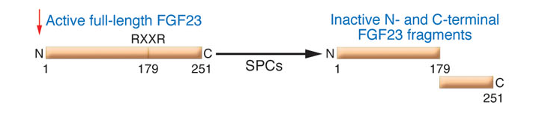
FGF23
FGF23 - ~32 kDa (251 amino acids) circulating protein with N-terminal region containing the FGF homology domain and a novel 71 aa C-terminus that has PHOSPATURIC activity in vivo
In kidney, regulation of proximal tubular P reabsorption
(via NaPi-2a/NaPi-2c transporters)
Predominately expressed in osteocytes, but also in the ventrolateral thalamic nucleus, central venous sinusoids and thymus
*
FGF Homology
Domain

Slide 15
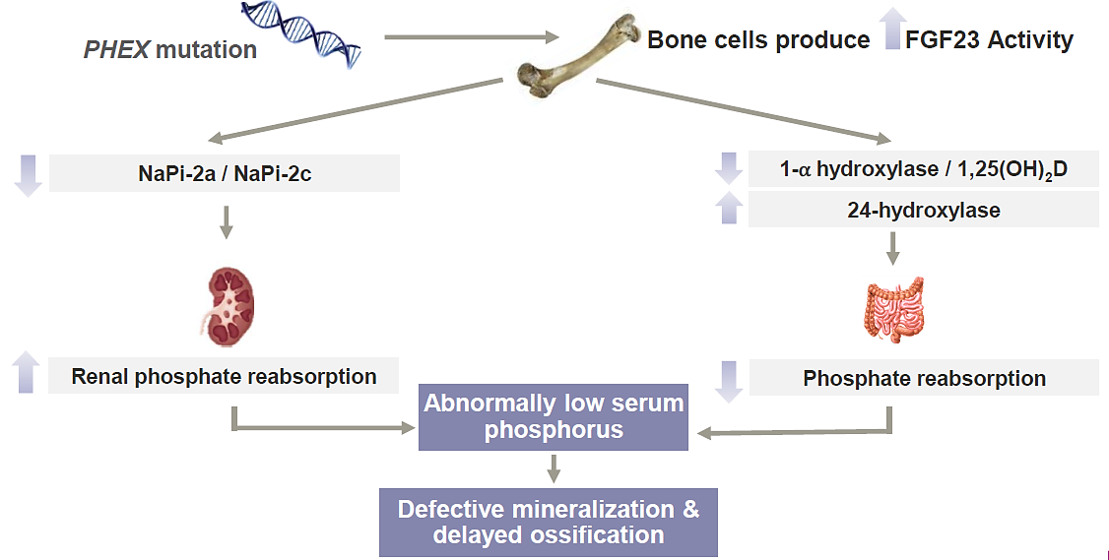
XLH and the Crucial Role of Excess FGF23

Slide 16
XLH and the Crucial Role of Excess FGF23
Low P

Slide 17
XLH and the Crucial Role of Excess FGF23
Low P
Elevated FGF23

