Slide 1
Key Novel Considerations for Pegcetacoplan?
Bhumika J. Patel, MD
Assistant Professor of Medicine
Prisma Health-Cancer Institute
University of South Carolina School of Medicine
Greenville, SC

Slide 2
Paroxysmal Nocturnal Hemoglobinuria (PNH)
Hemolytic anemia
Characterized by intravascular hemolysis, high risk of thrombosis, and bone marrow impairment
Rare disease, <10 cases per million population
Caused by a somatic mutation in the X-linked PIGA gene
  Hematopoietic stem cells are unable to synthesize the anchor that tethers proteins that are protective against activated complement
  Increased red cell susceptibility to complement activation results in hemolysis
Current FDA approved treatments include:
  C5 inhibitors: eculizumab, ravulizumab
  C3 inhibitor: pegcetacoplan

Slide 3
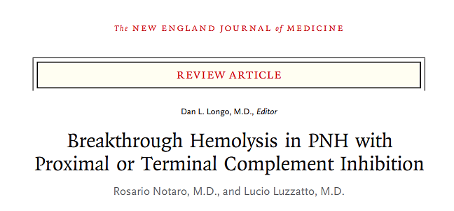
Goal: Describe and compare the benefits and adverse effects of proximal versus terminal inhibition of the complement system

Slide 4
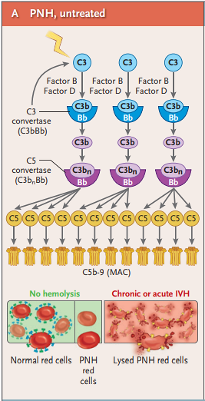
Intravascular Hemolysis (IVH)
Results in:
  Anemia
  Symptoms of smooth-muscle dystonia (abdominal pain, dysphagia, erectile dysfunction)
  High risk of thrombosis
Reduced with complement inhibition

Slide 5
Breakthrough Hemolysis
IVH that occurs during treatment with a C5 inhibitor
Characterized by sudden resurgence of signs and symptoms of IVH, including hemoglobinuria, marked increase in LDH, and sharp decrease in hemoglobin
Caused by suboptimal C5 inhibition
  Pharmacokinetic: low levels of monoclonal antibody
  Pharmacodynamic: inflammation results in strong complement activation, breaking through C5 blockade

Slide 6
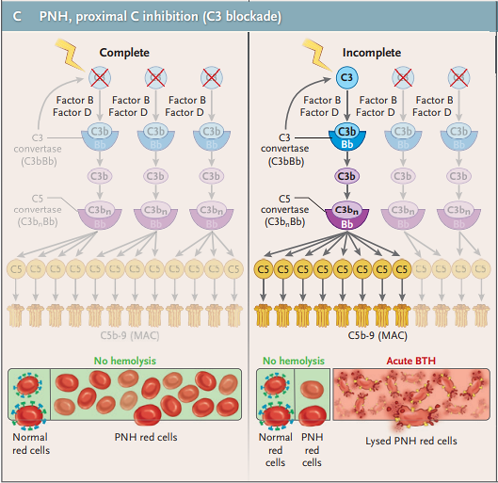
Extravascular Hemolysis (EVH)
During C5 blockade, C3 fragments bind to PNH red cells because C3 activation is unrestricted
Opsonized red cells are targeted by macrophages, resulting in EVH
Demonstrated by persistent reticulocytosis
Approximately 18-35% of patients remain transfusion-dependent during C5 inhibitor therapy
C3 inhibition with pegcetacoplan
  Prevents IVH and EVH
  Blocks formation of the membrane attack complex
  Prevents C3d deposition on red cells

Slide 7
Consequences of Complement Blockade
Breakthrough hemolysis reported
  Eculizumab: rare cases reported with LDH levels up to 5 x ULN
  Pegcetacoplan: very severe cases reported with LDH levels 10-15 x ULN
Authors theorize etiology of breakthrough hemolysis differs between proximal and terminal complement inhibition

Slide 8
Consequences of Complement Blockade
Risk of breakthrough hemolysis applies to any drug targeting the proximal and terminal pathway
  RBCs are larger with C3 versus C5 inhibitors
  Half life of pegcetacoplan is shorter resulting in a drop in plasma concentrations if doses are delayed or omitted
  Intrinsic features of the complement system
    Proximal: has complement amplification potential
    Terminal: completed in a 1:1 ratio

Slide 9
Combined Terminal and Proximal Complement Inhibition
May provide advantages in the treatment of PNH:
  Synergistic efficacy
  Prevention of C3 binding to PNH red cells and reduced EVH
Downsides to combined treatment:
  Affect on risk of infection largely unknown
  Financial toxicity

Slide 10
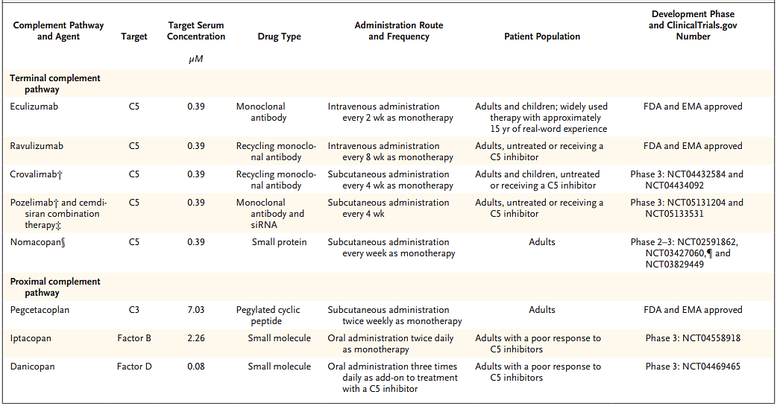
Complement Inhibitors for PNH Treatment

Slide 11
Conclusion
The sequencing and combination of proximal and terminal complement inhibitors will need to be further investigated in clinical trials for the treatment of PNH
Combined approach may prevent extravascular hemolysis and breakthrough hemolysis improving clinical care for patient with PNH
More to come…

