Slide 1
Case: Meet Penny Nancy Harvey –
41-Year-Old With Fatigue and
Aplastic Anemia
Carlos M. de Castro, MD
Professor of Medicine
Duke University School of Medicine
Durham, NC

Slide 2
Disclaimer
The views and opinions expressed in this educational activity are those of the faculty and do not necessarily represent the views of TotalCME, Inc., the CME providers, or the companies providing educational grants. This presentation is not intended to define an exclusive course of patient management; the participant should use their clinical judgment, knowledge, experience, and diagnostic skills in applying or adopting for professional use any of the information provided herein. Any procedures, medications, or other courses of diagnosis or treatment discussed or suggested in this activity should not be used by clinicians without evaluation of their patient's conditions and possible contraindications or dangers in use, review of any applicable manufacturer’s product information, and comparison with recommendations of other authorities. Links to other sites may be provided as additional sources of information.

Slide 3
Case Presentation
Patient PNH is a 41-year-old female
She initially presented 24 years ago with shortness of breath and heavy menstrual periods
She was found to be markedly pancytopenic
Work up included a bone marrow biopsy showing aplastic anemia
She was treated with ATG and cyclosporine with complete count recovery
A bone marrow biopsy one year later was normocellular

Slide 4
Case Presentation
She did well until 11 years ago when she started to notice increasing fatigue
Labs 8/22/13 showed:
  WBC 3.4 k/cumm, Hgb 5.7 gm/dL, Hct 17.5%, PLT 142 k/cumm
Referred to her local hematologist
BM biopsy showed 40-45% cellular marrow with erythroid hyperplasia. Normal FISH, normal cytogenetics
Peripheral blood flow cytometry was positive for PNH
She was started on eculizumab on 9/12/2013

Slide 5
Case Presentation
Labs on 1/13/2014 showed:
  WBC 3.8 k/cumm, Hgb 9.4 gm/dL, HCT 28%, PLT 188 k/cumm
  LDH 268 units/L
Evaluated for a bone marrow transplant, not felt to be a candidate
She still didn’t feel great, required transfusions q3months despite increasing dose of eculizumab to 1200 mg q2weeks
Referred for a second opinion in June 2017
Labs showed:
  WBC 5.8 k/cumm, Hgb 7.6 gm/dL, HCT 23%, PLT 247 k/cumm
  LDH 263 units/L, T bili 7.1 mg/dL, normal transaminases. Retic 20.60%

Slide 6
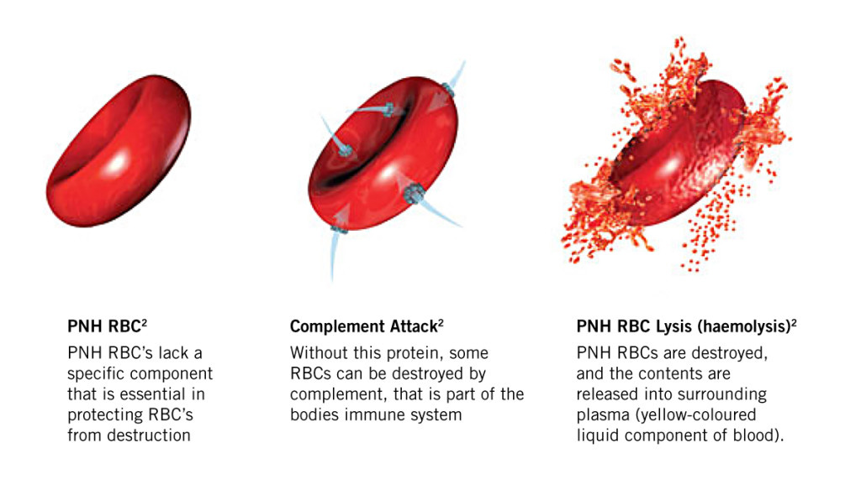
Case Presentation
Felt to be a sub-optimal responder to eculizumab
Likely due to C3 coating of red blood cells and extravascular hemolysis
Entered onto the PEGASUS clinical trial using APL-2 (pegcetacoplan) on 4/10/2019

Slide 7
Case Presentation Conclusion
Patient PNH was seen in clinic on 5/20/2021
Absolutely no complaints
Labs showed:
  WBC 6.0 k/cumm, Hgb 14.8 gm/dL, Hct 45%, PLT 183 k/cumm
  LDH 225 units/L, T bili 1.9 mg/dL, Retic 3.12%
Continued on extension study, then rolled over to commercial product when pegcetacoplan became FDA approved
Still feels well with stable blood counts

