Slide 1
Case: Meet Perry Nathaniel Henry – 42-Year-Old With Anemia
Catherine Broome, MD
Associate Professor
Medicine MedStar Georgetown University
Lombardi Cancer Center
Washington, DC

Slide 2
Disclaimer
The views and opinions expressed in this educational activity are those of the faculty and do not necessarily represent the views of TotalCME, Inc., the CME providers, or the companies providing educational grants. This presentation is not intended to define an exclusive course of patient management; the participant should use their clinical judgment, knowledge, experience, and diagnostic skills in applying or adopting for professional use any of the information provided herein. Any procedures, medications, or other courses of diagnosis or treatment discussed or suggested in this activity should not be used by clinicians without evaluation of their patient's conditions and possible contraindications or dangers in use, review of any applicable manufacturer’s product information, and comparison with recommendations of other authorities. Links to other sites may be provided as additional sources of information.

Slide 3
Patient Case
Perry Nathaniel Henry is a 42 YOM who has been seen in his primary care physician’s office multiple times over the past several months complaining of:
  Severe fatigue that began rather suddenly a month or so before his
  first visit
  He has noted some dyspnea on exertion
  He complains of intermittent severe abdominal pain which is not related to eating

Slide 4
Patient Case
After his 3rd visit to the PCP a CBC was performed that revealed:
  WBC 3.6 k/cumm
  Hgb 6.2 gm/dL
  Hct 24.6 %
  Plt 147 k/cumm
  MCV 85 fL
  RDW 17.9 %

Slide 5
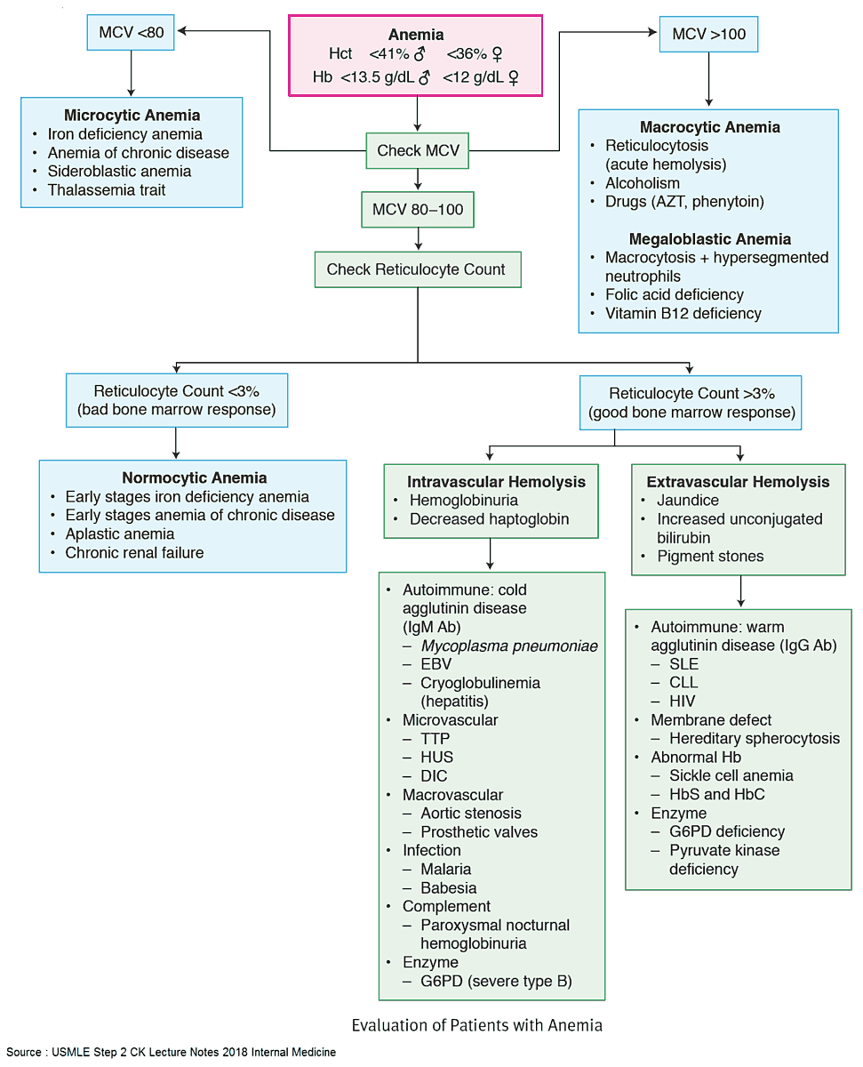
Evaluation of Patients with Anemia

Slide 6
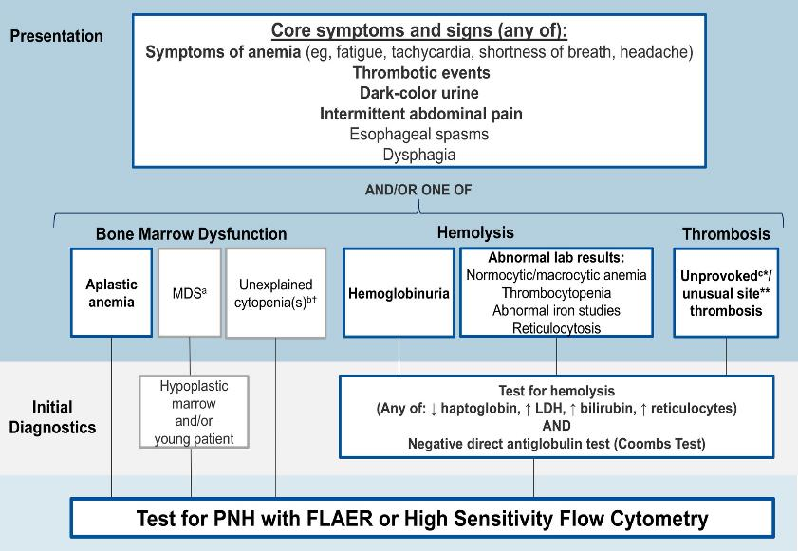
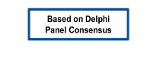
Expert Consensus Recommendations on PNH Screening

Slide 7
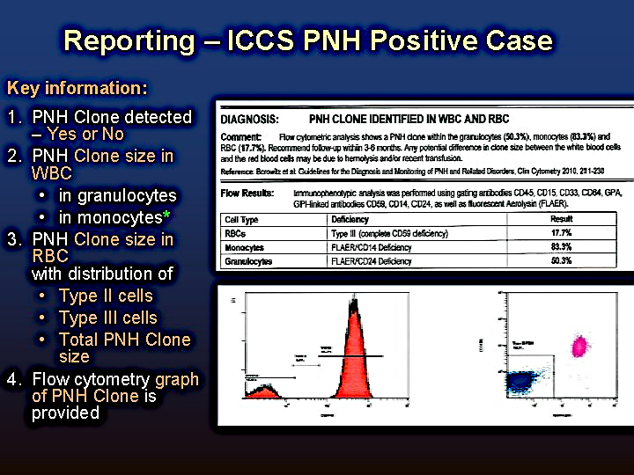
Reporting – ICCS PNH Positive Case
DIAGNOSIS: PNH CLONE IDENTIFIED IN WBC AND RBC
Comment: Flow cytometric analysis shows a PNH clone done within the granulocytes (50.3%), monocytes (83.3%) and RBC (17.7%). Recommended follow-up within 3-6 months. Any potential difference in clone size between the white blood cells and the red blood cells may be due to hemolysis and/or recent transfusion. Reference: Borowitz et al. Guidelines for the Diagnosis and Monitoring of PNH and Related Disorders, Clin Cytometry 2010, 211-230
Flow Results: | Immunophenotypic analysis was performed using gating antibodies CD45, CD15, CD33, CD64, GPA, GPI-linked antibodies CD59, CD14, CD24, as well as fluorescent Aerolysin (FLAER).
PNH Clone detected
  Yes or No
PNH Clone size in WBC
  In granulocytes
  In monocytes
PNH Clone size in RBC
with distribution of
  Type II cells
  Type III cells
  Total PNH Clone size
Flow cytometry graph of PNH Clone is provided
Cell Type | Deficiency | Result
RBCs | Type III (complete CD59 deficiency) | 17.7%
Monocytes | FLAER/CD14 Deficiency | 83.3%
Granulocytes | FLAER/CD24 Deficiency | 50.3%

Slide 8
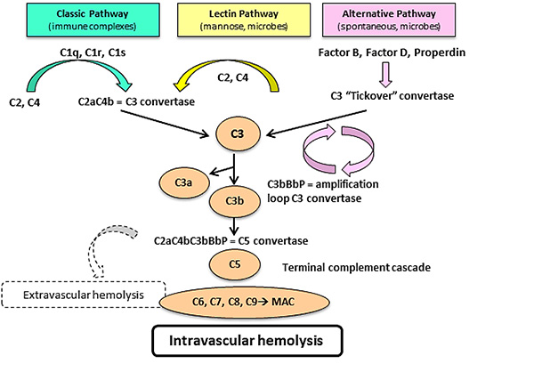
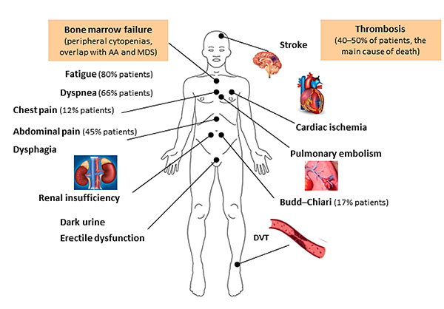
A.
B.

Slide 9
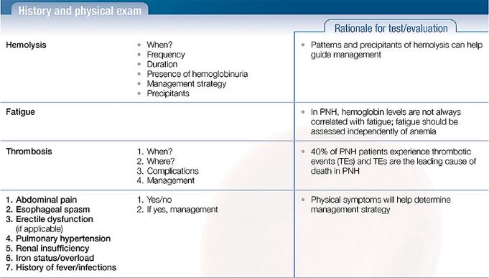
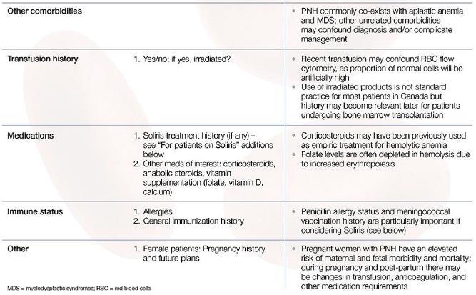

Slide 10
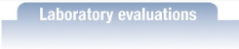
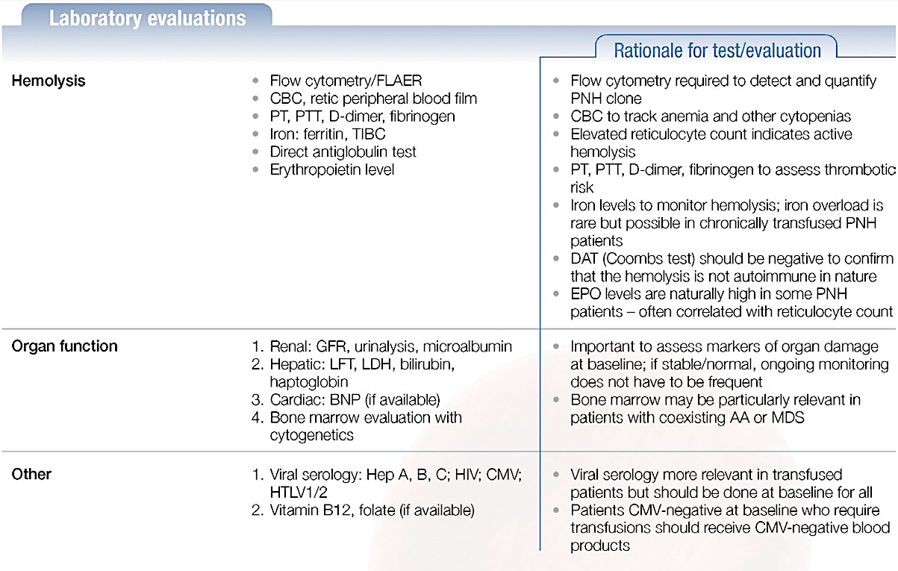
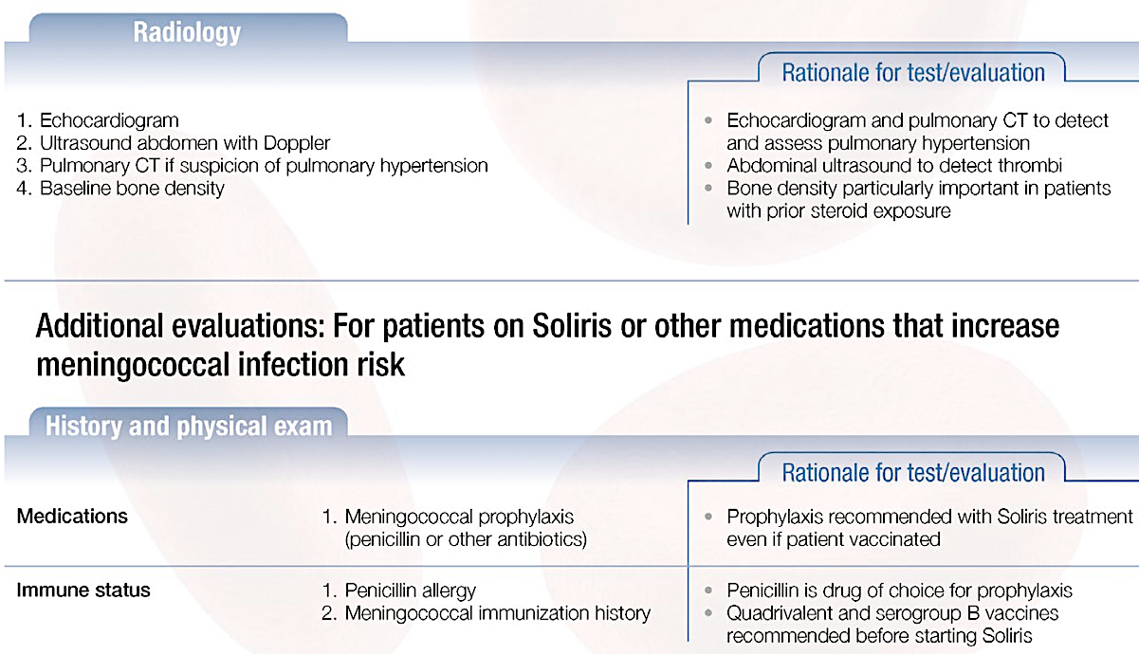
Additional evaluations: For patients on Soliris or other medications that increase meningococcal infection risk

Slide 11
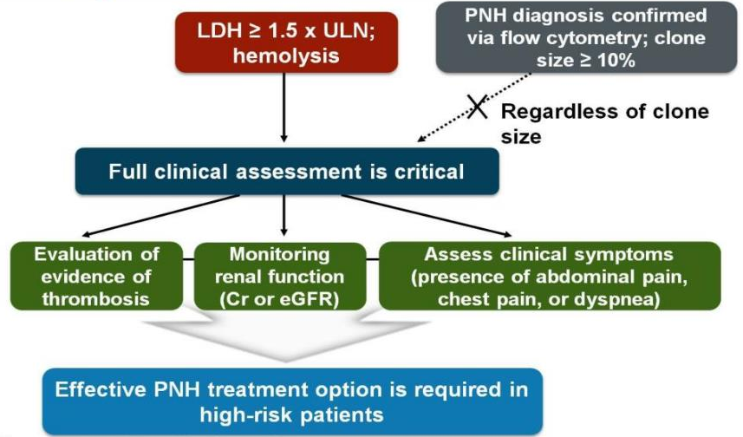
Proposed Guideline for the Management of PNH
PNH is suspected

Slide 12
Conceptual Model of PNH
Fatigue
Abdominal pain
Headaches
Shortness of breath
Difficulty swallowing
Erectile dysfunction
Hemoglobinuria
Cardiovascular symptoms (e.g., chest pain, irregular heartbeat)
Cognitive symptoms (e.g., confusion, poor concentration, dizziness)
Bruising/bleeding
Back pain
Leg pain
Impacts of PNH:
Preoccupation with disease
E.g., thoughts center around disease, disease center of life
Emotional impacts
E.g., fear, loss of lightheartedness, stress, helplessness
Physical impacts
E.g., trouble walking, jogging, standing
Impacts on ADLs
E.g., problems getting household work done
Impacts on relationship
E.g., support from family/friends
PNH Symptoms:
Impacts on illness perceptions
E.g., losing control of own body, visible symptoms remind me I'm sick
Impact on work/school life
E.g., problems with work, no flexibility in planning studies
Overall quality of life
E.g., normal rhythm of life affected, missing something in life, future prospects limited

Slide 13
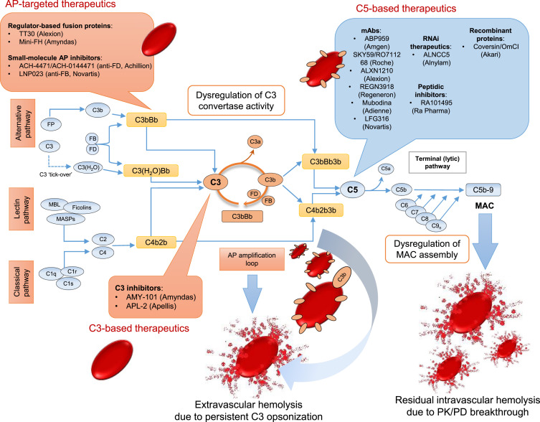



Overview of the Complement Activation Cascade Illustrating Targets for Therapeutic Modulation in PNH
AP-targeted therapeutics
C5-based therapeutics
Regulator-based fusion proteins:
TT30 (Alexion)
Mini-FH (Amyndas)
Small-molecule AP inhibitors:
ACH-4471/ACH-0144471 (anti-FD, Achillion)
LNP023 (anti-FB, Novartis)
mAbs:
ABP959 (Amgen)
SKY59/RO711268 (Roche)
ALXN1210 (Alexion)
REGN3918 (Regeneron)
Mubodina (Adienne)
LFG316 (Novartis)
RNAi therapeutics:
ALNCC5
(Alnylam)
Peptide Inhibitors:
RA101495
(Ra Pharma)
Recombinant proteins:
Coversin/OmCl
(Akari)
C3 inhibitors:
AMY-101 (Amyndas)
APL-2 (Apellis)
C3-based therapeutics

Slide 14
Assessment of Patients on a Complement Inhibitor
Commencement of Complement Inhibitor Treatment
Causes of anemia on C5 inhibition | Suggested action if symptomatic +/- transfusion dependent
LOW/NORMAL RETICULOCYTE COUNT
Bone Marrow Failure e.g. AA or MDS | Follow parallel concomitant recommendations for the underlying bone marrow failure
Folate deficiency | Folic acid supplementation
Relative erythropoietin deficiency | Exogenous erythropoietin supplementation
Iron overload | Iron chelation therapy
ELEVATED RETICULOCYTE COUNT
Breakthrough intravascular hemolysis | Resolution of activating event/ additional dose of complement inhibitor/ dose adjustment
Clinically significant extravascular hemolysis | Consider proximal complement inhibition in clinical trials
Hypersplenism | Splenic embolization in selected cases
Bleeding | Directed to cause
Alloantibodies | Blood transfusion recommendations
Ineffective erythropoiesis e.g. MDS | Follow parallel concomitant recommendations for the underlying bone marrow failure
LDH?*/CH50
Reduced
Unchanged
LDH >1.5 x ULN
LDH ≤ 1.5 x ULN
Assess for C5 mutation
Hb?
CH50 absent/ low
Continue therapy
and monitor
Other causes of high LDH should be evaluated
CH50 normal
Consider inadequate dosing (PK or PD BTH)
Satisfactory response
Symptomatic anemia
Continue therapy
Retics?
Breakthrough intravascular hemolysis
Extravascular hemolysis (EVH)
Hypersplenism (e.g. due to previous Budd-Chiari Syndrome)
Bleeding (especially if thrombocytopenia or dysfunctional platelets)
Prescence of alloantibodies from previous transfusions
Ineffective erythropoiesis
Elevated
Low/ Normal
RBC Transfusion?
Bone marrow failure
Folate deficiency
Relative Epo deficiency
Iron overload
Yes
No
*If patient had elevated LDH before commencing treatment
PK = pharmacokinetic, PD = pharmacodynamic, BTH = breakthrough hemolysis
AA = aplastic anemia; MDS = myelodysplastic syndrome

