Slide 1
LDH and Evolving Treatment Success?
Carlos M. de Castro, MD
Professor of Medicine
Duke University School of Medicine
Durham, NC

Slide 2
Disclaimer
The views and opinions expressed in this educational activity are those of the faculty and do not necessarily represent the views of TotalCME, Inc., the CME providers, or the companies providing educational grants. This presentation is not intended to define an exclusive course of patient management; the participant should use their clinical judgment, knowledge, experience, and diagnostic skills in applying or adopting for professional use any of the information provided herein. Any procedures, medications, or other courses of diagnosis or treatment discussed or suggested in this activity should not be used by clinicians without evaluation of their patient's conditions and possible contraindications or dangers in use, review of any applicable manufacturer’s product information, and comparison with recommendations of other authorities. Links to other sites may be provided as additional sources of information.

Slide 3
What is Lactate Dehydrogenase?
OH
O
O
O
H₃C
+ NAD⁺
H₃C
+ NADH + H⁺
OH
OH
Lactic Acid
Pyruvic Acid
Enzyme found in nearly all living cells
Catalyzes the conversion of lactate to pyruvate and back, converts NAD+ to NADH and back
Can be a marker of tissue damage, but non-specific

Slide 4
What is Lactate Dehydrogenase?
LDH enzyme is a tetramer consisting of 4 subunits
Different mixtures of these subunits lead to 5 isoforms
LDH-1 (4H)—in the heart and in RBC (red blood cells), as well as the brain
LDH-2 (3H1M)—in the reticuloendothelial system
LDH-3 (2H2M)—in the lungs
LDH-4 (1H3M)—in the kidneys, placenta, and pancreas
LDH-5 (4M)—in the liver and striated muscle, also present in the brain
Clinically rarely measure isoforms

Slide 5
LDH as a Diagnostic Tool
An elevated serum LDH reflects tissue damage
As LDH has a wide tissue distribution, it is very nonspecific as a diagnostic tool
Causes of an elevated LDH include:
Hemolytic anemia
Vitamin B12 deficiency anemia
Infections such as infectious mononucleosis, meningitis, encephalitis, HIV/AIDS
Notably increased in sepsis
Infarction, such as bowel infarction, myocardial infarction, and lung infarction
Acute kidney disease
Acute liver disease
Rhabdomyolysis
Pancreatitis
Bone fractures
Cancers, notably testicular cancer and lymphoma
Severe shock
Hypoxia

Slide 6
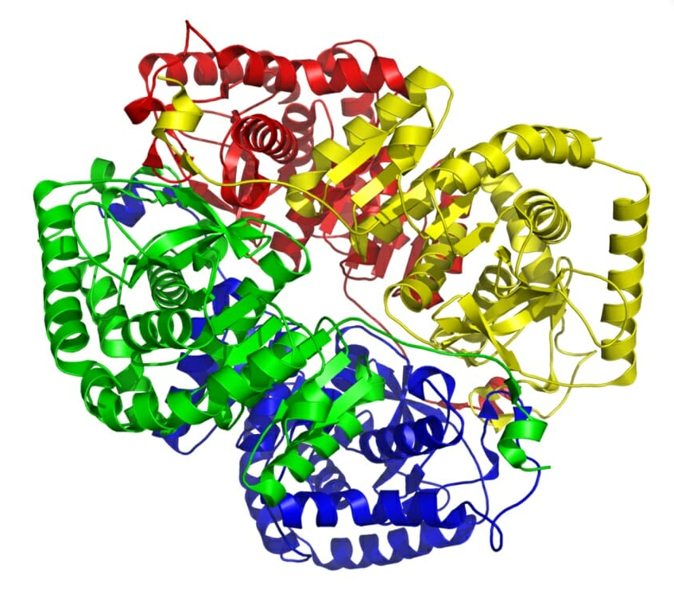
LDH as a Biomarker
LDH can be used as a biomarker for prognosis
LDH can be used to follow treatment effectiveness

Slide 7
LDH and Hemolysis
LDH in the right context can be a marker of hemolysis
Decrease Hgb
Elevated reticulocyte count
Low haptoglobin
Elevated total or indirect bilirubin
In PNH (untreated), LDH levels can be markedly elevated due to intravascular hemolysis
In PNH patients treated with a C5 inhibitor, LDH levels fall to near normal but often not normal levels. This may reflect some ongoing extravascular hemolysis

Slide 8
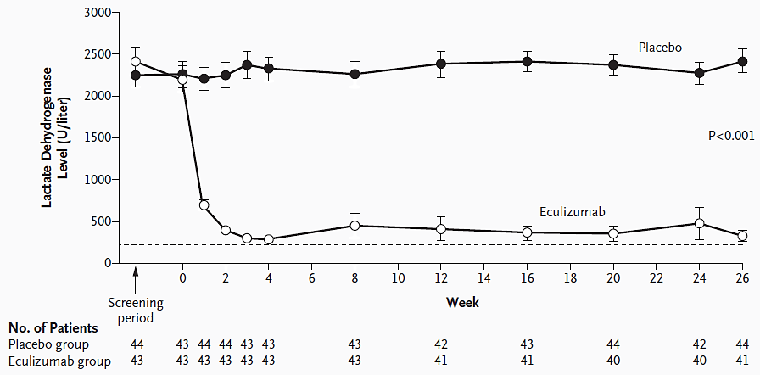
TRIUMPH: Eculizumab Reduced LDH

Slide 9
PEGASUS Efficacy Data - Effect of Pegcetacoplan on Secondary Endpoints (Including Post-Transfusion Data): LDH
4-week, run-in period
(pegcetacoplan & eculizumab)
Randomized, controlled period
(pegcetacoplan OR eculizumab)
500
Pegcetacoplan
397.0
Eculizumab
353.2
400
345.7
334.7
308.6
305.7
289.5
300
LDH, Mean (SE) U/L
ULN
200
257.5
153.6
188.6
230.5
219.9
194.5
189.1
145.5
163.5
LLN
100
0
Baseline
Day 1
Week 2
Week 4
Week 6
Week 8
Week 12
Week 16
Pegcetacoplan n
41
39
41
40
39
37
38
36
Eculizumab n
39
37
39
39
39
36
39
37

Slide 10
Summary
LDH used as a marker of hemolysis in PNH
LDH can be used to monitor response to therapy
If LDH is persistently elevated while on C5 inhibitor therapy, look for evidence of extravascular hemolysis (EVH)
If the patient has evidence of EVH and is symptomatic from their anemia, consider changing to a C3 inhibitor

