Slide 1
Thrombosis in PNH
Ilene Ceil Weitz, MD
Professor of Medicine
Jane Anne Nohl Division of Hematology
Keck-USC School of Medicine
Los Angeles, CA

Slide 2
Disclaimer
The views and opinions expressed in this educational activity are those of the faculty and do not necessarily represent the views of TotalCME, Inc., the CME providers, or the companies providing educational grants. This presentation is not intended to define an exclusive course of patient management; the participant should use their clinical judgment, knowledge, experience, and diagnostic skills in applying or adopting for professional use any of the information provided herein. Any procedures, medications, or other courses of diagnosis or treatment discussed or suggested in this activity should not be used by clinicians without evaluation of their patient's conditions and possible contraindications or dangers in use, review of any applicable manufacturer’s product information, and comparison with recommendations of other authorities. Links to other sites may be provided as additional sources of information.

Slide 3
Patient History
Labs:
  WBC = 6.1 k/cumm; ANC = 3.8 k/cumm
  Hgb = 9.0 gm/dL
  MCV = 93 fL
  Platelets = 69 k/cumm
  D-Dimer = 4751 ng/mL
  LDH = 750 Units/L; tbili = 12.0 mg/dL; ibili = 5.5 mg/dL
  Reticulocyte count = 169 k/cumm
  Haptoglobin <10
  B12/folate = normal; homocysteine = 10
  AlkPhos = 246 Units/L
  AST 114 = Units/L; ALT = 63 Units/L
  PT/PTT = 19.6 sec/37 sec
  Lupus Anticoagulant = not detected
  B2-glycoprotein 1 IgG= <9; IgM =<9
  PNH flow
    WBC Clone: Grans 68% GPI deficient, 69% Mono
    RBC Clone Type II 8.71%, Type III 21.83% (30%)
29-year-old female presented with chest pain and SOB
9-month history of abdominal pain. 3 months prior to admission she had a cholecystectomy for cholelithiasis, ascites and platelet count of 60K
Had persistent abdominal pain then developed SOB
PMH: unremarkable: no medications, no ETOH, no drugs, no cigarettes
FH: HTN
PE:
Alert and oriented
VS: BP 120/70, P 80 regular, RR 16, afebrile
Minimal scleral icterus
Cardiac exam: RRR, no murmurs or gallops
Abdomen: mild distention with ascites
Ext: bilateral edema
CTPA: PE left main PA extending to LLL artery with infarction of LLL
CT: hepatic, portal and mesenteric vein occlusion extending into the IVC, bilateral DVTs, abdominal wall hematoma

Slide 4
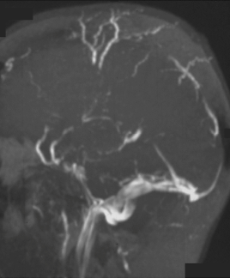
Thrombosis in PNH
Experienced by up to 43% of patients¹
Accounts for 40% to 67% of PNH deaths with known causes²
Common sites: deep vein thrombosis of the lower limbs affects ~33% of patients²
Unusual sites include intra-abdominal and cerebral veins²
Hepatic vein (Budd-Chiari syndrome) affects 7.25% to 25% of patients²
Arterial: 6x vs general population and younger age
First thrombotic event (TE) can be fatal²
  First event increases risk for death 5- to 10-fold
Not adequately managed with anticoagulation therapies^{1,2}
Magnetic resonance angiography of a patient with PNH and superior sagittal sinus thrombosis with collateral vessel formation²
TE, thrombotic event.

Slide 5
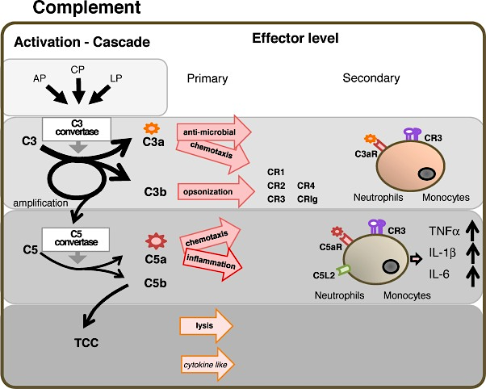
Human Complement Activation and Amplification
Complement is a central homeotic and immune defense system of the human organism and related vertebrates.
Complement consists of four major circuits one activation step and three connected effector levels.
Thrombin
TF

Slide 6

Consequences of Complement Amplification In PNH
COMPLEMENT AMPLIFICATION¹
EFFECTS OF COMPLEMENT DYSREGULATION¹⁻³
CAUSES OF PROGRESSIVE MORBIDITIES AND MORTALITY²⁻⁶
Complement amplification
Notes:
Schematic/Complement activation
Kelly/pg912/col1/P3 – col2/P1-2; pg913/Fig2
Schematic/Effects of complement DYSREGULATION
Haemolysis
Kelly/pg913/Fig2; Rother/pg1658/col3/P3/ln1-7; pg1659/col1/P1/ln2-6
NO depletion
Rother/pg1659/col3/P3 – pg1660/col1/P1; pg1656/Fig 1
Platelet aggregation
Hill 2013/pg4987/col2/P5 – pg4988/col1/P1
Leukocyte activation
Hill 2013/pg4991/col1/P6
Schematic/End Organ Damage
Chronic Kidney Disease
Rachidi/pg262/col2/P3-4
[link NO to CKD]
Zatz/pg2/P3
Pulmonary Hypertension
Hill 2010/pg421/col1/P2-3
SMC Dystonias
Rother/pg1656/Fig 1
Thrombosis
Hill 2013/pg4986/col1/P2/all;
Pg4987/col2/P4/ln5-9
l

Slide 7
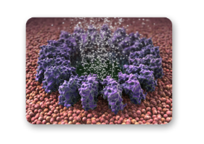
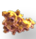
Consequences of Complement Amplification In PNH
COMPLEMENT AMPLIFICATION¹
EFFECTS OF COMPLEMENT DYSREGULATION¹⁻³
CAUSES OF PROGRESSIVE MORBIDITIES AND MORTALITY²⁻⁶
Complement amplification
C5b-9
Membrane attack complex
C5a
Potent proinflammatory
anaphylatoxin
Notes:
Schematic/Complement activation
Kelly/pg912/col1/P3 – col2/P1-2; pg913/Fig2
Schematic/Effects of complement DYSREGULATION
Haemolysis
Kelly/pg913/Fig2; Rother/pg1658/col3/P3/ln1-7; pg1659/col1/P1/ln2-6
NO depletion
Rother/pg1659/col3/P3 – pg1660/col1/P1; pg1656/Fig 1
Platelet aggregation
Hill 2013/pg4987/col2/P5 – pg4988/col1/P1
Leukocyte activation
Hill 2013/pg4991/col1/P6
Schematic/End Organ Damage
Chronic Kidney Disease
Rachidi/pg262/col2/P3-4
[link NO to CKD]
Zatz/pg2/P3
Pulmonary Hypertension
Hill 2010/pg421/col1/P2-3
SMC Dystonias
Rother/pg1656/Fig 1
Thrombosis
Hill 2013/pg4986/col1/P2/all;
Pg4987/col2/P4/ln5-9
l

Slide 8
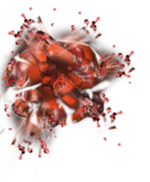
Consequences of Complement Amplification In PNH
COMPLEMENT AMPLIFICATION¹
EFFECTS OF COMPLEMENT DYSREGULATION¹⁻³
CAUSES OF PROGRESSIVE MORBIDITIES AND MORTALITY²⁻⁶
Hemolysis
Complement amplification
C5b-9
Membrane attack complex
C5a
Potent proinflammatory
anaphylatoxin
Notes:
Schematic/Complement activation
Kelly/pg912/col1/P3 – col2/P1-2; pg913/Fig2
Schematic/Effects of complement DYSREGULATION
Haemolysis
Kelly/pg913/Fig2; Rother/pg1658/col3/P3/ln1-7; pg1659/col1/P1/ln2-6
NO depletion
Rother/pg1659/col3/P3 – pg1660/col1/P1; pg1656/Fig 1
Platelet aggregation
Hill 2013/pg4987/col2/P5 – pg4988/col1/P1
Leukocyte activation
Hill 2013/pg4991/col1/P6
Schematic/End Organ Damage
Chronic Kidney Disease
Rachidi/pg262/col2/P3-4
[link NO to CKD]
Zatz/pg2/P3
Pulmonary Hypertension
Hill 2010/pg421/col1/P2-3
SMC Dystonias
Rother/pg1656/Fig 1
Thrombosis
Hill 2013/pg4986/col1/P2/all;
Pg4987/col2/P4/ln5-9
l

Slide 9

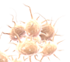
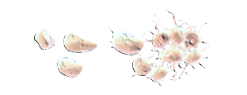



Consequences of Complement Amplification In PNH
COMPLEMENT AMPLIFICATION¹
EFFECTS OF COMPLEMENT DYSREGULATION¹⁻³
CAUSES OF PROGRESSIVE MORBIDITIES AND MORTALITY²⁻⁶
Hemolysis
Complement amplification
Fibrinogen cleavage
Platelet aggregation
C5b-9
Membrane attack complex
Platelet activation
Leukocyte
activation
Cytokine
release
C5a
Potent proinflammatory
anaphylatoxin
Notes:
Schematic/Complement activation
Kelly/pg912/col1/P3 – col2/P1-2; pg913/Fig2
Schematic/Effects of complement DYSREGULATION
Haemolysis
Kelly/pg913/Fig2; Rother/pg1658/col3/P3/ln1-7; pg1659/col1/P1/ln2-6
NO depletion
Rother/pg1659/col3/P3 – pg1660/col1/P1; pg1656/Fig 1
Platelet aggregation
Hill 2013/pg4987/col2/P5 – pg4988/col1/P1
Leukocyte activation
Hill 2013/pg4991/col1/P6
Schematic/End Organ Damage
Chronic Kidney Disease
Rachidi/pg262/col2/P3-4
[link NO to CKD]
Zatz/pg2/P3
Pulmonary Hypertension
Hill 2010/pg421/col1/P2-3
SMC Dystonias
Rother/pg1656/Fig 1
Thrombosis
Hill 2013/pg4986/col1/P2/all;
Pg4987/col2/P4/ln5-9
l

Slide 10
Consequences of Complement Amplification In PNH
COMPLEMENT AMPLIFICATION¹
EFFECTS OF COMPLEMENT DYSREGULATION¹⁻³
CAUSES OF PROGRESSIVE MORBIDITIES AND MORTALITY²⁻⁶
Hemolysis
Complement amplification
NO
NO
2NO₃-
NO scavenging/
Reduced NO synthesis
Fibrinogen cleavage
Platelet aggregation
C5b-9
Membrane attack complex
Platelet activation
Leukocyte
activation
Cytokine
release
C5a
Potent proinflammatory
anaphylatoxin
Notes:
Schematic/Complement activation
Kelly/pg912/col1/P3 – col2/P1-2; pg913/Fig2
Schematic/Effects of complement DYSREGULATION
Haemolysis
Kelly/pg913/Fig2; Rother/pg1658/col3/P3/ln1-7; pg1659/col1/P1/ln2-6
NO depletion
Rother/pg1659/col3/P3 – pg1660/col1/P1; pg1656/Fig 1
Platelet aggregation
Hill 2013/pg4987/col2/P5 – pg4988/col1/P1
Leukocyte activation
Hill 2013/pg4991/col1/P6
Schematic/End Organ Damage
Chronic Kidney Disease
Rachidi/pg262/col2/P3-4
[link NO to CKD]
Zatz/pg2/P3
Pulmonary Hypertension
Hill 2010/pg421/col1/P2-3
SMC Dystonias
Rother/pg1656/Fig 1
Thrombosis
Hill 2013/pg4986/col1/P2/all;
Pg4987/col2/P4/ln5-9
l

Slide 11
Consequences of Complement Amplification In PNH
COMPLEMENT AMPLIFICATION¹
EFFECTS OF COMPLEMENT DYSREGULATION¹⁻³
CAUSES OF PROGRESSIVE MORBIDITIES AND MORTALITY²⁻⁶
End-organ damage
eg, chronic kidney disease,
pulmonary hypertension,
liver damage
Hemolysis
Complement amplification
NO
NO
2NO₃-
NO scavenging/
Reduced NO synthesis
Fibrinogen cleavage
Platelet aggregation
C5b-9
Membrane attack complex
Platelet activation
Leukocyte
activation
Cytokine
release
C5a
Potent proinflammatory
anaphylatoxin
Notes:
Schematic/Complement activation
Kelly/pg912/col1/P3 – col2/P1-2; pg913/Fig2
Schematic/Effects of complement DYSREGULATION
Haemolysis
Kelly/pg913/Fig2; Rother/pg1658/col3/P3/ln1-7; pg1659/col1/P1/ln2-6
NO depletion
Rother/pg1659/col3/P3 – pg1660/col1/P1; pg1656/Fig 1
Platelet aggregation
Hill 2013/pg4987/col2/P5 – pg4988/col1/P1
Leukocyte activation
Hill 2013/pg4991/col1/P6
Schematic/End Organ Damage
Chronic Kidney Disease
Rachidi/pg262/col2/P3-4
[link NO to CKD]
Zatz/pg2/P3
Pulmonary Hypertension
Hill 2010/pg421/col1/P2-3
SMC Dystonias
Rother/pg1656/Fig 1
Thrombosis
Hill 2013/pg4986/col1/P2/all;
Pg4987/col2/P4/ln5-9
l

Slide 12
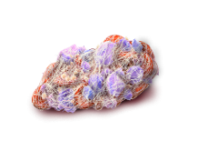
Consequences of Complement Amplification In PNH
COMPLEMENT AMPLIFICATION¹
EFFECTS OF COMPLEMENT DYSREGULATION¹⁻³
CAUSES OF PROGRESSIVE MORBIDITIES AND MORTALITY²⁻⁶
End-organ damage
eg, chronic kidney disease,
pulmonary hypertension,
liver damage
Hemolysis
Complement amplification
NO
NO
2NO₃-
Smooth muscle dystonias
eg, dyspnoea, dysphagia, erectile dysfunction, abdominal pain,
chest pain
NO scavenging/
Reduced NO synthesis
Fibrinogen cleavage
Platelet aggregation
C5b-9
Membrane attack complex
Platelet activation
Thrombosis
eg, intra-abdominal, hepatic, cerebral, pulmonary, or renal thromboemboli
Fatigue
Leukocyte
activation
Cytokine
release
C5a
Potent proinflammatory
anaphylatoxin
Notes:
Schematic/Complement activation
Kelly/pg912/col1/P3 – col2/P1-2; pg913/Fig2
Schematic/Effects of complement DYSREGULATION
Haemolysis
Kelly/pg913/Fig2; Rother/pg1658/col3/P3/ln1-7; pg1659/col1/P1/ln2-6
NO depletion
Rother/pg1659/col3/P3 – pg1660/col1/P1; pg1656/Fig 1
Platelet aggregation
Hill 2013/pg4987/col2/P5 – pg4988/col1/P1
Leukocyte activation
Hill 2013/pg4991/col1/P6
Schematic/End Organ Damage
Chronic Kidney Disease
Rachidi/pg262/col2/P3-4
[link NO to CKD]
Zatz/pg2/P3
Pulmonary Hypertension
Hill 2010/pg421/col1/P2-3
SMC Dystonias
Rother/pg1656/Fig 1
Thrombosis
Hill 2013/pg4986/col1/P2/all;
Pg4987/col2/P4/ln5-9
l

Slide 13
Consequences of Complement Amplification In PNH
COMPLEMENT AMPLIFICATION¹
EFFECTS OF COMPLEMENT DYSREGULATION¹⁻³
CAUSES OF PROGRESSIVE MORBIDITIES AND MORTALITY²⁻⁶
End-organ damage
eg, chronic kidney disease,
pulmonary hypertension,
liver damage
Hemolysis
Complement amplification
NO
NO
2NO₃-
Smooth muscle dystonias
eg, dyspnoea, dysphagia, erectile dysfunction, abdominal pain,
chest pain
NO scavenging/
Reduced NO synthesis
Fibrinogen cleavage
Platelet aggregation
C5b-9
Membrane attack complex
Platelet activation
Thrombosis
eg, intra-abdominal, hepatic, cerebral, pulmonary, or renal thromboemboli
Fatigue
Leukocyte
activation
Cytokine
release
C5a
Potent proinflammatory
anaphylatoxin
Notes:
Schematic/Complement activation
Kelly/pg912/col1/P3 – col2/P1-2; pg913/Fig2
Schematic/Effects of complement DYSREGULATION
Haemolysis
Kelly/pg913/Fig2; Rother/pg1658/col3/P3/ln1-7; pg1659/col1/P1/ln2-6
NO depletion
Rother/pg1659/col3/P3 – pg1660/col1/P1; pg1656/Fig 1
Platelet aggregation
Hill 2013/pg4987/col2/P5 – pg4988/col1/P1
Leukocyte activation
Hill 2013/pg4991/col1/P6
Schematic/End Organ Damage
Chronic Kidney Disease
Rachidi/pg262/col2/P3-4
[link NO to CKD]
Zatz/pg2/P3
Pulmonary Hypertension
Hill 2010/pg421/col1/P2-3
SMC Dystonias
Rother/pg1656/Fig 1
Thrombosis
Hill 2013/pg4986/col1/P2/all;
Pg4987/col2/P4/ln5-9
l

Slide 14
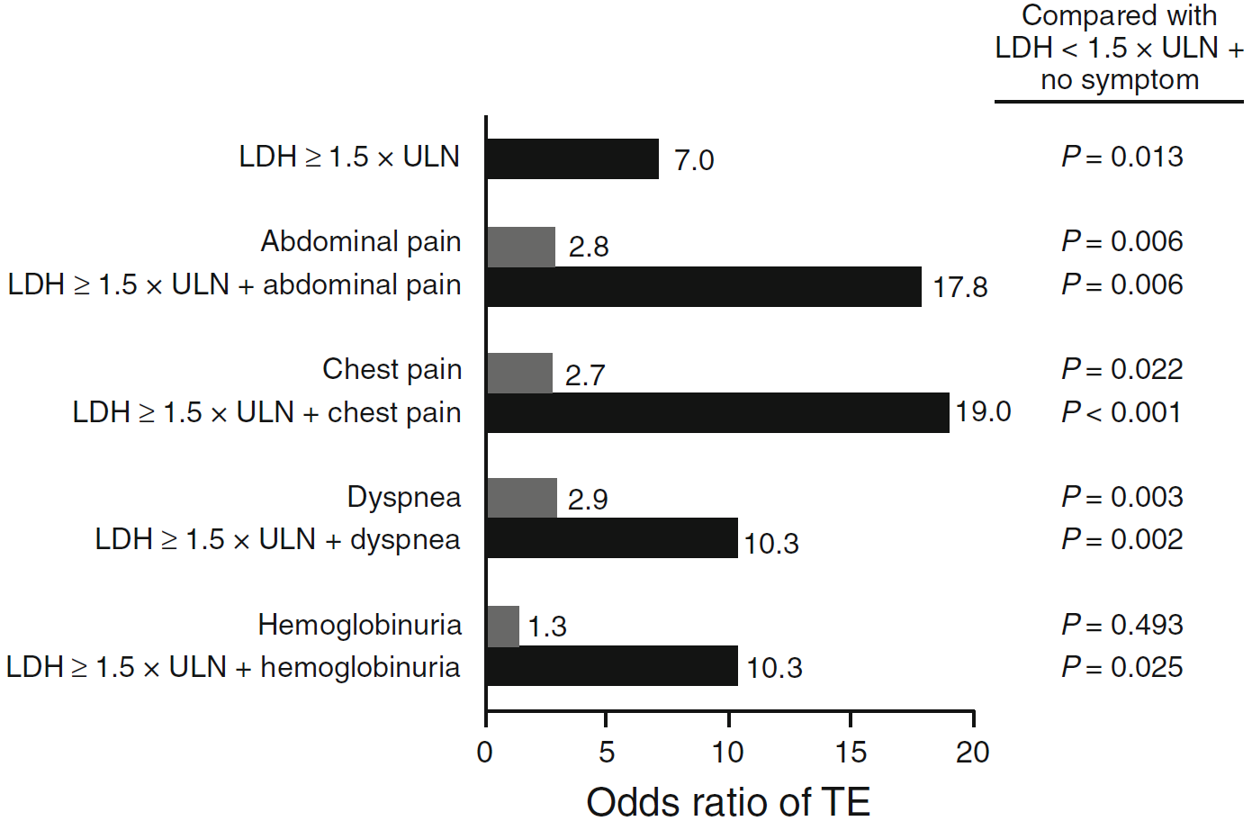
Hemolysis and Certain Clinical Symptoms Place Patients at Increased Risk for TE
The risk for TE in patients with LDH ≥1.5 x ULN was 7 times greater than in patients with LDH <1.5 x ULN (P=0.013)¹
Study Description: A retrospective analysis of the medical charts of 301 patients in a national registry

Slide 15
Thrombosis in PNH - Pathophysiology
COMPLEMENT INJURY
NO
PS
C5b-9
HEMOLYSIS
Granulocytes
MONOCYTES
PLATELET
Endothelial cells
THROMBIN
GENERATION
COMPLEMENT
C5a
CYTOKINES IL-6
INFLAMMATION
TF
TF = Tissue factor.

Slide 16
Effect of Eculizumab Complement Inhibition (CI) on the Number of Thrombotic Events in Patients with PNH
45
39
40
35
92% reduction
P<0.000001
30
25
No. of Thrombotic Events*
in All Clinical Trial Patients
20
15
10
5
3
N=195
0
Pre CI Treatment
Post CI Treatment
Events observed in both venous and arterial sites pre-CI, and only in venous sites during treatment
A majority of patients received concomitant antithrombotic agents, predominantly anticoagulants
  The effect of anticoagulant withdrawal was not studied
Notes:
Graph
Hillmen 2007 Pg4127/Tbl4
92% reduction
Hillmen 2007 Pg4125/Col2/P1/Ln6-9
Footnote
Hillmen 2007 Pg4125/Col2/P1/Ln1-12
Bullet 1
Hillmen 2007 Pg4126/Tbl2; Pg4127/Col1/P2
Bullet 2
Hillmen 2007 Pg4125/Tbl1; Pg4127/Col1/P3/Ln1-5
Bullet 2 sub 1
Hillmen 2007 Pg4127/Col1/P3/Ln21-23

Slide 17
Complement Inhibition on Markers of Hemostatic Activation and Inflammation
(Weitz, IC et al. JTR 2012) All but 2/11 patients were activated
pre-treatment both were receiving prophylactic anticoagulation
  There was a statistically significant decrease in LDH (p<0.0001)
  D-D (p=0.0057), TAT (p=0.0138), IL-6 (p=0.0362), TFMP (P=0.0014) during the 4 week induction phase of treatment (D29)
  All decreases in D-D, TAT, Il-6 , TFMP and LDH were sustained in the maintenance phase of treatment (D29-90). There was no correlation with LDH (DD=0.143, TAT p=0.188, IL-6=0.90, TFMP=0.48)
  TFMP did not correlate with markers of D- D, TAT, or IL-6; MPXa, fTFMP no change and inverse correlation with markers of thrombin generation
  P-selectin correlated with platelet count, LDH, inversely with TAT
  Untreated, PNH patients demonstrate evidence of excess thrombin generation as measured by D-Dimers and TAT as well as an inflammatory state, as measures by IL-6 levels, that correlates significantly with thrombin generation
(Helley, D. et al) pre vs week 5, 11
  There was a significant decrease in plasma measures of coagulation activation (prothrombin fragment 1 + 2, P = 0.012, and D dimers, P = 0.01)
  A lower consecutive fibrinolysis (tissue type plasminogen activator, P = 0.0005, and plasmin antiplasmin complexes, P = 0.0002)
  Decreased plasma measures of endothelial cell activation (soluble VCAM, P < 0.0001, and vWF antigen, P = 0.0047) and total (P = 0.0008) and free (P = 0.0013) TFPI plasma levels

Slide 18
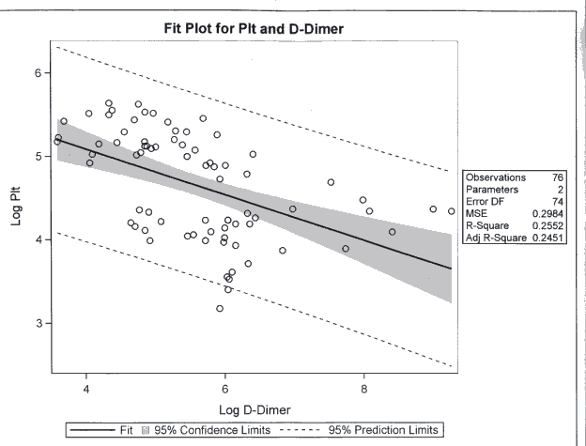
Thrombocytopenia in Patients with PNH
Fit Plot for Plt and D-Dimer
6
5
Observations | 76
Parameters | 2
Error DF | 74
MSE | 0.2984
R-Square | 0.2552
Adj R-Square | 0.2451
Log Plt
4
3
4
6
8
Log D-Dimer
Fit 95% Confidence Limits 95% Prediction Limits

Slide 19
Clinical Benefits in Patients With PNH
Actuarial Survival From the Time of Diagnosis in 80 Patients With PNH (Pre-Eculizumab)¹
Survival of Patients With PNH Treated
With Eculizumab Compared With the
Normal UK Population²
100
Age matched controls
100
80
Age- and Gender-
Matched Controls
2
Age- and gender-
matched controls
80
N=153
60
Patient Survival, %
60
Age- and gender-matched
normal population
Cumulative Survival, %
40
40
Eculizumab-treated PNH population
20
Patients with PNH
Patients With PNH
20
Numbers at risk:
0
153
93
45
43
12
0
0
0
0
5
10
15
20
25
0
2
4
6
8
10
Years After Diagnosis
Time, years

