Slide 1
PNH – What Is It and How Does It Affect Patients?
Catherine Broome, MD
Associate Professor
Medicine MedStar Georgetown University
Lombardi Cancer Center
Washington, DC

Slide 2
Disclaimer
The views and opinions expressed in this educational activity are those of the faculty and do not necessarily represent the views of TotalCME, Inc., the CME providers, or the companies providing educational grants. This presentation is not intended to define an exclusive course of patient management; the participant should use their clinical judgment, knowledge, experience, and diagnostic skills in applying or adopting for professional use any of the information provided herein. Any procedures, medications, or other courses of diagnosis or treatment discussed or suggested in this activity should not be used by clinicians without evaluation of their patient's conditions and possible contraindications or dangers in use, review of any applicable manufacturer’s product information, and comparison with recommendations of other authorities. Links to other sites may be provided as additional sources of information.

Slide 3
Paroxysmal Nocturnal Hemoglobinuria
Paroxysmal nocturnal hemoglobinuria (PNH) first reported in the medical literature by Gull
Role of complement and developed the serum test which can still be used for diagnosis “Ham Test” by Ham
1866
1925
1930
1990’s
Name “paroxysmal nocturnal hemoglobinuria” created based on the mistaken belief that hemolysis (red blood cell break down) and subsequent hemoglobinuria (free hemoglobin in urine) occurred by Enneking:
Intermittent episodes (paroxysmal)
Greater frequency during the night (nocturnal)
Somatic mutation responsible was identified as PIG-A gene

Slide 4
Genesis of PNH
A Somatic Mutation in the PIG-A Gene in 1 HSC
GPI-linked Proteins Deficient on a Clone of Blood Cells
Immunologic
Attack on HSC
Selection of Defective HSC
? Second
Mutation HMGA2?
Expansion of Defective Clone

Slide 5
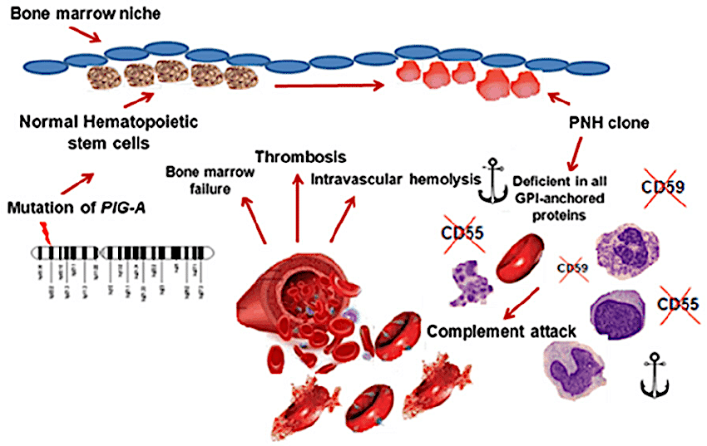
PNH

Slide 6
Key PNH Considerations:
Actuarial Survival From the Time of
Diagnosis in 80 Patients With PNH¹
Estimated 4,000 – 6,000 patients in U.S.¹
5-year mortality: 35%²
Diagnosed at all ages –
median age early 30’s^{3,4}
Quality of life diminished⁵
Progressive disease⁵
100
80
Age- and sex-
matched controls
60
Patients Surviving (%)
40
20
Patients with PNH
0
0
5
10
15
20
25
Years After Diagnosis
The expected survival of an age- and sex-matched control group is shown for comparison (Hillmen et al 1995).
Notes:
6
6

Slide 7
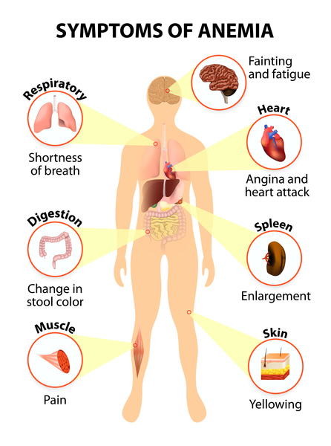
PNH: Anemia
Symptoms of Anemia

Slide 8

Consequences of Chronic Hemolysis and Free Hemoglobin
Normal red blood cells are protected from complement attack by a shield of terminal complement inhibitors
Without this protective complement inhibitor shield, PNH red blood cells are destroyed
Thrombosis
Renal Failure
Significant Impact on Survival
Pulmonary Hypertension
Abdominal Pain
Complement
Activation
Dyspnea
Dysphagia
Fatigue
Significant Impact on Morbidity
Intact RBC
Free Hgb/Anemia
Hemoglobinuria
Erectile Dysfunction
NO↓

Slide 9
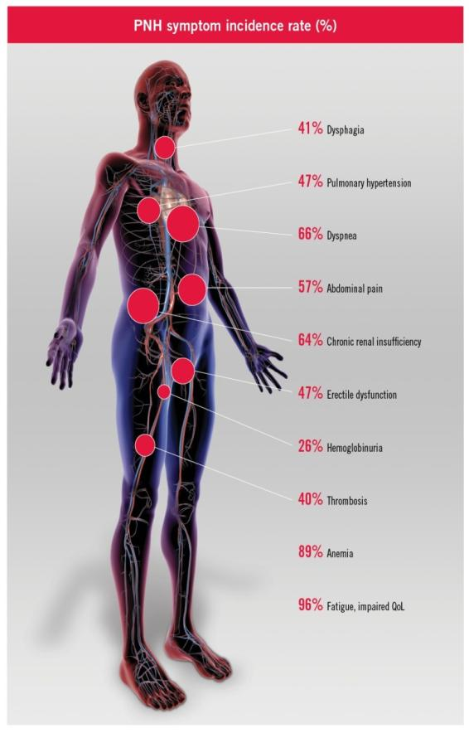
Common Symptoms in Patients With PNH
PNH Symptom Incidence Rate (%)
41% Dysphagia¹
47% Pulmonary Hypertension²
66% Dyspnea¹
57% Abdominal Pain¹
64% Chronic Renal Insufficiency³
47% Erectile dysfunction¹
26% Hemoglobinuria⁴
39% Thrombosis⁵
88% Anemia⁶
96% Fatigue, Impaired QoL¹

Slide 10
Laboratory Findings in PNH
Anemia (low red blood cell counts)
  Note: possible to have hemolysis without anemia if the bone marrow able to compensate
Increased reticulocyte count
Increased lactate dehydrogenase (LDH) and indirect bilirubin
Decreased haptoglobin
Free serum hemoglobin with pink/red serum
Hemoglobinuria with pink/red urine
  Positive dipstick for heme
  Negative sediment for red blood cells
Negative direct antiglobulin (Coombs or DAT)

