Slide 1
The Role and Limitations of Hematopoietic Stem Cell Transplantation in Farber Disease
John Mitchell, MD, MSc
Pediatric Endocrinologist
Division of Medical Genetics
McGill University Health Center, Montreal
Quebec, Canada

Slide 2
Disclaimer
The views and opinions expressed in this educational activity are those of the faculty and do not necessarily represent the views of TotalCME, Inc., the CME providers, or the companies providing educational grants. This presentation is not intended to define an exclusive course of patient management; the participant should use their clinical judgment, knowledge, experience, and diagnostic skills in applying or adopting for professional use any of the information provided herein. Any procedures, medications, or other courses of diagnosis or treatment discussed or suggested in this activity should not be used by clinicians without evaluation of their patient's conditions and possible contraindications or dangers in use, review of any applicable manufacturer’s product information, and comparison with recommendations of other authorities. Links to other sites may be provided as additional sources of information.

Slide 3
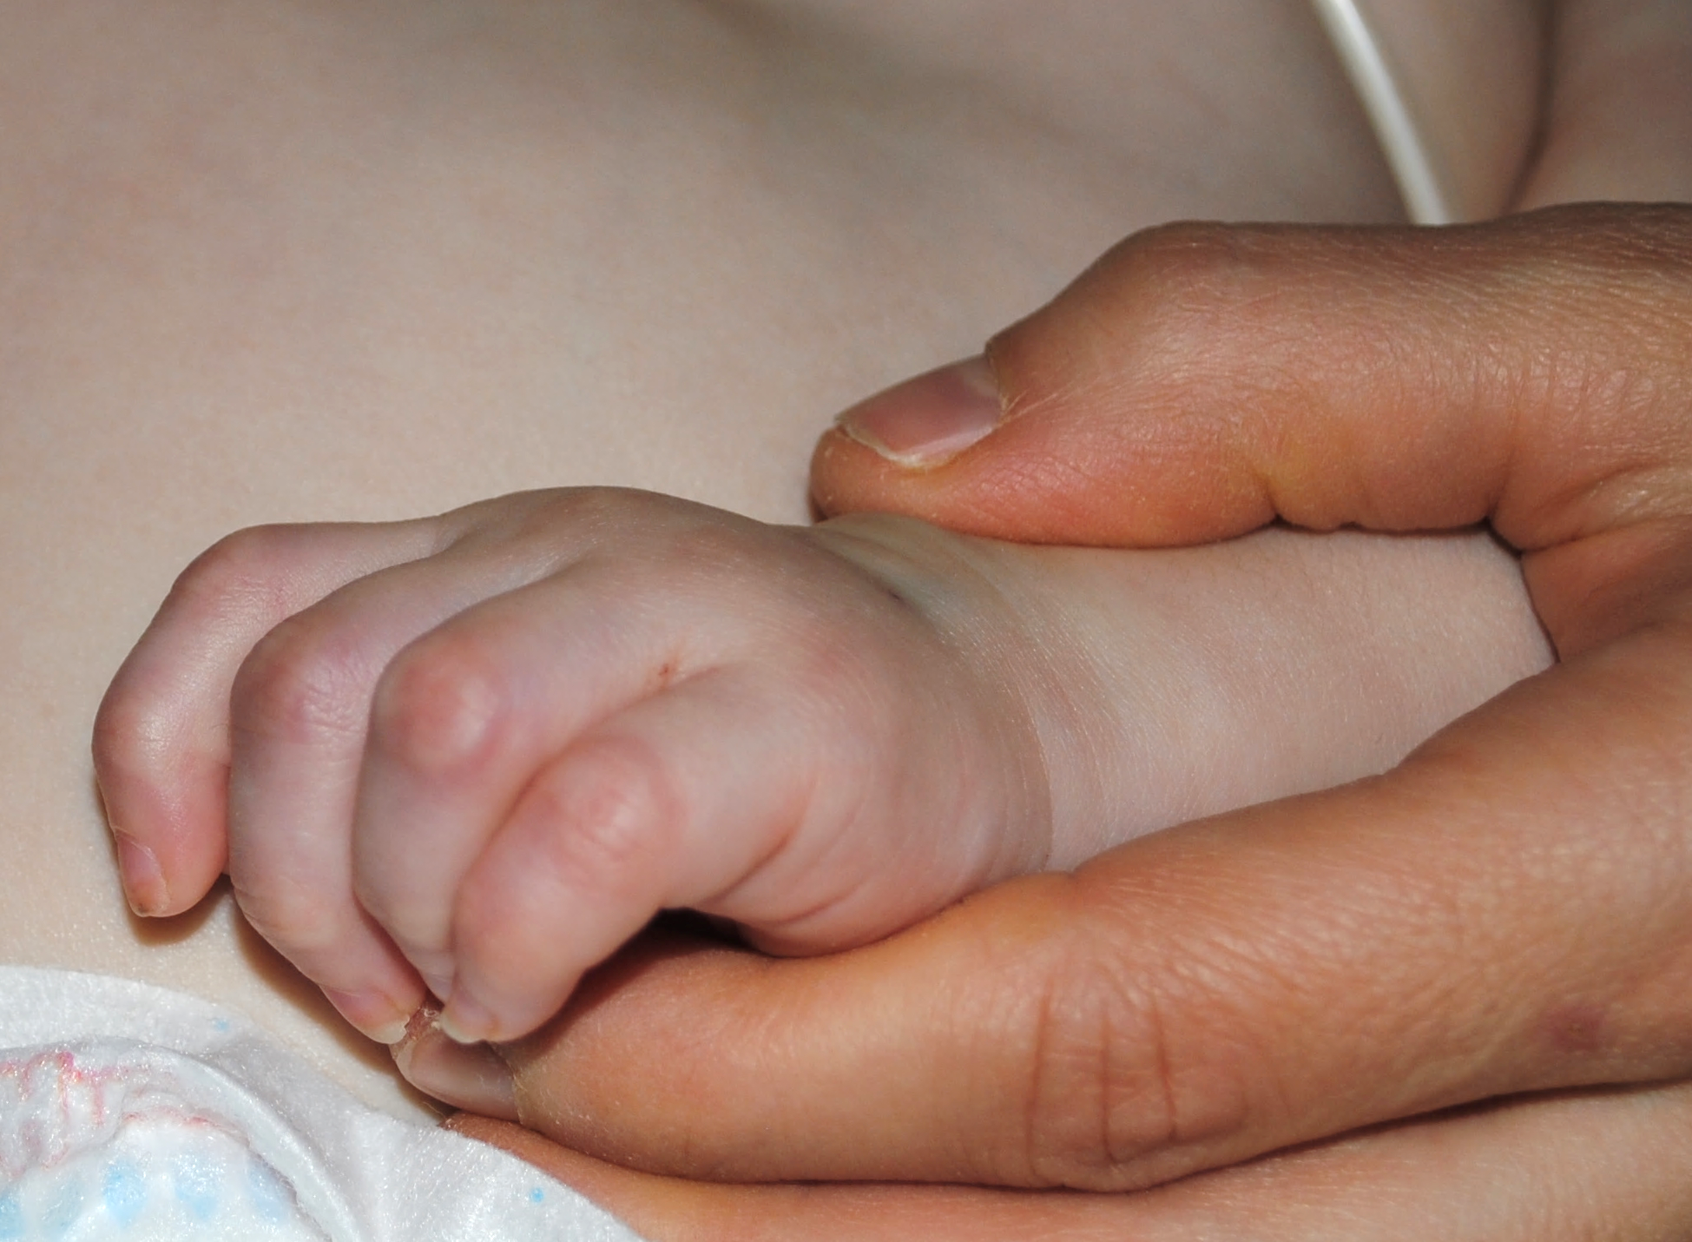
Case Presentation
French Canadian girl presented at 3 months of age to ER with inability to cut nails
Swelling and erythema in all proximal interphalangeal and distal interphalangeal joints, including both wrist and toes
Noisy breathing with hoarse cry
Referred to rheumatology
Nodules appeared at 4 months of age
Referred to genetics, as this was not keeping with rheumatologic diagnoses

Slide 4
Classical Triad for Farber Disease
Polyarticular arthritis
Hoarse voice
Subcutaneous nodules
An ultra-rare lysosomal storage disease marked by inflammation
Incidence (~1:1 000 000)
Classical triad of arthritis, nodules, and hoarse voice
Symptoms may not appear together which can lead to delay in diagnosis
Other features include CNS, ophthalmologic, pulmonary, skeletal, and gastroenterological

Slide 5
Farber Disease Pathophysiology
Ceramide functions include the regulation of:
Cell signaling
Inflammation
Maintenance of water barriers (e.g., skin)
Cell migration
Cell differentiation
Macrophage driven inflammation (local and systemic)
ASAH1 gene mutations (autosomal recessive)
Acid ceramidase deficiency
Ceramide accumulation

Slide 6
Farber Diagnosis
ASAH1 homozygote c.458A>G (p.Tyr153Cys)
This is a Quebec founder mutation that has resulted in classical onset Farber disease in previous cases
Neurodegeneration and death in the first 5 years of life
Symptomatic control difficult with poor response to pain medications
Are there any disease-modifying therapies?

Slide 7
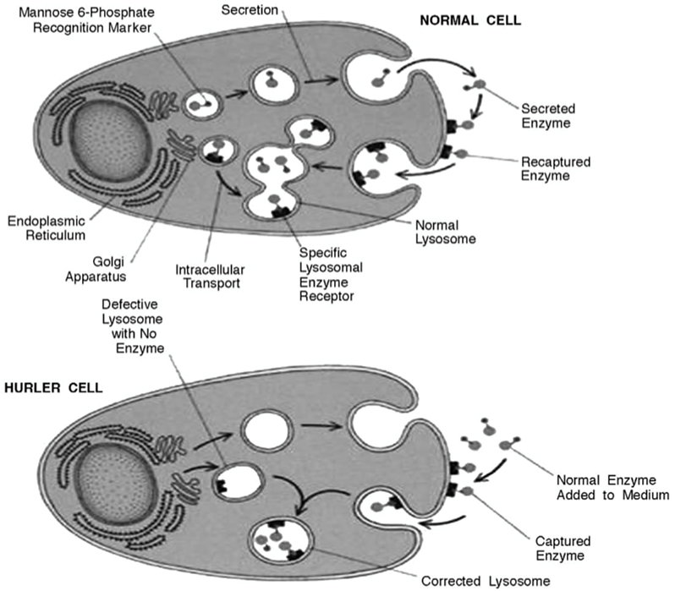
Stem Cell Transplant
Hematopoietic stem cell transplant has been routinely performed for some neurodegenerative LSDs
In the brain, these donor progenitors engraft in recipient tissue and differentiate into microglial cells
They then produce lysosomal enzymes, which can cross-correct neighboring oligodendrocytes and neurons
Does this improve outcomes in Farber?

Slide 8
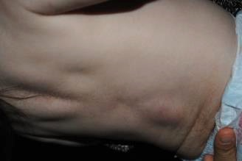
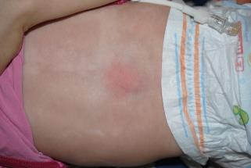
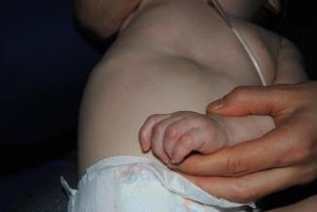
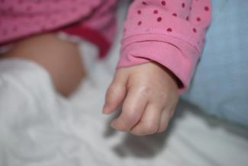
Stem Cell Transplant at 9 Months
Pre-transplant
2 Months Post-transplant

Slide 9
Neurodevelopmental Outcome
Despite improved peripheral manifestations, noted gradual decline in development
At 19 months
Good eye contact but no crawling and no pincer grasp
Transfers from hand to hand are clumsy
Decreased response to pin prick
At 29 months
Severe developmental delay with deceleration of head growth
No response to name

Slide 10
Conclusion
Transplantation has a role to play in Farber disease
Clear improvement of peripheral manifestations
Improved quality of life
Resolution of pain
Less irritability
However, no effect on central nervous decline
She died of respiratory failure at the age of 37 months, 28 months after transplant
This case is similar to experience with other existing cases with no impact on CNS
Clear need for new therapies

Slide 11
Future Therapies
Stem cell transplantation has demonstrated proof of concept that replacement of enzyme function can treat symptoms
Aceragen has an enzyme replacement therapy that is in development (www.aceragen.com)
First-in-human trial expected to start in 2023
If you have patients that you think may benefit from this trial, you can contact me (john.mitchell@much.mcgill.ca)

