Slide 1
Farber Disease:
A Rheumatological Perspective
John Mitchell, MD, MSc
Division of Medical Genetics
McGill University Health Center, Montreal
Quebec, Canada

Slide 2
Disclaimer
The views and opinions expressed in this educational activity are those of the faculty and do not necessarily represent the views of TotalCME, Inc., the CME providers, or the companies providing educational grants. This presentation is not intended to define an exclusive course of patient management; the participant should use their clinical judgment, knowledge, experience, and diagnostic skills in applying or adopting for professional use any of the information provided herein. Any procedures, medications, or other courses of diagnosis or treatment discussed or suggested in this activity should not be used by clinicians without evaluation of their patient's conditions and possible contraindications or dangers in use, review of any applicable manufacturer’s product information, and comparison with recommendations of other authorities. Links to other sites may be provided as additional sources of information.

Slide 3
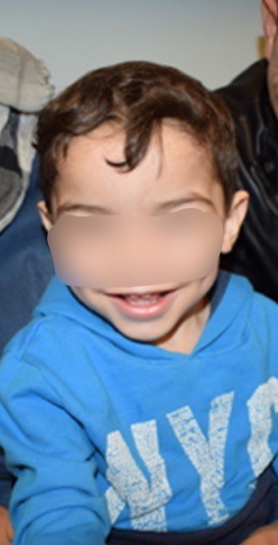
Case Presentation
2-year-old male born to consanguineous Syrian couple
At 7 months of age, the parents noted there was pain when they attempted to straighten his hands
Swelling noted by pediatrician at 11 months, and he was referred to rheumatology
  Presumed severe JIA
  Inflammatory markers, RF, and ANA negative
  Started on naproxen, methotrexate, and folic acid

Slide 4
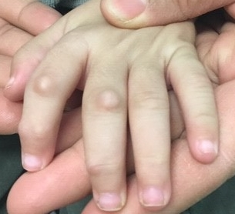
Case I
Good initial response with increased movement, but had continued pain
Increasingly difficult to handle
Normal x-rays of hands, feet, and knees. Poor weight gain
Developed nodules at 14 months
Rheumatologist referred to genetics due to poor response to first line JIA therapies

Slide 5
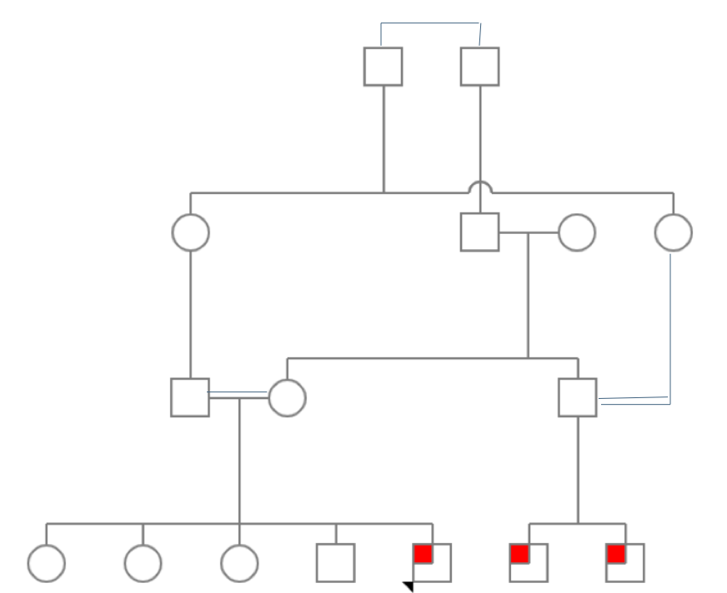
Case Study I Diagnosis
Genetics noted mild hepatomegaly and coarse features
Lysosomal panel revealed homozygote mutation c.704G>A in the ASAH1 gene
Compatible with acid ceramidase deficiency or Farber disease
Family history detected 2 maternal cousins with similar features

Slide 6
Farber Disease
An ultra-rare lysosomal storage disease marked by inflammation
Classic triad: polyarticular arthritis, subcutaneous nodules, and hoarse voice
Symptoms may not appear together which can lead to delay in diagnosis
Other features include CNS, ophthalmologic, pulmonary, skeletal, and gastroenterological
Wide heterogeneity of features
Macrophage
driven inflammation (local and systemic)
ASAH1 gene mutations (autosomal recessive)
Acid ceramidase deficiency
Ceramide accumulation
Ceramide functions include the regulation of:
Cell signaling
Inflammation
Maintenance of water barriers (e.g., skin)
Cell migration
Cell differentiation

Slide 7
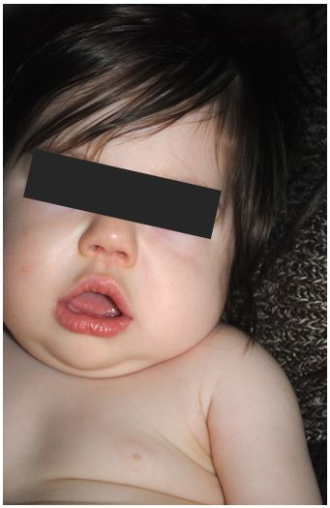


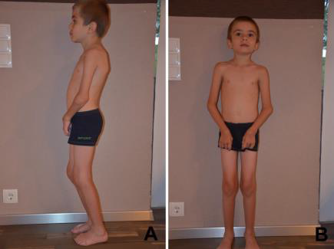
Rapidly progressive Slowly progressive
Often with CNS and
pulmonary involvement
No apparent CNS or
pulmonary involvement

Slide 8
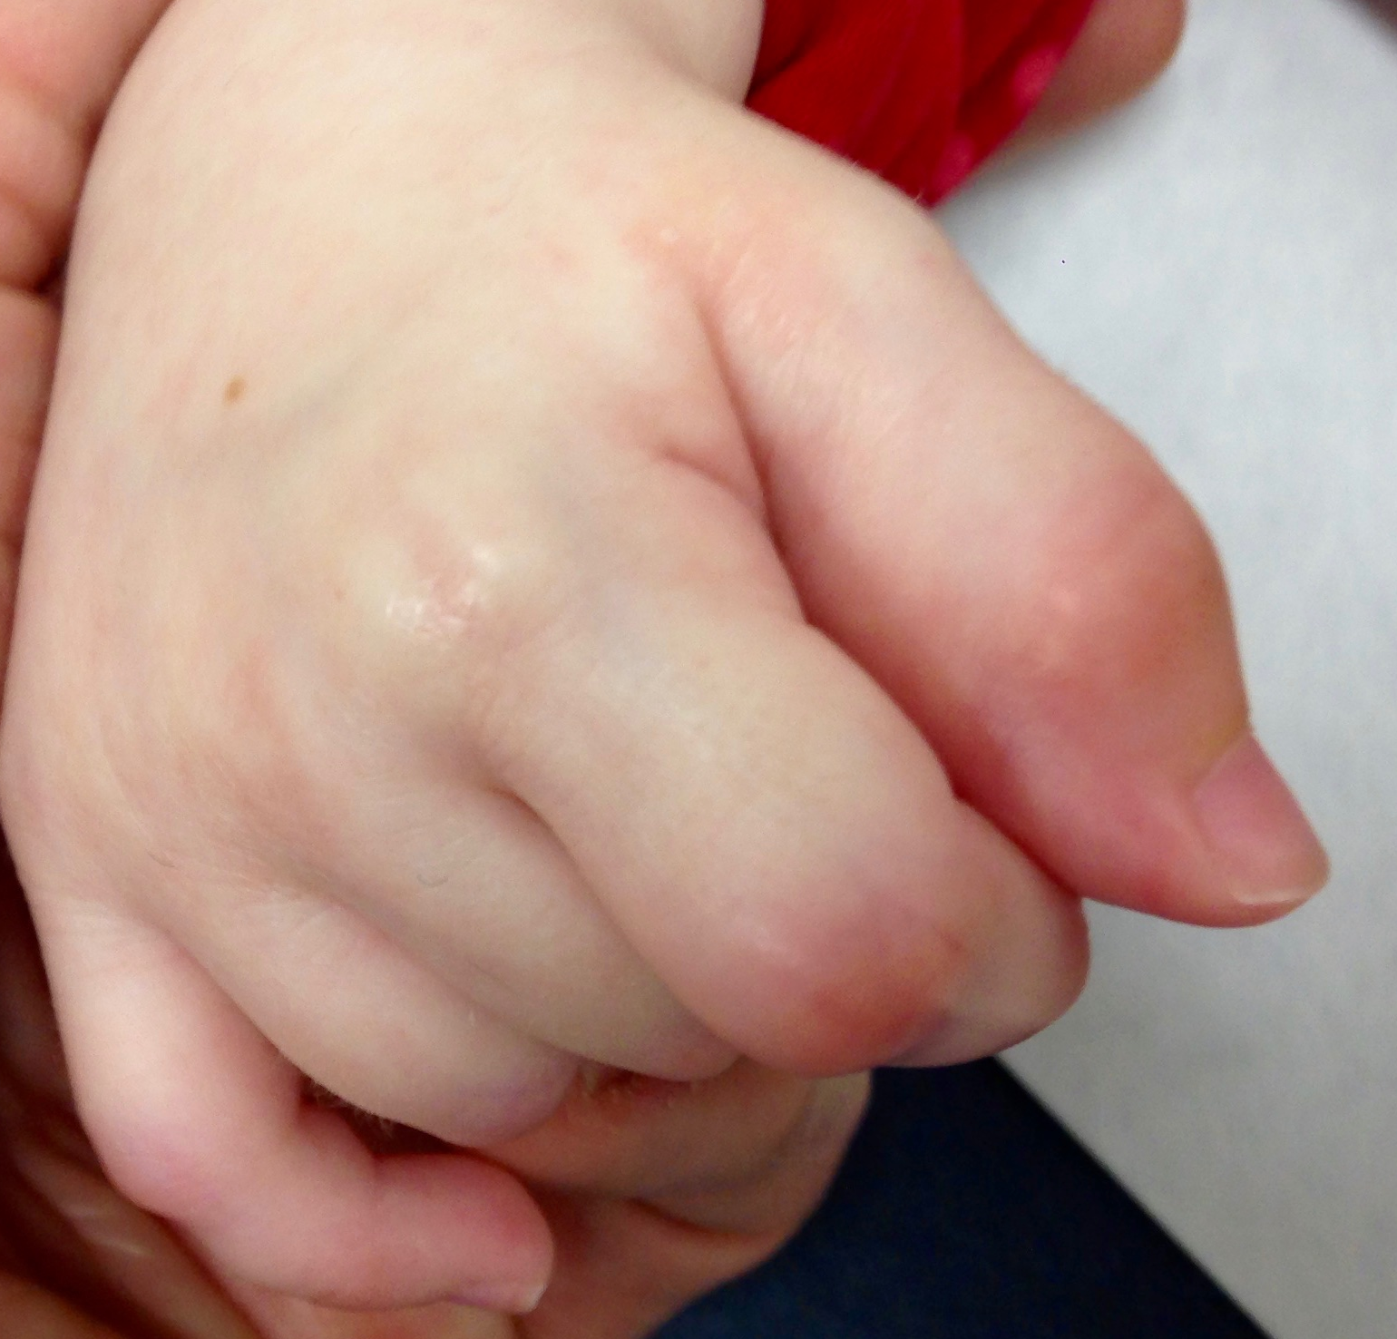
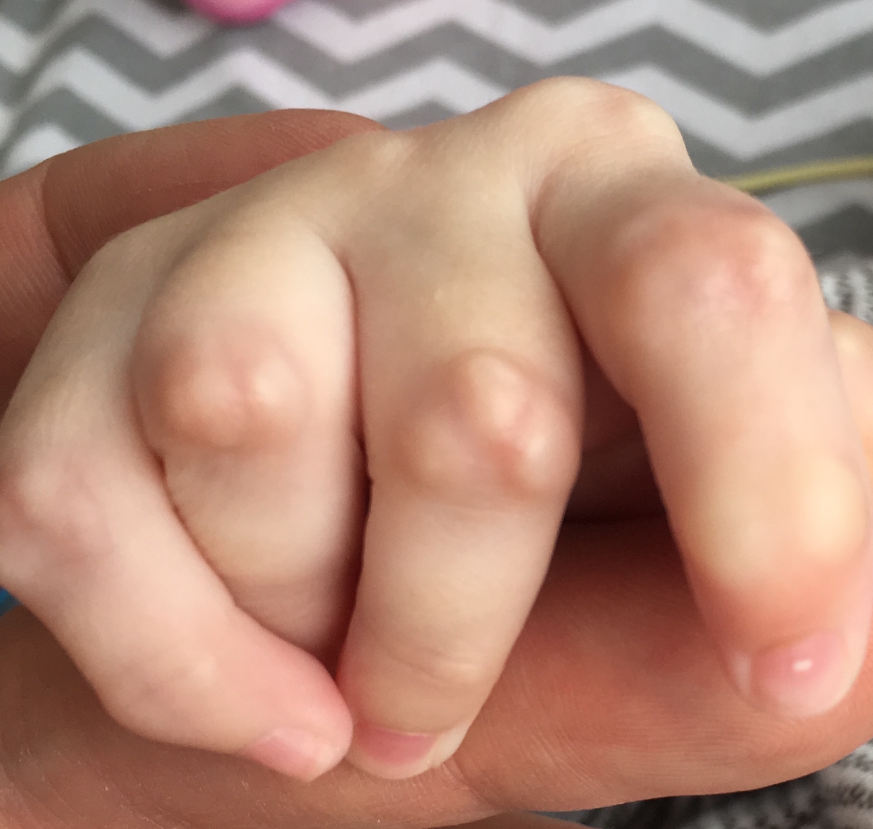
Management of Symptoms
Pain management is critical to QOL
Hematopoietic stem cell transplant
  Resolution of the inflammatory aspect of Farber disease, but no impact on nervous system involvement
Anti-inflammatory medications
Use of tocilizumab (Interleukin 6 receptor antibody) symptomatic therapy has the greatest effect to date
Clear reduction of erythema and induration around the nodules, as well as a significant reduction of pain
Pre-tocilizumab
8 months on tocilizumab

Slide 9
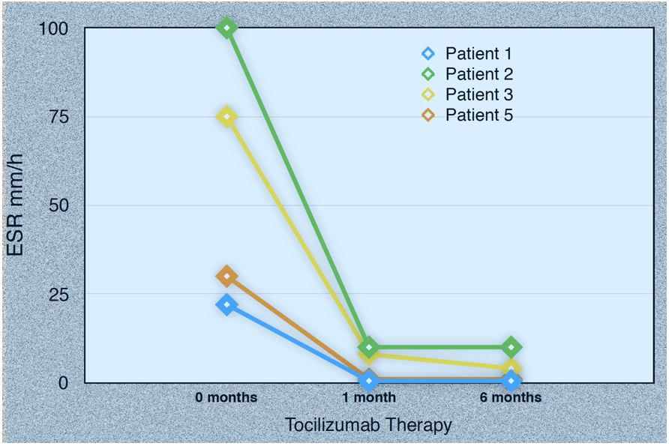
Tocilizumab Experience in Farber
Reported outcomes in 5 patients treated with tocilizumab
Clinically significant reduction in pain
Reduction in ESR in 4/5 patients
No change in progression of disease

Slide 10
Natural History Study
Approximately 158 cases reported over the last 50 years
Recent multinational natural history study included 45 patients
More common than previously thought
Approximately half of these patients were initially misdiagnosed with juvenile idiopathic arthritis

Slide 11
Conclusion
Farber disease is a rare progressive multisystemic lysosomal storage disease that can present as severe joint pain and inflammation
Farber disease is often misdiagnosed as juvenile idiopathic arthritis
Once diagnosis is confirmed, anti-inflammatory therapies should be considered to reduce pain, improve joint function, and improve quality of life
Although treatment with anti-inflammatory medications can reduce pain, it does not prevent progression in patients with severe disease
New disease-modifying therapies are necessary

Slide 12
Future Therapies
Aceragen has an enzyme replacement therapy that is in development (www.aceragen.com)
First-in-human trial expected to start in 2023
If you have patients that you think may benefit from this trial, you can contact me (john.mitchell@much.mcgill.ca)

