Slide 1
Farber Disease Case Study:
Don’t Miss the Diagnosis
V. Reid Sutton, MD
Professor of Molecular & Human Genetics
Baylor College of Medicine & Texas Children's Hospital
Houston, TX

Slide 2
Disclaimer
The views and opinions expressed in this educational activity are those of the faculty and do not necessarily represent the views of TotalCME, Inc., the CME providers, or the companies providing educational grants. This presentation is not intended to define an exclusive course of patient management; the participant should use their clinical judgment, knowledge, experience, and diagnostic skills in applying or adopting for professional use any of the information provided herein. Any procedures, medications, or other courses of diagnosis or treatment discussed or suggested in this activity should not be used by clinicians without evaluation of their patient's conditions and possible contraindications or dangers in use, review of any applicable manufacturer’s product information, and comparison with recommendations of other authorities. Links to other sites may be provided as additional sources of information.

Slide 3
Initial Presentation
Initial presentation at 17-months-of-age
Difficulty walking
Pediatric Orthopedic surgical evaluation
  Subcutaneous nodules noted on soles of feet as well as arms and legs
  Synovial thickening of elbows, wrists, knees and ankles
  Flexion contractures of fingers and limited motion of ankles
  Pain with limit of range of motion
Family History: Older brother with Blau syndrome; neither parent affected
Diagnosed with Blau syndrome

Slide 4
Blau Syndrome
Autoimmune granulomatous inflammation of the skin, eye, and joints
Papular erythematous rash (may be transient)
Arthritis and minimally erosive swelling of wrists, ankles, knees, and elbows, usually in the first decade of life (typically before 4 years of age)
Progressive flexion contractures of fingers
Non-caseating granulomas of joints and subcutaneous tissue
Uveitis that can lead to glaucoma
Less common features
  Cranial neuropathies
  Arteritis
Autosomal dominant disorder of NFκB signaling (gene NOD2)

Slide 5
Initial Management (Rheumatology)
Initially treated with naproxen sodium & methotrexate daily
30 months - limited improvement, etanercept weekly injection added
34 months - maybe improved walking but no significant changes
3.5 years – “…has not been doing well.”
  Ongoing diffuse arthritis
  Development of new subcutaneous nodules
  Occasional low-grade fever
  Prednisone and adalimumab added to regimen
4 years of age – no improvement
  Mostly sits on couch due to pain/joint limitations
  Cannot wear therapist-prescribed splints due to nodule pain & contractures
  Fevers continue
  Adalimumab stopped; methotrexate increased; IV solumedrol; IV etanercept

Slide 6
Diagnostic Studies
Radiographs - Multiple areas of soft tissue prominence in the periarticular regions which could represent synovial inflammation or cysts
Sedimentation rate 26 mm/hr (0-20)
Aldolase 11.7 U/L (2.7-8.8)
Normal - creatine kinase fractionation, IgA/IgM/IgG, CBC, LDH, c-reactive protein, lysozyme
NOD2 gene sequencing - IVS8+158C>T variant detected – “…a Crohn's disease susceptibility allele in the Ashkenazi Jewish population; however, it also has about a 10% incidence in an unaffected white population…”
“…not known if pathogenic…”

Slide 7
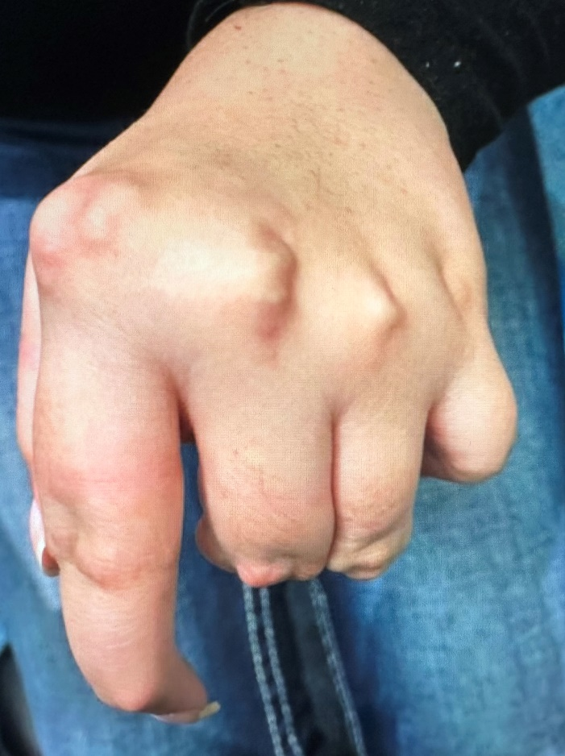
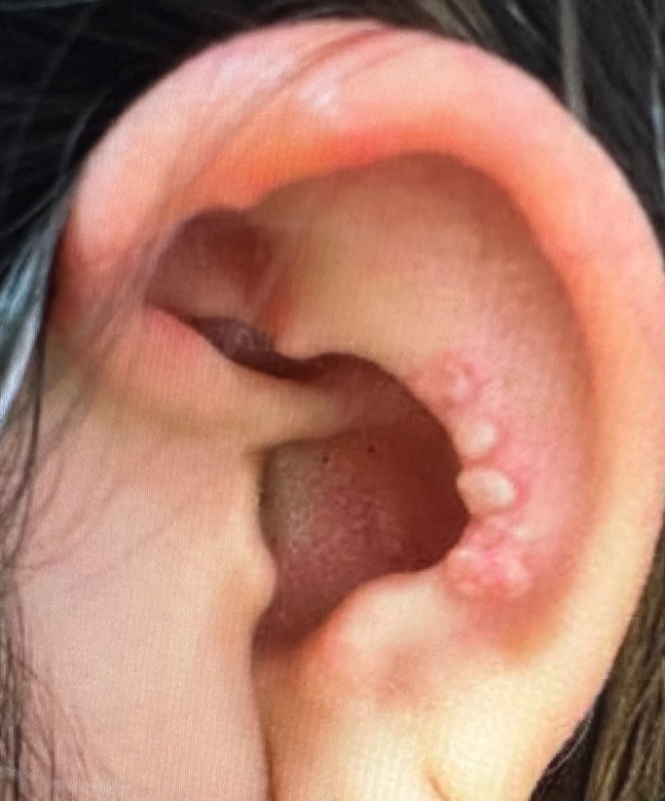
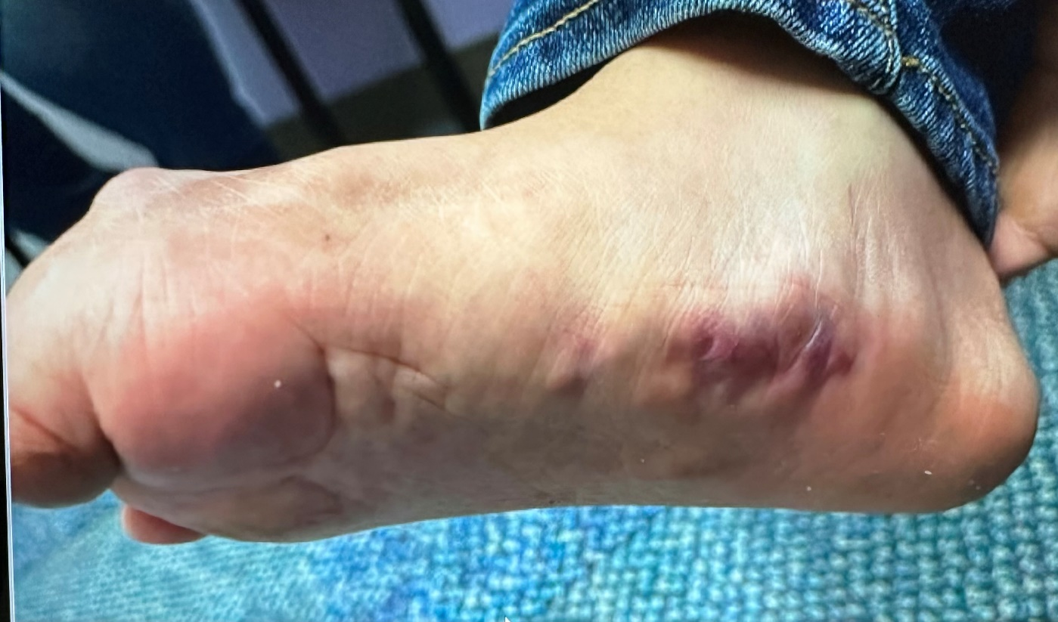
10 Years of Intervention
Continued progression
  Subcutaneous nodules
  Joint contractures
Interventions
  Multiple surgeries/injections for nodules & joint contractures
  Wide variety of immune modulating medications prescribed

Slide 8
Diagnostic Testing
Autoimmune gene panel
  ASAH1
    c.868C>T (p.Arg296*) Pathogenic
    c.785+2T>C Likely pathogenic
    Confirmed in trans by parental testing
  ASAH1 related to a spectrum of disorders ranging from infantile-onset Farber disease to spinal muscular atrophy with progressive myoclonic epilepsy
  NOD2 – no pathogenic variants detected
Leukocyte acid ceramidase enzyme activity level 3.4% that of control specimens

Slide 9
Diagnosis – Farber Disease
Classic (type 1) - most common form with onset occurring in the first weeks of life
  Classic Triad
    Progressive joint deformity
    Subcutaneous nodules of joints and pressure points
    Hoarse cry (granulomas of epiglottis and larynx)
  Other Features - Lower motor neuron disease, macular cherry red spot, pulmonary infiltration
  Life expectancy < 2 years
Intermediate (type 2) – onset at about 8 months of age
Mild (type 3) onset after 1 year of age – often misdiagnosed as juvenile idiopathic arthritis; half have neurologic involvement; life expectancy into teens
Neonatal-visceral (type 4) – neonatal onset with hepatosplenomegaly without classic triad
Neurologic (type 5) – normal development for first months of life, then regression, refractory epilepsy, and paraparesis

