Slide 1
Do You Know Farber Disease? A Lysosomal Storage Disorder
Paul Harmatz, MD
Pediatric Gastroenterologist
UCSF Benioff Children's Hospital Oakland
Oakland, CA

Slide 2
Disclaimer
The views and opinions expressed in this educational activity are those of the faculty and do not necessarily represent the views of TotalCME, Inc., the CME providers, or the companies providing educational grants. This presentation is not intended to define an exclusive course of patient management; the participant should use their clinical judgment, knowledge, experience, and diagnostic skills in applying or adopting for professional use any of the information provided herein. Any procedures, medications, or other courses of diagnosis or treatment discussed or suggested in this activity should not be used by clinicians without evaluation of their patient's conditions and possible contraindications or dangers in use, review of any applicable manufacturer’s product information, and comparison with recommendations of other authorities. Links to other sites may be provided as additional sources of information.

Slide 3

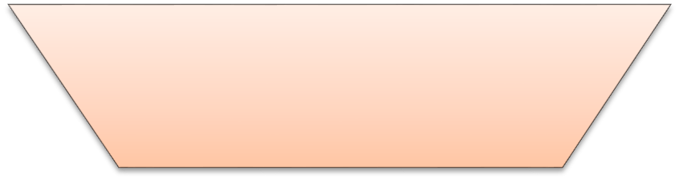



Inborn Errors of Metabolism: Farber in the LSD Landscape
- more than 500 metabolic diseases (~10 % of the known genetic diseases)
5,000 genetic diseases
- vast majority are recessive conditions
500 metabolic disorders
- individually rare or very rare
50 LSD
LSDs: 20: 100,000 live births
10 SLD
Sphingolipidoses: 1: 10,000
Farber disease: 1:1,000,000

Slide 4
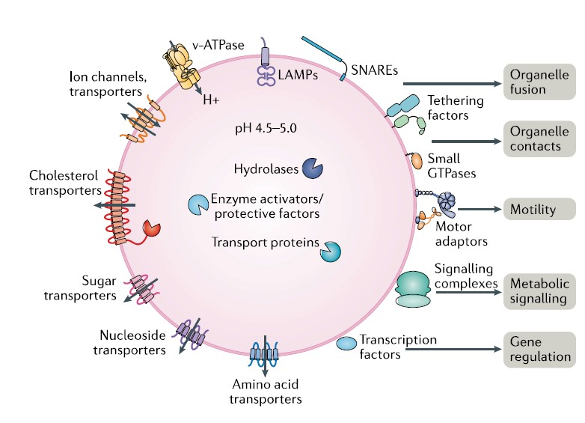
Lysosomal Biology
Discovered by C. de Duve, 1950s, Nobel Prize
Membrane bound collection of more than 60 acid hydrolases
Digestion site for macromolecules
Now recognized for much more complex functions
Metabolic signaling
Gene regulation
Immunity
Plasma membrane repair cell adhesion
Migration

Slide 5
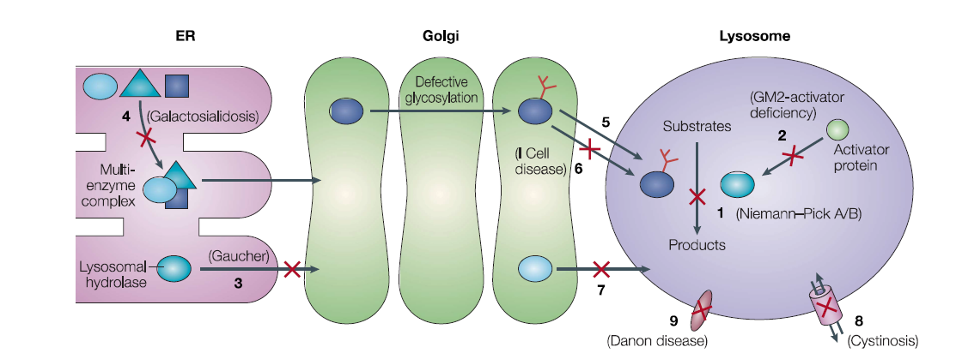
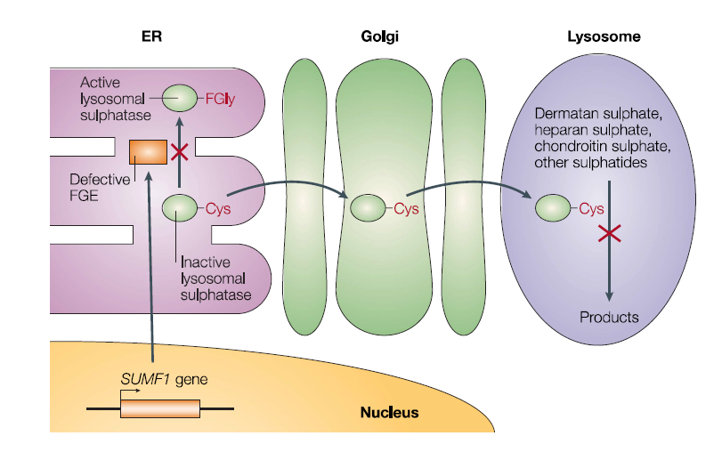
Lysosomal Storage Diseases
Biochemical Basis for LSDs
LSDs are caused by a deficiency in a degradative enzyme, membrane transporter, or enzyme activator
Lysosomal accumulation of substrate
Mucopolysaccharides (Glycosaminoglycans, aminosugar/acid chain)
Sphingolipids (sugars attached to a fat)
Oligosaccharides (short chains of sugars)
Glycogen (glucose polymers used for energy)
Worldwide incidence ~1/8,000
> 40 disorders with a wide range of features
Mainly neurologic, mainly somatic, or both
Multiple Sulfatase Deficiency

Slide 6
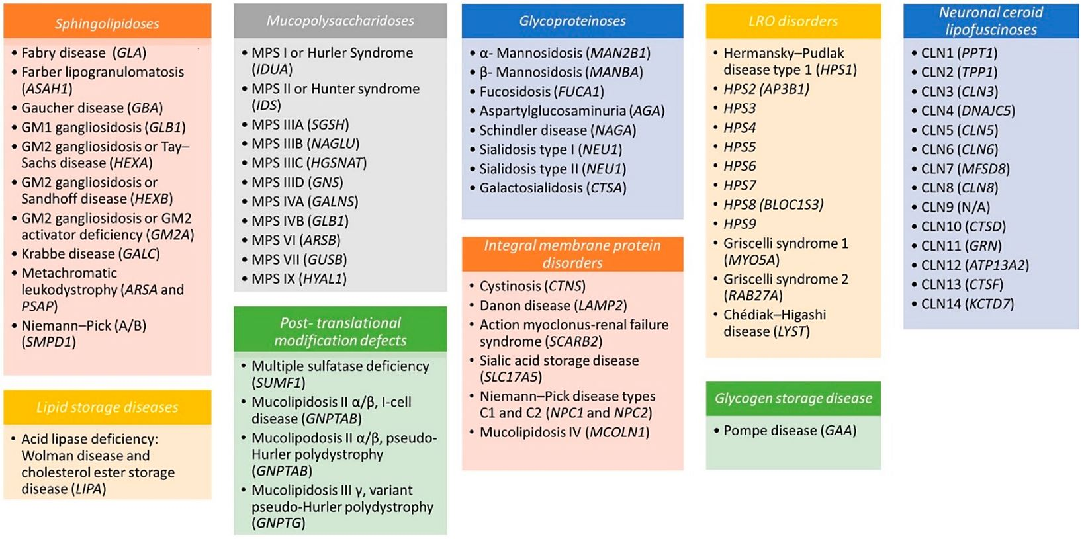
Family of LSDs by Type With Identified Gene

Slide 7
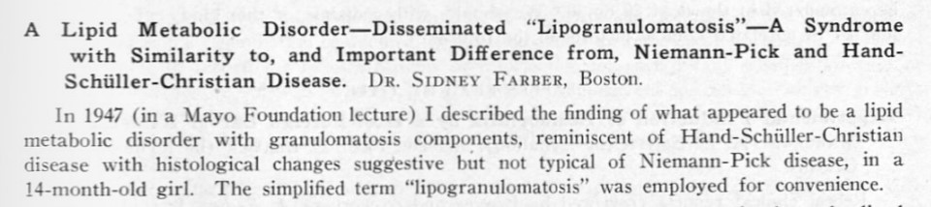
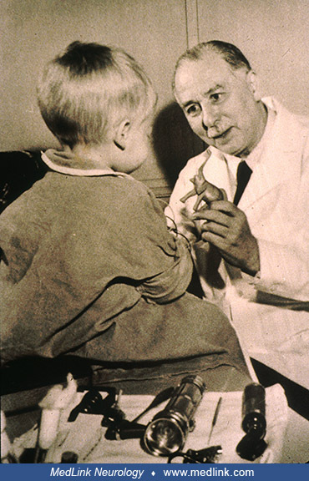
3 cases– survived to 14 mo female, 13 mo female, 9 mo male
Hoarse cry, feeding difficulty, respiratory distress, extensive joint involvement, subcutaneous nodules, bone destruction, hepatomegaly, skin pigmentation
Organ disruption with extensive foam cell infiltration and granulomatous reaction
Increase in tissue lipid, especially sphingomyelin

Slide 8
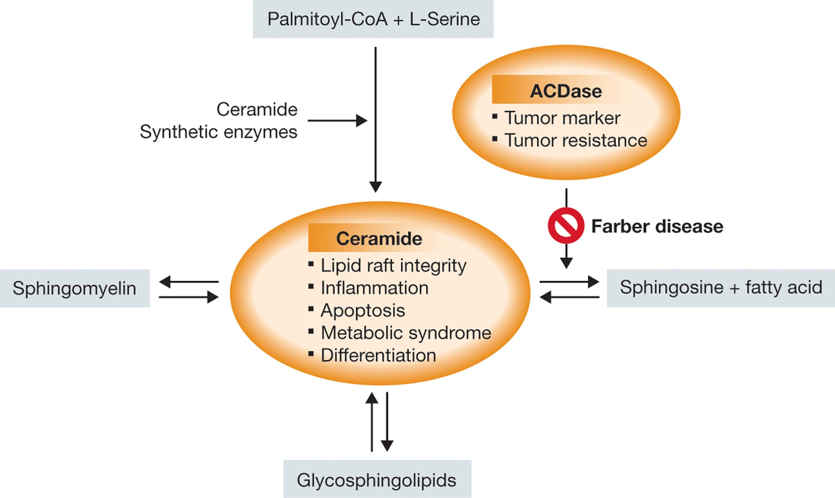
Biochemical Mechanism for Farber Disease
Farber Disease other names: AC deficiency; Acid ceramidase deficiency; Ceramidase deficiency; Farber lipogranulomatosis; Farber's disease; N-Laurylsphingosine deacylase deficiency
Lysosomal Storage Disease
Sphingolipidosis
Autosomal Recessive
ASAH1 gene mutation
Acid ceramidase enzyme deficiency
Increased storage ceramide
Prevalence not precisely known – 1 per million live births estimate
Mild to severe forms—severity lies along a continuum
Progression with age

Slide 9
Acid Ceramidase Deficiency: Two Allelic Disorders and Broad Spectrum of Phenotypes
Farber Disease
(Farber lipogranulomatosis)
SMA-PME
(Spinal Muscular Atrophy with Progressive Myoclonic Epilepsy)
Typical:
Subcutaneous nodules
Joint contractures/arthritis
Dysphonia
Pain
Systemic inflammation
Variable:
Pulmonary disease
CNS (developmental delay/regression, hypotonia)
Peripheral osteolysis
Hepatosplenomegaly rare except for severe phenotype
Other organ systems (Cherry-red spot)
Non-immune hydrops fetalis
Typical:
Muscle weakness/Motor neuron disease
Myoclonus/Tremor – Myoclonic epilepsy
Variable:
Cognitive development and intellect appear intact until seizure activity leads to degeneration
Most cases show no signs of disease outside of CNS but there have been reports of overlap phenotypes (Teoh 2016)

Slide 10
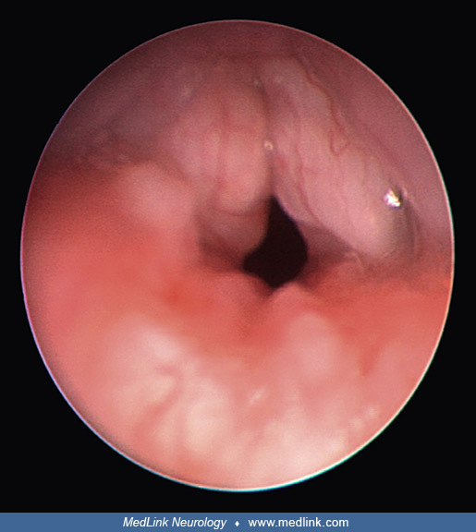
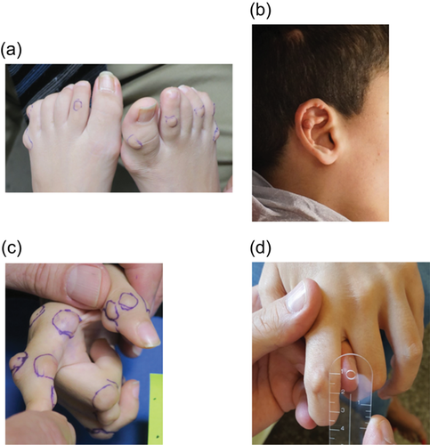
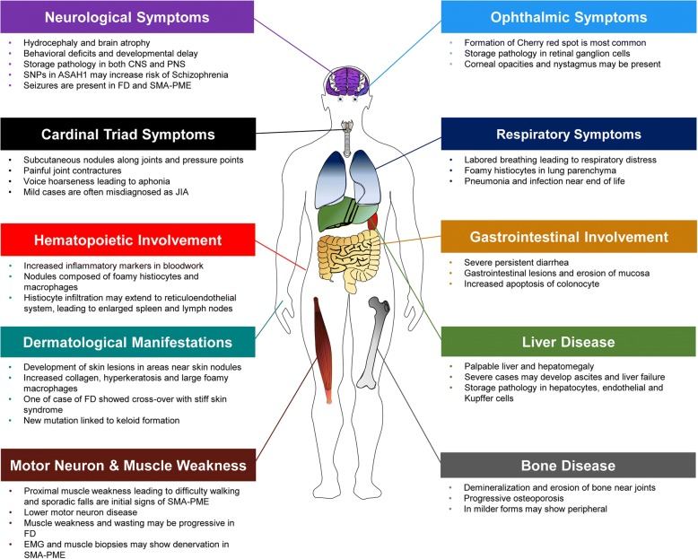
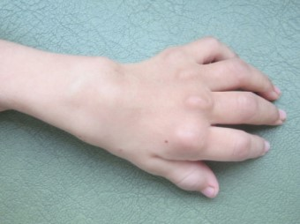
Signs and Symptoms of Farber Disease (similar to many LSDs)
¹
²
³
⁴

Slide 11
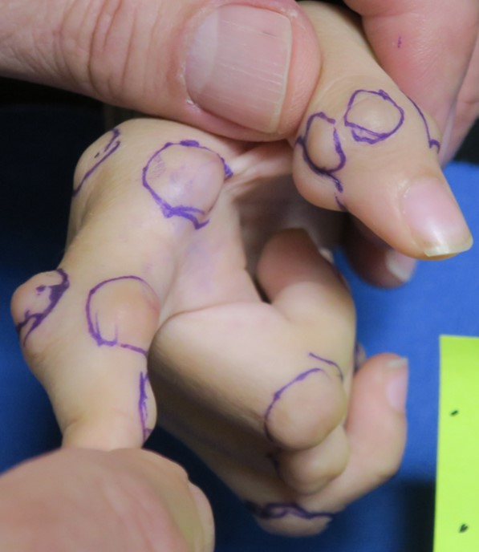
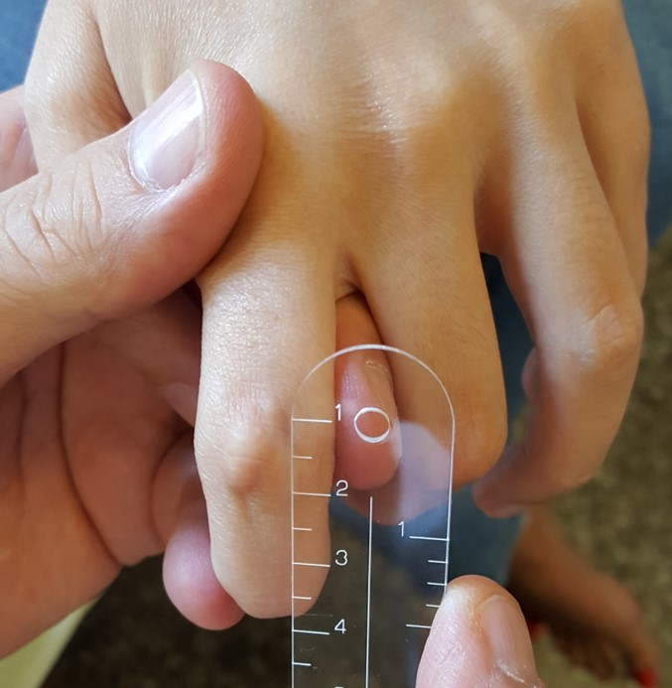
Farber Disease Phenotypic Spectrum
Rapidly progressive Slowly progressive
Often with CNS and pulmonary involvement No apparent CNS or pulmonary involvement
3 yo with moderately progressive disease
28 yo with slowly progressive disease

Slide 12
Diagnosis of Lysosomal Storage Diseases (Including Farber Disease)
Clinical Suspicion of Farber- look for:
hoarse cry
joint contractures
subcutaneous nodules
hepatosplenomegaly
developmental delay
hypotonia
seizure
Enzyme analysis in skin fibroblasts or WBCs can be done for Farber, but is not readily available (Supra-Regional Assay Service, UK)
Leukocytes or skin fibroblasts
Method: Hydrolysis of radiolabelled ceramide at acid
Genetic mutation analysis: either Nex-Gen Exome or Sequencing of suspected ASAH1 (concern about pseudodeficency or mutation in region not sequenced)

Slide 13
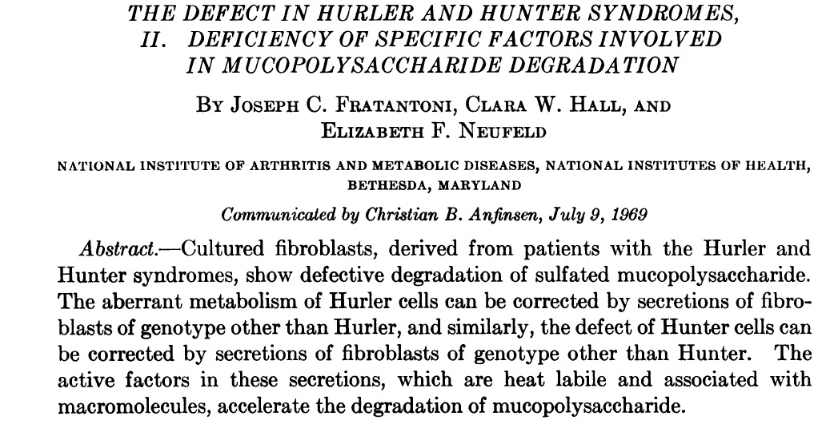
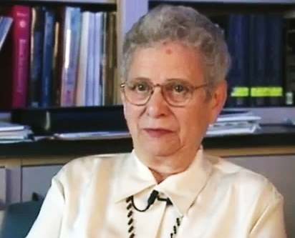
Treatment of Lysosomal Storage Disease: Farber
Supportive—anti-inflammatory agents, nutritional support (possible G-tube), pulmonary care, treatment of seizure
Specific Enzyme Replacement—HSCT, Enzyme Replacement Therapy—”Cross-Correction”

