Slide 1
The Spectrum Of Disease Due to the Inherited Deficiency of Acid Ceramidase Activity (ASAH1-Related Disorders)
Edward H. Schuchman, MD
Genetic Disease Foundation, Francis Crick Professor
Department of Genetics & Genomic Sciences
Icahn School of Medicine at Mount Sinai
New York, NY

Slide 2
Disclaimer
The views and opinions expressed in this educational activity are those of the faculty and do not necessarily represent the views of TotalCME, Inc., the CME providers, or the companies providing educational grants. This presentation is not intended to define an exclusive course of patient management; the participant should use their clinical judgment, knowledge, experience, and diagnostic skills in applying or adopting for professional use any of the information provided herein. Any procedures, medications, or other courses of diagnosis or treatment discussed or suggested in this activity should not be used by clinicians without evaluation of their patient's conditions and possible contraindications or dangers in use, review of any applicable manufacturer’s product information, and comparison with recommendations of other authorities. Links to other sites may be provided as additional sources of information.

Slide 3
Historical Milestones - I
1947 – First case of disseminated lipogranulomatosis reported by Sidney Farber in a 14-month-old infant

Slide 4
Historical Milestones - I
1947 – First case of disseminated lipogranulomatosis reported by Sidney Farber in a 14-month-old infant
1952 – Report of three new cases by Farber, and identification of a new syndrome
Common findings included dysphonia, enlarged nodules on joints, hepatomegaly, developmental delay
Infiltrative lesions of skin and subcutaneous tissue with evidence of lipid accumulation
Symptoms appeared within first few months of life and death occurred by 14 months

Slide 5
Historical Milestones - I
1967 – Accumulating lipid in Farber disease identified as ceramide by Moser and colleagues
1972 – Deficient activity of the lysosomal enzyme acid ceramidase identified in several Farber disease patients

Slide 6
Historical Milestones - I
1967 – Accumulating lipid in Farber disease identified as ceramide by Moser and colleagues
1972 – Deficient activity of the lysosomal enzyme acid ceramidase identified in several Farber disease patients

Slide 7
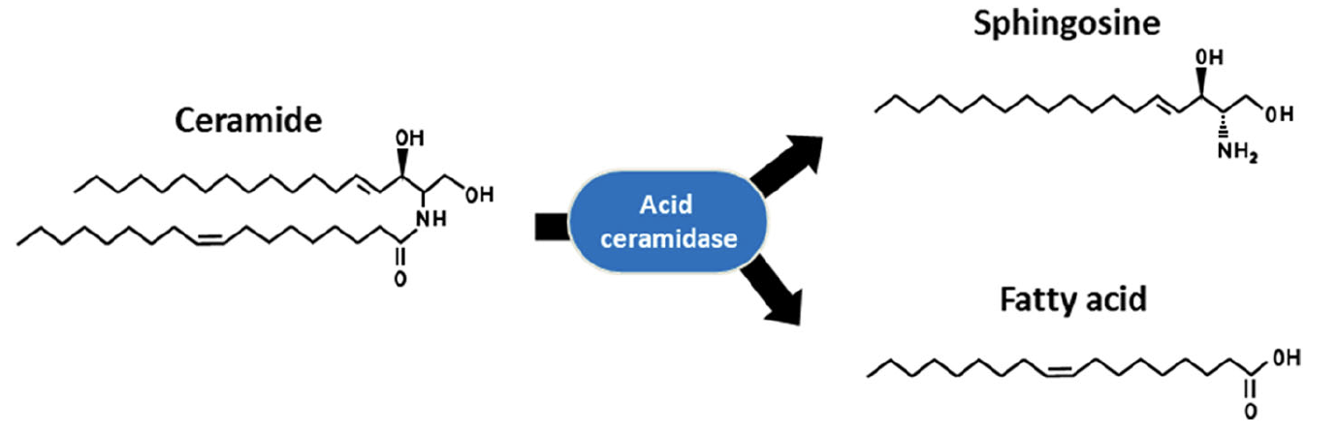
Historical Milestones - I
1967 – Accumulating lipid in Farber disease identified as ceramide by Moser and colleagues
1972 – Deficient activity of the lysosomal enzyme acid ceramidase identified in several Farber disease patients
Image adapted from Yu FPS, et al. Orphanet J Rare Dis. 2018;13(1):121.

Slide 8
Historical Milestones - I
1967 – Accumulating lipid in Farber disease identified as ceramide by Moser and colleagues
1972 – Deficient activity of the lysosomal enzyme acid ceramidase identified in several Farber disease patients
X
Image adapted from Yu FPS, et al. Orphanet J Rare Dis. 2018;13(1):121.

Slide 9
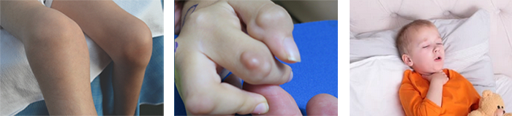
Historical Milestones - II
1983 – Moser and Chen review all reported cases of Farber disease (27)
All presented with common “triad” of painful and deformed joints, subcutaneous nodules, and hoarse voice
10/27 cases had impaired psychomotor development
Other findings included respiratory difficulties, hepatomegaly, poor weight gain and intermittent fevers
Most cases presented with severe/early onset phenotype, although variability in presentation was observed

Slide 10
Historical Milestones - II
1983 – Moser and Chen review all reported cases of Farber disease (27)
All presented with common “triad” of painful and deformed joints, subcutaneous nodules, and hoarse voice
10/27 cases had impaired psychomotor development
Other findings included respiratory difficulties, hepatomegaly, poor weight gain and intermittent fevers
Most cases presented with severe/early onset phenotype, although variability in presentation was observed
1987 – First Farber disease case reported with progressive myoclonic seizures
Symptom onset at 22 months; death at 6 years
Patients had common Farber disease triad, but lacked hepatomegaly

Slide 11
Historical Milestones - III
1996 – cDNA and gene sequences encoding human acid ceramidase (ASAH1) isolated
First ASAH1 mutation causing Farber disease identified (T222K)
First production & characterization of human recombinant acid ceramidase
Composed of α and β subunit held together by disulfide bonds
Self-activating enzyme that requires cleavage of a precursor protein into the two subunits
First isolation of the mouse acid ceramidase gene and construction of knock-out and knock-in mice
Demonstration that complete loss of acid ceramidase activity in the mouse results in early embryonic lethality
First “proof-of-principle” treatment studies in the Farber disease mouse model
Enzyme replacement, gene therapy

Slide 12
Historical Milestones - III
1996 – cDNA and gene sequences encoding human acid ceramidase (ASAH1) isolated
First ASAH1 mutation causing Farber disease identified (T222K)
First production & characterization of human recombinant acid ceramidase
Composed of α and β subunit held together by disulfide bonds
Self-activating enzyme that requires cleavage of a precursor protein into the two subunits
First isolation of the mouse acid ceramidase gene and construction of knock-out and knock-in mice
Demonstration that complete loss of acid ceramidase activity in the mouse results in early embryonic lethality
First “proof-of-principle” treatment studies in the Farber disease mouse model
Enzyme replacement, gene therapy
2012 – First demonstration that a rare form of spinal muscular atrophy (spinal muscular atrophy associated with progressive myoclonic epilepsy; SMA-PME) is due to mutations in the ASAH1 gene
Three unrelated families; 6 patients
Common findings included muscle weakness, progressive myoclonic seizures, loss of mobility
No skin or joint abnormalities; no other signs of classical Farber disease

Slide 13
Historical Milestones - IV
2018 – Over 200 reported cases of acid ceramidase deficiency reviewed by Medin, Levade and colleagues
158 cases of Farber disease, 23 with SMA-PME, and 20 with SMA-PME “like” presentations
Wide clinical spectrum described
age of onset ranged from ~6 months to 8 years
age of death ranged from ~2.5 to 17 years
Alternative phenotypes observed
Association of ASAH1 mutation (L386P) with keloid formation
Downregulation of the ASAH1 gene associated with schizophrenia (Han Chinese and Sweedish populations)

Slide 14
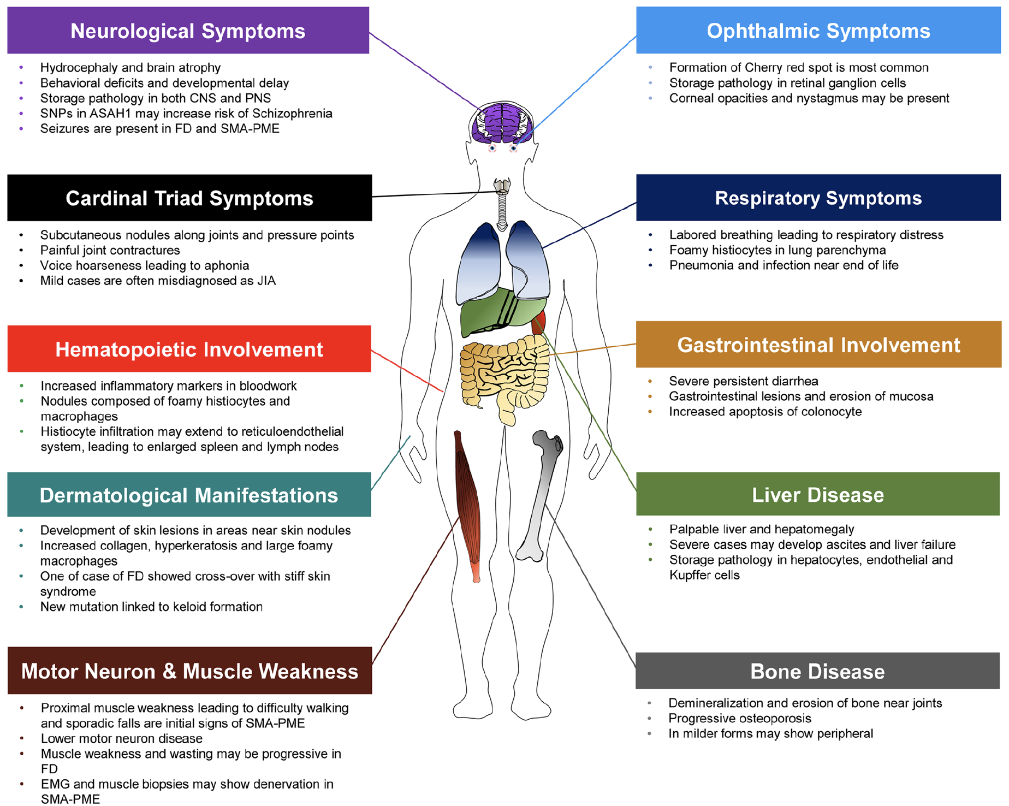
Acid Ceramidase Deficiency: A Complex, Multiorgan System Disease With A Very Wide Range Of Phenotypes
Farber
SMA-PME

Slide 15
Acid Ceramidase Deficiency: A Complex, Multiorgan System Disease With A Very Wide Range Of Phenotypes
Schizophrenia?
Farber
Keloids?
SMA-PME

Slide 16
What Is Responsible For This Phenotypic Variability?
No clear genotype-phenotype correlations
Majority of mutations in Farber patients found within the catalytic, β-subunit
Most are unique to individual families (private); > 80 described
Majority of mutations in SMA-PME patients within the α-subunit
Two mutations at amino acid 42 (T42A and T42M) account for ~ 50% of SMA-PME cases
No clear relationship between acid ceramidase residual activity & disease
Residual acid ceramidase activity has been detected in all patients tested
Methods vary greatly among labs and no consistent correlation of phenotype with residual activity

Slide 17
What Is Responsible For This Phenotypic Variability?
No clear genotype-phenotype correlations
Majority of mutations in Farber patients found within the catalytic, β-subunit
Most are unique to individual families (private); > 80 described
Majority of mutations in SMA-PME patients within the α-subunit
Two mutations at amino acid 42 (T42A and T42M) account for ~ 50% of SMA-PME cases
No clear relationship between acid ceramidase residual activity & disease
Residual acid ceramidase activity has been detected in all patients tested
Methods vary greatly among labs and no consistent correlation of phenotype with residual activity
Development Of Improved Methods To Predict
Phenotype Variability Is An Important Focus Of Future Research

