Slide 1
How Should I Evaluate Treatment Responses in Non-Advanced Systemic Mastocytosis?
Matthew P. Giannetti, MD
Assistant Professor of Medicine
Brigham and Women’s Hospital
Boston, MA

Slide 2
Disclaimer
The views and opinions expressed in this educational activity are those of the faculty and do not necessarily represent the views of TotalCME, Inc., the CME providers, or the companies providing educational grants. This presentation is not intended to define an exclusive course of patient management; the participant should use their clinical judgment, knowledge, experience, and diagnostic skills in applying or adopting for professional use any of the information provided herein. Any procedures, medications, or other courses of diagnosis or treatment discussed or suggested in this activity should not be used by clinicians without evaluation of their patient's conditions and possible contraindications or dangers in use, review of any applicable manufacturer’s product information, and comparison with recommendations of other authorities. Links to other sites may be provided as additional sources of information.

Slide 3
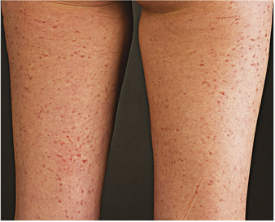
Patient KA
59-year-old woman with history of mastocytosis for 20 years
First developed cutaneous lesions in her late 20s
Tryptase: 135ng/mL
Bone marrow:
  20% mast cell burden
  KIT D816V 11.3% VAF
Symptoms across multiple organs
  GI: Bloating, diarrhea, cramping
  Skin: Pruritis, erythema, ’flaring’ of her spots
  Constitutional: Fatigue
Medications
  Cetirizine 10mg BID
  Famotidine 20mg BID
  Cromolyn 200mg QID

Slide 4
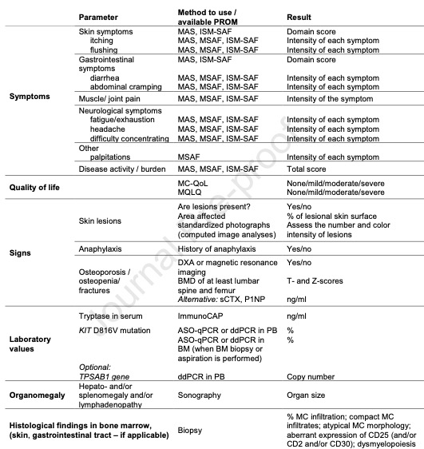
Treatment ‘Response’ Includes Multiple Domains

Slide 5
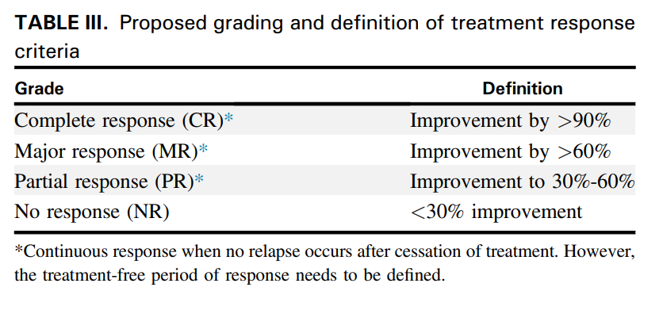
ECNM-AIM Treatment Response Criteria for ISM

Slide 6
TKI Therapy Improves Cutaneous Lesions
Before During

Slide 7
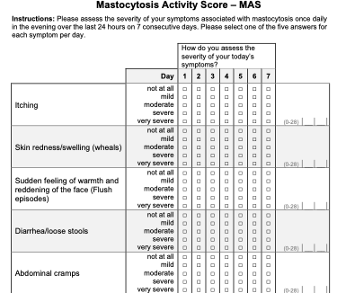
Mastocytosis Activity Score (MAS)

Slide 8
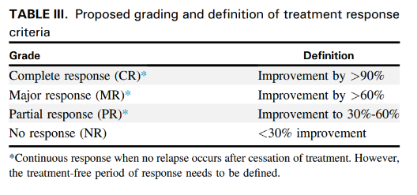
Patient KA
Pre-tyrosine kinase inhibitor
One year post-tyrosine kinase inhibitor
81% decrease
Tryptase: 135ng/mL
KIT D816V 11.3% VAF
Symptoms:
  Skin: +Lesions and itch
  GI: Bloating, diarrhea cramping
Tryptase: 25ng/mL
KIT D816V 2%
Symptoms
Skin: Lesions largely resolved
GI: Much improved
82% decrease
~70% decrease
MAJOR response

Slide 9
Summary: Evaluation of Treatment Response
Time to response differs based on dose!
  Three to six months for lower dose TKI
Continue to assess every several months
Repeat bone marrow biopsy may be necessary
If tryptase does not trend to <11.5ng/mL consider testing for hereditary alpha tryptasemia

