Slide 1
Symptoms of Systemic Mastocytosis
Mariana Castells MD, PhD
Mastocytosis Center Director
Brigham and Women’s Hospital
Dana-Farber Cancer Institute
Harvard Medical School
Boston, MA

Slide 2
Disclaimer
The views and opinions expressed in this educational activity are those of the faculty and do not necessarily represent the views of TotalCME, Inc., the CME providers, or the companies providing educational grants. This presentation is not intended to define an exclusive course of patient management; the participant should use their clinical judgment, knowledge, experience, and diagnostic skills in applying or adopting for professional use any of the information provided herein. Any procedures, medications, or other courses of diagnosis or treatment discussed or suggested in this activity should not be used by clinicians without evaluation of their patient's conditions and possible contraindications or dangers in use, review of any applicable manufacturer’s product information, and comparison with recommendations of other authorities. Links to other sites may be provided as additional sources of information.

Slide 3
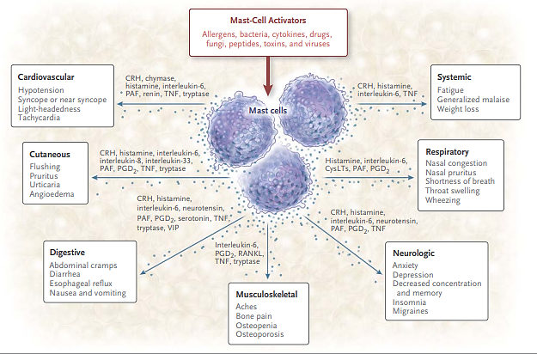
Clinically Relevant Mediators Released from Mast Cells and Putative Effects

Slide 4
Mediator-Related Signs and Symptoms in Mastocytosis
Constitutional: Fatigue, fever, sweats, anorexia
Cutaneous: Flushing, pruritus, urticaria (80-100%)
Gastrointestinal: Abdominal pain, dyspepsia, gastroesophageal reflux, diarrhea, malabsorption (70%)
Skeletal: Bone pain, osteolytic, osteoclastic lesions, fractures (50%)
Neuropsychiatric: Headache, mixed organic brain syndrome (depression, sleepiness, anxiety, irritability) (40%)
Pulmonary and ENT: Rhinitis acute or perennial, vasomotor, lacrimation, wheezing
Atopy: Asthma, rhinitis, conjunctivitis (20%)

Slide 5
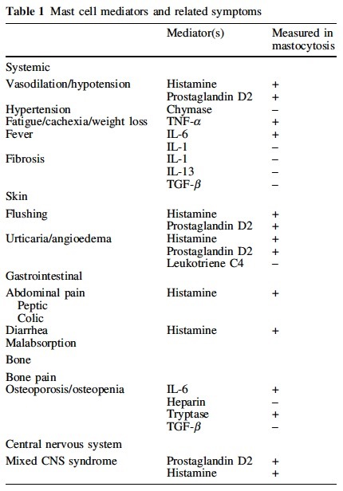
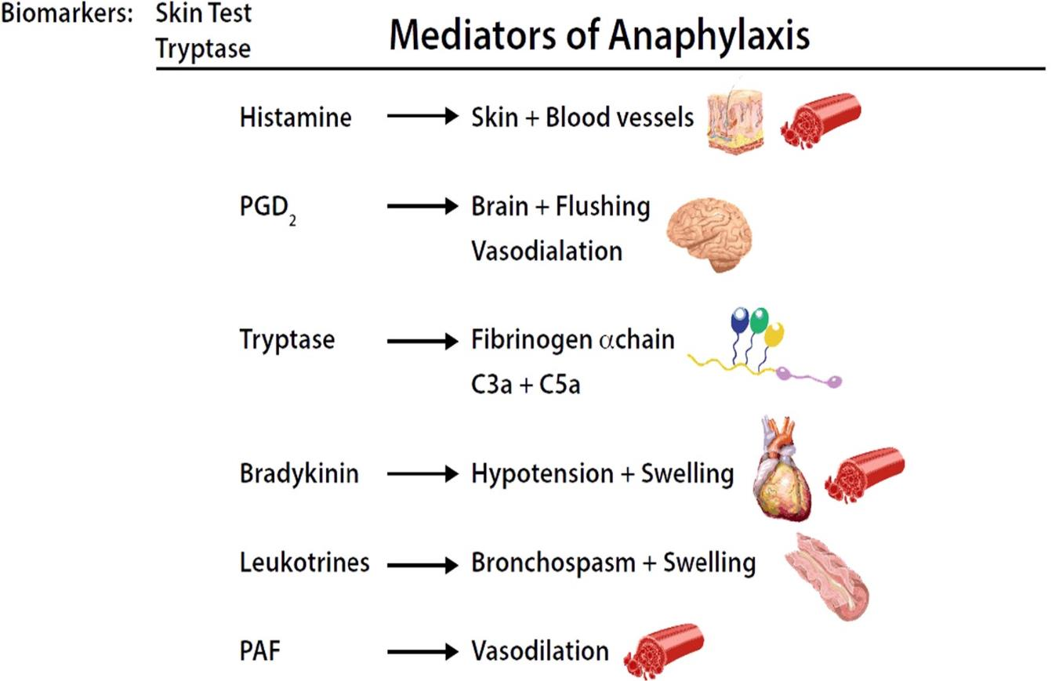
Mast Cells Mediators and Related Symptoms

Slide 6
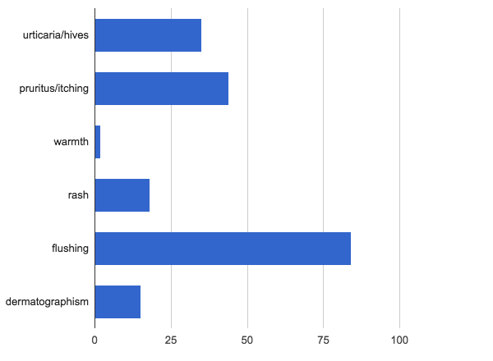
Cutaneous Symptoms
N=97/100
Urticaria/Hives
Pruritus/Itching
Warmth
Rash
Flushing
Dermatographism

Slide 7
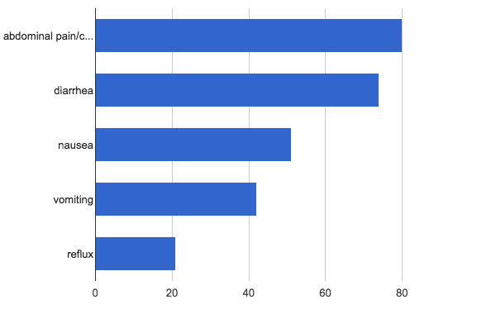
Gastrointestinal Symptoms
N=97/100
Abdominal pain
Diarrhea
Nausea
Vomiting
Reflux

Slide 8
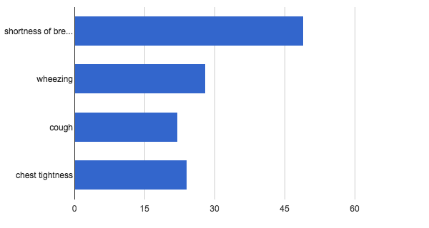
Respiratory Symptoms
N=64/100
Shortness of Breath
Wheezing
Cough
Chest Tightness

Slide 9
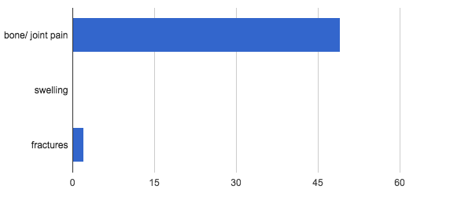
Skeletal Symptoms
N=64/100
Bone/Joint Pain
Swelling
Fractures

Slide 10
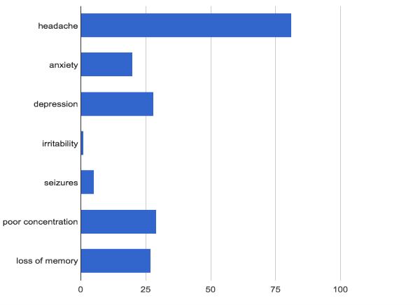
Neuropsychiatric Symptoms
N=110/300 (>30%)
Headache
Anxiety
Depression
Clinical presentation:
  May be underrepresented
Irritability
Seizures
Poor Concentration
Loss of Memory

Slide 11
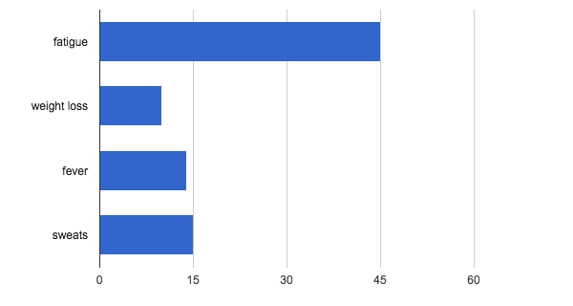
Constitutional Symptoms
N=57/100 (>50%)
Fatigue
Weight Loss
Fever
Sweats

Slide 12
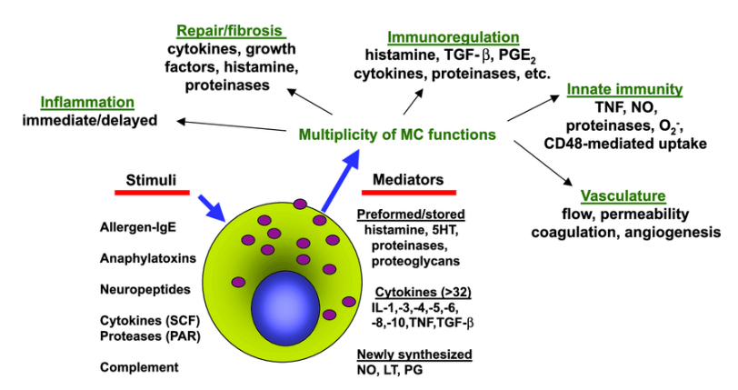
Mediators Released From Activated Mast Cells

Slide 13
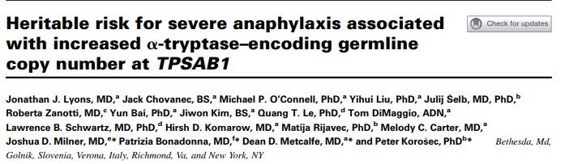
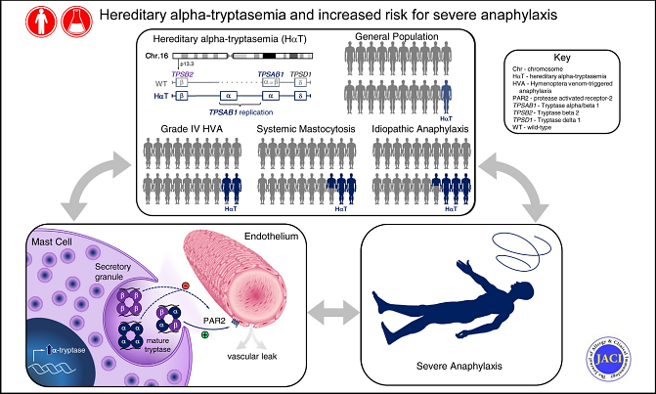
Mastocytosis Associated with Hereditary Alpha-Tryptasemia Genetic Trait

Slide 14
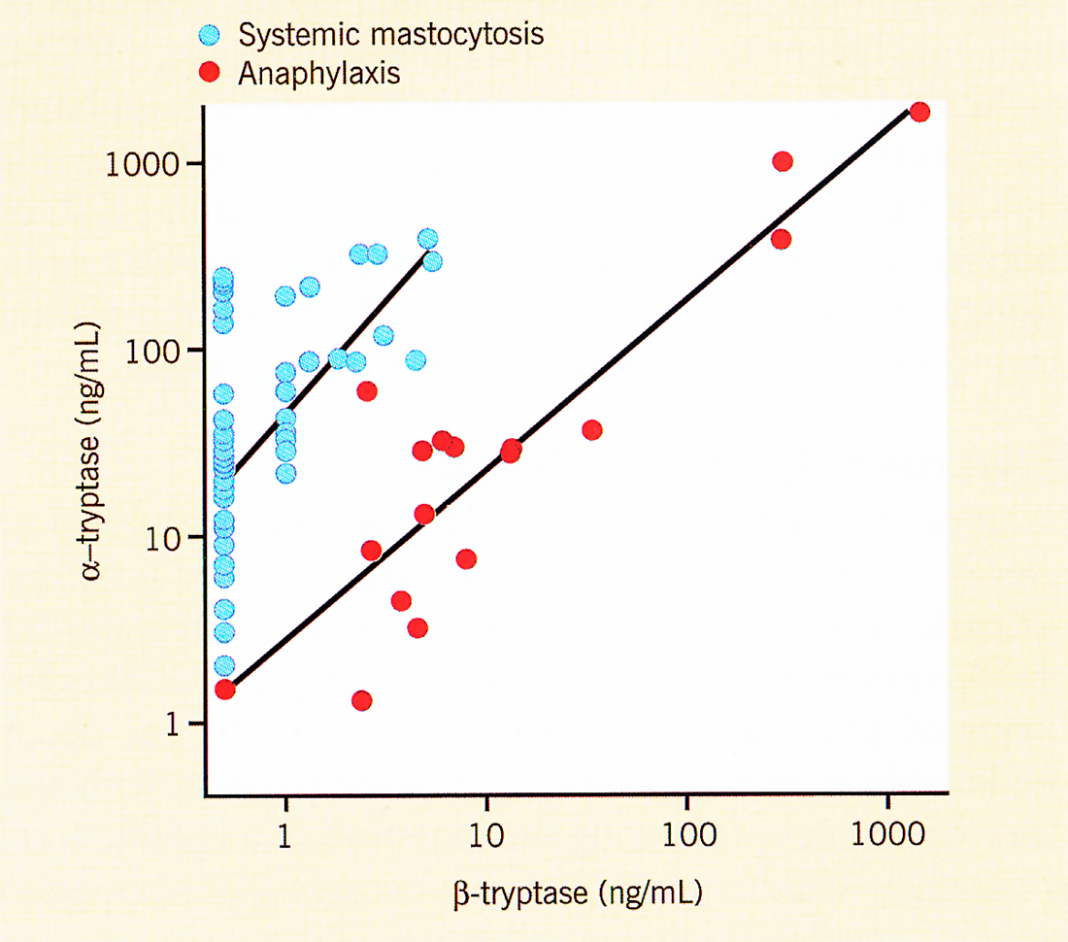
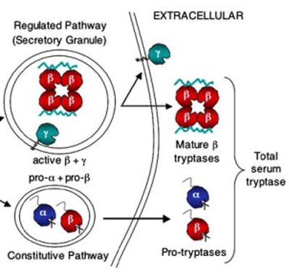
Systemic Mastocytosis Tryptases
Total tryptase
  Mostly inactive protryptase at baseline
  Reflect mast cell burden at baseline
Mature β-tryptase
  Measure of MC activation
Total: Mature tryptase ratio
  >20 in SM at baseline
  <10 during systemic anaphylaxis
27% of White pts lack an alpha tryptase gene
Low baseline tryptase (significant elevation: >20% baseline +2 ng/mL)
Normal Tryptase in 10% Mastocytosis Patients
Activation and Secretion of
α, β, and γ Tryptases
Elevated tryptase is present in anaphylaxis and two measurements are required to assess baseline

Slide 15
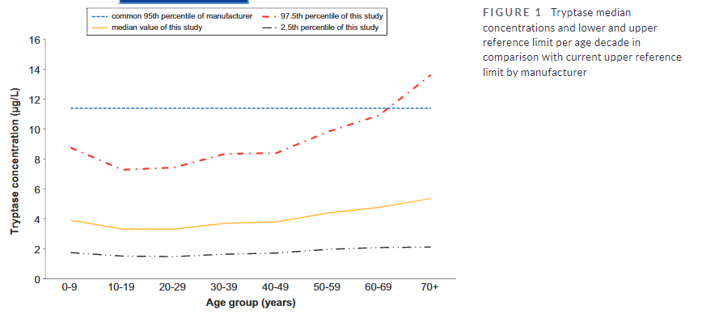
Tryptase Reference Ranges Are Age-Dependent in a Large Population-Based Cohort

Slide 16
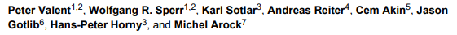
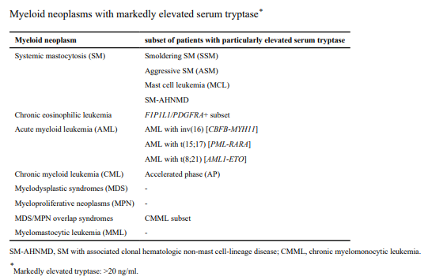
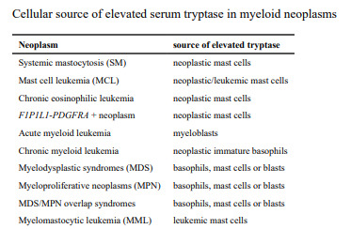
The Serum Tryptase Test: An Emerging Robust Biomarker in Clinical Hematology

Slide 17
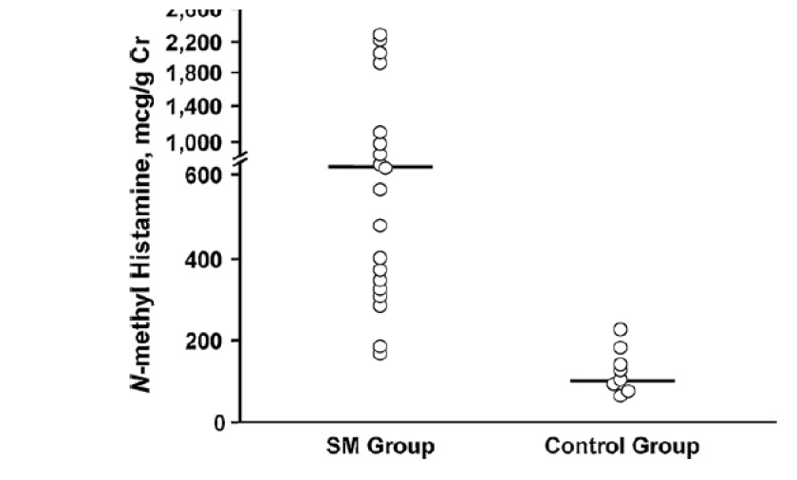
Urinary N-methyl Histamine (mcg/g Creatinine [Cr] in Systemic Mastocytosis and Controls)
Normal Value is 30-200 mcg/g Cr.
N-methyl histamine, mcg/g Cr
SM group
Control group

Slide 18
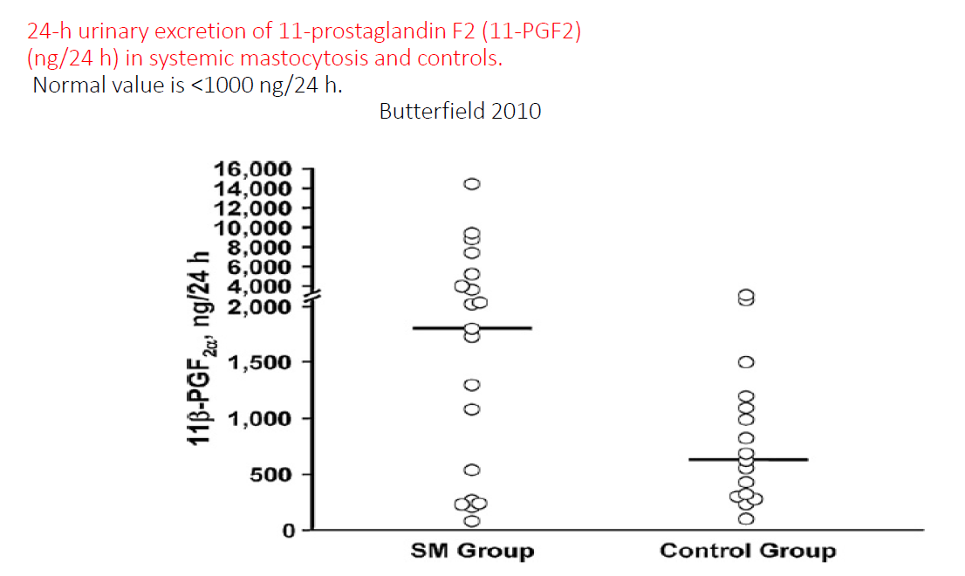
24-h Urinary Excretion of 11-Prostaglandin F2 (11-PGF2) (ng/24 h) in Systemic Mastocytosis and Controls
Normal Value is <1000 ng/24h.
1β-PGF_{2α}, ng/24h
SM group
Control group

Slide 19
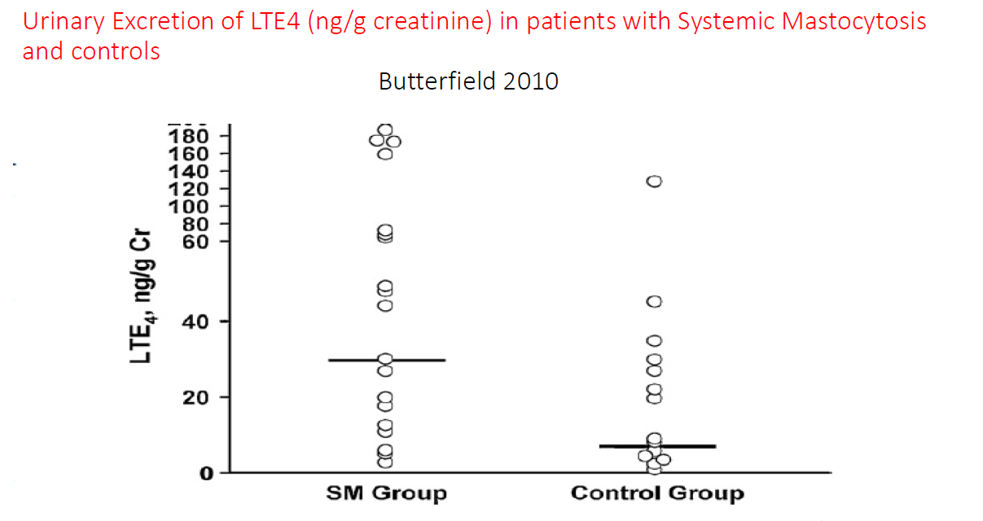
Urinary Excretion of LTE4 (ng/g creatinine in Patients With Systemic Mastocytosis and Controls)
Normal Value is <1000 ng/24h.
LTE_{4,} ng/g Cr
SM group
Control group

Slide 20
Triggers*
Physical stimuli
Heat
Sudden changes of temperature
Rubbing/pressure of skin lesions
(Darier’s sign may induce hypotension)
Scalp trauma
(children with scalp involvement)
Infrequent
Cold
Sunlight
Emotional factors
Stress
Anxiety
Sleep deprivation
Infectious diseases with fever
Viral (URTI)
Bacterial (bronchitis, pneumonia)
Drugs
Nonsteroidal anti-inflammatory drugs**
Morphine and derivatives
Cough medication: Dextromethorphan
Miscellaneous
Dentition
Vaccines
Surgery
Associated allergic diseases ***
*Patients with known sensitivities must wear a medical alert device.
** 2/92 cases (ref.) If patients have not taken these drugs before, provocation test may be performed under close medical supervision.
*** Foods, environmental allergens and other factors may exacerbate or precipitate mast cell activation in mastocytosis patients.

Slide 21
Summary
Symptoms caused by mediator release from mast cells
Symptoms occur in the following organ systems:
  Cutaneous
  Gastrointestinal
  Respiratory
  Skeletal
  Neuropsychiatric
  Anaphylaxis
Symptoms affect quality of life and activities of daily living
Patients typically have two or more organ systems affected
If there is clinical suspicion of a mast cell disorder:
  Obtain serum tryptase level, urine mediators, and KIT mutation

