Slide 1
Multidisciplinary Approach to Making the Diagnosis of Systemic Mastocytosis
Mariana Castells MD, PhD
Mastocytosis Center Director
Brigham and Women’s Hospital
Dana-Farber Cancer Institute
Harvard Medical School
Boston, MA

Slide 2
Disclaimer
The views and opinions expressed in this educational activity are those of the faculty and do not necessarily represent the views of TotalCME, Inc., the CME providers, or the companies providing educational grants. This presentation is not intended to define an exclusive course of patient management; the participant should use their clinical judgment, knowledge, experience, and diagnostic skills in applying or adopting for professional use any of the information provided herein. Any procedures, medications, or other courses of diagnosis or treatment discussed or suggested in this activity should not be used by clinicians without evaluation of their patient's conditions and possible contraindications or dangers in use, review of any applicable manufacturer’s product information, and comparison with recommendations of other authorities. Links to other sites may be provided as additional sources of information.

Slide 3
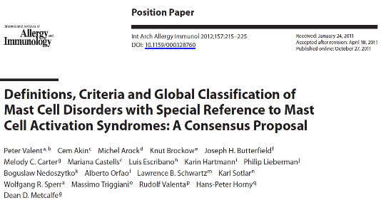
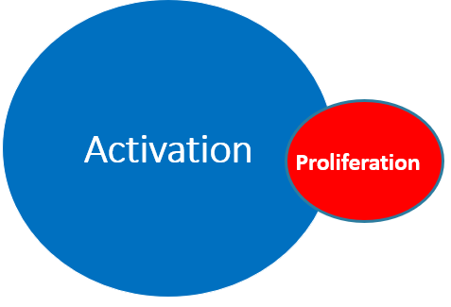
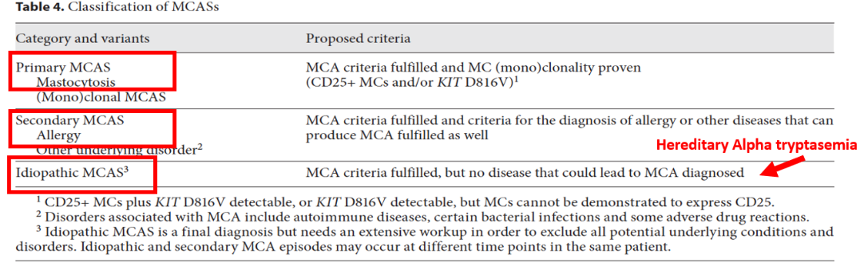

Slide 4
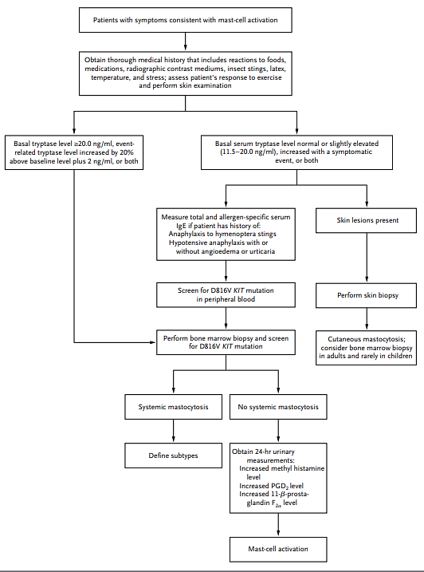
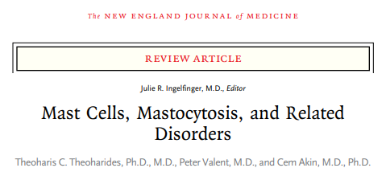

Slide 5
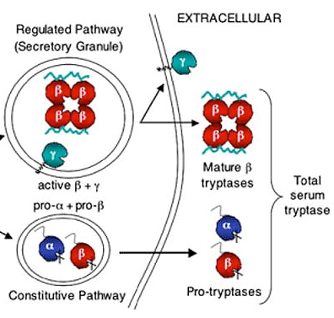
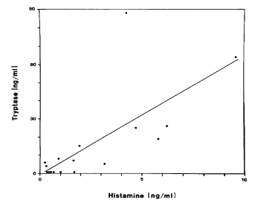
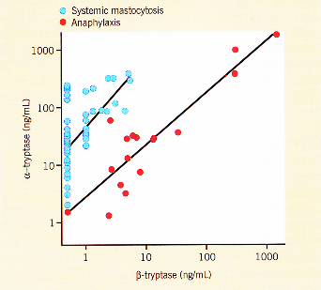
Systemic Mastocytosis: Tryptases
Activation and Secretion
of α, β, and γ Tryptases
Correlation of Plasma Tryptase
and Histamine Concentrations
Normal Tryptase in 10% Mastocytosis Patients
Elevated tryptase is present in anaphylaxis and
two measurements are required to assess baseline
Low baseline tryptase (significant elevation: >20% baseline + 2ng/mL)

Slide 6
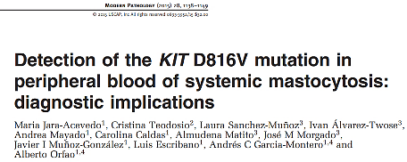
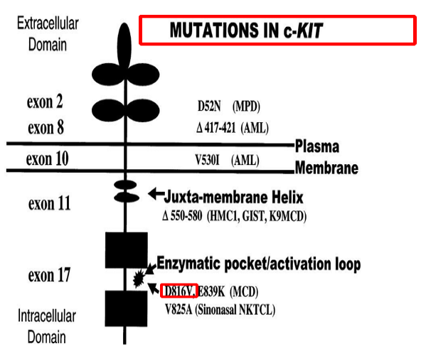
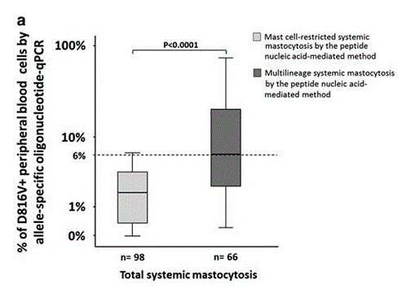
10% of Mastocytosis are negative for KITD816V
Longley BJ, et al. Leuk Res. 2001;25(7):571-576. doi:10.1016/s0145-2126(01)00028-5

Slide 7
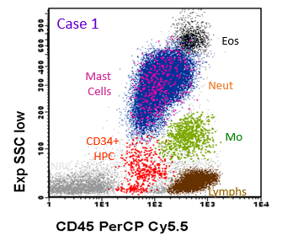
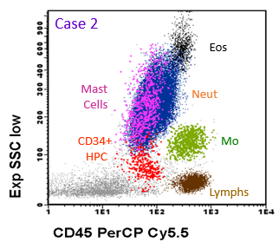
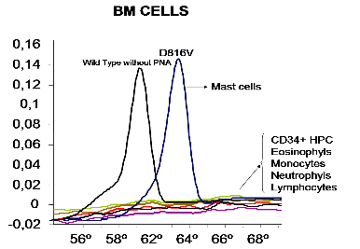
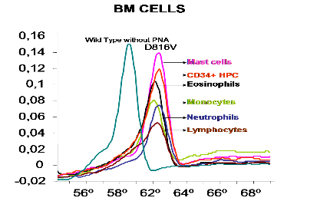
Different Patterns of KIT Mutation in Indolent Systemic Mastocytosis
Peptide nucleic acid (PNA)–mediated PCR

Slide 8
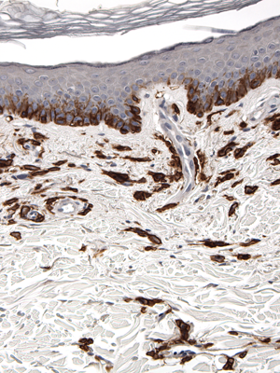
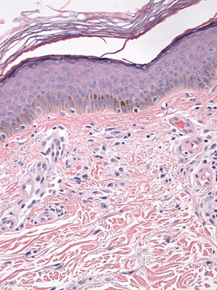
Maculopapular Cutaneous Mastocytosis
Urticaria Pigmentosa
H&E
CD117

Slide 9
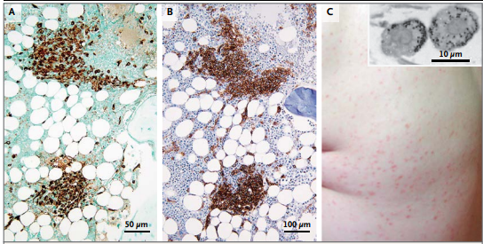
Mast Cells, Mastocytosis, and Related Disorders
Bone Marrow
Biopsy
Urticaria Pigmentosa
Skin Biopsy
Tryptase CD 25

Slide 10
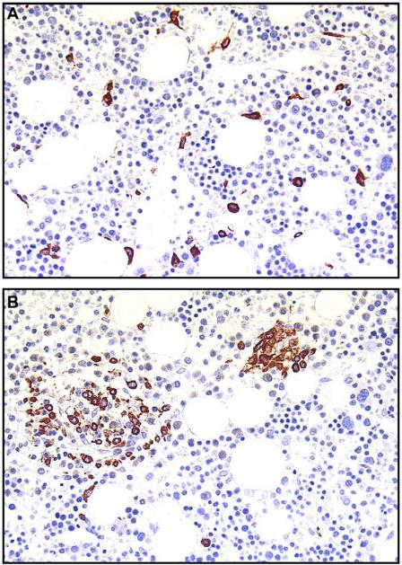
Monoclonal Mast Cell
Activation Disorder
Systemic Mastocytosis

Slide 11
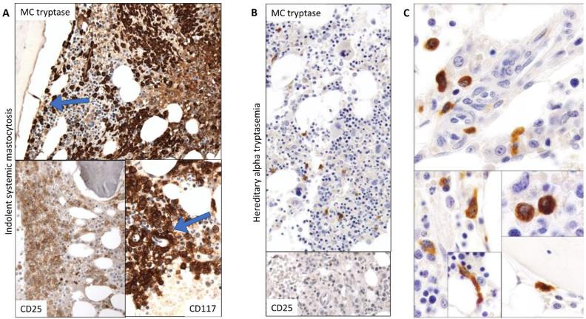
Bone Marrow Morphologic Findings in Patients with Indolent Systemic Mastocytosis and Hereditary Alpha-Tryptasemia (HαT)

Slide 12
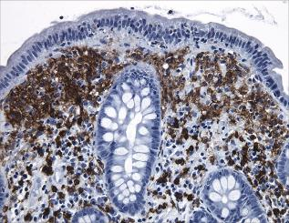
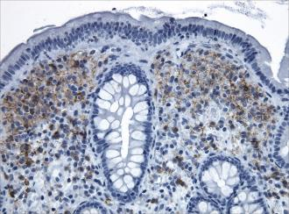
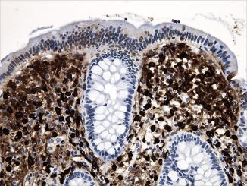
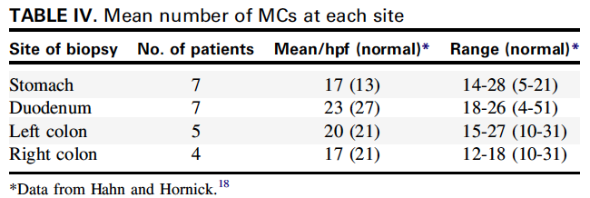
Mast Cell Gastrointestinal Infiltration in Systemic Mastocytosis
KIT
Tryptase
A Clinicopathologic Study of 24 Cases of Systemic Mastocytosis Involving the Gastrointestinal Tract and Assessment of Mucosal Mast Cell Density in Irritable Bowel Syndrome and Asymptomatic Patients
Leona A. Doyle, MD*, Golrokh J. Sepehr, MD*, Matthew J. Hamilton, MD†,‡, Cem Akin, MD,
PhD†,‡, Mariana C. Castells, MD†,‡, and Jason L. Hornick, MD ,PhD 2014
CD25

Slide 13
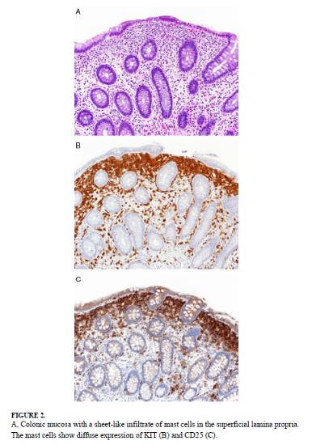
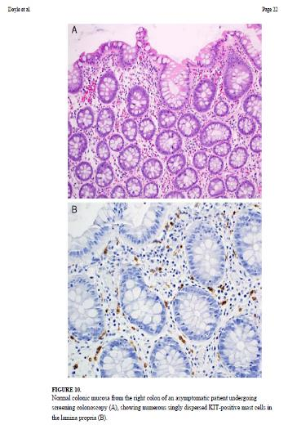
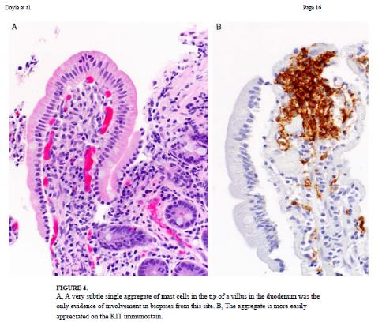
Gastrointestinal Biopsy May Be Used to Diagnose Mastocytosis

Slide 14
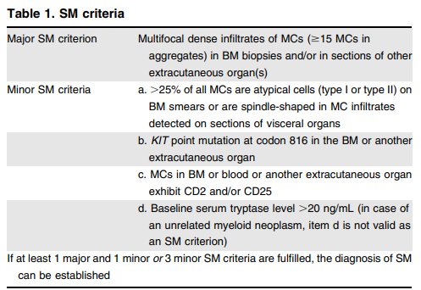
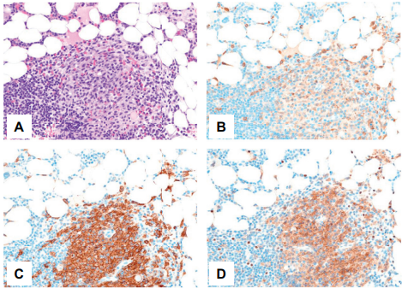
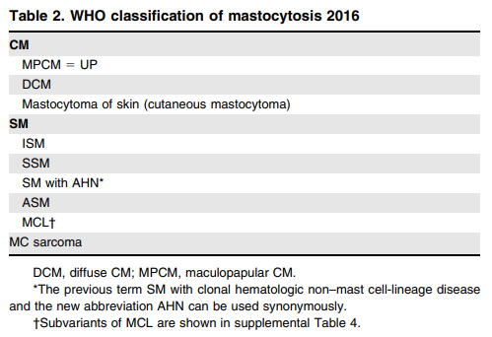
Primary Clonal Mast Cell Diseases
Well-Differentiated Mastocytosis (WDSM)
  Álvarez-Twose I, et al. J Allergy Clin Immunol. 2016;137(1):168-178.e1. doi:10.1016/j.jaci.2015.05.008
Systemic Mastocytosis Without Cutaneous
Involvement and With Hymenoptera Anaphylaxis
Bonadonna P, et al. Curr Allergy Asthma Rep. 2016;16(1):5.
doi:10.1007/s11882-015-0582-5

Slide 15
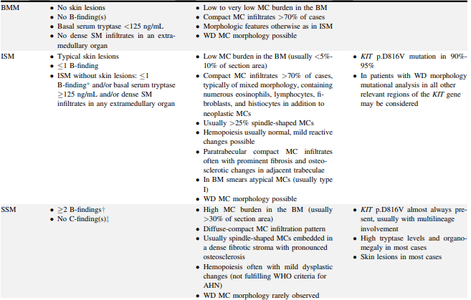
Criteria for SM Variants: EU-US Cooperative Group Recommendations

Slide 16
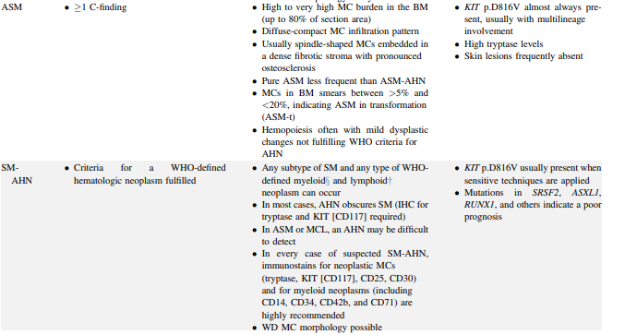
Criteria for SM Variants: EU-US Cooperative Group Recommendations

Slide 17
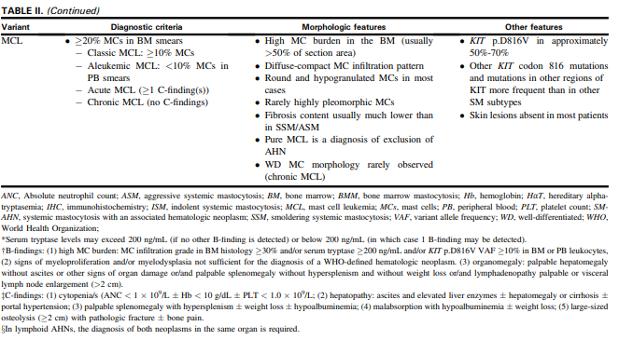
Criteria for SM Variants: EU-US Cooperative Group Recommendations

Slide 18
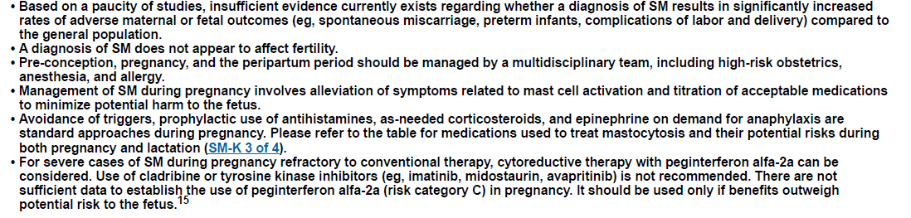
Special Considerations for the Management of Patients With Systemic Mastocytosis: Pregnancy

Slide 19
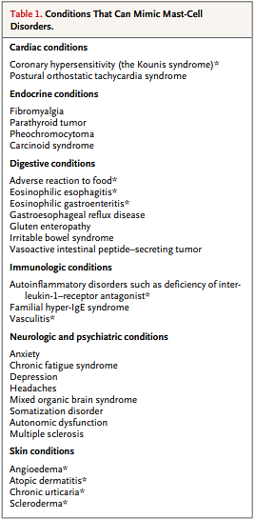
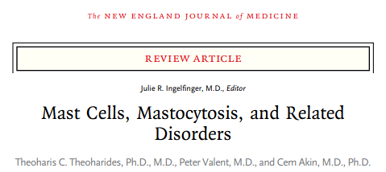

Slide 20
Summary
Mastocytosis is a rare disease
Symptoms
  Multi-organ involvement
  Mast cell activation symptoms
Diagnosis may be delayed due to nonspecific symptoms
Evaluate
  Tryptase level
  KIT mutation
  Biopsy of involved organs: Skin, bone marrow, to evaluate for infiltration of mast cells

