Slide 1
The Many Clinical Presentations of Non-Advanced Systemic Mastocytosis
Mariana Castells MD, PhD
Mastocytosis Center Director
Brigham and Women’s Hospital
Dana-Farber Cancer Institute
Harvard Medical School
Boston, MA

Slide 2
Disclaimer
The views and opinions expressed in this educational activity are those of the faculty and do not necessarily represent the views of TotalCME, Inc., the CME providers, or the companies providing educational grants. This presentation is not intended to define an exclusive course of patient management; the participant should use their clinical judgment, knowledge, experience, and diagnostic skills in applying or adopting for professional use any of the information provided herein. Any procedures, medications, or other courses of diagnosis or treatment discussed or suggested in this activity should not be used by clinicians without evaluation of their patient's conditions and possible contraindications or dangers in use, review of any applicable manufacturer’s product information, and comparison with recommendations of other authorities. Links to other sites may be provided as additional sources of information.

Slide 3
Epidemiology
Rare disease, true incidence/prevalence not known
Underdiagnosed and long delays in diagnosis
Systemic mastocytosis estimated to occur in 1 per 10,000 persons
More frequent in White patients
However, studies are needed to characterize incidence in all racial and ethnic groups

Slide 4
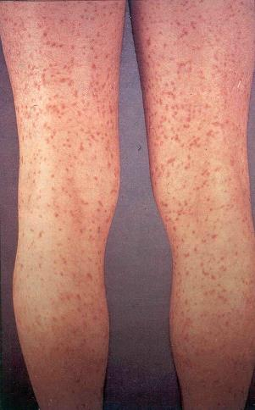
Systemic Mastocytosis: Acute Anaphylaxis Adult Presentation
The New York Times Magazine
“Mommy, I’m afraid. Tell me what to do.”
The mother, aged 32 years, was lying unconscious in a public bathroom in a pool of bloody stool after feeling hot and dizzy, with a fluttering heart
She told ER doctors that her only medical problems were panic attacks, flushing, and a rash that she has had for over 10 years that she had been told was freckles

Slide 5
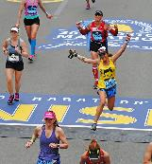

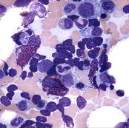
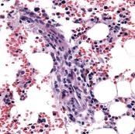
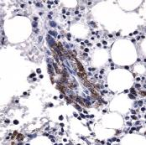
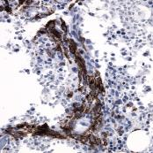
Systemic Mastocytosis Acute Drug Hypersensitivity: Adult Presentation
33-year-old male runner at Boston Marathon
Joint pain: Ibuprofen 800 mg
Flushing, hypotension, SOB, intubation
Tryptase of >2000 ng/ml
Symptoms: Flushing, chronic fatigue, depression, anxiety, bone pain, chest pain (multiple MI R/O)
PE: Few macular lesions in chest (CM)
BMB: MC aggregates, CD25+
Positive c-KIT D816V mutation
Baseline tryptase: 32 ng/ml

Slide 6
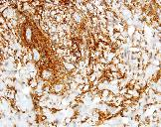
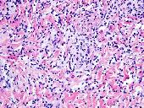
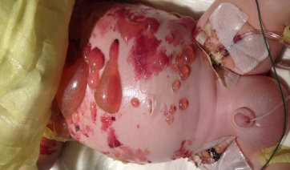
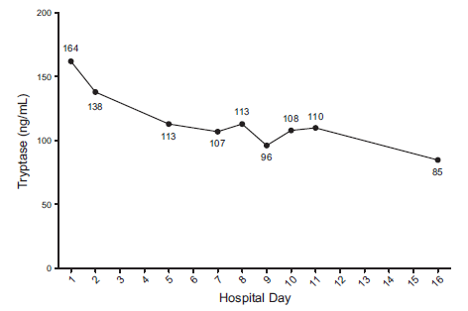
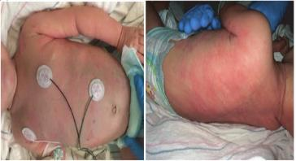
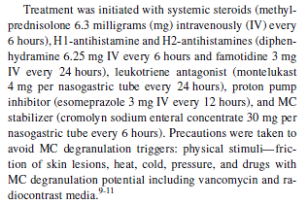
Cutaneous Mastocytosis: Acute Pediatric Presentation
Tryptase Giemsa
Four-month-old boy with fever, viral disease, skin blistering, seizure after vancomycin, acute respiratory distress, cardiac arrest
Tryptase Levels During Hospitalization

Slide 7
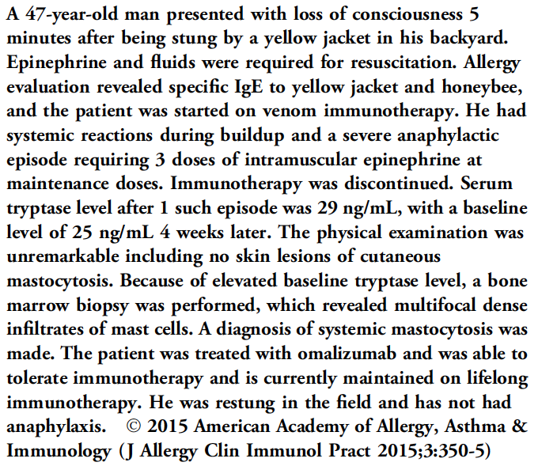
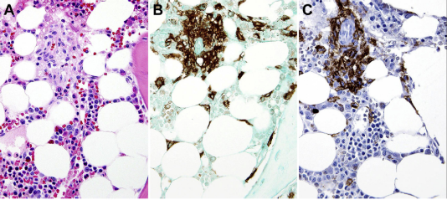
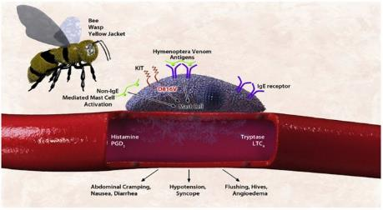
Systemic Mastocytosis: Presenting as Hymenoptera Anaphylaxis
Tryptase
KIT

Slide 8
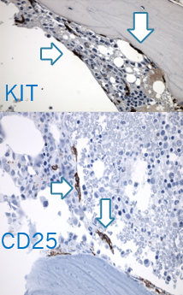
Monoclonal Mast Cell Activation Syndrome: Anaphylaxis During Immunotherapy
44-year-old woman with seasonal rhinitis ST + grasses, ragweed
Immunotherapy: Burning hands and feet, chest pressure, lightheadedness → epinephrine
Severe cramping, abdominal pain, nausea, vomiting, dizziness, feet and hand burning, feeling of impending doom, no hives
ER: 60/30 → multiple epinephrine doses
Tryptase: 8.75 ng/ml total, <1 ng/ml mature
PB: c-KIT D816V mutation+
IgE: 18 IU/ml; Specific IgE foods (-)
BMB: No MC aggregates, spindle MC, positive CD25 MC

Slide 9
Bone Loss and Pathological Fractures as Presentation of Systemic Mastocytosis
30-year-old man with severe osteoporosis of unprovoked fractures of hips with bilateral prosthesis
Symptoms: Intermittent diarrhea, inability to concentrate, mental fogginess, flushing, unprovoked anaphylaxis
Tryptase: 60 ng/ml
Hip biopsy: Aggregates of >50 mast cells, spindle shaped, CD25+

Slide 10
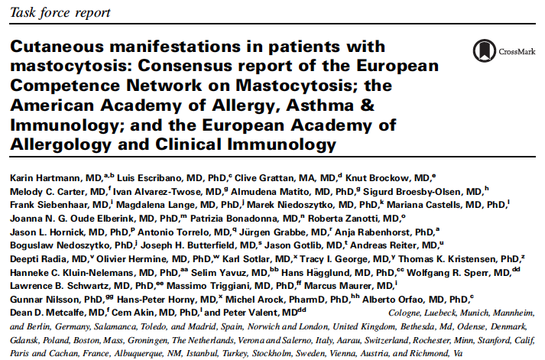
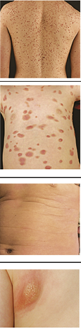
Subforms
Variants
Typical manifestations
Monomorphic
Maculopapular cutaneous
mastocytosis
(syn. urticaria pigmentosa)
JACI 2016
Polymorphic
Diffuse cutaneous mastocytosis
Cutaneous mastocytoma

Slide 11
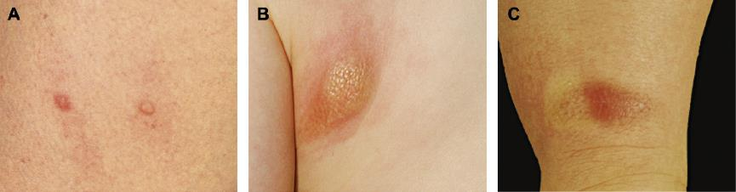
Darier’s Sign
Darier’s sign: A wheal and flare reaction develops upon stroking of a CM lesion with a tongue spatula. Darier’s sign is a highly specific diagnostic feature of CM

Slide 12
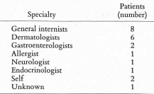
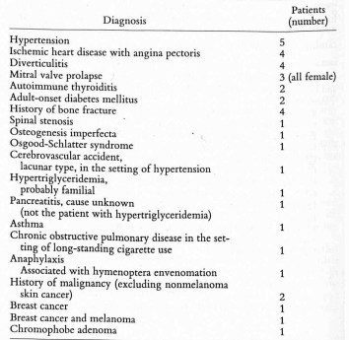
Mastocytosis at Presentation
Duration of symptoms: 5 to 55 years
No increase in allergies or asthma
No familial history
Cutaneous manifestations
Abdominal symptoms
Psychological symptoms
Adverse reactions to medications : NSAIDs, opioids
Abnormal blood counts: Leukopenia, eosinophilia

Slide 13
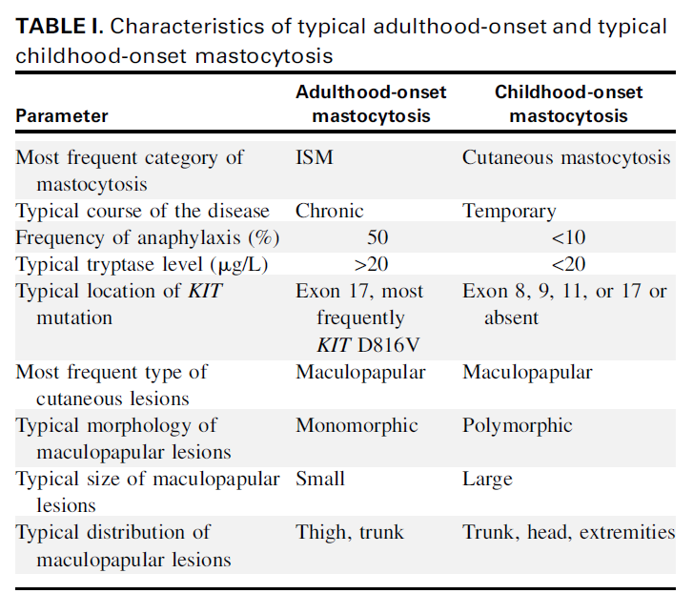
Cutaneous Manifestations in Patients with Mastocytosis:
Consensus Report of the European Competence Network on Mastocytosis; the American Academy of Allergy, Asthma & Immunology; and the European Academy of Allergology and Clinical Immunology

Slide 14
Classification of Mast Cell Disorders
Clonal
Increased MC
Abnormal morphology
Aberrant immunophenotype
KIT mutation
Mastocytosis
- systemic
- cutaneous
Monoclonal MCAS
Primary
Allergic disorders
Physical urticarias
Chronic inflammation or neoplasms
Secondary
Nonclonal
? Normal numbers
? Normal morphology
? Normal immunophenotype
? No mutations
Idiopathic anaphylaxis
Idiopathic urticaria
Idiopathic histaminergic angioedema
Idiopathic MCAS
Idiopathic

Slide 15
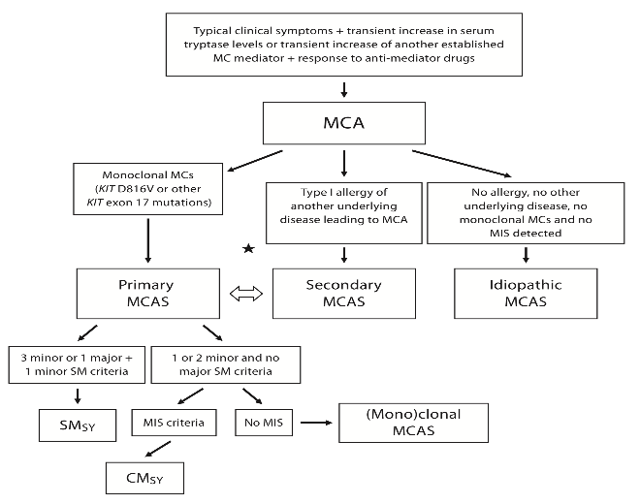
Algorithm for the Diagnosis of Mast Cell Disorders
Hereditary Alpha Tryptasemia TPSAB1 Genotype

Slide 16
Summary
Wide variety of clinical presentations
Duration of symptoms: Few to many years
Acute anaphylaxis: Hymenoptera, drugs
Cutaneous manifestations
Osteoporosis/osteopenia
Clinical suspicion of mastocytosis requires investigating for multiorgan system involvement
Cutaneous
Gastrointestinal
Neuropsychiatric
Anaphylaxis

