Slide 1
Who Is the Best Candidate for Sequencing Sacituzumab Govitecan Before T-DXd in HR+ Breast Cancer?
Sarah Sammons, MD Associate Director, Metastatic Breast Cancer Dana Farber Cancer Institute Boston, MA

Slide 2



Resource Information
About This Resource
These slides are one component of a continuing education program available online at MedEd On The Go titled Expanding ADCs Across Metastatic Breast Cancer: Disrupting Dx & Tx Silos
Program Learning Objectives:
Correctly determine HER2 expression status in existing and newly diagnosed metastatic breast cancer patients
Develop evidence-based treatment strategies for patients with HR-positive/HER2-low MBC
Differentiate key components and advantages of ADCs in special populations of patients with metastatic breast cancer
Identify strategies for improving adherence through adverse effect management
MedEd On The Go®
www.mededonthego.com
This content or portions thereof may not be published, posted online or used in presentations without permission.
This content can be saved for personal use (non-commercial use only) with credit given to the resource authors.
To contact us regarding inaccuracies, omissions or permissions please email us at support@MedEdOTG.com

Slide 3
Disclaimer
The views and opinions expressed in this educational activity are those of the faculty and do not necessarily represent the views of Total CME, LLC, the CME providers, or the companies providing educational grants. This presentation is not intended to define an exclusive course of patient management; the participant should use their clinical judgment, knowledge, experience, and diagnostic skills in applying or adopting for professional use any of the information provided herein. Any procedures, medications, or other courses of diagnosis or treatment discussed or suggested in this activity should not be used by clinicians without evaluation of their patient's conditions and possible contraindications or dangers in use, review of any applicable manufacturer’s product information, and comparison with recommendations of other authorities. Links to other sites may be provided as additional sources of information.

Slide 4
Case: 49-year-old Female with Metastatic HR+, HER2 0 Breast Cancer
2019: De Novo Metastatic disease with bone metastases. TMB Low, No ESR1 or PIK3CA mutation. BRCA negative.
1st Line: palbociclib, letrozole, zolendronic acid 2021: Progression with 2 new liver metastases after 22 months
2nd Line: everolimus/ exemestane
2021: Progressive liver disease after 4 months
3rd Line: capecitabine
2022: Progressive disease in the liver and bone after 6 months. Biopsy HER2 0.
4th Line: paclitaxel

Slide 5
Now she has progressive disease after 5 months of paclitaxel. What next line of therapy would you choose?
Trastuzumab deruxtecan
Sacituzumab govitecan
Liposomal doxorubicin
Eribulin

Slide 6
Sacituzumab Govitecan: TROP2–Targeted ADC
TROP2 is expressed in all breast cancer subtypes and is associated with poor prognosis
Humanized Anti–TROP2 Antibody
Targets TROP2, an antigen expressed in many epithelial cancers
Antibody type: hRS7 IgG1κ
SN-38 Payload
Delivers up to 136-fold more SN-38 to tumors than parent compound irinotecan
Unique chemistry improves solubility; selectively delivers SN-38 to tumor
Linker for SN-38
High drug-to-antibody ratio (7.6:1)
pH-sensitive linker for rapid release of payload at or inside tumor
HO
N
O
N
O
O
O
]
H
H
O
O
[
O
N
O
Lys-N
CH₂O
SN-38
7
O
O
N
N
N
O
H
O
N
N
S
Anti–TROP2 mAb
O

Slide 7
TROPiCS-02 Phase 3 Trial
 | SG (n=272) | TPC (n=271)
Female, n (%) | 270 (99) | 268 (99)
Median age, y (range) | 57 (29-86) | 55 (27-78)
<65 y, n (%) | 199 (73) | 204 (75)
≥65 y, n (%) | 73 (27) | 67 (25)
Race or ethnic group, n (%)
White | 184 (68) | 178 (66)
Black | 8 (3) | 13 (5)
Asian | 11 (4) | 5 (2)
Otherª / Not reported^{b} | 69 (25) | 75 (28)
ECOG PS, n (%)
0 | 116 (43) | 126 (46)
1 | 156 (57) | 145 (54)
Visceral metastases at baseline, n (%) | 259 (95) | 258 (95)
Liver metastases,^{c} n (%) | 229 (84) | 237 (87)
De novo metastatic breast cancer, n (%) | 78 (29) | 60 (22)
 | SG (n=272) | TPC (n=271)
Median time from initial metastatic diagnosis to randomization, mo (range) | 48.5 (1.2- 243.8) | 46.6 (3.0- 248.8)
Prior chemotherapy in (neo)adjuvant setting, n (%) | 173 (64) | 184 (68)
Prior endocrine therapy use in the metastatic setting ≥6 mo, n (%) | 235 (86) | 234 (86)
Prior CDK4/6 inhibitor use, n (%)
≤12 months | 161 (59) | 166 (61)
>12 months | 106 (39) | 102 (38)
Unknown | 5 (2) | 3 (1)
Median prior chemotherapy regimens in the metastatic setting, n (range)^{d} | 3 (0-8) | 3 (1-5)
All patients had prior CDK4/6 inhibitors and a median of 3 prior chemotherapies

Slide 8
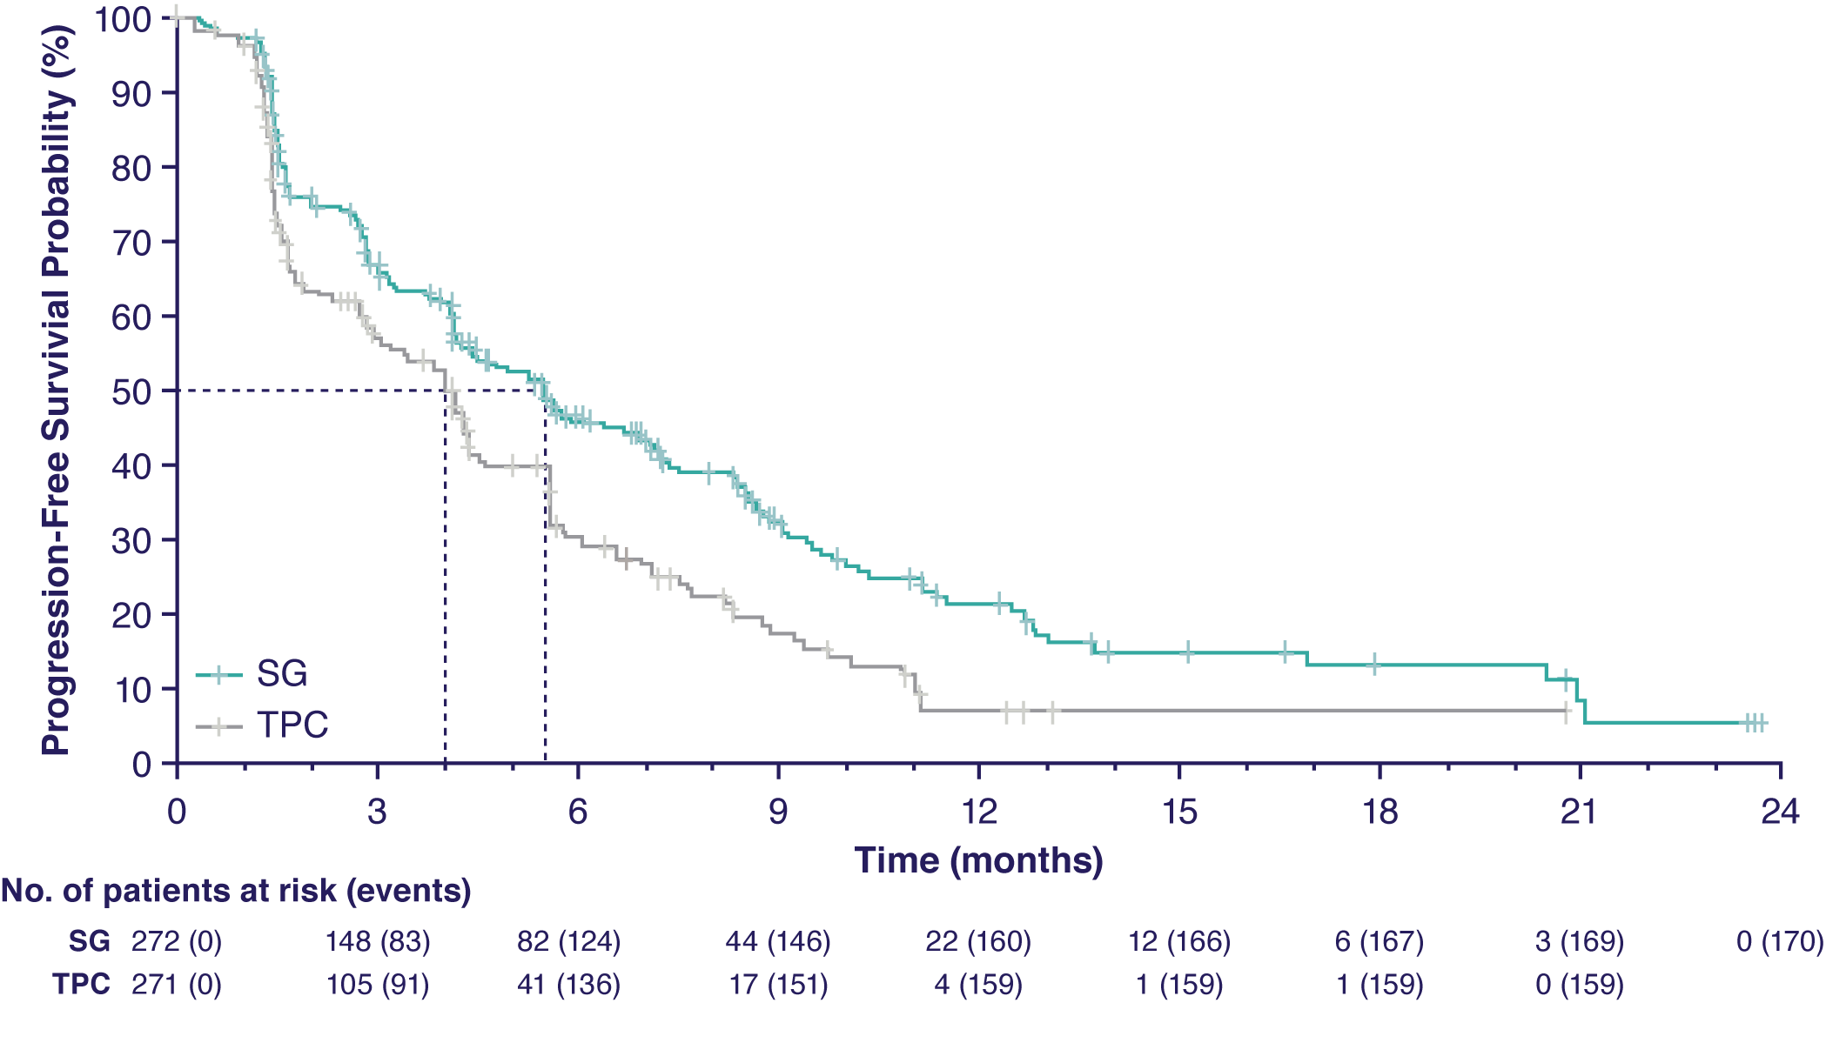
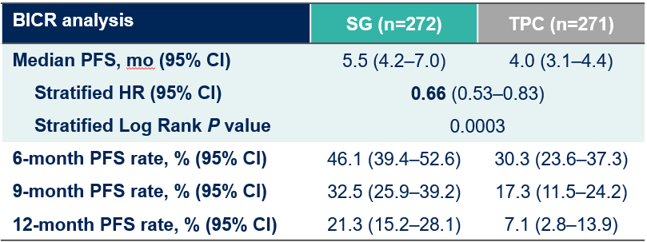
TROPiCS-02 Phase 3 Trial: Improved PFS
SG demonstrated a statistically significant improvement in PFS versus TPC with a 34% reduction in the risk of disease progression/death; a higher proportion of patients were alive and progression-free at all landmark timepoints
6 months
9 months
12 months
BICR analysis | SG (n=272) | TPC (n=271)
Median PFS, mo (95% CI) | 5.5 (4.2–7.0) | 4.0 (3.1–4.4)
Stratified HR (95% CI) | 0.66 (0.53–0.83)
Stratified Log Rank P value | 0.0003
6-month PFS rate, % (95% CI) | 46.1 (39.4–52.6) | 30.3 (23.6–37.3)
9-month PFS rate, % (95% CI) | 32.5 (25.9–39.2) | 17.3 (11.5–24.2)
12-month PFS rate, % (95% CI) | 21.3 (15.2–28.1) | 7.1 (2.8–13.9)
Significant PFS benefit over chemotherapy
Significant ORR benefit (21% vs 14%, p=0.03)
Median follow-up was 10.2 months.

Slide 9
Refining the Treatment Algorithm for HR+ Metastatic Breast Cancer (MBC)
HR+ HER2-low MBC
EXHAUST ENDOCRINE TREATMENT STRATEGIES
FIRST LINE CHEMO*
(Preferred choice: capecitabine)
THIRD LINE
SACI or CHEMO
SECOND LINE
T-DXd
HR+ HER2-0 MBC
EXHAUST ENDOCRINE TREATMENT STRATEGIES
FIRST LINE CHEMO*
(Preferred choice: capecitabine)
SECOND LINE CHEMO*
(Preferred choice: taxanes)
THIRD LINE
SACI or CHEMO

Slide 10
When to Sequence Sacituzumab Govitecan?
Used after endocrine resistance and at least 2 lines of chemotherapy
Sacituzumab govitecan should be considered as the 1st ADC in HER2 0 patients
Could be used in HER2-low patients with toxicity concerns for T-DXd, such as those with ILD or cardiac history

Slide 11



Looking for more resources on this topic?
CME/CE in minutes
Congress highlights
Late-breaking data
Quizzes
Webinars
In-person events
Slides & resources
www.MedEdOTG.com

