Slide 1
Who Is the Best Candidate for Sequencing Trastuzumab Detruxtecan (T-DXd) First?
Erica L. Mayer, MD, MPH Institute Physician, Breast Oncology Center Dana-Farber Cancer Institute Assistant Professor of Medicine Harvard Medical School Boston, MA

Slide 2



Resource Information
About This Resource
These slides are one component of a continuing education program available online at MedEd On The Go titled Expanding ADCs Across Metastatic Breast Cancer: Disrupting Dx & Tx Silos
Program Learning Objectives:
Correctly determine HER2 expression status in existing and newly diagnosed metastatic breast cancer patients
Develop evidence-based treatment strategies for patients with HR-positive/HER2-low MBC
Differentiate key components and advantages of ADCs in special populations of patients with metastatic breast cancer
Identify strategies for improving adherence through adverse effect management
MedEd On The Go®
www.mededonthego.com
This content or portions thereof may not be published, posted online or used in presentations without permission.
This content can be saved for personal use (non-commercial use only) with credit given to the resource authors.
To contact us regarding inaccuracies, omissions or permissions please email us at support@MedEdOTG.com

Slide 3
Disclaimer
The views and opinions expressed in this educational activity are those of the faculty and do not necessarily represent the views of Total CME, LLC, the CME providers, or the companies providing educational grants. This presentation is not intended to define an exclusive course of patient management; the participant should use their clinical judgment, knowledge, experience, and diagnostic skills in applying or adopting for professional use any of the information provided herein. Any procedures, medications, or other courses of diagnosis or treatment discussed or suggested in this activity should not be used by clinicians without evaluation of their patient's conditions and possible contraindications or dangers in use, review of any applicable manufacturer’s product information, and comparison with recommendations of other authorities. Links to other sites may be provided as additional sources of information.

Slide 4
Patient Case (58-year-old Woman)
Presented 5 years ago with de novo metastatic breast cancer.
On biopsy, disease was ER/PR+, HER2 2+, FISH-
She has received treatment with:
First-line letrozole and ribociclib (3 years)
Second-line fulvestrant and everolimus (9 months)
Third-line capecitabine (1 year)
Her disease is now progressing in the liver and lymph nodes
ctDNA was evaluated
No actionable mutations identified in ESR1, PI3K, or HER2
Testing of liver biopsy confirmed HR+/HER2 2+, FISH-

Slide 5
What Is the Best Next Step in Treatment?
Paclitaxel
Tamoxifen
Trastuzumab deruxtecan
Abemaciclib
Sacituzumab govitecan

Slide 6
NCCN Guidelines: New Systemic Therapy Regimens For Recurrent Unresectable (Local or Regional) or Stage IV (M1) Disease
New antibody drug conjugates are available to treat metastatic HR+ HER2-negative/HER2-low breast cancer:
Sacituzumab govitecan
Trastuzumab deruxtecan
Sequence of ADCs depends on what 1L therapy they received, plus patient characteristics

Slide 7
Refining the Treatment Algorithm for HR+ Metastatic Breast Cancer (MBC)
HR+ HER2-low MBC
EXHAUST ENDOCRINE TREATMENT STRATEGIES
FIRST LINE CHEMO*
(Preferred choice: capecitabine)
THIRD LINE
SACI or CHEMO
SECOND LINE
T-DXd
HR+ HER2-0 MBC
EXHAUST ENDOCRINE TREATMENT STRATEGIES
FIRST LINE CHEMO*
(Preferred choice: capecitabine)
SECOND LINE CHEMO*
(Preferred choice: taxanes)
THIRD LINE
SACI or CHEMO

Slide 8
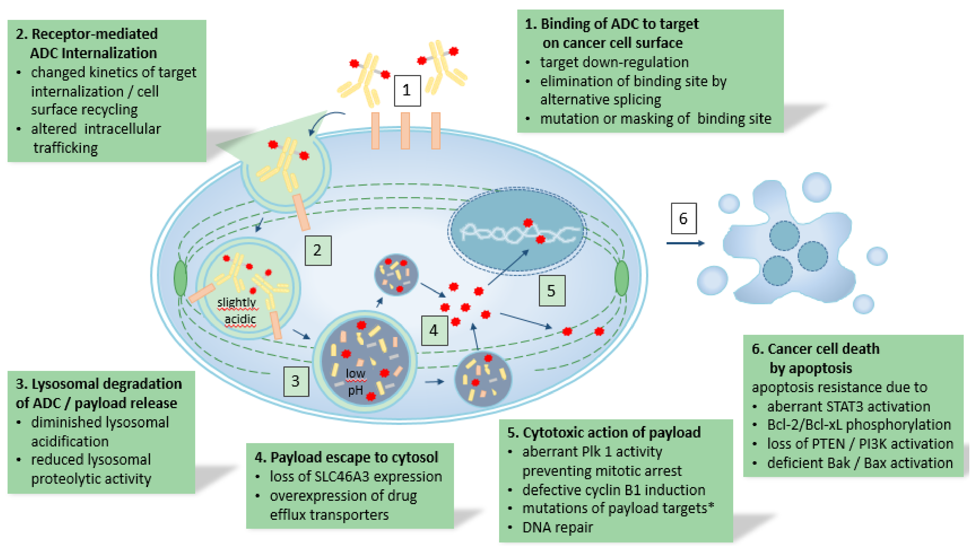
Mechanisms of Resistance to ADCs Based on Mechanisms of Action

Slide 9
Sequential Use of ADC After ADC for MBC: ADC After ADC (A3) Study
MBC patients treated with ADCs Multiple ADCs | 193 35
Breast cancer subtype HR+/HER2- TNBC HER2-low | 15 (42.9%) 20 (57.1%) 24 (68.6%)
Median prior lines of treatment HR+/HER2- TNBC | 7 3
Antibody target of ADC1 HER2 TROP2 Other | 8 (22.9%) 26 (74.3%) 1 (2.9%)
Antibody target of ADC2 HER2 TROP2 Other | 14 (40.0%) 19 (54.3%) 2 (5.7%)
Payload of ADC1 Topoisomerase-I inhibitor Microtubule inhibitor Other | 35 (100%) 0 0
Payload of ADC2 Topoisomerase-I inhibitor Microtubule inhibitor Other | 31 (88.6%) 2 (5.7%) 2 (5.7%)

Slide 10
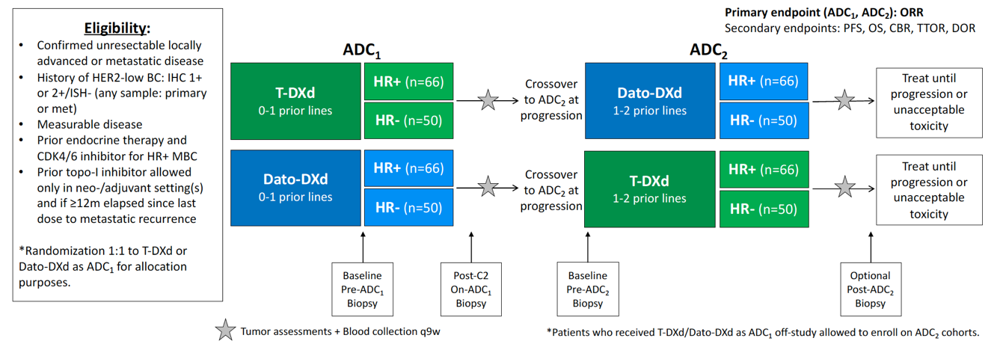

ADC Sequencing Efforts in TBCRC
Prospective Registry of ADC Sequencing
PI: Laura Huppert
TBCRC 064: TReatment of ADC-Refractory Breast CancEr with Dato-DXd or T-DXd (TRADE DXd) PI: Ana Garrido-Castro

Slide 11



Looking for more resources on this topic?
CME/CE in minutes
Congress highlights
Late-breaking data
Quizzes
Webinars
In-person events
Slides & resources
www.MedEdOTG.com

