Slide 1
What Are the Data for HER2- Targeted ADCs in HR+/HER2-low Metastatic Breast Cancer?
Erica L. Mayer, MD, MPH Institute Physician, Breast Oncology Center Dana-Farber Cancer Institute Assistant Professor of Medicine Harvard Medical School Boston, MA

Slide 2



Resource Information
About This Resource
These slides are one component of a continuing education program available online at MedEd On The Go titled Expanding ADCs Across Metastatic Breast Cancer: Disrupting Dx & Tx Silos
Program Learning Objectives:
Correctly determine HER2 expression status in existing and newly diagnosed metastatic breast cancer patients
Develop evidence-based treatment strategies for patients with HR-positive/HER2-low MBC
Differentiate key components and advantages of ADCs in special populations of patients with metastatic breast cancer
Identify strategies for improving adherence through adverse effect management
MedEd On The Go®
www.mededonthego.com
This content or portions thereof may not be published, posted online or used in presentations without permission.
This content can be saved for personal use (non-commercial use only) with credit given to the resource authors.
To contact us regarding inaccuracies, omissions or permissions please email us at support@MedEdOTG.com

Slide 3
Disclaimer
The views and opinions expressed in this educational activity are those of the faculty and do not necessarily represent the views of Total CME, LLC, the CME providers, or the companies providing educational grants. This presentation is not intended to define an exclusive course of patient management; the participant should use their clinical judgment, knowledge, experience, and diagnostic skills in applying or adopting for professional use any of the information provided herein. Any procedures, medications, or other courses of diagnosis or treatment discussed or suggested in this activity should not be used by clinicians without evaluation of their patient's conditions and possible contraindications or dangers in use, review of any applicable manufacturer’s product information, and comparison with recommendations of other authorities. Links to other sites may be provided as additional sources of information.

Slide 4
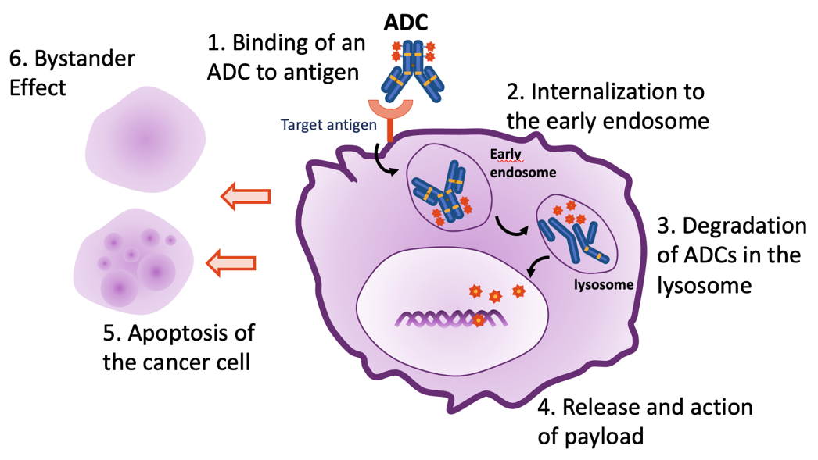
T-DXd* Mechanism of Action: Selective Delivery of Toxic Payload and Bystander Effect

Slide 5
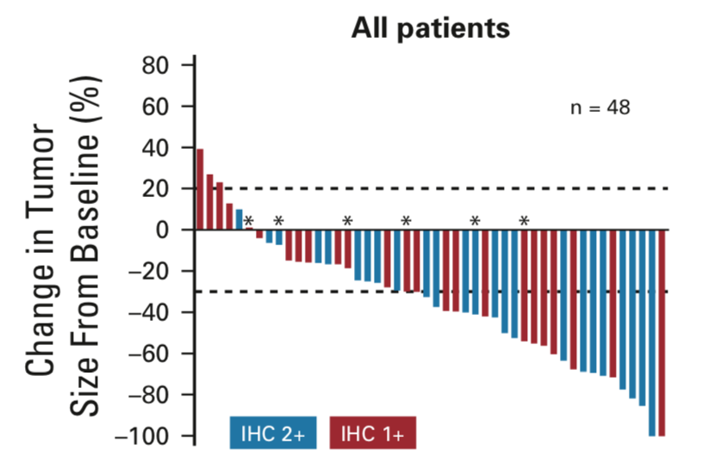
Trastuzumab Deruxtecan (T-DXd)
Activity in HER2-low Metastatic Breast Cancer (MBC)
First presented at ASCO 2018, results from a Phase 1b study of T-DXd suggested activity in HER2-low MBC
Among 54 highly pre-treated (median 7.5 prior therapies) metastatic breast cancer patients with HER2 IHC 1+ or 2+/FISH-:
ORR 37%
mPFS 11 months
Common Grade ≥3 TEAEs included decreases in neutrophil, platelet, and WBC counts; anaemia; hypokalaemia; AST increase; decreased appetite; and diarrhea

Slide 6
DESTINY-Breast04: First Randomized Phase 3 Study of T-DXd for HER2-low Metastatic Breast Cancer
An open-label, multicenter study (NCT03734029)
T-DXd
5.4 mg/kg Q3W
(n = 373)
Primary endpoint
PFS by BICR (HR+)
Key secondary endpoints^{b}
PFS by BICR (all patients)
OS (HR+ and all patients)
Patientsª
HER2-low (IHC 1+ vs IHC 2+/ISH−), unresectable, and/or MBC treated with 1-2 prior lines of chemotherapy in the metastatic setting
HR+ disease considered endocrine refractory
R
2:1
HR+ ≈ 480
HR− ≈ 60
TPC
Capecitabine, eribulin, gemcitabine, paclitaxel, nab-paclitaxel^{c}
(n = 184)
Chemotherapy, n (%)
Eribulin | 94 (51.1)
Capecitabine | 37 (20.1)
Nab-paclitaxel | 19 (10.3)
Gemcitabine | 19 (10.3)
Paclitaxel | 15 (8.2)
Stratification factors
Centrally assessed HER2 status^{d} (IHC 1+ vs IHC 2+/ISH−)
1 versus 2 prior lines of chemotherapy
HR+ (with vs without prior treatment with CDK4/6 inhibitor) versus HR−

Slide 7
DESTINY-Breast04: PFS and OS in HR+/HER2-low Metastatic Breast Cancer
PFS
OS
100
Hazard ratio: 0.51
95% CI, 0.40-0.64
P < 0.0001
100
Hazard ratio: 0.64
95% CI, 0.48-0.86
P = 0.0028
80
80
T-DXd
mOS: 23.9 mo
T-DXd
mPFS: 10.1 mo
60
Δ 4.7 mo
60
Progression-Free Survival Probability (%)
Overall Survival Probability (%)
Δ 6.4 mo
40
40
TPC
mOS: 17.5 mo
TPC
mPFS: 5.4 mo
20
20
0
0
0
1
2
3
4
5
6
7
8
9
10
11
12
13
14
15
16
17
18
19
20
21
22
23
24
25
26
27
28
29
0
1
2
3
4
5
6
7
8
9
10
11
12
13
14
15
16
17
19
20
21
22
23
24
25
26
27
28
29
30
31
32
Months
18
33
34
Months
Significant improvement in PFS and OS in patients with 1-2 prior lines of chemotherapy: new standard of care for HER2-low metastatic breast cancer.

Slide 8
DESTINY-BREAST04: PFS and OS in HR−/HER2-low Metastatic Breast Cancer
Exploratory Endpoints*
PFS
OS
100
Hazard ratio: 0.46
95% CI, 0.24-0.89
100
Hazard ratio: 0.48
95% CI, 0.24-0.95
80
T-DXd
mPFS: 8.5 mo
80
T-DXd
mOS: 18.2 mo
60
60
Δ 9.9 mo
Progression-Free Survival Probability (%)
Overall Survival Probability (%)
40
Δ 5.6 mo
40
20
20
TPC
mPFS: 2.9 mo
TPC
mOS: 8.3 mo
0
0
0
1
2
3
4
5
6
7
8
9
10
11
12
13
14
15
16
17
18
19
20
21
22
23
24
25
26
27
28
0
1
2
3
4
5
6
7
8
9
10
11
12
13
14
15
16
17
18
19
20
21
22
23
24
25
26
27
28
Months
Months

Slide 9
Confirmed Objective Response Rate (ORR)
Hormone receptor–positive
Hormone receptor–negative
52.6%ª
50.0%
 |  | Complete Response
 |  | Partial Response
3.6
2.5
Percentage
49.2
16.3%
47.5
16.7%
0.6
5.6
15.7
11.1
T-DXd (n = 333)
TPC (n = 166)
T-DXd (n = 40)
TPC (n = 18)
Progressive disease, %
Not evaluable, %
Clinical benefit rate,^{b} %
Duration of response, months
7.8 | 21.1 | 12.5 | 33.3
4.2 | 12.7 | 7.5 | 5.6
71.2 | 34.3 | 62.5 | 27.8
10.7 | 6.8 | 8.6 | 4.9
Hormone receptor status is based on data from the electronic data capture corrected for misstratification.

Slide 10
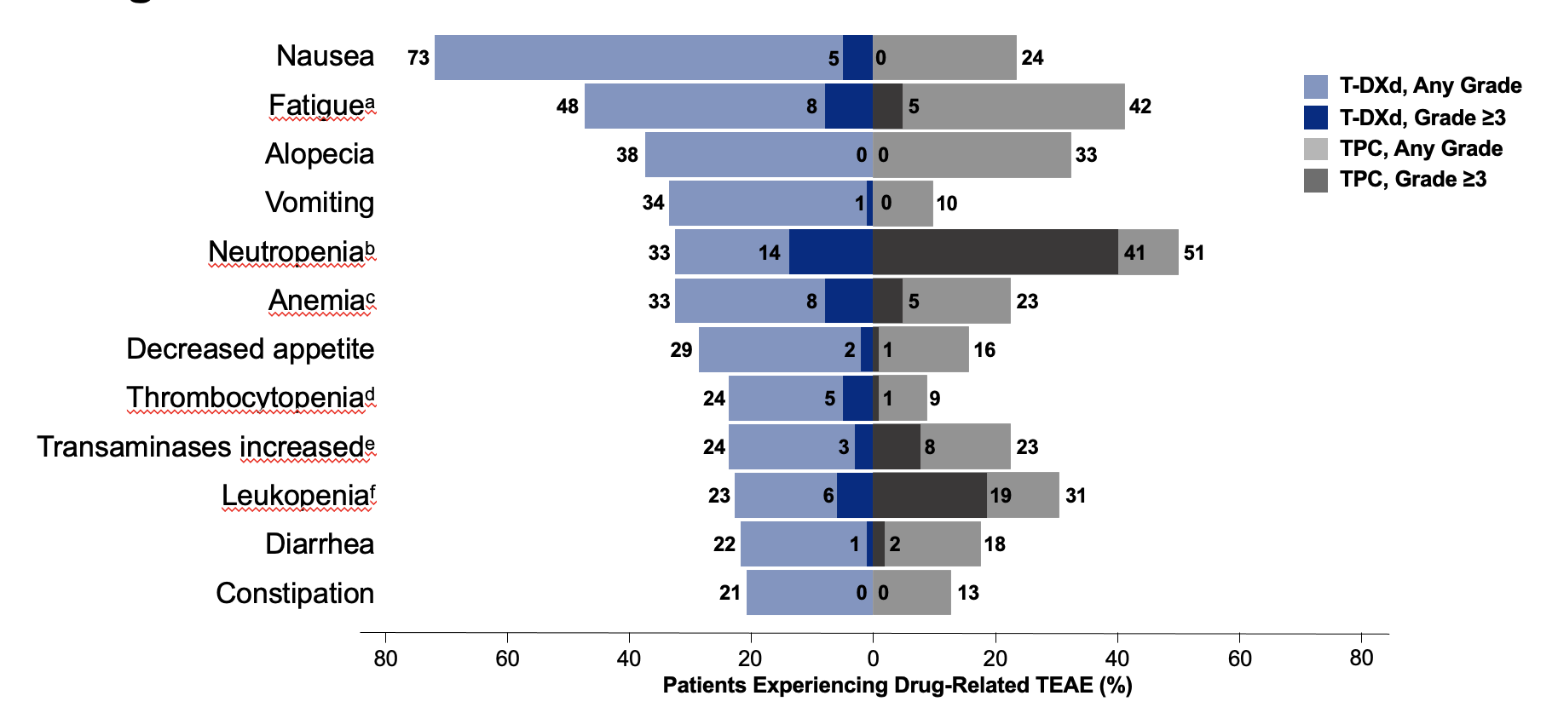
DESTINY-Breast04: Drug-related TEAEs in ≥20% of Patients
Nausea
Fatigue
Alopecia
Vomiting
Neutropenia
Anemia
Decreased appetite
Thrombocytopenia
Transaminases increased
Leukopenia
Diarrhea
Constipation
Most common TEAE associated with:
Dose reduction: 4.6%, nausea and fatigue
Tx discontinuation: 8.2%, ILD

Slide 11
Approach to Therapy for HR+/HER2- Metastatic Breast Cancer: Move to Personalization
1L^{[1-4]}
2L^{[1]}
3L
4L/5L^{[1]}
4L+^{[1]}
AI + CDK4/6i
Fulvestrant
(+/- CDK4/6i)
Exemestane + everolimus^{[8]}
Taxane or capecitabine
Eribulin
Doxorubicin (liposomal)
Vinorelbine
Gemcitabine
Carboplatin
Fulvestrant + CDK4/6i
Tamoxifen
BRCAm: olaparib or talazoparib^{[9,10]}
Exemestane + everolimus
PIK3CAm:
fulvestrant + alpelisib^{[5]}
ESR1m: SERD (+ CDK4/6i)^{[6,7]}
HER2 low: trastuzumab deruxtecan (DS8201a)^{[11]}
Sacituzumab govitecan
(IMMU-132)^{[13]}

Slide 12



Looking for more resources on this topic?
CME/CE in minutes
Congress highlights
Late-breaking data
Quizzes
Webinars
In-person events
Slides & resources
www.MedEdOTG.com

