Slide 1
What Are the Clinical and Therapeutic Implications of the Evolving HER2 Testing Landscape?
Sarah Sammons, MD Associate Director, Metastatic Breast Cancer Dana Farber Cancer Institute Boston, MA

Slide 2



Resource Information
About This Resource
These slides are one component of a continuing education program available online at MedEd On The Go titled Expanding ADCs Across Metastatic Breast Cancer: Disrupting Dx & Tx Silos
Program Learning Objectives:
Correctly determine HER2 expression status in existing and newly diagnosed metastatic breast cancer patients
Develop evidence-based treatment strategies for patients with HR-positive/HER2-low MBC
Differentiate key components and advantages of ADCs in special populations of patients with metastatic breast cancer
Identify strategies for improving adherence through adverse effect management
MedEd On The Go®
www.mededonthego.com
This content or portions thereof may not be published, posted online or used in presentations without permission.
This content can be saved for personal use (non-commercial use only) with credit given to the resource authors.
To contact us regarding inaccuracies, omissions or permissions please email us at support@MedEdOTG.com

Slide 3
Disclaimer
The views and opinions expressed in this educational activity are those of the faculty and do not necessarily represent the views of Total CME, LLC, the CME providers, or the companies providing educational grants. This presentation is not intended to define an exclusive course of patient management; the participant should use their clinical judgment, knowledge, experience, and diagnostic skills in applying or adopting for professional use any of the information provided herein. Any procedures, medications, or other courses of diagnosis or treatment discussed or suggested in this activity should not be used by clinicians without evaluation of their patient's conditions and possible contraindications or dangers in use, review of any applicable manufacturer’s product information, and comparison with recommendations of other authorities. Links to other sites may be provided as additional sources of information.

Slide 4
The “Traditional” HER2 Pie Chart
Based on this paradigm, most breast tumors (~80-85%) have been defined HER2-negative for decades, despite the presence of detectable HER2 expression

Slide 5
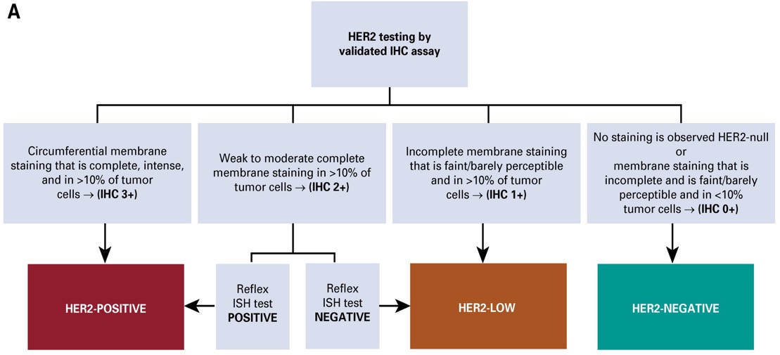
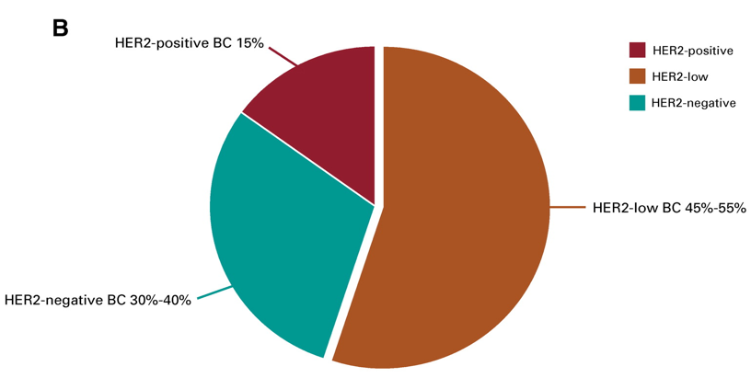
Due to Highly Effective HER2-targeting Agents, HER2-Low as a Biomarker Has Emerged
HER2-low Definition: IHC 1+ or 2+ ISH non-amplified

Slide 6
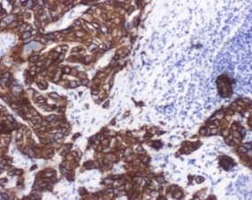
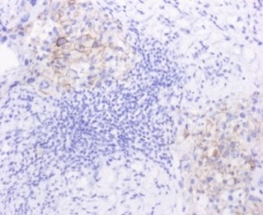
Prevalence of HER2-Low Status in Breast Cancer
HER2 IHC Examples
HR+ Disease (n = 2962)
TNBC (n = 706)
HER2+
9.8%
21.6%
34.6%
26.8%
HER2-low
63.4%
43.8%
HER2-
IHC 0
IHC 1+
IHC 2+
HER2-
65.4% HER2-low
36.5% HER2-low

Slide 7
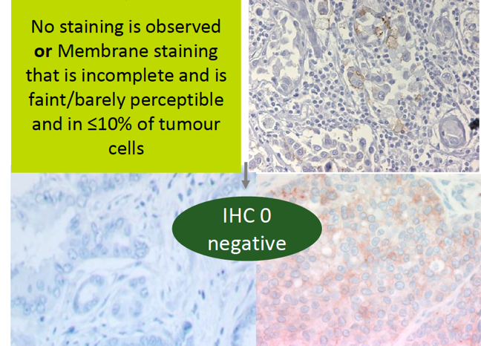
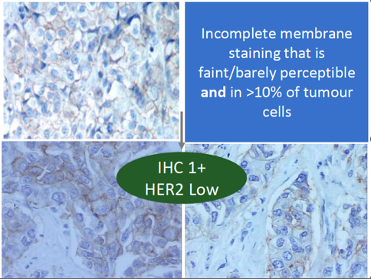
Low Concordance Among Pathologists for HER2-0 Versus HER2-Low
In a recent study which included 18 experienced pathologists, there was only a 26% concordance between the diagnoses of HER2-0 and HER2 1+. Current IHC assays were developed to identify overexpressing cases and are unsuitable for distinguishing HER2-0 from HER2-low
Importantly, HER2-0 does not mean the absence of HER2; it also includes tumors with “ultralow” expression

Slide 8
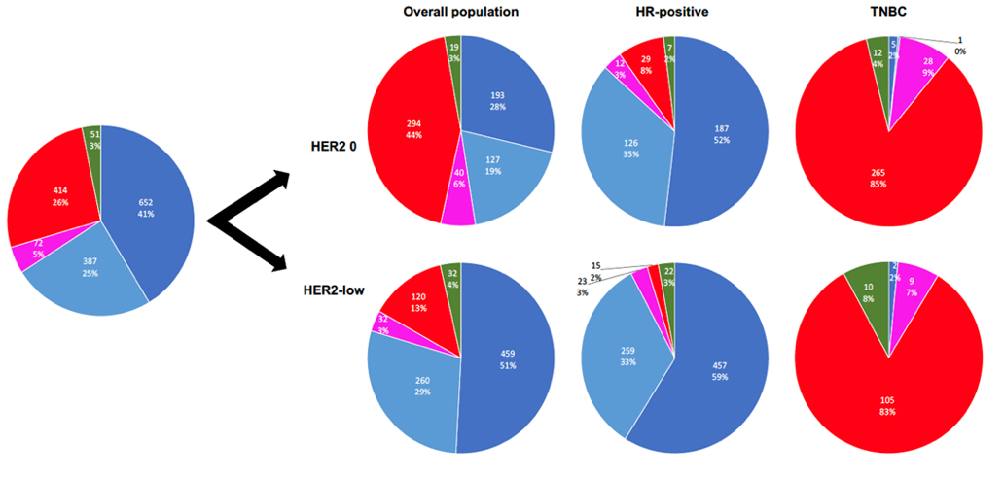

HER2-Low Does Not Appear To Be a Distinct Biologic Entity
Little to no difference in gene expression between HER2-zero and HER2-low tumors
TNBC are mostly (85%) basal-like at PAM50, regardless of HER2-low expression
HR+ cancers are mostly (90%) luminal at PAM50, regardless of HER2-low expression
Slightly more basal-like among HR+/HER2-0, possibly ER-low tumors
HR-positive
TNBC

Slide 9
HER2-Low Does Not Have Prognostic Implications*
STUDY | N | SETTING | HR+ | TNBC
Won HS, et al. Breast Can Res. 2022. | 30,491 | EARLY
Hazelwood E, et al. BMC Med. 2022. | 28, 280 | EARLY
Tarantino P, et al. JAMA Onc. 2022. | 5,235 | EARLY
Horisawa N, et al. Breast Cancer. 2022. | 4,918 | EARLY
Denkert C, et al. Lancet Oncol. 2021. | 2,310 | EARLY
Gampenrieder SP, et al. Breast Cancer Res. 2021. | 1,378 | ADVANCED
Schettini F, et al. NPJ Breast Cancer. 2021. | 1304 | ADVANCED
Hein A, et al. Eur J Cancer. 2021. | 1,022 | ADVANCED
de Moura Leite L, et al. Breast Cancer Res Treat. 2021. | 855 | EARLY
Agostinetto E, et al. Cancers (Basel). 2021. | 804 | EARLY
Mutai R, et al. Breast. 2021. | 608 | EARLY
Jacot W, et al. Cancers (Basel). 2021. | 296 | EARLY
Tarantino P, et al. Eur J Cancer. 2021. | 232 | ADVANCED
A multitude of studies conducted to evaluate the prognostic role of HER2-low expression
Most studies found no OS difference in HER2-low versus HER2-0 BC, regardless of HR expression
= no OS difference
= significant OS difference
= not evaluated

Slide 10
Clinical Implications of HER2-Low
Fam-trastuzumab deruxtecan-nxki is the first FDA approved therapy targeting the HER2-low biomarker based on results of the DESTINY Breast 04 clinical trial
Approved for adult patients with unresectable or metastatic HER2-low breast cancer who have received a prior chemotherapy in the metastatic setting or developed disease recurrence during or within six months of completing adjuvant therapy
Many other clinical trials in the early stage and metastatic setting are ongoing targeting HER2-low

Slide 11



Looking for more resources on this topic?
CME/CE in minutes
Congress highlights
Late-breaking data
Quizzes
Webinars
In-person events
Slides & resources
www.MedEdOTG.com

