Slide 1
What Dermatologists & Surgeons Need to Know: Adjuvant Treatment for Resectable Stage III/IV Melanoma
Jeffrey S. Weber, MD, PhD, FASCO, FAIO
Deputy Director and Head, Experimental Therapeutics
Co-Program Director, NYU SPORE in Melanoma
Laura and Isaac Perlmutter Comprehensive Cancer Center
Professor of Medicine and Perlmutter Professor of Oncology
NYU Grossman School of Medicine
New York, NY

Slide 2
Resource Information
About This Resource
These slides are one component of a continuing education program available online at MedEd On The Go titled Expanded Options in Adjuvant Immunotherapy for Resectable Melanoma: A Multidisciplinary Conversation
Program Learning Objectives:
Summarize the efficacy and safety data of clinical trials related to adjuvant treatment for resectable melanoma
Select individualized adjuvant immunotherapy regimens for patients with resectable melanoma, including risk/benefit analysis based on patient and disease characteristics
Identify and manage irAEs in the setting of adjuvant ICI therapy for resectable melanoma
Recognize the role of multidisciplinary, team-based care in clinical decision-making and implementation of multimodal treatment approaches for patients with resectable melanoma
MedEd On The Go®
www.mededonthego.com
This content or portions thereof may not be published, posted online or used in presentations without permission.
This content can be saved for personal use (non-commercial use only) with credit given to the resource authors.
To contact us regarding inaccuracies, omissions or permissions please email us at support@MedEdOTG.com

Slide 3
Disclaimer
The views and opinions expressed in this educational activity are those of the faculty and do not necessarily represent the views of Total CME, LLC, the CME providers, or the companies providing educational grants. This presentation is not intended to define an exclusive course of patient management; the participant should use their clinical judgment, knowledge, experience, and diagnostic skills in applying or adopting for professional use any of the information provided herein. Any procedures, medications, or other courses of diagnosis or treatment discussed or suggested in this activity should not be used by clinicians without evaluation of their patient's conditions and possible contraindications or dangers in use, review of any applicable manufacturer’s product information, and comparison with recommendations of other authorities. Links to other sites may be provided as additional sources of information.

Slide 4
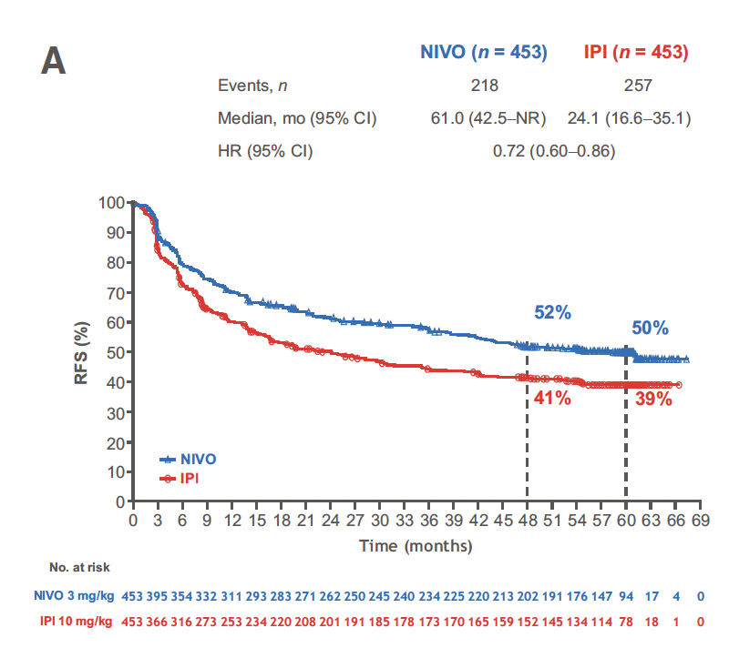
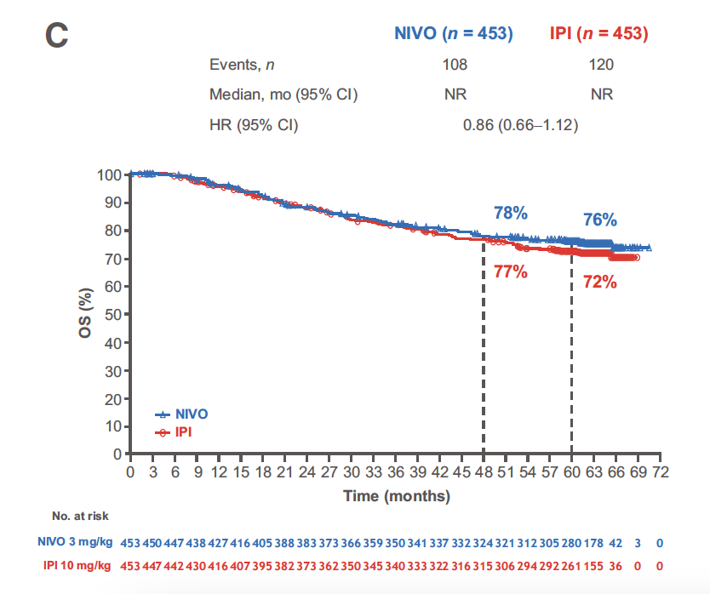
CheckMate 238 Updated Five-Year Results: Adjuvant Nivolumab Versus Ipilimumab in Resected Stage IIIB/IIIC/IV Melanoma
RFS
OS
Adjuvant nivolumab retained significant reduction in risk of recurrence or death compared with ipilimumab at 5 years, with a non-significant improvement in overall survival

Slide 5
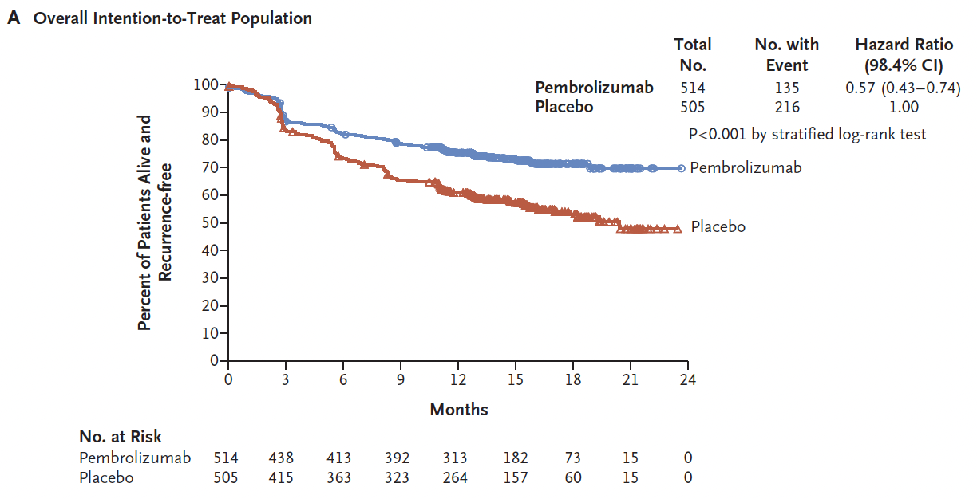
KEYNOTE-054: Adjuvant Pembrolizumab Versus Placebo in Stages IIIA/B/C Resected Melanoma
Double-blind, randomized phase 3 study
Resected stage III A/B/C melanoma (N = 1019)
Primary endpoint: Recurrence-free survival
Adjuvant pembrolizumab significantly reduced the risk of recurrence or death compared with placebo

Slide 6
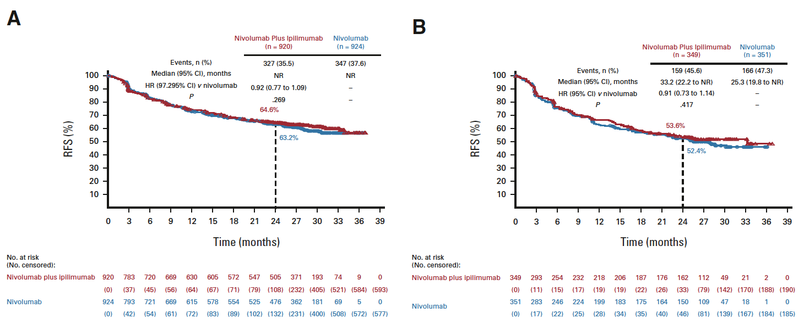
CheckMate 915: Adjuvant Nivolumab + Ipilimumab Versus Nivolumab in Stage IIIB/IIIC/IIID/IV Resected Melanoma
Double-blind, randomized phase 3 study
Resected stage III B/C/D or IV melanoma (N = 1833)
Primary endpoint: Recurrence-free survival (all patients and tumor PD-L1 expression level <1%)
All Randomized Patients
PD-L1 <1%
Adjuvant NIVO + IPI did not significantly reduce the risk of recurrence or death compared with NIVO alone

Slide 7
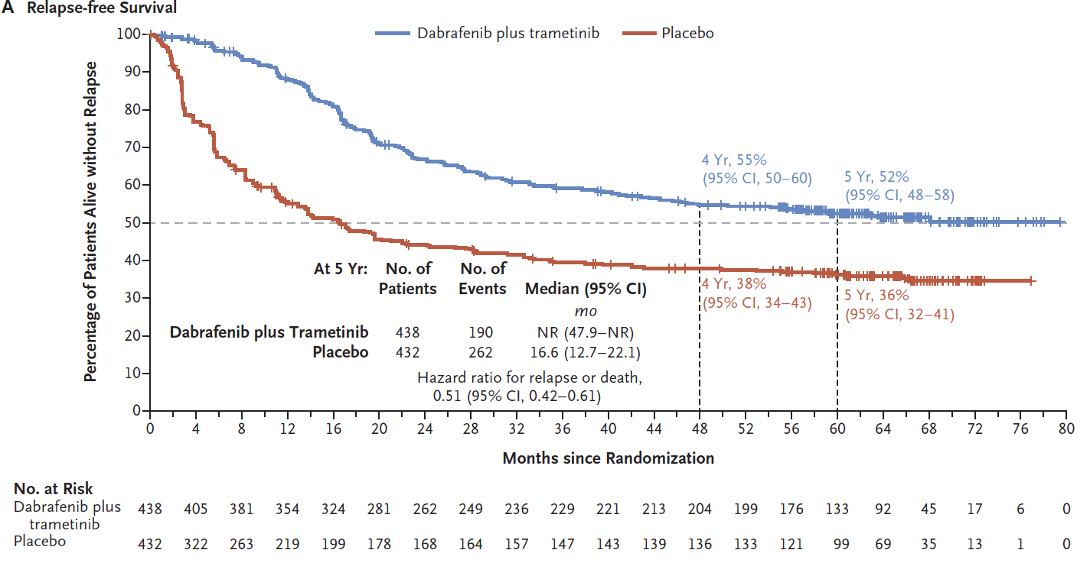
COMBI-AD 5-Year Results: Adjuvant Dabrafenib + Trametinib Versus Placebo in Stage IIIA/B/C Resected Melanoma
Reduction in risk of recurrence or death
compared with placebo is maintained through 5 years follow-up

Slide 8
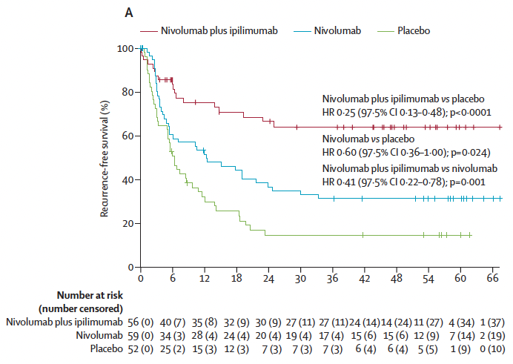
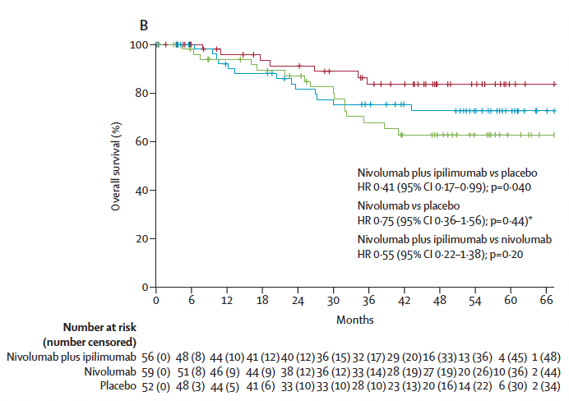
IMMUNED: Phase II Adjuvant Nivolumab + Ipilimumab Versus Nivolumab Versus Placebo in Stage IV Resected Melanoma
RFS
OS

Slide 9
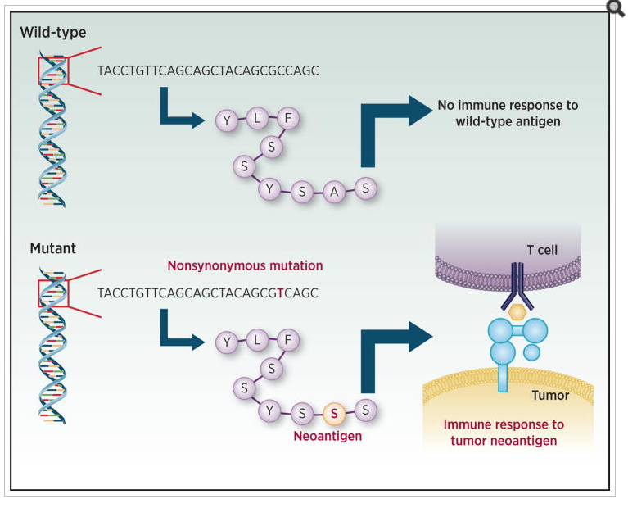
Generation of Neoantigens by Mutations (and insertions, fusions and deletions…)

Slide 10
mRNA-4157 (V940) and Pembrolizumab Demonstrated an Improvement in RFS Versus Pembrolizumab Monotherapy
+
+
12-month RFS
18-month RFS
+
+
+
83.4%
+
+
78.6%
+ Censored
+
+
+
+
+
+
+
+
+
+
+
+
+
+
+
+
+
+
+
+
+
+
+
+
+
+
+
+
+
+
+
+
+
+
+
+
+
+
+
+
+
77.1%
+
+
+
+
+
+
+
+
+
+
+
+
+
+
+
+
+
+
+
+
+
62.2%
+
+
+
+
+
+
+
+
+
+
+
+
+
+
+
+
 | Events (n/N) | Hazard ratio (95% CI)ª
mRNA-4157 + pembrolizumab | 24/107 | 0.561 (0.309–1.017) P = 0.0266
pembrolizumab | 20/50
Number at risk
mRNA-4157 + pembrolizumab
107
92
85
73
49
24
20
8
1
pembrolizumab
50
42
40
37
28
13
6
1
0
ITT population. ªThe HR and 95% CI for mRNA-4157 (V940) plus pembrolizumab versus pembrolizumab is estimated using a Cox proportional hazards model with treatment group as a covariate, stratified by disease stage (stages IIIB or IIIC or IIID versus stage IV) used for randomization. The p-value is based on a 1-sided log-rank test stratified by disease stage (stages IIIB or IIIC or IIID versus stage IV) used for randomization.
CI, confidence interval; ITT, intent to treat; mRNA, messenger RNA; RFS, recurrence-free survival.

Slide 11
Conclusions: Adjuvant Therapy for High-Risk Stages III/IV Resected Melanoma
Adjuvant single agent PD-1 or BRAF + MEK therapy prolong recurrence-free survival and distant metastasis-free survival in patients with stage III resected melanoma
There is no clear change in overall survival in current adjuvant trials compared to placebo or any control arm
IPI/NIVO with every 6-week IPI did not prolong recurrence-free survival compared to nivolumab alone in stage III/IV resected melanoma
Full-dose IPI/NIVO did prolong recurrence-free survival in resected stage IV melanoma in a small randomized study
The greatest need in adjuvant therapy is biomarkers to select the highest-risk patients to avoid the toxicity of treatment in those who do not need treatment after surgery

Slide 12
Looking for more resources on this topic?
CME/CE in minutes
Congress highlights
Late-breaking data
Quizzes
Webinars
In-person events
Slides & resources
www.MedEdOTG.com

