Slide 1
Managing Immunotherapy-Related Adverse Events during Adjuvant Treatment for Resectable Melanoma
Mario E. Lacouture, MD
Chief, Dermatology Division, Department of Medicine
NYU Grossman Long Island School of Medicine
Medical Director, Symptom Management Program
Perlmutter Cancer Center
NYU Langone Hospital
Long Island, NY

Slide 2



Resource Information
About This Resource
These slides are one component of a continuing education program available online at MedEd On The Go titled Expanded Options in Adjuvant Immunotherapy for Resectable Melanoma: A Multidisciplinary Conversation
Program Learning Objectives:
Summarize the efficacy and safety data of clinical trials related to adjuvant treatment for resectable melanoma
Select individualized adjuvant immunotherapy regimens for patients with resectable melanoma, including risk/benefit analysis based on patient and disease characteristics
Identify and manage irAEs in the setting of adjuvant ICI therapy for resectable melanoma
Recognize the role of multidisciplinary, team-based care in clinical decision-making and implementation of multimodal treatment approaches for patients with resectable melanoma
MedEd On The Go®
www.mededonthego.com
This content or portions thereof may not be published, posted online or used in presentations without permission.
This content can be saved for personal use (non-commercial use only) with credit given to the resource authors.
To contact us regarding inaccuracies, omissions or permissions please email us at support@MedEdOTG.com

Slide 3
Disclaimer
The views and opinions expressed in this educational activity are those of the faculty and do not necessarily represent the views of Total CME, LLC, the CME providers, or the companies providing educational grants. This presentation is not intended to define an exclusive course of patient management; the participant should use their clinical judgment, knowledge, experience, and diagnostic skills in applying or adopting for professional use any of the information provided herein. Any procedures, medications, or other courses of diagnosis or treatment discussed or suggested in this activity should not be used by clinicians without evaluation of their patient's conditions and possible contraindications or dangers in use, review of any applicable manufacturer’s product information, and comparison with recommendations of other authorities. Links to other sites may be provided as additional sources of information.

Slide 4
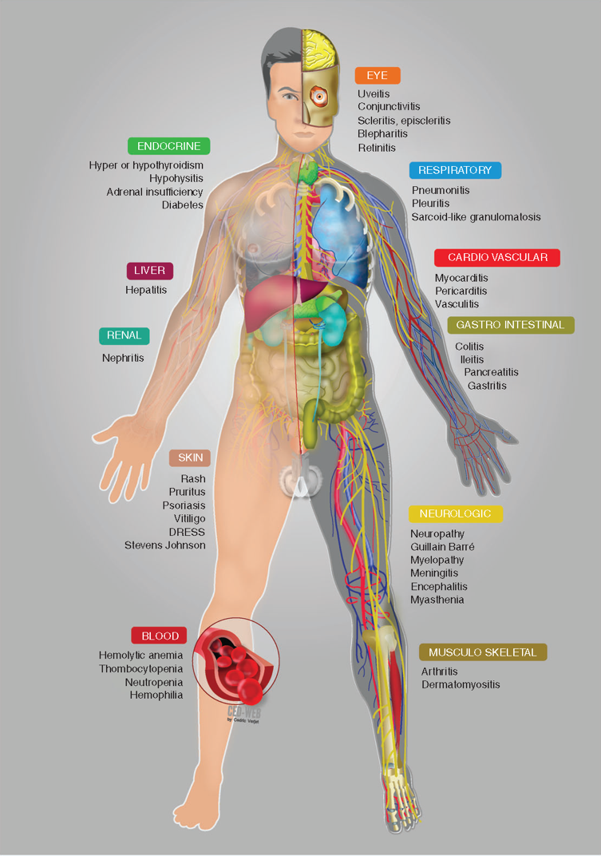
Immune-Related Adverse Events: Any Organ, Any Time

Slide 5
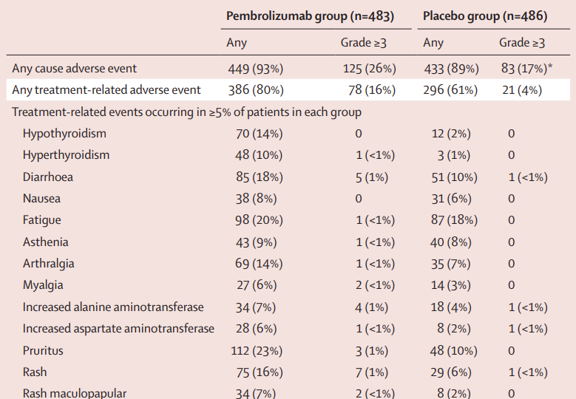
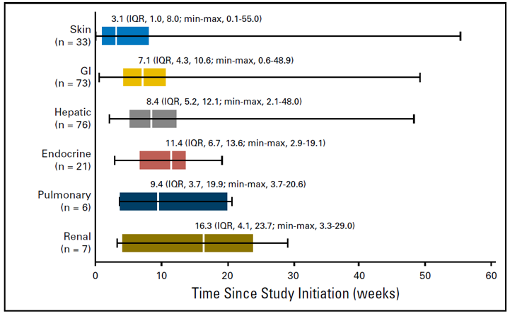
Time and Severity of Immune-Related Adverse Events
Melanoma (IIb/IIc)
(n=976)
Timeline: Severe AEs
(n=448)

Slide 6
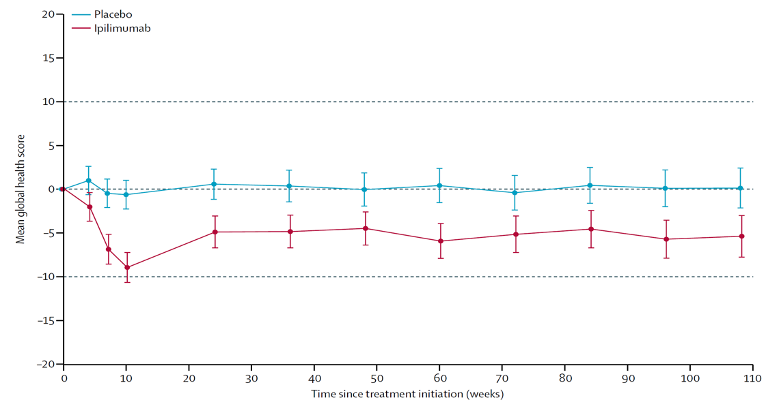
irAEs Impact Quality of Life and Dosing
Impact on Quality of Life
(n=951)
Impact on Dose Intensity
(n=945)
Interrupt
Discontinue
CTLA-4
PD-1/L-1 CTLA-4

Slide 7
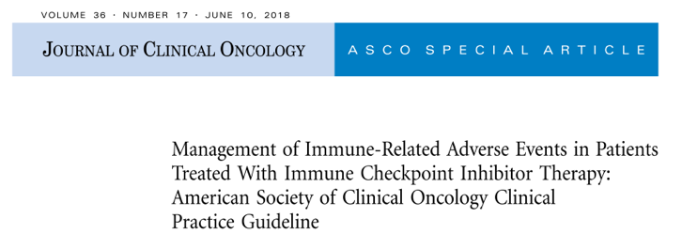

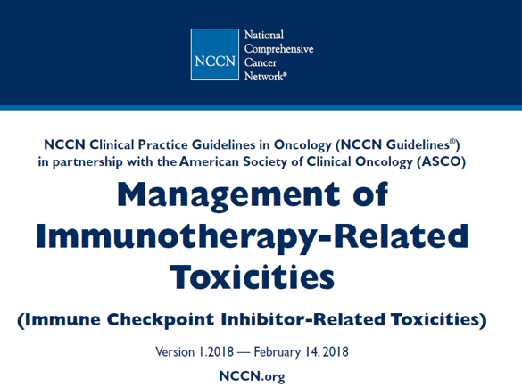
Guidelines for the Management of irAEs
Corticosteroids/
Dosing

Slide 8
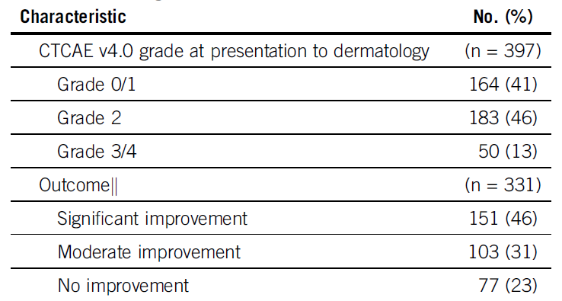
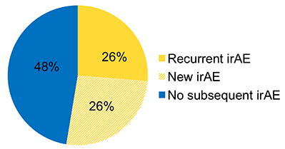
Treatment Outcomes of irAEs
PD-1/L1 ± CTLA-4
(n=482)
PD-L1
(n=38)

Slide 9
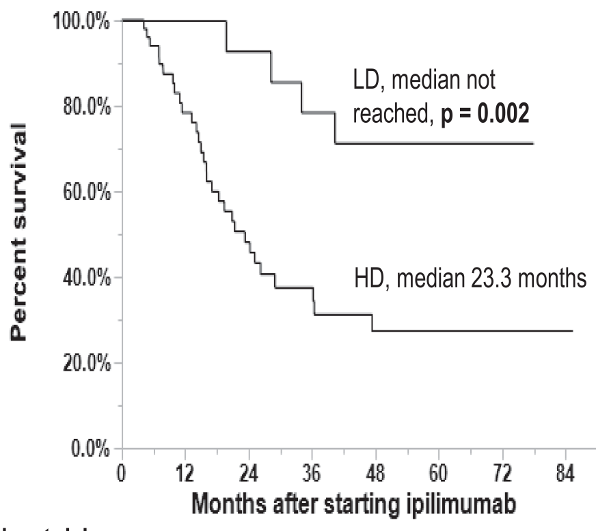
Corticosteroids May Affect IO Efficacy
CTLA-4 Hypophysitis
(n=98)
PD-(L)1
(n=640)

Slide 10
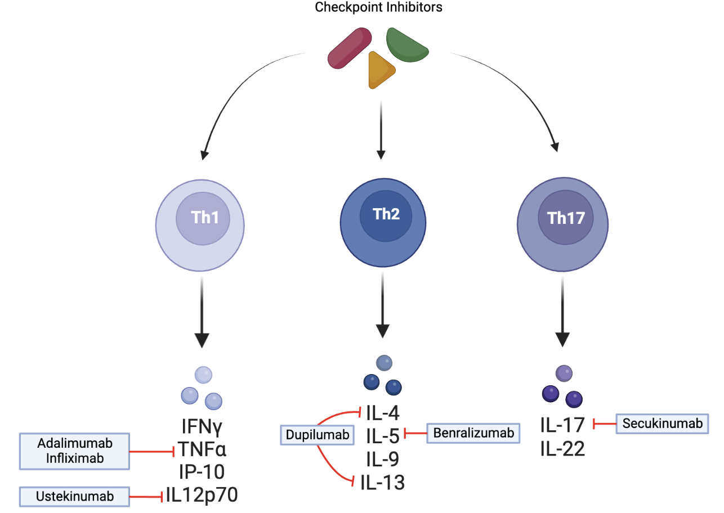
Specialist Symptom Management

Slide 11
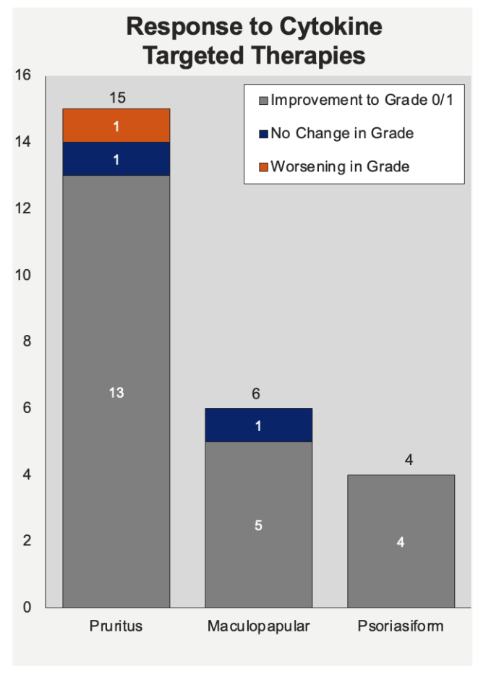
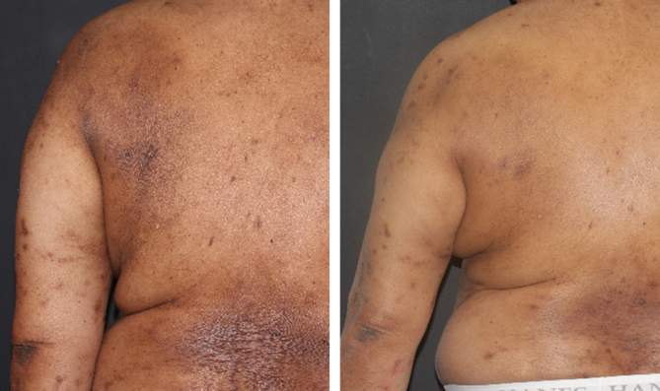
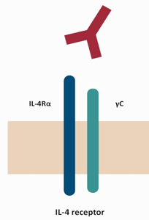
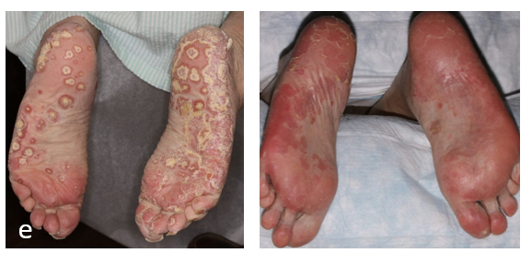
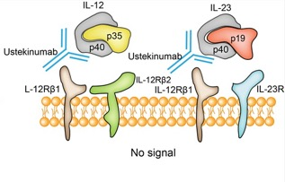
Pathway Blockade in Immune-Related Cutaneous Adverse Events
4 weeks
Dupilumab (Th2)
Ustekinumab (Th1)
NYU Langone Health
11

Slide 12
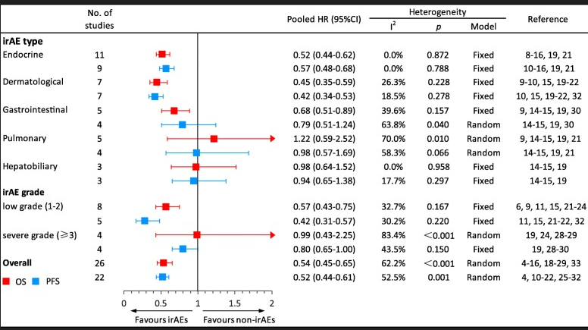
The Positive Side of irAEs
Patients on PD1/L1
n=4971

Slide 13
Immune-Related Adverse Events: Conclusions
irAEs are expected and manageable
Most patients able to complete course of therapy
Interdisciplinary and interprofessional approach is key
Targeted interventions
Counseling and support

Slide 14



Looking for more resources on this topic?
CME/CE in minutes
Congress highlights
Late-breaking data
Quizzes
Webinars
In-person events
Slides & resources
www.MedEdOTG.com

