Slide 1
Case Study:
Managing Common Adverse Events Associated with Second-Line Treatment of ES-SCLC
Jacob Sands, MD
Thoracic Medical Oncologist, Dana-Farber Cancer Institute
Assistant Professor, Harvard Medical School
Boston, MA

Slide 2



Resource Information
About This Resource
These slides are one component of a continuing education program available online at MedEd On The Go titled ES-SCLC: Sequencing Strategies in Previously Treated Patients
Program Learning Objectives:
Apply the latest evidence and guidelines to individualize second-line treatment plans for patients with extensive-stage small-cell lung cancer
Implement evidence-based strategies to prevent, monitor, and manage adverse effects in patients receiving second-line treatment for extensive-stage small-cell lung cancer
MedEd On The Go®
www.mededonthego.com
This content or portions thereof may not be published, posted online or used in presentations without permission.
This content can be saved for personal use (non-commercial use only) with credit given to the resource authors.
To contact us regarding inaccuracies, omissions or permissions please email us at support@MedEdOTG.com

Slide 3
Disclaimer
The views and opinions expressed in this educational activity are those of the faculty and do not necessarily represent the views of Total CME, LLC, the CME providers, or the companies providing educational grants. This presentation is not intended to define an exclusive course of patient management; the participant should use their clinical judgment, knowledge, experience, and diagnostic skills in applying or adopting for professional use any of the information provided herein. Any procedures, medications, or other courses of diagnosis or treatment discussed or suggested in this activity should not be used by clinicians without evaluation of their patient's conditions and possible contraindications or dangers in use, review of any applicable manufacturer’s product information, and comparison with recommendations of other authorities. Links to other sites may be provided as additional sources of information.

Slide 4
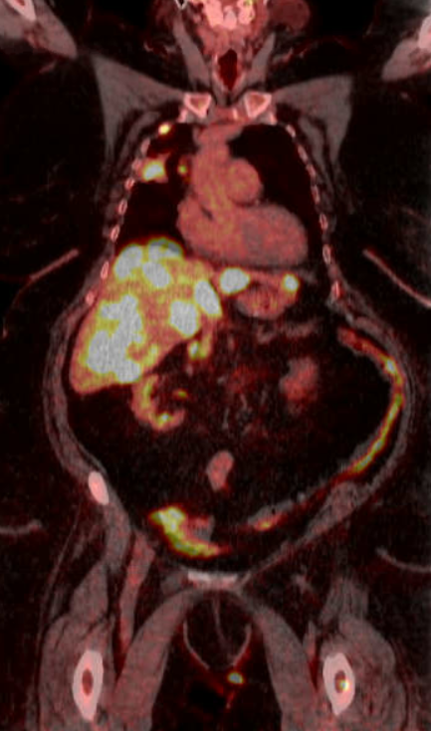
Clinical Case
62-year-old nurse with approximately 45-pack
year smoking history presented to ER with
right chest wall pain
CT scan showed no evidence of PE but noted
a right lung mass
  Metastatic disease noted in liver
PET/CT confirmed extensive stage disease
Started carboplatin, etoposide, and atezolizumab
Near-complete response noted; approximately
1 year in developed worsening anemia

Slide 5
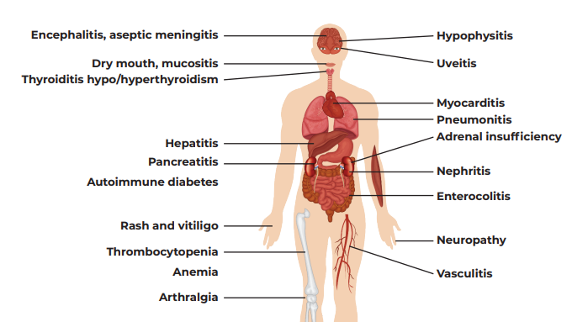
Caring for Patients Being Treated with First-Line Therapy Who Experience a TRAE
How do the AE profiles of currently approved ICIs compare with each other?

Slide 6
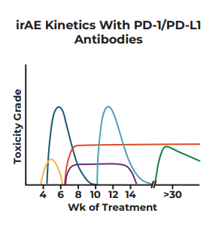
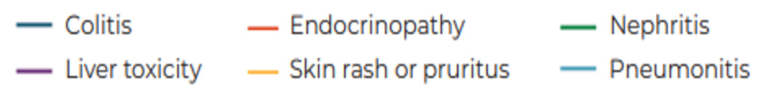
Timing of Immune-Related Adverse Events

Slide 7
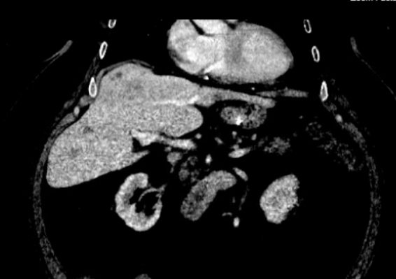
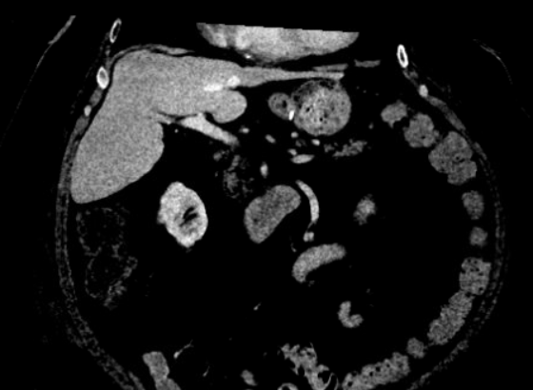
Clinical Case
2 months into treatment
62-year-old nurse with metastatic SCLC
Diagnosed with pure red cell aplasia
Prednisone was started without improvement
Treated with IVIG; maintained on long
steroid taper with resolution of anemia
Almost 3 years since starting treatment

Slide 8
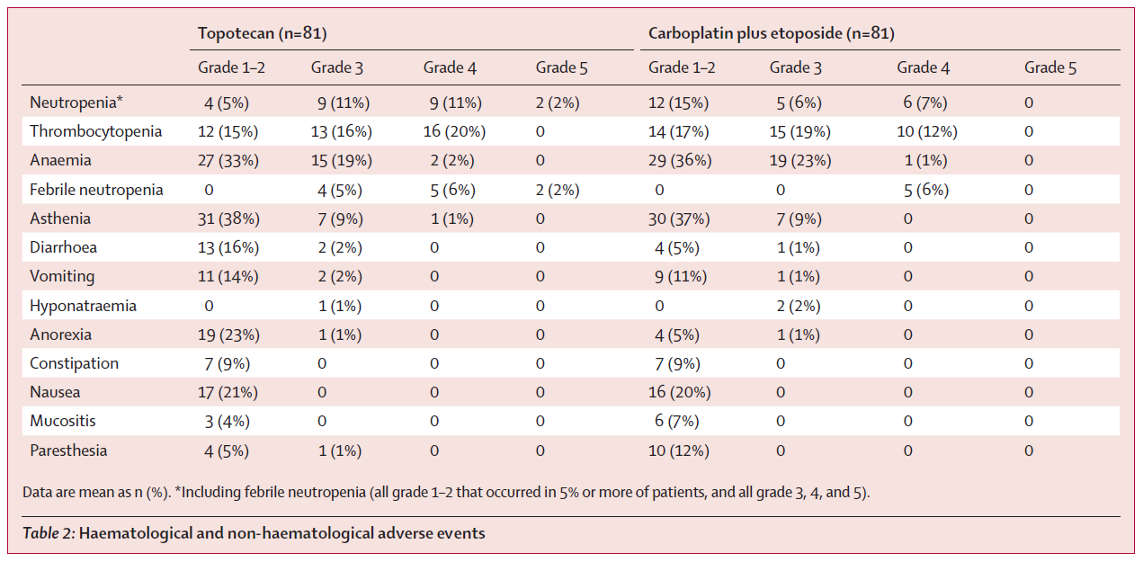
Toxicity of Platinum Re-Treatment of Topotecan

Slide 9
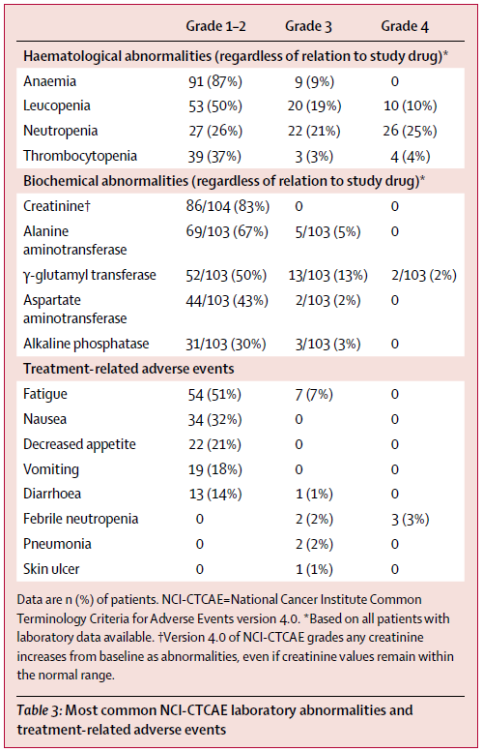
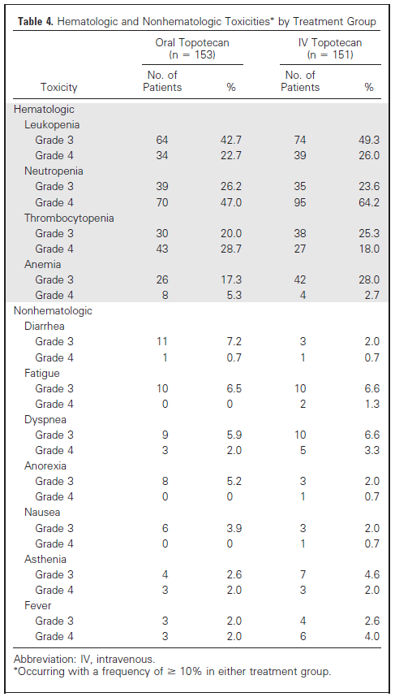
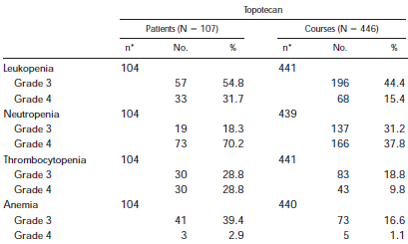
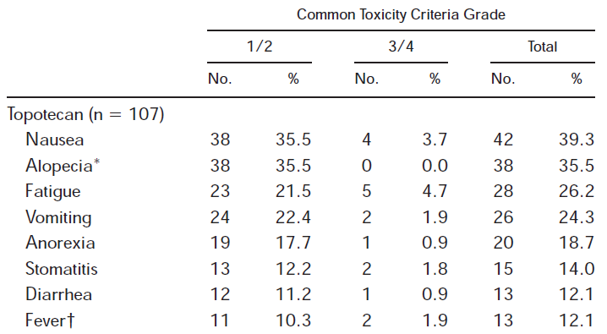
Common Second-Line Line Toxicities
Lurbinectedin¹
Topotecan PO²
Topotecan IV for days 1-5 every 21 days³

Slide 10
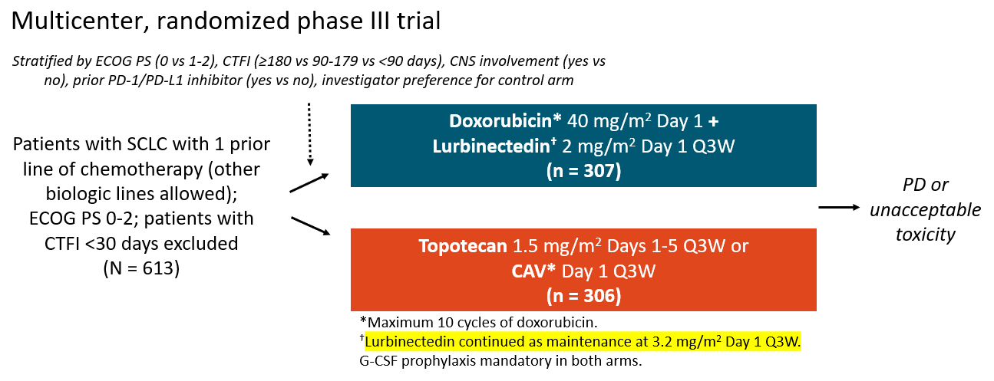
ATLANTIS

Slide 11
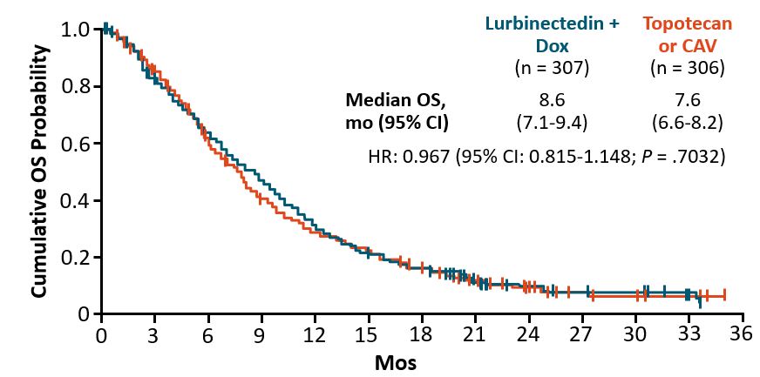
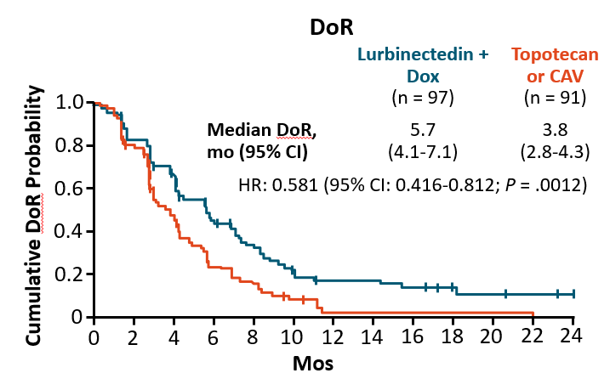
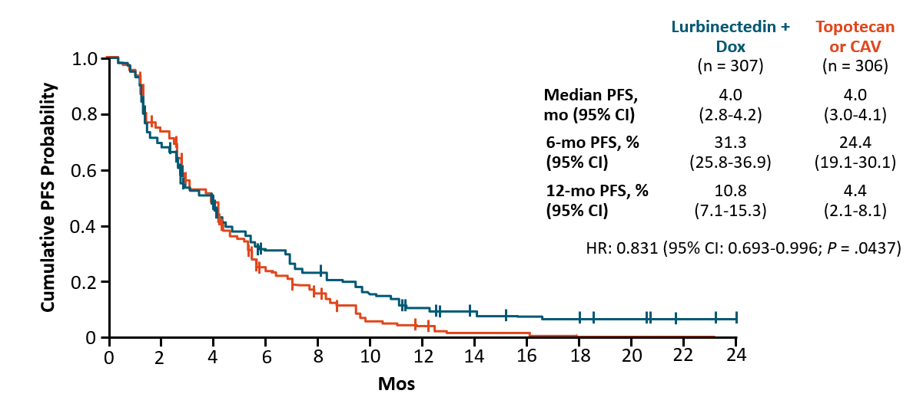
ATLANTIS
Lurbinectedin + doxorubicin combination
negative in median PFS and OS relative
to control
Lurbinectedin + doxorubicin exhibited
superior safety profile

Slide 12
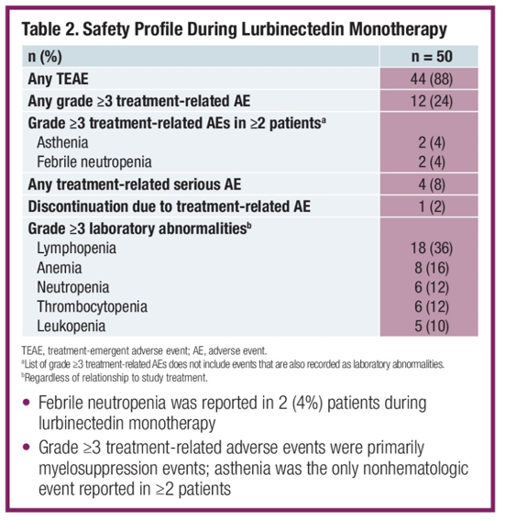
Lurbinectedin Toxicities
Safety profile of lurbinectedin after completing 10 cycles lurbinectedin in plus doxorubicin
 | Basket (n=26) | ATLANTIS*
 | Lurbinectedin Single Agent | Lurbi/DOX (n=121) | Control (CAV/topotecan) (n=118) | OR/HR (95%CI)**
Most frequent AEs, regardless of relationship (%) | Grade ≥3 | Grade ≥3 | Grade ≥3 | p-value**
Anemia | 19.2 | 23.1 | 36.4 | 0.0333
Febrile neutropenia | 3.8 | 5.0 | 9.3 | 0.2161
Fatigue | 15.4 | 13.2 | 15.3 | 0.7130
Neutropenia | 65.4 | 43.8 | 73.7 | <0.0001
Thrombocytopenia | 7.7 | 16.5 | 33.9 | 0.0027
Safety profile among patients age >65 in lurbinectedin single arm study and from ATLANTIS cohorts

Slide 13
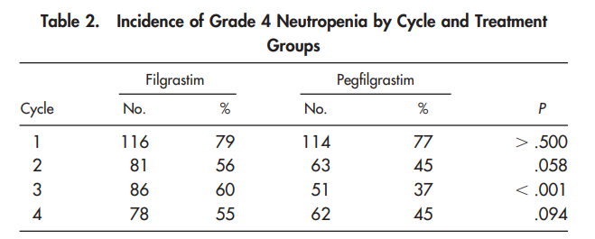
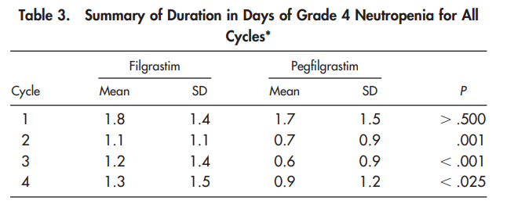
Filgrastim Versus Pegfilgrastrim (Neutropenia)
ASCO Clinical Practice Guidelines recommend use of hematopoietic colony-stimulating factors if risk of febrile neutropenia is >20%.*

Slide 14
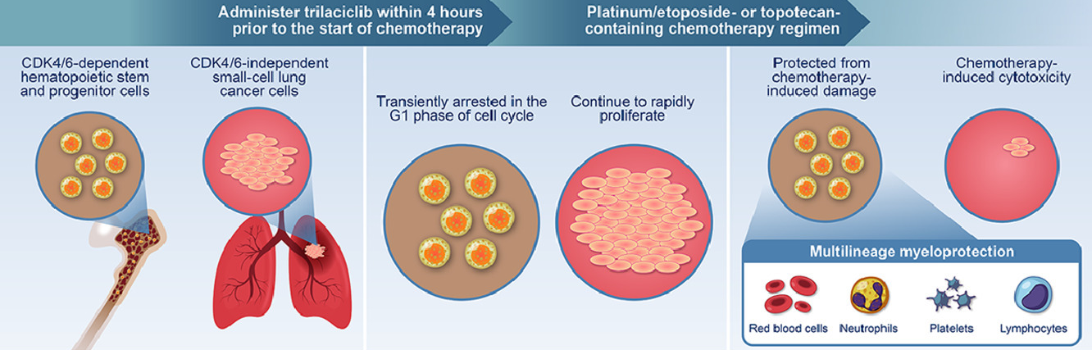
Trilaciclib for Prophylaxis in SCLC
Transient and reversible inhibitor of cyclin-dependent kinase 4 and 6
Pooled data from 3 phase 2 randomized, double-blind, placebo-controlled studies showed:
  Significant decrease in most measures of multilineage cytopenias
  Reduced need for supportive interventions and hospitalizations from cytopenias
  No significant difference in antitumor efficacy

Slide 15
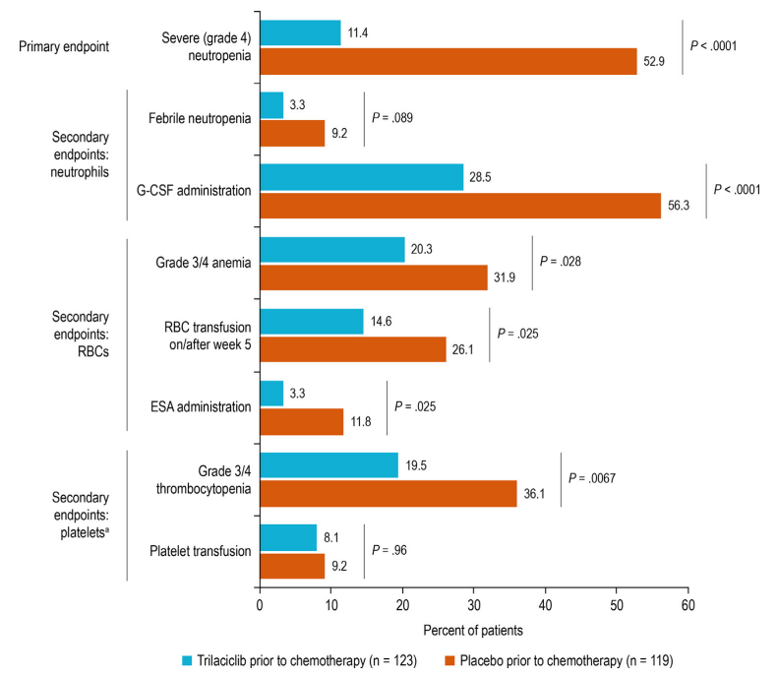
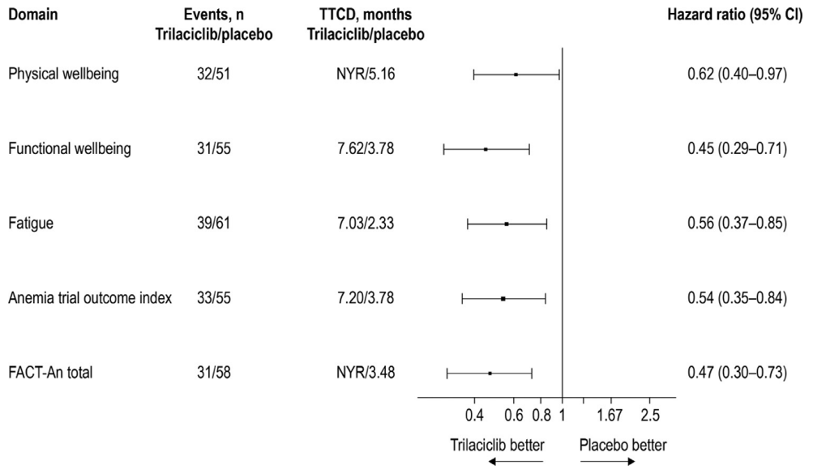
Trilaciclib Improves Quality of Life

Slide 16
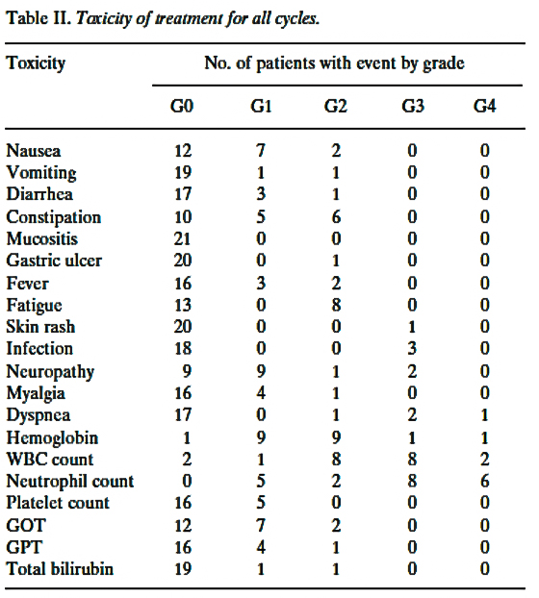
Other Regimens with Tolerable Toxicity Profile
Paclitaxel²
Irinotecan¹
Paclitaxel 80 mg/m² weekly x6 weeks for 8-week cycles in 21 patients enrolled
Table 2. Worst Toxicity by 15 Patients on CPT-11
Toxicity | WHO Grade | WHO Grade | Grade |  | No. of Patients With Grade ≥3
Toxicity | 1 2 3 4 | 2 | 3 |  | With Grade 3 | %
Leukopenia | 4 | 5 | 4 | 1 | 5 | 33
Thrombocytopenia | 0 | 1 | 0 | 0 | 0 | 0
Anemia | 6 | 1 | 3 | 0 | 3 | 20
Nausea/vomiting | 5 | 2 | 2 | 0 | 2 | 13
Diarrhea | 7 | 3 | 1 | 0 | 1 | 7
Constipation | 1 | 0 | 0 | 1 | 1 | 7
Alopecia* | 2 | 2 | 0 | 0 | 0 | 0
Pulmonary toxicity | 0 | 0 | 1 | 1 | 2 | 13
ECG abnormality | 0 | 1 | 0 | 0 | 0 | 0
Fever | 0 | 0 | 0 | 0 | 0 | 0
Elevation of serum creatinine | 0 | 0 | 0 | 0 | 0 | 0
Elevation of transaminases | 2 | 0 | 0 | 0 | 0 | 0
*N = 14

Slide 17
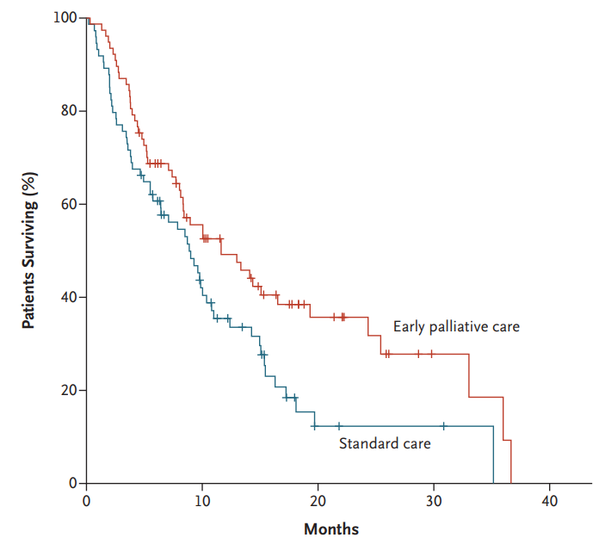
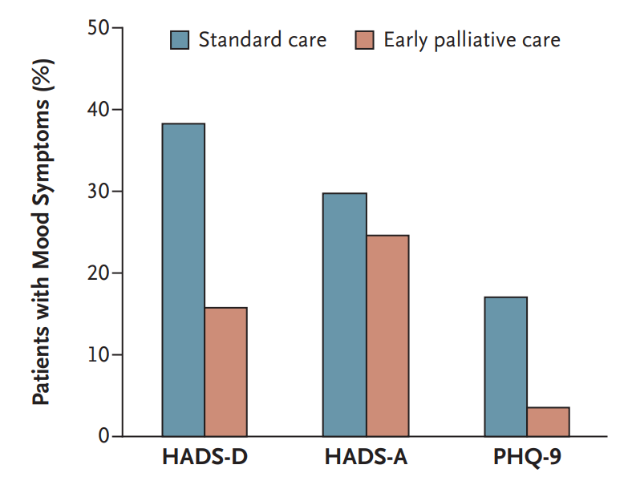
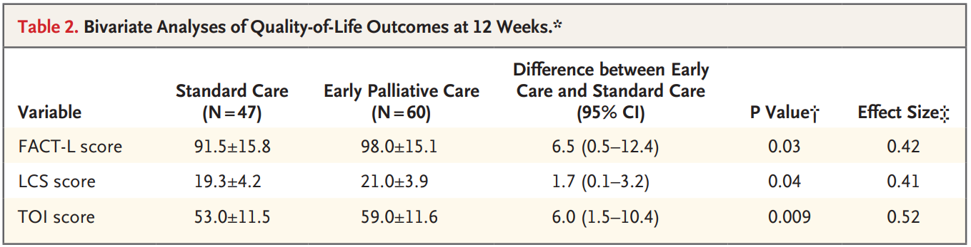
Early Palliative Care in SCLC

Slide 18
Summary
Checkpoint inhibitors have a unique toxicity profile
Cytopenias are common adverse events with cytotoxic therapy
Pegfilgrastim is effective at reducing duration and complications related to neutropenia
Trilaciclib reduces neutropenia, anemia, and thrombocytopenia and has demonstrated improvement in health-related quality of life
Including palliative care earlier can improve outcomes

Slide 19



Looking for more resources
on this topic?
CME/CE in minutes
Congress highlights
Late-breaking data
Quizzes
Webinars
In-person events
Slides & resources
www.MedEdOTG.com

