Slide 1
Case Study:
Sequencing Therapy in ES-SCLC in Special Patient Populations
Ticiana Leal, MD
Associate Professor
Department of Hematology & Oncology
Director, Thoracic Medical Oncology
Winship Cancer Institute
Emory University
Atlanta, GA

Slide 2



Resource Information
About This Resource
These slides are one component of a continuing education program available online at MedEd On The Go titled ES-SCLC: Sequencing Strategies in Previously Treated Patients
Program Learning Objectives:
Apply the latest evidence and guidelines to individualize second-line treatment plans for patients with extensive-stage small-cell lung cancer
Implement evidence-based strategies to prevent, monitor, and manage adverse effects in patients receiving second-line treatment for extensive-stage small-cell lung cancer
MedEd On The Go®
www.mededonthego.com
This content or portions thereof may not be published, posted online or used in presentations without permission.
This content can be saved for personal use (non-commercial use only) with credit given to the resource authors.
To contact us regarding inaccuracies, omissions or permissions please email us at support@MedEdOTG.com

Slide 3
Disclaimer
The views and opinions expressed in this educational activity are those of the faculty and do not necessarily represent the views of Total CME, LLC, the CME providers, or the companies providing educational grants. This presentation is not intended to define an exclusive course of patient management; the participant should use their clinical judgment, knowledge, experience, and diagnostic skills in applying or adopting for professional use any of the information provided herein. Any procedures, medications, or other courses of diagnosis or treatment discussed or suggested in this activity should not be used by clinicians without evaluation of their patient's conditions and possible contraindications or dangers in use, review of any applicable manufacturer’s product information, and comparison with recommendations of other authorities. Links to other sites may be provided as additional sources of information.

Slide 4
Clinical Case
62-year-old female former smoker was initially diagnosed with limited stage SCLC in 2021
She was treated with concurrent chemoradiation with 4 cycles of cisplatin/etoposide and prophylactic whole brain RT (PCI)
At follow-up, approximately 12 months after completion of platinum chemotherapy, PET/CT showed new retroperitoneal adenopathy and left adnexal mass
The retroperitoneal lymph node was biopsied and revealed metastatic small cell carcinoma with associated necrosis

Slide 5
Clinical Course
She initiated carboplatin/atezolizumab/etoposide x 4 cycles, followed by maintenance atezolizumab
CT scan 3 months after completion of platinum chemotherapy showed an increase in size of the left adnexal mass and retroperitoneal lymph nodes
The patient states she is feeling well, continues to work full time, and remains active
She is presenting to the medical oncology clinic to discuss further management

Slide 6
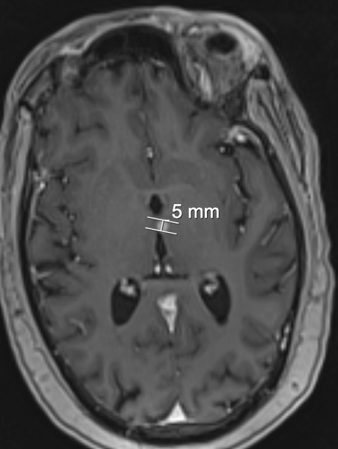
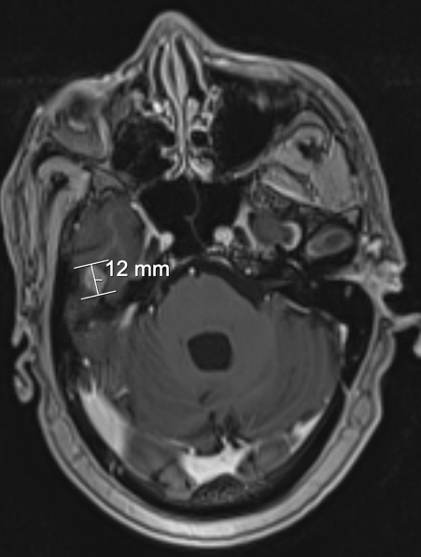
Brain MRI
Image #2
Right middle cranial fossa. Intraparenchymal
and/or extra-23axial (contiguous with the dura
and leptomeninges). This is likely dural based;
Measurement: 1.19 cm. Mild associated
edema. Mild associated mass effect.
Left thalamus, contiguous with the third
ventricle approximating the right thalamus.
Abuts the ventricular system. Mild associated
edema. Mild associated mass effect.
Image #1
Images courtesy of Ticiana Leal, MD

Slide 7

NCCN Guidelines
Subsequent Systemic Therapy for Relapsed SCLC
SCLC SUBSEQUENT SYSTEMIC THERAPY (PS 0-2) Consider dose reduction or growth factor support for patients with PS 2.
CHEMOTHERAPY-FREE INTERVAL (CTFI) >6 MONTHS
Preferred Regimens Clinical trial enrollment Re-treatment with platinum-based doublet Other Recommended Regimens Lurbinectedin Topotecan oral (PO) or intravenous (IV) Irinotecan
CTFI ≤6 MONTHS
Preferred Regimens Clinical trial enrollment Lurbinectedin Topotecan oral (PO) or intravenous (IV) Irinotecan Re-treatment with platinum-based doublet may be considered for CTFI 3-6 months Other Recommended Regimens Nivolumab or pembrolizumab (if not previously treated with an ICI) Paclitaxel Temozolomide Cyclophosphamide/doxorubicin/vincristine (CAV) Docetaxel Gemcitabine Oral etoposide

Slide 8
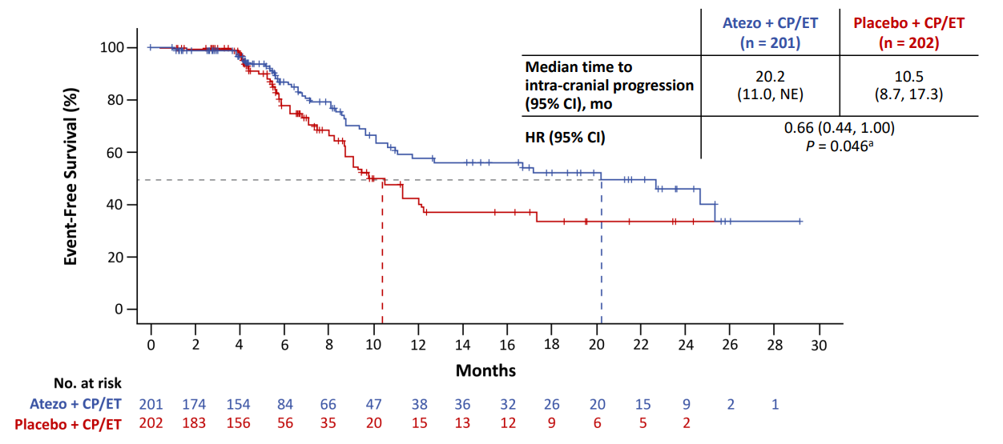
Intracranial Progression in IMpower133
(ITT Population)*
* Atezo = atezolizumab; CP/ET = carboplatin + etoposide

Slide 9
Management of Brain Metastatic Disease in Patients with ES-SCLC
Brain metastases may occur in up to 50% of patients with ES-SCLC in the course of their disease
International guidelines and surveys on care patterns still regard whole brain radiotherapy (WBRT) as a standard of care for this setting in clinical practice
Despite the continuous implementation of stereotactic radiosurgery (SRS) for patients with limited (≤4) brain metastases from various solid tumors and despite the increasing evidence of neurocognitive toxicity from WBRT, patients with brain metastases from SCLC are still considered typical candidates for WBRT

Slide 10
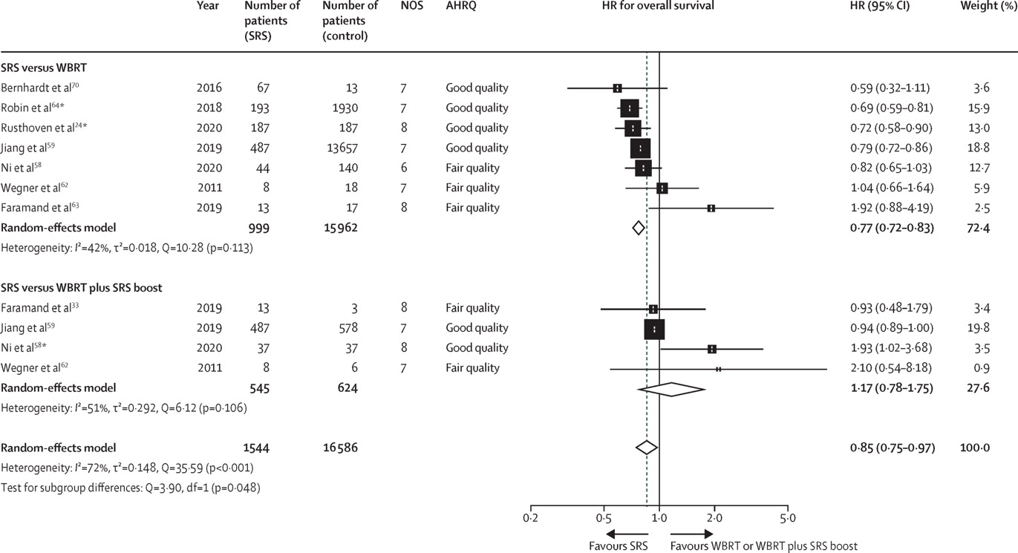
SRS Versus WBRT in SCLC
In the meta-analysis, SRS was associated with longer survival compared with WBRT with or without SRS boost (HR 0·85 [95% CI 0·75–0·97].

Slide 11
SRS Versus WBRT in SCLC
In patients with SCLC, a study on PCI with or without hippocampal avoidance has shown that (at least partial) sparing of the uninvolved brain can translate into improved preservation of cognition
In a meta-analysis, this study found no significant reduction in overall survival associated with SRS compared with WBRT with or without SRS boost, as well as SRS compared with WBRT alone
The ENCEPHALON trial is investigating the potential cognitive benefit of SRS versus WBRT in patients with SCLC

Slide 12
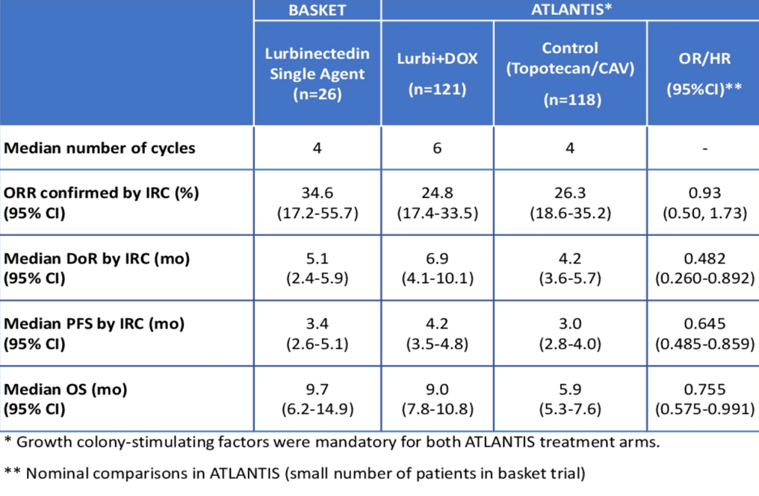
ASCO 2023: Efficacy and Safety of Lurbinectedin in Elderly Patients With Relapsed SCLC
Post hoc analysis of efficacy and safety of lurbinectedin in relapsed SCLC patients ≥65 years included in both phase 2 basket (26 patients treated with lurbinectedin) and ATLANTIS (121 patients treated with lurbinectedin/DOX and 118 patients treated in the control arm) trials
In elderly patients, lurbinectedin compared favorably to standard of care in terms of both efficacy (higher response rate and longer duration of response and overall survival) and safety (less associated hematological AEs).
This reinforces a role for lurbinectedin as a treatment option in relapsed SCLC patients ≥65 years.

Slide 13
Real-World Outcomes with Lurbinectedin in the Second-Line Setting for ES-SCLC
Within the second-line cohort:
Median age at diagnosis was 67 years; 50% were females
  Of these, 94% (47/50) had de novo SCLC, while 6% (3/50) had SCLC transformed from NSCLC
Most patients had ECOG performance status of 0 (22%) or 1 (66%) with only 10% of patients having ECOG PS of 2 or 3
52% had CTFI <90 days
54% (27/50) had CNS metastases prior to second-line lurbinectedin
All patients had previously received platinum-based chemotherapy and immunotherapy

Slide 14
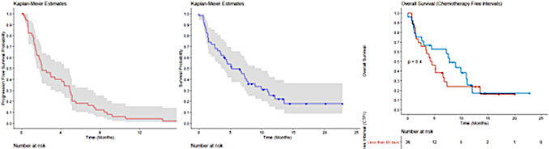
Real-World Outcomes with Lurbinectedin in the Second-Line Setting for ES-SCLC: Efficacy
Outcomes in patients who received lurbinectedin in second-line for ES-SCLC
A) Progression Free Survival
B) Overall Survival
C) Overall Survival
Stratified by CTFI

Slide 15
Real-World Outcomes with Lurbinectedin in the Second-Line Setting for ES-SCLC: Safety
In the present study, lurbinectedin was generally well tolerated
Most common adverse events included neutropenia, anemia, and fatigue
Febrile neutropenia incidence was consistent with that found in the registrational trial
  The rate of G-CSF administration was similar to that in the trial (22%)
No patients discontinued lurbinectedin therapy due to treatment-related adverse events and no grade 5 toxicities were seen

Slide 16
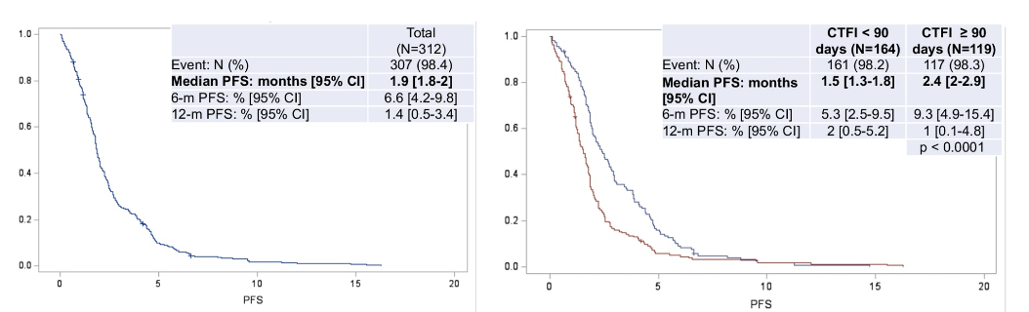
Real-World Outcomes with Lurbinectedin in the 2L setting for ES-SCLC
At multivariate analysis, only CTFI ≥ 90 was significantly associated
with more prolonged PFS.
Progression-Free Survival (PFS)

Slide 17
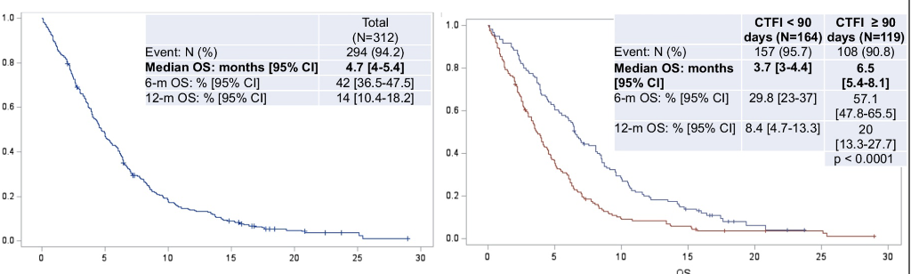
Real-World Outcomes with Lurbinectedin in the 2L setting for ES-SCLC
Overall Survival (OS)
At multivariate analysis, only performance status and CTFI ≥ 90 were significantly associated with more prolonged OS.

Slide 18
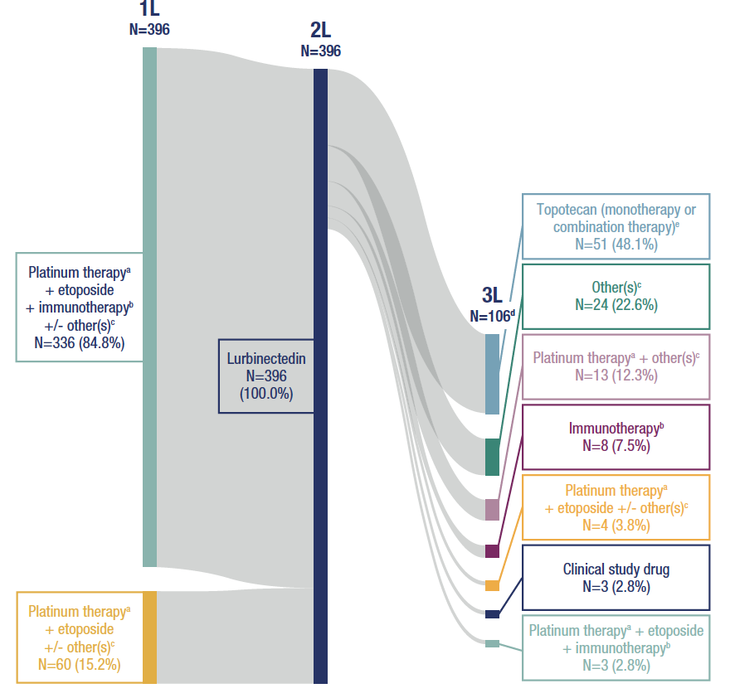
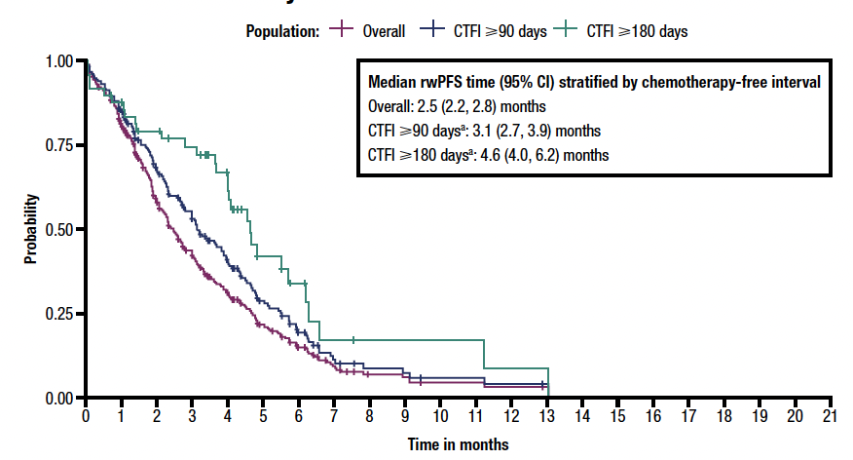
Real-World Treatment Patterns and Outcomes with Lurbinectedin in Second-Line for ES-SCLC
rwPFS for the Overall 2L Lurbinectedin Monotherapy
Population and Subsets of Patients With CTFI ≥ 90 Days
and ≥180 Days
• 84.8% of patients received immunotherapy in combination with platinum therapy in the 1L setting
• 26.8% of patients had a recorded 3L treatment after their 2L lurbinectedin treatment; 288 did not have subsequent therapy

Slide 19
Clinical Course
She underwent SRS to the two brain lesions and tolerated it well
She initiated therapy with lurbinectedin with clinical benefit

Slide 20
Summary
Treatment for patients with SCLC in the relapsed setting needs to be individualized
In patients with SCLC, a study on PCI with or without hippocampal avoidance has shown that (at least partial) sparing of the uninvolved brain can translate into improved preservation of cognition
In a meta-analysis, there was no significant reduction in overall survival associated with SRS compared with WBRT with or without SRS boost, as well as SRS compared with WBRT alone
The ENCEPHALON trial is investigating the potential cognitive benefit of SRS versus WBRT in patients with SCLC
Real-world treatment and outcomes have shown that lurbinectedin is generally well tolerated

Slide 21



Looking for more resources
on this topic?
CME/CE in minutes
Congress highlights
Late-breaking data
Quizzes
Webinars
In-person events
Slides & resources
www.MedEdOTG.com

