Slide 1
Case Study: Treatment Sequencing in Platinum-Sensitive Relapse ES-SCLC
Ticiana Leal, MD Associate Professor Department of Hematology & Oncology Director, Thoracic Medical Oncology Winship Cancer Institute Emory University Atlanta, GA

Slide 2
Resource Information
About This Resource
These slides are one component of a continuing education program available online at MedEd On The Go titled ES-SCLC: Sequencing Strategies in Previously Treated Patients
Program Learning Objectives:
Apply the latest evidence and guidelines to individualize second-line treatment plans for patients with extensive-stage small-cell lung cancer
Implement evidence-based strategies to prevent, monitor, and manage adverse effects in patients receiving second-line treatment for extensive-stage small-cell lung cancer
MedEd On The Go®
www.mededonthego.com
This content or portions thereof may not be published, posted online or used in presentations without permission.
This content can be saved for personal use (non-commercial use only) with credit given to the resource authors.
To contact us regarding inaccuracies, omissions or permissions please email us at support@MedEdOTG.com

Slide 3
Disclaimer
The views and opinions expressed in this educational activity are those of the faculty and do not necessarily represent the views of Total CME, LLC, the CME providers, or the companies providing educational grants. This presentation is not intended to define an exclusive course of patient management; the participant should use their clinical judgment, knowledge, experience, and diagnostic skills in applying or adopting for professional use any of the information provided herein. Any procedures, medications, or other courses of diagnosis or treatment discussed or suggested in this activity should not be used by clinicians without evaluation of their patient's conditions and possible contraindications or dangers in use, review of any applicable manufacturer’s product information, and comparison with recommendations of other authorities. Links to other sites may be provided as additional sources of information.

Slide 4
Clinical Case
67-year-old man with a PMHx of HTN, COPD, and HLD, and 45 pack-year smoking history presented to the ED with c/o cough and chest pain x 1 week; ECOG PS 1
Initial CXR reveals a RLL opacity; follow-up CT of the chest reveals a 4.6 cm RLL mass with associated right hilar and mediastinal LAD
Blood work notable for anemia (Hb 8.4 g/dL)
He underwent a bronchoscopy and biopsy R4 LN that revealed the diagnosis of SCLC
MRI brain is negative

Slide 5
PET/CT at Diagnosis
He is presenting to the medical oncology clinic to discuss further management
Image provided courtesy of Ticiana Leal, MD

Slide 6
Clinical Course
Patient was successfully initiated on EP + durvalumab
He completed four cycles of induction chemoimmunotherapy with delays in initiating C3 and C4 because of the delayed count recovery
He transitioned to durvalumab maintenance
Routine restaging CT scans after 7 cycles of Q4W maintenance durvalumab demonstrated multiple new or progressive hepatic lesions
ECOG PS remains preserved, and he wants to explore other therapeutic options

Slide 7
NCCN Guidelines Subsequent Systemic Therapy for Relapsed SCLC
SCLC SUBSEQUENT SYSTEMIC THERAPY (PS 0-2) Consider dose reduction or growth factor support for patients with PS 2.
CHEMOTHERAPY-FREE INTERVAL (CTFI) >6 MONTHS
Preferred Regimens Clinical trial enrollment Re-treatment with platinum-based doublet Other Recommended Regimens Lurbinectedin Topotecan oral (PO) or intravenous (IV) Irinotecan
CTFI ≤6 MONTHS
Preferred Regimens Clinical trial enrollment Lurbinectedin Topotecan oral (PO) or intravenous (IV) Irinotecan Re-treatment with platinum-based doublet may be considered for CTFI 3-6 months Other Recommended Regimens Nivolumab or pembrolizumab (if not previously treated with an ICI) Paclitaxel Temozolomide Cyclophosphamide/doxorubicin/vincristine (CAV) Docetaxel Gemcitabine Oral etoposide

Slide 8
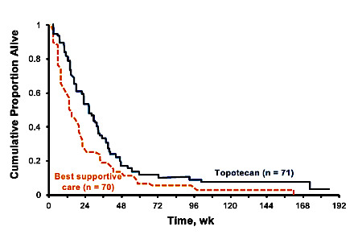
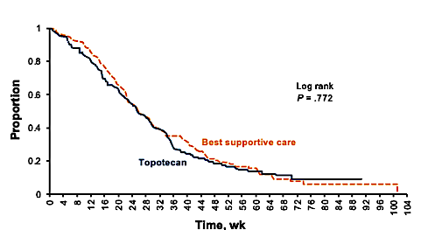
Topotecan Efficacy in SCLC
Topotecan 2.3 mg/m2/d by PO for days 1 to 5 every 21 days¹
Eligibility included chemotherapy-free interval of at least 45 days after 1L therapy
Topotecan 1.5 mg/m2/d IV for days 1 to 5 every 21 days versus CAV²
Eligibility included chemotherapy-free interval of at least 60 days after 1L therapy

Slide 9
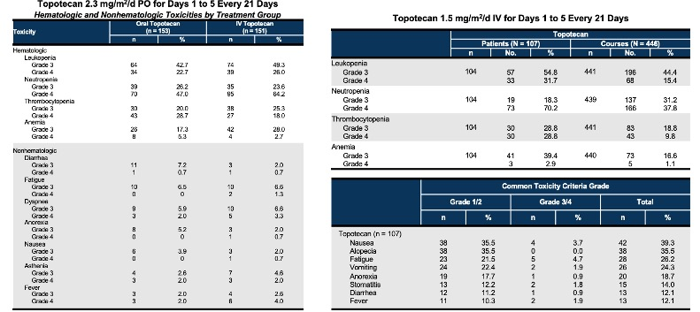
Topotecan: Safety in SCLC
O’Brien MER, et al
Pawel JV, et al

Slide 10
Platinum Doublet Rechallenge Versus Topotecan in SCLC
Topotecan
Combination chemotherapy
Topotecan (2.7 mo; 90% CI, 2.3-3.2)
Combination chemotherapy
(4.7 mo; 90% CI, 3.9-5.5)
HR = 0.57 (90% CI, 0.41-0.73)
Log-rank P = .0041
OS, %
PFS, %
Time, mo
Time, mo
High rates of crossover, almost 40% in the topotecan group

Slide 11
Lurbinectedin – A Selective Inhibitor of Oncogenic Transcription

Slide 12
Lurbinectedin as a Single Agent in Second Line SCLC: Phase II BASKET Trial

Slide 13
Lurbinectedin: Efficacy in SCLC

Slide 14
Activity of Lurbinectedin in Patients with SCLC and CTFI ≥90 Days or ≥180 Days

Slide 15
Outcomes with Lurbinectedin in Patients Assessed as Responders by IA
 |  | CTFI subgroups
 | Overall (n = 37) | <90 days (n = 10) | ≥90 days (n = 27)
Median time from randomization to response (range), weeks | 5.4 (5.0, 11.7) | 5.6 (5.0, 11.7) | 5.4 (5.0, 11.1)
Median duration of response (95% CI), months | 5.3 (4.1, 6.4) | 4.7 (2.6, 5.6) | 6.2 (3.5, 7.3)
Median OS (95% CI), months | 12.6 (10.8, 15.8) | 10.9 (6.3, 14.0) | 15.8 (10.2, NR)
OS at 12 months, % | 54.3% | 40.0% | 60.0 %

Slide 16
Lurbinectedin: Safety in SCLC

Slide 17
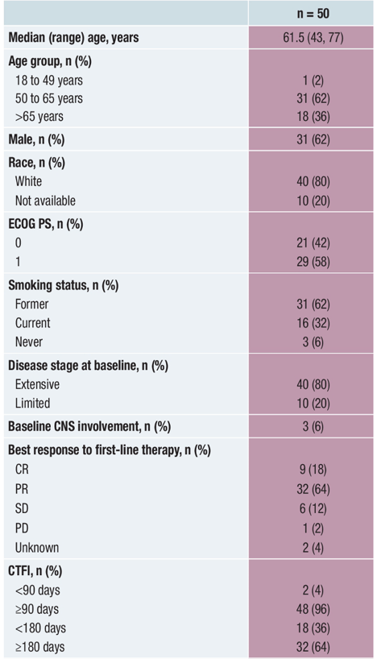
Analysis of Patients with Relapsed SCLC Receiving Lurbinectedin in the Phase 3 ATLANTIS Trial
Baseline Characteristics

Slide 18
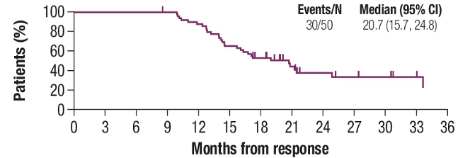
Analysis of Patients with Relapsed SCLC Receiving Lurbinectedin in the Phase 3 ATLANTIS Trial

Slide 19
Clinical Course: Second-Line Treatment
The patient was initiated on lurbinectedin
Patient tolerated treatment well, but progression was noted after four cycles of lurbinectedin with an increasing number of hepatic metastases and mediastinal adenopathy
Patient remains with preserved PS and inquires about other treatment options

Slide 20
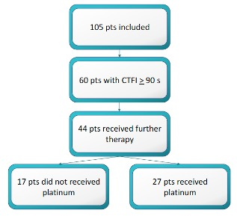
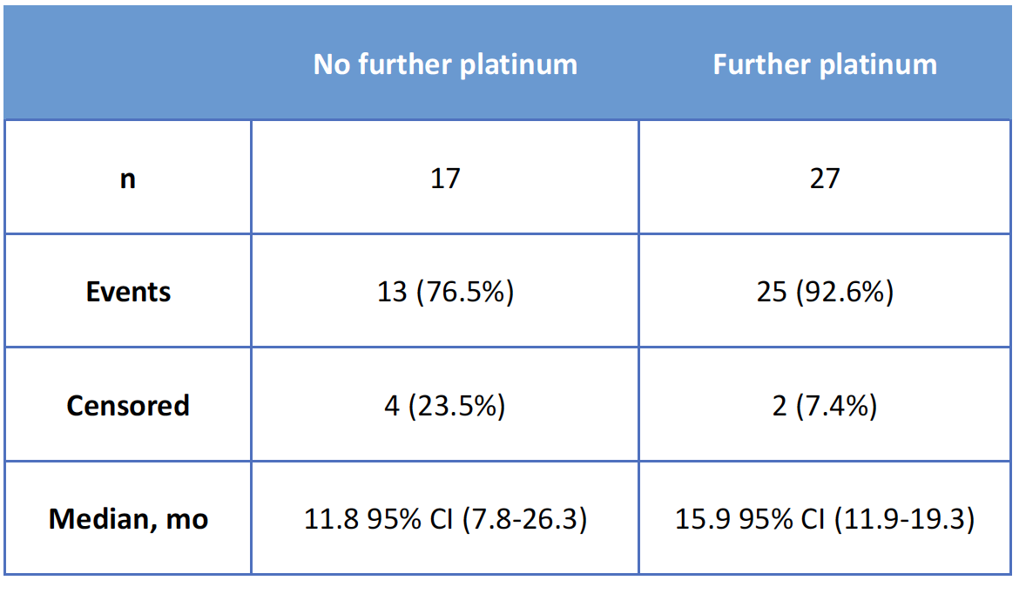
Efficacy of Platinum Given after Lurbinectedin: Post Hoc Exploratory Analysis

Slide 21
Take Home Points
Treatment for patients with SCLC in the relapsed setting needs to be individualized.
Platinum rechallenge is an option for patients with platinum-sensitive disease in the relapsed setting
However, there was no significant difference in OS compared to topotecan
Lurbinectedin as single agent remains an option for salvage therapy, preferably in platinum-sensitive disease

Slide 22
Looking for more resources on this topic?
CME/CE in minutes
Congress highlights
Late-breaking data
Quizzes
Webinars
In-person events
Slides & resources
www.MedEdOTG.com

