Slide 1
Seralutinib for Treatment of Group 1 PAH
Oksana A. Shlobin, MD
Medical Director, Pulmonary Hypertension Program
Inova Fairfax Hospital
Associate Professor, University of Virginia School of Medicine
Associate Professor, Georgetown University School of Medicine
Falls Church, VA

Slide 2



Resource Information
About This Resource
These slides are one component of a continuing education program available online at MedEd On The Go titled Emerging PH Therapeutics, The Promise of a New Future
Program Learning Objectives:
Discuss how ongoing phase 3 and 4 trial results within the PH community will impact care moving forward
Understand the potential of utilizing novel molecular mechanisms of disease to affect the pathological progression of PH and the potential for treatment combinations to attack parallel disease pathways
MedEd On The Go®
www.mededonthego.com
This content or portions thereof may not be published, posted online or used in presentations without permission.
This content can be saved for personal use (non-commercial use only) with credit given to the resource authors.
To contact us regarding inaccuracies, omissions or permissions please email us at support@MedEdOTG.com

Slide 3
Disclaimer
The views and opinions expressed in this educational activity are those of the faculty and do not necessarily represent the views of Total CME, LLC, the CME providers, or the companies providing educational grants. This presentation is not intended to define an exclusive course of patient management; the participant should use their clinical judgment, knowledge, experience, and diagnostic skills in applying or adopting for professional use any of the information provided herein. Any procedures, medications, or other courses of diagnosis or treatment discussed or suggested in this activity should not be used by clinicians without evaluation of their patient's conditions and possible contraindications or dangers in use, review of any applicable manufacturer’s product information, and comparison with recommendations of other authorities. Links to other sites may be provided as additional sources of information.

Slide 4
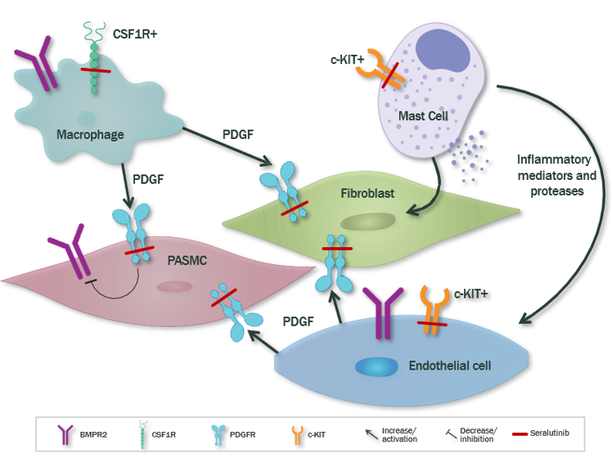
Seralutinib: Mechanism of Action
CSF1R+ macrophages secrete PDGF and contribute to inflammation and vascular remodeling
C-KIT+ cells are increased and further drive
the inflammatory and proliferative disease processes
Aberrant PDGFR signaling drives overgrowth
of vascular smooth muscle cell myofibroblasts, leading to medial hypertrophy, neointimal lesions and fibrosis
PDGF activation decreases BMPR2, which further drives pulmonary arterial smooth muscle cell proliferation
Seralutinib targets PDGFα/β, CSF1R and c-KIT and modulates expression of BMPR2

Slide 5
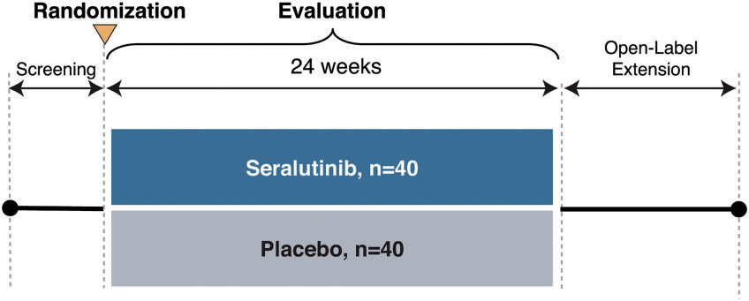
The TORREY Phase 2 Trial Design
A 24-week double-blind placebo-controlled study with 1:1 randomization (n = 86 with 42 patients in placebo & 44 seralutinib groups)
Inclusion criteria
  FC II-III on standard stable PAH therapy, including triple therapy
  PVR ≥ 5 WU
Dose titrated in range of 45 to 90mg BID
Endpoints
  Primary: PVR change from baseline
  Secondary: 6MWD change from baseline
Treatment completion: 41 placebo and 37 seralutinib patients
  15.9% discontinued treatment
  (13.6% due to SEs)
  13.6% withdrew from the study
  (9.1% due to SAEs)
Just over 50% of patients on triple therapy
Torrey Phase 2 Design

Slide 6
TORREY 2: Patient Baseline Characteristics
Characteristic | Placebo (N = 42) | Seralutinib (N = 44) | Total (N = 86)
Age at PAH Diagnosis (y), mean ± SD | 41.2 ± 11.65 | 40.7 ± 15.84 | 40.9 ± 13.87
Years since PAH diagnosis – mean ± SD | 8.78 ± 7.218 | 8.07 ± 7.074 | 8.41 ± 7.111
PAH Classification n (%)
Idiopathic | 22 (52.4) | 20 (45.5) | 42 (48.8)
Heritable | 5 (11.9) | 10 (22.7) | 15 (17.4)
Associated with:
CTD | 11 (26.2) | 6 (13.6) | 17 (19.8)
Anorexigen Use | 0 | 3 (6.8) | 3 (3.5)
Methamphetamine Use | 4 (9.5) | 4 (9.1) | 8 (9.3)
Corrected Congenital Shunts | 0 | 3 (6.8) | 3 (3.5)
WHO FC – n (%)
Class II | 20 (47.6) | 30 (68.2) | 50 (58.1)
Class III | 22 (52.4) | 14 (31.8) | 36 (41.9)
REVEAL 2.0 Risk Score ≥ 6.0 – n (%) | 17 (40.5) | 20 (45.5) | 37 (43.0)
PVR (dyn・sec/cm⁵) | 661.3 ± 164.91 | 675.8 ± 240.35 | 668.7 ± 205.90
6MWD (m) – mean ± SD | 407.1 ± 107.02 | 408.6 ± 75.11 | 407.9 ± 91.54
NT-proBNP (ng/L) – mean ± SD | 645.6 ± 1158.75 | 611.0 ± 714.580 | 628.3 ± 956.83

Slide 7
TORREY 2: Demographics by WHO-FC
 | Baseline WHO FC Class II |  |  |  | Baseline WHO FC Class III
Characteristic | Placebo (N = 20) | Seralutinib (N = 30) | Total (N = 50) |  | Placebo (N = 22) | Seralutinib (N = 14) | Total (N = 36)
Age (y), mean ± SD | 47.6 ± 11.69 | 47.7 ± 13.42 | 47.7 ± 12.63 |  | 51.1 ± 11.94 | 49.4 ± 11.40 | 50.4 ± 11.60
Female, n (%) | 19 (95.0) | 27 (90.0) | 46 (42.0) |  | 19 (86.4) | 13 (92.9) | 32 (88.9)
Race, White – n (%) | 19 (95.0) | 24 (80.0) | 43 (86.0) |  | 18 (81.8) | 13 (92.9) | 31 (86.1)
Region, North America – n (%) | 13 (65.0) | 20 (66.7) | 33 (66.0) |  | 17 (77.3) | 9 (64.3) | 26 (72.2)
Years Since PAH Diagnosis – mean ± SD | 9.60 ± 7.262 | 8.40 ± 6.961 | 8.88 ± 7.034 |  | 8.02 ± 7.263 | 7.36 ± 7.527 | 7.76 ± 7.266
PAH Classification n (%)
Idiopathic | 11 (55.0) | 16 (53.3) | 27 (54.0) |  | 11 (50.0) | 4 (26.6) | 15 (41.7)
Heritable | 4 (20.0) | 6 (20.0) | 10 (20.0) |  | 1 (4.5) | 4 (28.6) | 5 13.9)
Associated with CTD | 5 (25.0) | 5 (16.7) | 10 (20.0) |  | 6 (27.3) | 1 (7.1) | 7 )19.4)
REVEAL 2.0 Risk Score ≥ 6.0 – n (%) | 4 (20.0) | 11 (36.7) | 15 (30.0) |  | 13 (59.1) | 9 (64.3) | 22 (61.1)
PVR (dyn・sec/cm⁵) | 638.3 ± 161.85 | 689.9 ± 265.72 | 669.3 ± 229.34 |  | 682.2 ± 168.62 | 645.7 ± 179.29 | 668.0 ± 171.25
6MWD (m) – mean ± SD | 455.5 ± 63.96 | 525.5 ± 62.98 | 437.5 ± 64.45 |  | 363.2 ± 120.05 | 372.4 ± 87.97 | 366.8 ± 107.43
NT-proBNP (ng/L) – mean ± SD | 406.8 ± 798.39 | 609.9 ± 725.3 | 525.3 ± 749.58 |  | 873.0 ± 1403.06 | 613.3 ± 742.17 | 773.7 ± 1187.34
On 3 Background Therapies – n (%) | 11 (55.0) | 18 (60.0) | 29 (58.0) |  | 13 (59.1) | 7 (50.0) | 20 (55.6)
ERA + PDE5i + Prostacyclin/PRA | 8 (40.0) | 16 (53.3) | 24 (48.0) |  | 10 (45.5) | 6 (42.9) | 16 (44.4)
ERA + sGC + Prostacyclin/PRA | 3 (15.0) | 2 (6.7) | 5 (50.0) |  | 3 (13.6) | 1 (7.1) | 4 (11.1)

Slide 8
TORREY Phase 2: Top Line Results
Met primary endpoint of statistically significant PVR reduction of 14% with enhanced effect in patients with more severe disease
  FC III at baseline: PVR drop of 21%
  REVEAL 2.0 ≥ 6 at baseline:
  decrease of 23%
6MWD favored seralutinib (+6.5m) with enhanced effect in patients with more severe disease
  FC III patients: +37.3m
  Reveal 2.0 ≥ 6 at baseline: +21.9m
Statistically significant reduction in NT-proBNP
Statistically significant reduction in ECHO assessed RV parameters
  RA area
  RV free wall strain
  PA compliance
30/39 seralutinib patients improved or maintained baseline REVEAL 2.0 risk score

Slide 9
Summary
Inhaled seralutinib resulted in statistically significant PVR reduction
6MWD favored seralutinib (+6.5m) with enhanced effect in patients with more severe disease
The results are supported by NT-proBNP and ECHO RV parameters

Slide 10
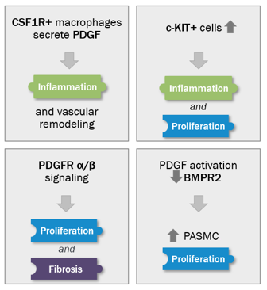
Seralutinib Mechanism of Action
Abnormal signaling of PDGF (present on pulmonary arterial smooth muscle cells), CSF1R (present on macrophages), c-KIT+ (found on endothelial cells) and BMPR2 deficiency drive cellular overgrowth in lung vasculature and play a key role in pathogenesis of PAH
Seralutinib (tyrosine kinase inhibitor) modulates expression of BMPR2 by targeting the above cytokines
Seralutinib is delivered by dry powder inhalation to maximize the effect of the drug on pulmonary vasculature

Slide 11



Looking for more resources
on this topic?
CME/CE in minutes
Congress highlights
Late-breaking data
Quizzes
Webinars
In-person events
Slides & resources
www.MedEdOTG.com

