Slide 1
Imatinib for Group 1 PAH
Oksana A. Shlobin, MD
Medical Director, Pulmonary Hypertension Program
Inova Fairfax Hospital
Associate Professor, University of Virginia School of Medicine
Associate Professor, Georgetown University School of Medicine
Falls Church, VA

Slide 2
Resource Information
About This Resource
These slides are one component of a continuing education program available online at MedEd On The Go titled Emerging PH Therapeutics, The Promise of a New Future
Program Learning Objectives:
Discuss how ongoing phase 3 and 4 trial results within the PH community will impact care moving forward
Understand the potential of utilizing novel molecular mechanisms of disease to affect the pathological progression of PH and the potential for treatment combinations to attack parallel disease pathways
MedEd On The Go®
www.mededonthego.com
This content or portions thereof may not be published, posted online or used in presentations without permission.
This content can be saved for personal use (non-commercial use only) with credit given to the resource authors.
To contact us regarding inaccuracies, omissions or permissions please email us at support@MedEdOTG.com

Slide 3
Disclaimer
The views and opinions expressed in this educational activity are those of the faculty and do not necessarily represent the views of Total CME, LLC, the CME providers, or the companies providing educational grants. This presentation is not intended to define an exclusive course of patient management; the participant should use their clinical judgment, knowledge, experience, and diagnostic skills in applying or adopting for professional use any of the information provided herein. Any procedures, medications, or other courses of diagnosis or treatment discussed or suggested in this activity should not be used by clinicians without evaluation of their patient's conditions and possible contraindications or dangers in use, review of any applicable manufacturer’s product information, and comparison with recommendations of other authorities. Links to other sites may be provided as additional sources of information.

Slide 4
Imatinib: Unique Mechanism of Action
Antiproliferative agent and tyrosine kinase inhibitor originally developed to target the BCR-ABL tyrosine kinase in patients with chronic myeloid leukemia¹
Inhibits PDGF receptors α and β, KIT, DDR, CSF1R and ABL, some of which have been implicated in PAH¹⁻³
Imatinib: Reversed experimentally-induced pulmonary hypertension³; has pulmonary vasodilatory effects in animal models⁴ and proapoptotic effects on pulmonary artery smooth muscle cells from patients with idiopathic PAH
Randomized, double-blind, placebo-controlled phase II study in 59 patients reported that imatinib significantly improved pulmonary hemodynamics⁵
Does not target signals that maintain homeostasis in pulmonary vasculature

Slide 5
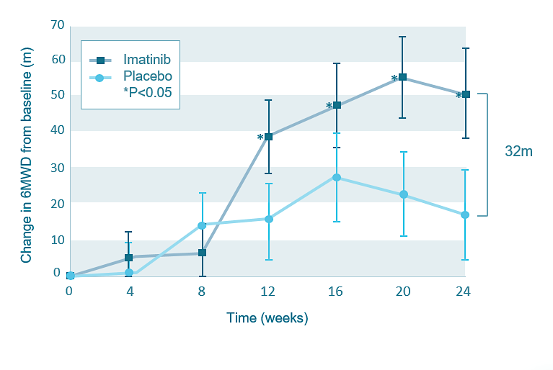
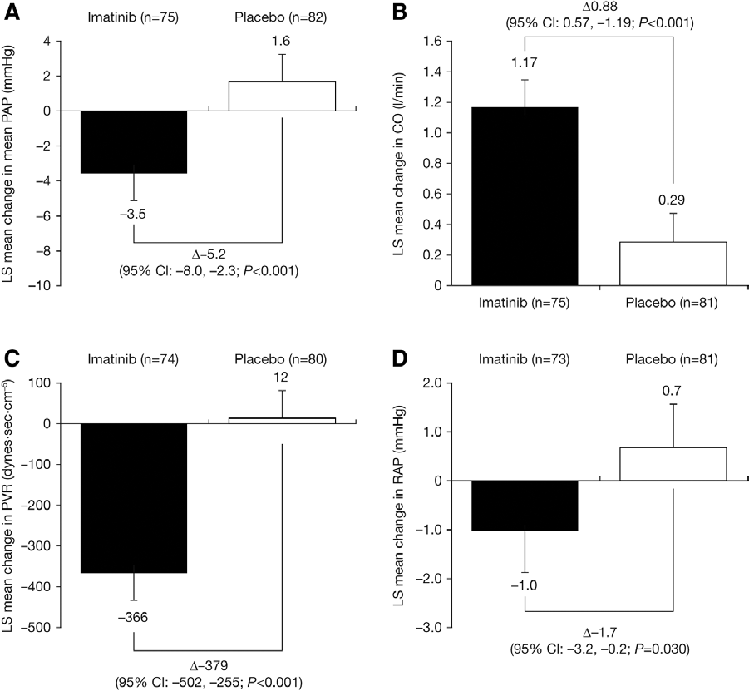
Phase 3 IMPRESS Trial of Oral Imatinib FC II-IV patients were on at least 2 background therapies
Least Squares (LS) Mean Changes from Baseline to End of Study
mPAP
Cardiac Output
Change in 6MWD from Baseline by Treatment
PVR
RAP
Values = least squares means and SEs
P values are for between-group comparisons from ANCOVA of change from baseline in 6MWD (m) at each time
69 patients receiving imatinib and 81 patients receiving placebo completed the study

Slide 6
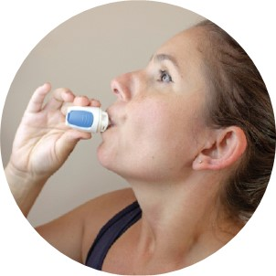
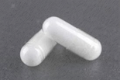
AV-101 Inhaled Dry Powder Imatinib
Deliver drug to the lungs
Limit systemic exposure
Dosing: 2 capsules BID via CDA-Haler®
Phase 1 trial showed safety and tolerability
No serious adverse events reported
No change in pulmonary function (FEV1 and FVC), oxygen saturation, or QTc interval
Most common AE, cough, occurred mostly at max dose and was limited to within 30 minutes of dosing

Slide 7
IMPAHCT: Adaptive Continuous Trial of AV-101
Phase 2b Primary Endpoint:
Change from baseline at week 24 in PVR
Phase 3 Primary Endpoint: Change from baseline at week 24 in 6MWD*
Rolling Enrollment
Subjects 1-200
Subject 201 until optimal dose selection
Optimal dose selection and onward
Phase 2b
Intermediate Phase
Phase 3
Patients from all 3 parts have the option to continue in the LTE**
PART 1
PART 2
PART 3
10 mg (n=50)
10 mg
Optimal Dose
35 mg (n=50)
35 mg
70 mg (n=50)
70 mg
Placebo
Placebo (n=50)
Placebo
24 weeks
24 weeks
24 weeks

Slide 8
IMPAHCT: Key Inclusion/Exclusion Criteria & Endpoints
Inclusion Criteria
Exclusion Criteria
Males/females 18-75 years of age at screening within 28 days before Day 1
Group 1 PAH
IPAH/HPAH
CTD-PAH
PAH due to drugs/toxins
HIV-associated
PAH due to repaired congenital heart disease (at least 1 year since repair)
PVR > 400 dynes•sec/cm⁵
On at least two background PAH medications
6MWD 100 – 475m
Vit K, DOACs, antiplatelet therapy within 2 weeks
Inhaled prostacyclins
Primary Endpoints
Phase 2b:
Change in PVR @24 weeks
Phase 3:
Change in 6MWD @24 weeks

Slide 9
IMPAHCT: Key Secondary and Exploratory Endpoints
Phase 2b
Phase 3
Change from baseline at Week 24:
6MWD
NT-proBNP
Hemodynamic measures
Incidence of Clinical Worsening events
Achieving the multi-component improvement parameters
Improvement at Week 24 in WHO Functional Class
Change in REVEAL Lite 2.0 risk score
Change from baseline at Week 24 in QoL
Change from baseline at Week 24 in NT-proBNP
Time to Clinical Worsening events
Achieving the multi-component improvement parameters
Improvement at Week 24 in WHO Functional Class
Change in REVEAL Lite 2.0 risk score
Change from baseline at Week 24 in QoL
Exploratory Endpoints
Change from baseline at Week 24 in echocardiographic measures of right ventricular function

Slide 10
Looking for more resources on this topic?
CME/CE in minutes
Congress highlights
Late-breaking data
Quizzes
Webinars
In-person events
Slides & resources
www.MedEdOTG.com

