Slide 1
Gene- and Nano-therapy for PAH: Could This Be the Future?
Sudarshan Rajagopal, MD, PhD
Associate Professor of Medicine
Co-Director, Pulmonary Vascular Disease Center
Duke University School of Medicine
Durham, NC

Slide 2



Resource Information
About This Resource
These slides are one component of a continuing education program available online at MedEd On The Go titled Emerging PH Therapeutics, The Promise of a New Future
Program Learning Objectives:
Discuss how ongoing phase 3 and 4 trial results within the PH community will impact care moving forward
Understand the potential of utilizing novel molecular mechanisms of disease to affect the pathological progression of PH and the potential for treatment combinations to attack parallel disease pathways
MedEd On The Go®
www.mededonthego.com
This content or portions thereof may not be published, posted online or used in presentations without permission.
This content can be saved for personal use (non-commercial use only) with credit given to the resource authors.
To contact us regarding inaccuracies, omissions or permissions please email us at support@MedEdOTG.com

Slide 3
Disclaimer
The views and opinions expressed in this educational activity are those of the faculty and do not necessarily represent the views of Total CME, LLC, the CME providers, or the companies providing educational grants. This presentation is not intended to define an exclusive course of patient management; the participant should use their clinical judgment, knowledge, experience, and diagnostic skills in applying or adopting for professional use any of the information provided herein. Any procedures, medications, or other courses of diagnosis or treatment discussed or suggested in this activity should not be used by clinicians without evaluation of their patient's conditions and possible contraindications or dangers in use, review of any applicable manufacturer’s product information, and comparison with recommendations of other authorities. Links to other sites may be provided as additional sources of information.

Slide 4
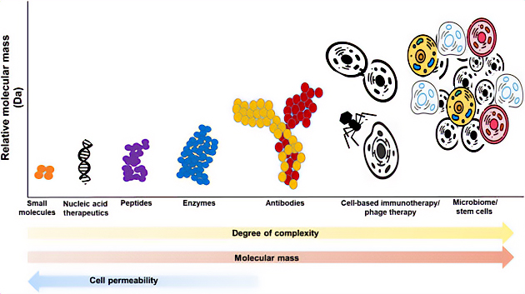
Different Types of Therapeutics
Small molecules
Peptides
Biologics
  Proteins
  Antibodies
Gene Therapy
  Antisense therapies
  Adenovirus
  CRISPR
Cellular Therapies
  CAR-T cells
  Stem cells

Slide 5
FDA-Approved Small Molecules and Biologics

Slide 6
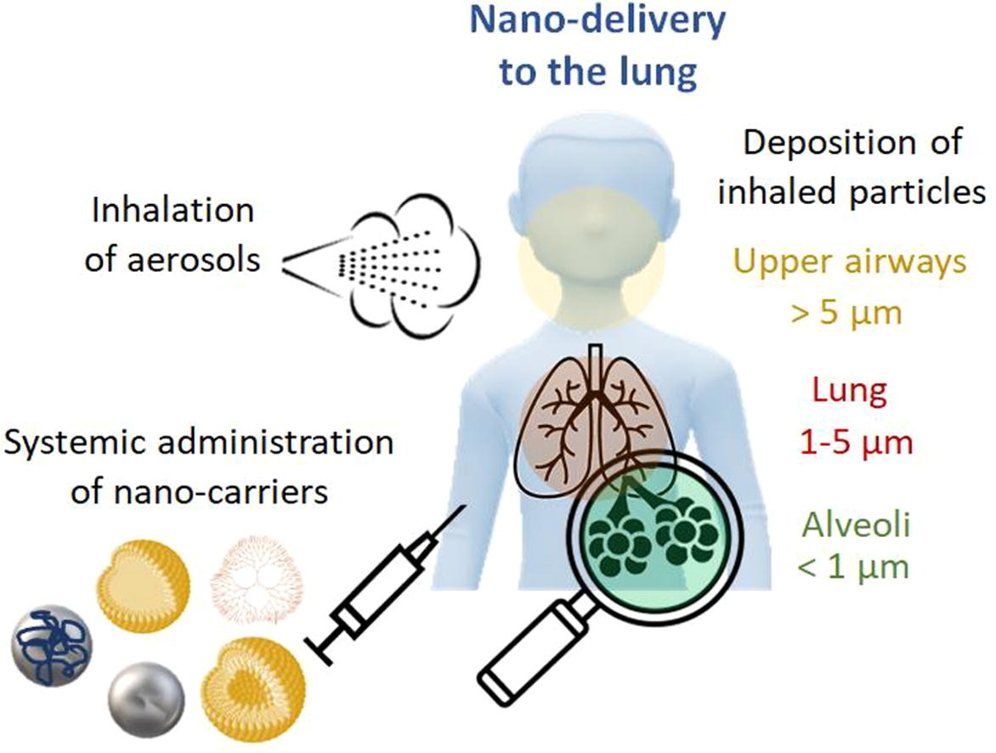
Nano-delivery Systems to the Lungs

Slide 7
New Therapeutic Modalities in PAH
Sotatercept – a biologic antibody that targets activins
New formulations
of drugs for inhaled therapy
Gene therapy approaches
Exosome-based therapies
Stem cell therapies

Slide 8
Summary
We now have several different ways of developing new drugs to treat disease such as PAH
Current FDA-approved therapies for PAH are small molecules
Future therapies in PAH include biologics and novel delivery systems for different formulations of drugs that directly target the lungs
These new approaches have promising potential to better target the molecular abnormalities in PAH or target the lung directly with fewer systemic side effects

Slide 9



Looking for more resources
on this topic?
CME/CE in minutes
Congress highlights
Late-breaking data
Quizzes
Webinars
In-person events
Slides & resources
www.MedEdOTG.com

