Slide 1
Emerging Therapeutics: The Potential of Targeting the Serotonin Pathway in PAH
Sudarshan Rajagopal, MD, PhD Associate Professor of Medicine Co-Director, Pulmonary Vascular Disease Center Duke University School of Medicine Durham, NC

Slide 2
Resource Information
About This Resource
These slides are one component of a continuing education program available online at MedEd On The Go titled Emerging PH Therapeutics, The Promise of a New Future
Program Learning Objectives:
Discuss how ongoing phase 3 and 4 trial results within the PH community will impact care moving forward
Understand the potential of utilizing novel molecular mechanisms of disease to affect the pathological progression of PH and the potential for treatment combinations to attack parallel disease pathways
MedEd On The Go®
www.mededonthego.com
This content or portions thereof may not be published, posted online or used in presentations without permission.
This content can be saved for personal use (non-commercial use only) with credit given to the resource authors.
To contact us regarding inaccuracies, omissions or permissions please email us at support@MedEdOTG.com

Slide 3
Disclaimer
The views and opinions expressed in this educational activity are those of the faculty and do not necessarily represent the views of Total CME, LLC, the CME providers, or the companies providing educational grants. This presentation is not intended to define an exclusive course of patient management; the participant should use their clinical judgment, knowledge, experience, and diagnostic skills in applying or adopting for professional use any of the information provided herein. Any procedures, medications, or other courses of diagnosis or treatment discussed or suggested in this activity should not be used by clinicians without evaluation of their patient's conditions and possible contraindications or dangers in use, review of any applicable manufacturer’s product information, and comparison with recommendations of other authorities. Links to other sites may be provided as additional sources of information.

Slide 4
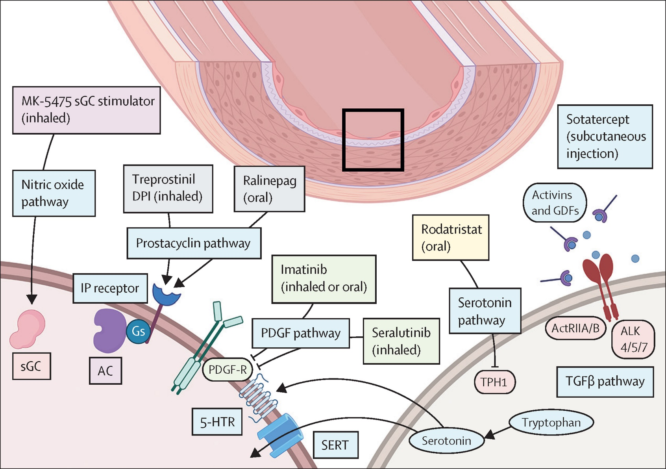
The Science Behind Current PAH Clinical Trials

Slide 5
Drugs that Target Serotonin Are Associated with PAH Development (2022 ESC/ERS)
Drugs Definitely Associated With PAH Development
Aminorex
Benfluorex
Dasatinib
Dexfenfluramine
Fenfluramine
Methamphetamines
Toxic Rapeseed Oil

Slide 6
The Role of Serotonin in PAH
Endothelium
Tryptophan Hydroxylase 1
Stimulus (e.g. hypoxia, PAH)
Serotonin
Serotonin
Serotonin
BMPR-II
BMPR-I
-ve
BMP
Heterodimer
Formation
Kv1.5
Activation of Receptor I
5HT2A
5HT1B
SERT
PO₄
Serotonin
PO₄
ROS
MAPK
ROCK
-ve
Smad 1,5,8
R-Smad
Contraction
Smad 4
Nuclear Growth Factors
lds
Nucleus
Proliferation
Smooth Muscle Cell

Slide 7
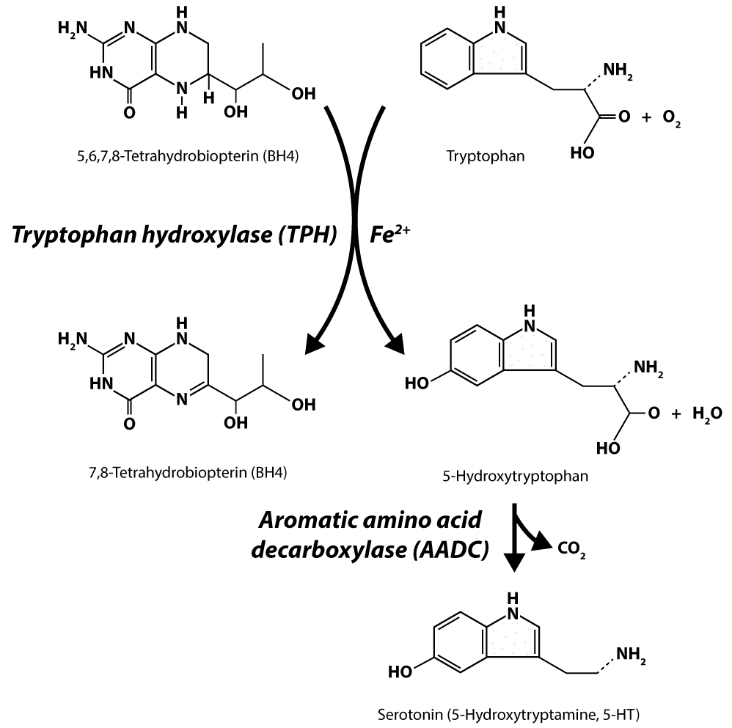
Targeting Serotonin Biosynthesis Through Tryptophan Hydroxylase
Tryptophan
Tryptophan
TPH1
TPH2
Serotonin
Serotonin
Peripheral
Effects
Central
Effects
Migraine
Immune
System
Sleep
Anxiety
Hemostasis
Vasoconstriction
Epilepsy
Aggression
Melatonin Synthesis
Schizophrenia
Food Intake
Depression

Slide 8
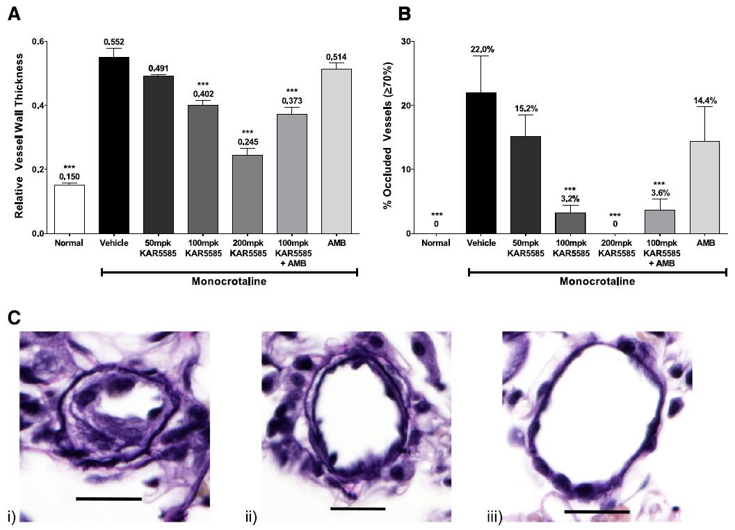
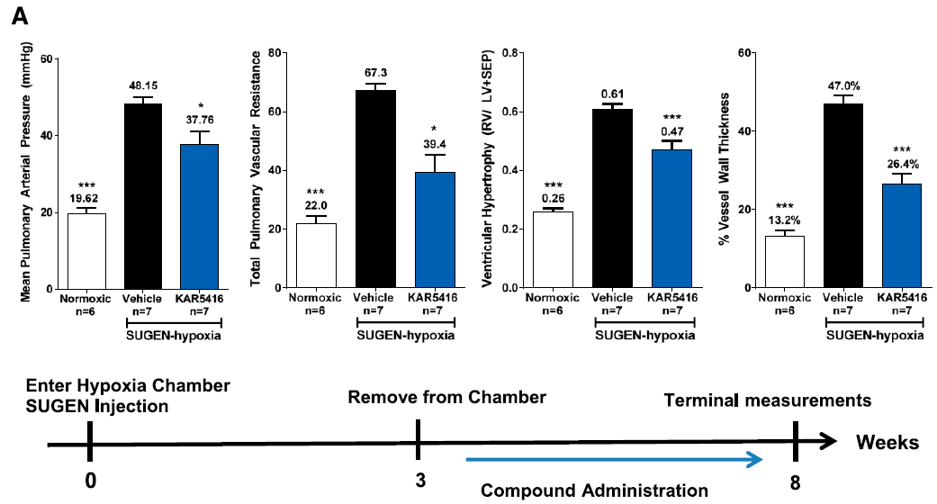
Efficacy of Rodatristat Ethyl in Rodent PAH Models
MCT Model
SUGEN-Hypox Model
MCT/Veh
MCT/KAR5585
Untreated

Slide 9
ELEVATE 2 Trial of Rodatristat Ethyl
Phase 2b clinical trial of “Rodatristat Ethyl in Patients with Pulmonary Arterial Hypertension”
Arms: Placebo / Rodatristat ethyl 300 mg BID / Rodatristat ethyl 600 mg BID
Primary Outcome Measure: Percent change from baseline in PVR at 24 weeks
Secondary Outcome Measures: Improvement in FC, 6MWD, and NTproBNP
Estimated enrollment of 90 subjects with primary completion expected in 2023
Treatment Period
Placebo-Controlled
Open-Label Extension
Long-Term Treatment
600 mg BID
N=90
Standard of Care (SOC)
300 mg BID
Placebo
Randomized to Rodatristat
Weeks -4 1 2 4 8 12 16 20 2 4 8 12 16 20 24
Screening
Week 24: Primary Analysis All Efficacy Endpoints

Slide 10
Take Home Points
There are several new pathways targeted by novel PAH therapies; many of these therapies are being developed in clinical trials at this time
The serotonin pathway has been clinically validated as contributing to the development of PAH
The strategy of TPH1 inhibition has shown benefit in rodent models of PAH
This approach is currently being tested in the ELEVATE 2 phase 2b clinical trial of rodatristat ethyl in PAH

Slide 11
Looking for more resources on this topic?
CME/CE in minutes
Congress highlights
Late-breaking data
Quizzes
Webinars
In-person events
Slides & resources
www.MedEdOTG.com

