Slide 1
Emerging Therapeutics: Ralinepag
Ioana Preston, MD
Associate Professor of Medicine
Tufts University School of Medicine
Director, Pulmonary Hypertension Center
Director, Pulmonary Function Test Lab
Pulmonary, Critical Care and Sleep Division
Tufts Medical Center
Boston, MA

Slide 2



Resource Information
About This Resource
These slides are one component of a continuing education program available online at MedEd On The Go titled Emerging PH Therapeutics, The Promise of a New Future
Program Learning Objectives:
Discuss how ongoing phase 3 and 4 trial results within the PH community will impact care moving forward
Understand the potential of utilizing novel molecular mechanisms of disease to affect the pathological progression of PH and the potential for treatment combinations to attack parallel disease pathways
MedEd On The Go®
www.mededonthego.com
This content or portions thereof may not be published, posted online or used in presentations without permission.
This content can be saved for personal use (non-commercial use only) with credit given to the resource authors.
To contact us regarding inaccuracies, omissions or permissions please email us at support@MedEdOTG.com

Slide 3
Disclaimer
The views and opinions expressed in this educational activity are those of the faculty and do not necessarily represent the views of Total CME, LLC, the CME providers, or the companies providing educational grants. This presentation is not intended to define an exclusive course of patient management; the participant should use their clinical judgment, knowledge, experience, and diagnostic skills in applying or adopting for professional use any of the information provided herein. Any procedures, medications, or other courses of diagnosis or treatment discussed or suggested in this activity should not be used by clinicians without evaluation of their patient's conditions and possible contraindications or dangers in use, review of any applicable manufacturer’s product information, and comparison with recommendations of other authorities. Links to other sites may be provided as additional sources of information.

Slide 4
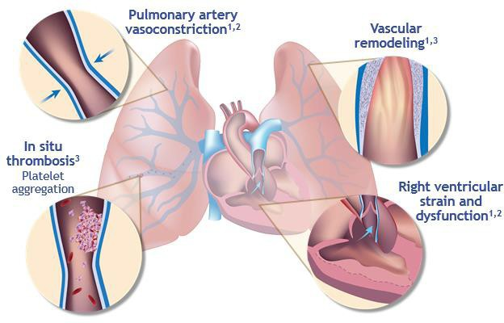
Pathological Mechanisms of PAH Potentially Related to Prostacyclin Pathway Deficiency¹⁻³
Pulmonary Artery Vasoconstriction
Ralinepag
Vascular
Remodeling
Receptor | Binding Affinity K_{i} (nM) | Fold Selectivity
IP | 3.4 | 1
DP₁ | 2,610 | 770
EP₁ | 9,600 | 2,800
EP₂ | 610 | 180
EP₃ | 143 | 42
EP₄ | 678 | 200
TP | > 10,000 | >2,900
In situ
Thrombosis
Platelet
Aggregation
Right Ventricular Strain
And Dysfunction
Ralinepag is a novel, next-generation, highly selective IP receptor agonist that has demonstrated positive findings in a phase 2 clinical study of PAH
Preclinical findings on pharmacology, pharmacokinetics, and efficacy with ralinepag have been presented⁴

Slide 5
Efficacy/Safety of Ralinepag (Novel Oral IP Agonist) in PAH Patients on Mono- or Dual-background Therapy
Phase 2 randomized, parallel group, placebo-controlled trial
Primary Efficacy Endpoint
Absolute change in PVR from
Baseline to Week 22
Secondary Endpoints
Changes in 6MWD and hemodynamics
Percent change in PVR
Safety and tolerability
Exploratory Endpoints
Changes in BNP and NT-proBNP from Baseline to Week 22

Slide 6
Ralinepag Phase 2 Trial: Study Design
22-week treatment period
Up to 9-week dose titration period
13-week
maintenance period
Transition period
[3±1 week]
Week 25
Follow-up visit
Stable dose of ralinepag
(0.01–0.3 mg twice daily)
R
Study exit
Randomized 2:1
Placebo
Week 25
Follow-up visit
–28-day
screening
period
End of study assessments
Follow-up
Week 0 1 2 3 4 5 6 7 8 9 10 14 18 22 25

Slide 7
Ralinepag Phase 2: Demographics and Baseline Characteristics
 | All Patients | Ralinepag | Placebo | p- value
Subjects, n | 61 | 40 | 21
Age, years | 49.4 (19-73) | 46.2 (19-68) | 55.6 (29-73) | 0.0057
Female, % | 53 (87) | 33 (83) | 20 (95)
Ethnicity, Caucasian, % | 57 (93) | 38 (95) | 19 (91)
PVR dyn·s·cm−5 mean (median) | 717 (576) | 780 (705) | 598 (480) | 0.110
6MWD, m, mean (median) | 378 (400) | 393 (405) | 351 (367)
WHO FC, n (%)
II | 34 (56) | 22 (55) | 12 (57) | 0.800
III | 26 (43) | 17 (43) | 9 (43)
IV | 1 (2) | 1 (3) | 0
PAH Etiology, n (%)
Idiopathic | 21 (52.5) | 11 (52.4) | 32 (52.5
Heritable | 4 (10.0) | 1 (4.8) | 5 (8.2)
Drug/Toxin induced | 4 (10.0) | 0 (0) | 4 (6.6)
Associated PAH | 11 (27.5) | 9 (42.9) | 20 (32.8)
NT-proBNP pg·mL−1 mean (median) | 980 (343) | 792 (335) | 1362 (343) | 0.700
Background PAH Therapy, %
Monotherapy | 41 | 35 | 52
Combination Therapy | 59 | 65 | 48
Monotherapy
ERA | 6 (10) | 2 (5) | 4 (19) | 0.170
PDE5i | 19 (31) | 12 (30) | 7 (33)
Combination Therapy
ERA + PDE5i | 34 (56) | 24 (60) | 10 (48) | 0.420
ERA + sGCS | 2 (3) | 2 (5) | 0 (0)
New PAH Treatment w/in 3-6 months of day 1 | 13 (21 | 5 (13) | 8 (38) | 0.049

Slide 8
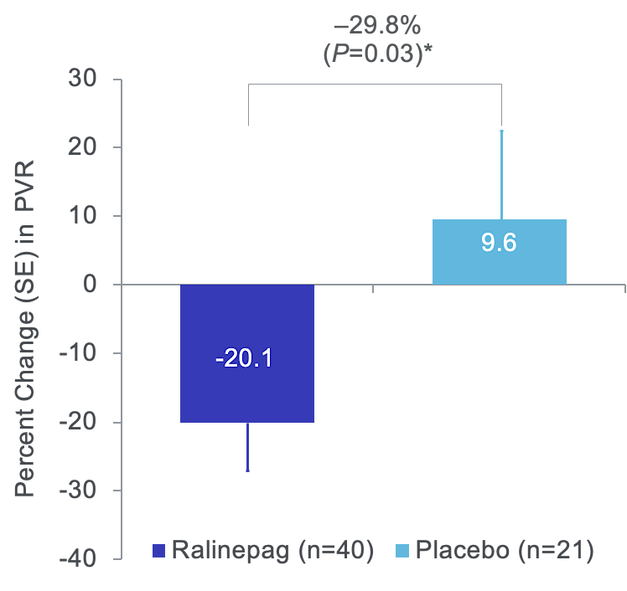
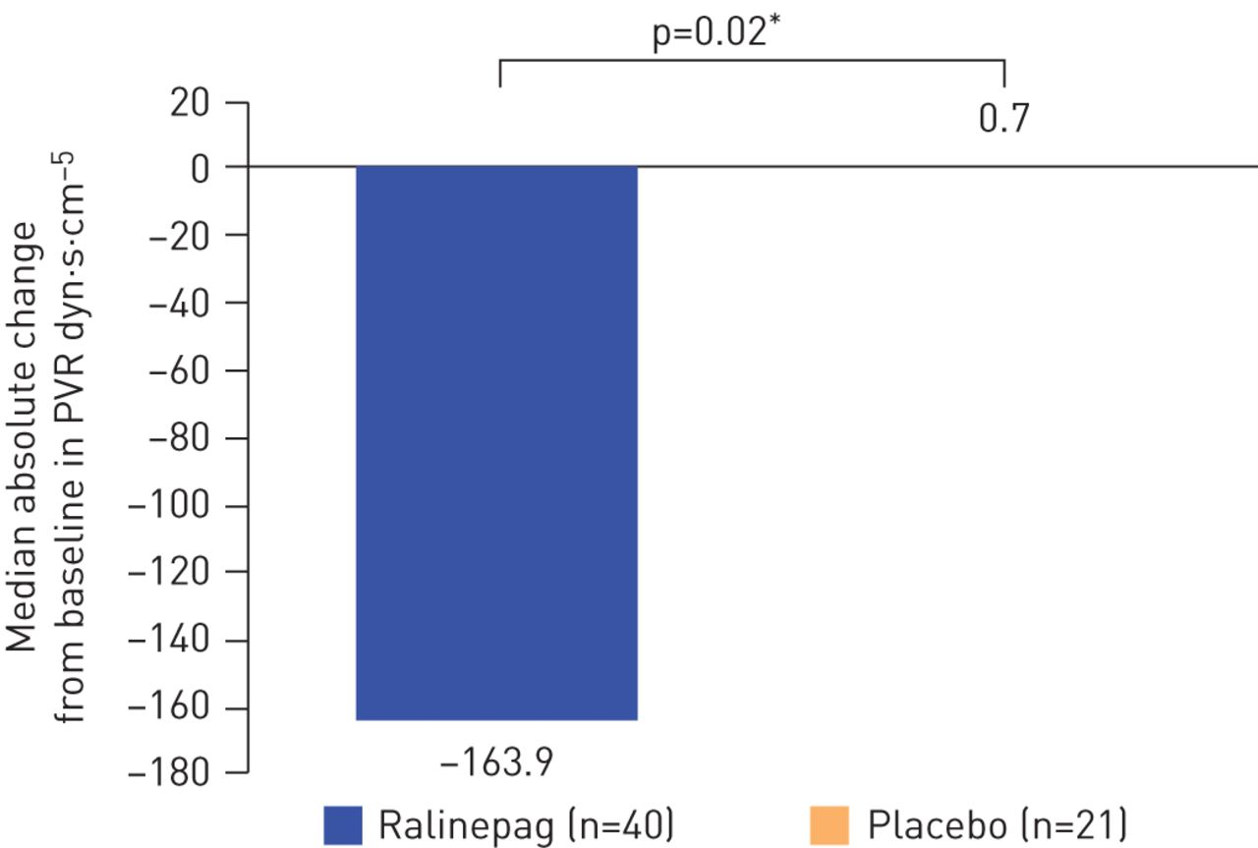
Ralinepag Significantly Reduced Pulmonary Vascular Resistance (PVR) Compared to Placebo

Slide 9
Secondary Hemodynamic Parameters:
Change from Baseline to Week 22
 | Baseline |  | Δ from Baseline to Week 22 |  | p-value
 | Ralinepag | Placebo | Ralinepag | Placebo
Subjects, n | 34 | 19 | 34 | 19
mPAP, mmHg | 51.0 ± 15.26 | 43.1 ± 10.08 | -6.1 ± 1.5 | -2.9 ± 2.0 | 0.028
Cardiac Index, L·min·m⁻² | 2.6 ± 0.60 | 2.9 ± 0.49 | 0.31 ± 0.12 | -0.0 ± 0.16 | 0.183
Mixed Venous O₂, % | 65.0 ± 7.86 | 68.0 ± 6.28 | 1.0 ± 1.05 | 0.6 ± 1.56 | 0.412
RAP, mmHg | 8.1 ± 6.14 | 8.7 ± 5.06 | -0.3 ± 0.68 | -2.0 ± 0.89 | 0.118
PCWP, mmHg | 9.3 ± 2.93 | 10.5 ± 3.17 | -0.4 ± 0.59 | -0.3 ± 0.77 | 0.119
SVR, dyn·s·cm⁻⁵ | 1449.0 ± 378.53 | 1309.9 ± 286.65 | -258.7 ± 286.54 | 152.9 ± 374.47 | < 0.001
MAP, mmHg | 89.6 ± 16.13 | 86.8 ± 10.55 | -8.2 ± 1.83 | -2.7 ± 2.35 | 0.001
Heart Rate, bpm | 77.1 ± 13.61 | 71.6 ± 7.87 | 0.9 ± 1.92 | -0.8 ± 2.49 | 0.961

Slide 10
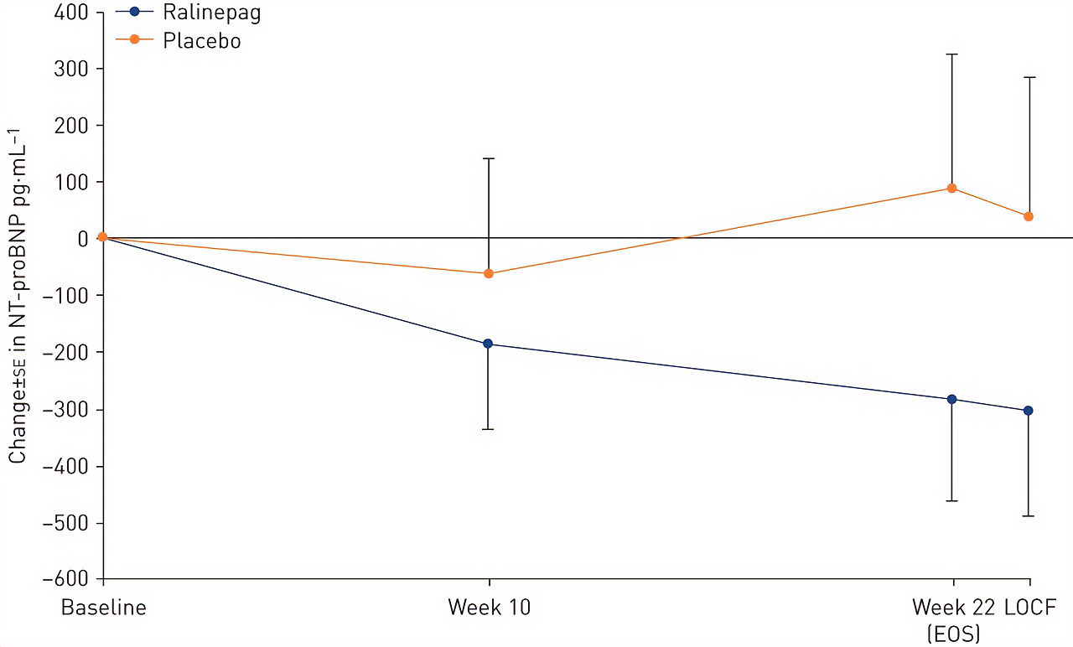
Ralinepag Reduced NT-proBNP Compared to Placebo
6MWD increased from baseline by 36.2 m with ralinepag and 29.4 m with placebo (p=0.90)
Serious adverse events occurred in 10% of ralinepag patients and 29% of placebo patients
Study discontinuations occurred in 13% of ralinepag patients and 10% of placebo patients

Slide 11
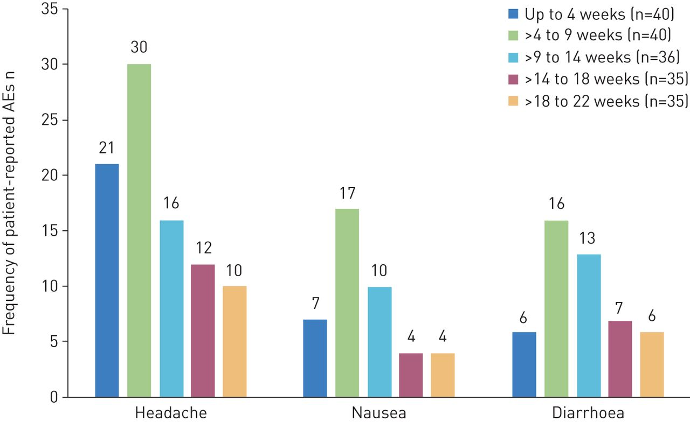
Frequency of Patient-Reported Adverse Events (AEs)
Adverse Events Occurring in ≥ 30% of
Patients in Either Ralinepag or Placebo
Groups During 22-Week Study
 | Ralinepag | Placebo
Subjects | 40 | 21
Headache | 78 (31) | 29 (6)
Nausea | 50 (20) | 24 (5)
Diarrhea | 48 (1) | 14 (3)
Pain in Jaw | 35 (14) | 14 (3)
Flushing | 33 (13) | 5 (1)
Data presented as n or % (n)

Slide 12
Conclusions
Phase 2 study was designed to assess the efficacy, safety, and tolerability of twice-daily ralinepag administered orally in a cohort of adult patients with PAH
Ralinepag caused a statistically significant absolute change in PVR, meeting the primary efficacy endpoint
  Expressed as a percentage change relative to placebo, a 29.8% difference was observed, including a 20.1% decrease from baseline in the ralinepag-treated group
Additional signals of efficacy were also observed for other hemodynamic parameters:
  Ralinepag produced greater mean reductions in both systolic and mean PAP when compared with placebo
22 weeks of treatment with ralinepag was well tolerated by most patients in this study
  Treatment-related adverse events were generally consistent with the known safety profile of prostacyclin receptor agonists
Ralinepag, a next-generation, orally available, non-prostanoid, selective prostacyclin receptor agonist significantly reduced PVR compared with placebo in patients with moderately symptomatic PAH
This effect was observed in subjects who were taking either monotherapy or combination therapy at the time of enrolment

Slide 13
Ralinepag Phase 3 Trial:
ADVANCE OUTCOMES (Recruiting)
Study ROR-PH-301, ADVANCE OUTCOMES, is designed to assess the efficacy and safety of ralinepag when added to pulmonary arterial hypertension (PAH) standard of care or PAH-specific background therapy in subjects with World Health Organization (WHO) Group 1 PAH
Worsening event:
  Death
  Nonelective hospital admission for worsening PAH
  Initiation of parenteral or inhaled prostacyclin pathway agent for treatment of worsening PAH
  Disease progression
  Unsatisfactory long-term clinical response
Several secondary endpoints:
  Including change in REVEAL risk score,
  6MWD, NT-proBNP, and WHO FC
Formulation: New once-a-day extended-release tablet
1000 subjects
Primary Endpoint
The time (in days) from randomization
to the first adjudicated protocol-defined
clinical worsening event

Slide 14



Looking for more resources
on this topic?
CME/CE in minutes
Congress highlights
Late-breaking data
Quizzes
Webinars
In-person events
Slides & resources
www.MedEdOTG.com

