Slide 1
Emerging Therapeutics: Vardenafil
Ioana Preston, MD Associate Professor of Medicine Tufts University School of Medicine Director, Pulmonary Hypertension Center Director, Pulmonary Function Test Lab Pulmonary, Critical Care and Sleep Division Tufts Medical Center Boston, MA

Slide 2



Resource Information
About This Resource
These slides are one component of a continuing education program available online at MedEd On The Go titled Emerging PH Therapeutics, The Promise of a New Future
Program Learning Objectives:
Discuss how ongoing phase 3 and 4 trial results within the PH community will impact care moving forward
Understand the potential of utilizing novel molecular mechanisms of disease to affect the pathological progression of PH and the potential for treatment combinations to attack parallel disease pathways
MedEd On The Go®
www.mededonthego.com
This content or portions thereof may not be published, posted online or used in presentations without permission.
This content can be saved for personal use (non-commercial use only) with credit given to the resource authors.
To contact us regarding inaccuracies, omissions or permissions please email us at support@MedEdOTG.com

Slide 3
Disclaimer
The views and opinions expressed in this educational activity are those of the faculty and do not necessarily represent the views of Total CME, LLC, the CME providers, or the companies providing educational grants. This presentation is not intended to define an exclusive course of patient management; the participant should use their clinical judgment, knowledge, experience, and diagnostic skills in applying or adopting for professional use any of the information provided herein. Any procedures, medications, or other courses of diagnosis or treatment discussed or suggested in this activity should not be used by clinicians without evaluation of their patient's conditions and possible contraindications or dangers in use, review of any applicable manufacturer’s product information, and comparison with recommendations of other authorities. Links to other sites may be provided as additional sources of information.

Slide 4
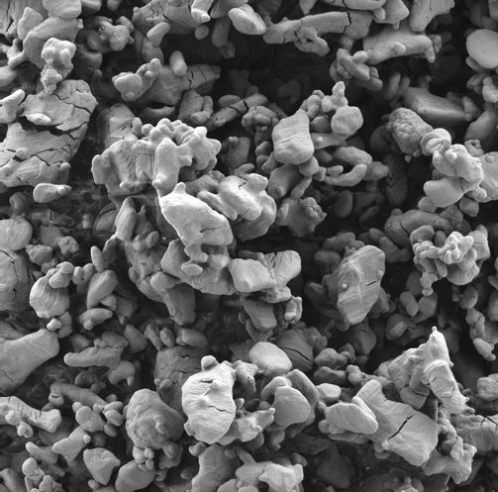
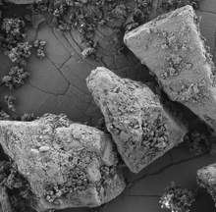
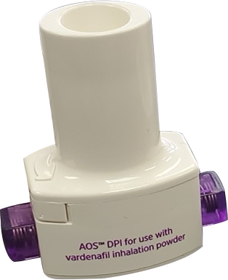
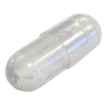
Safety/Efficacy of RT234 Vardenafil Inhalation Powder on Exercise Parameters in PAH: Phase 2 Dose-Escalation Study Design
No treatment exists to acutely improve exercise capacity and symptoms on an “as-needed” basis in PAH
RT234 is an inhaled drug/device combination of the PDE5 inhibitor vardenafil hydrochloride and the novel AOS DPI
Oral vardenafil is approved for the treatment of erectile dysfunction and its safety profile is well established
A phase 2A RT234 dose escalating (0.6–2.4 mg) study (N=14) demonstrated a dose-dependent reduction in pulmonary vascular resistance and was safe and well tolerated in PAH
This phase 2B study will evaluate efficacy and safety of RT234 AOS DPI on exercise capacity and symptoms assessed by CPET and 6MWT in PAH participants on stable background therapy
Vardenafil
Vardenafil + lactose

Slide 5
VIPAH PRN^{2B}: Prospective, Multicenter, Open-label, Dose-escalation, Phase 2b Study
Objective
To evaluate efficacy and safety of RT234 (vardenafil inhalation powder) delivered via AOS DPI on exercise capacity and symptoms assessed by CPET and 6MWT in PAH participants on stable background therapy
Statistical Assumptions
Sample size derived using 1-sample, 2-sided t test [0.05 significance level and 80% power] to test null hypothesis of no difference between Baseline and post-dose peak VO₂; SD 2 ml O₂/kg/min; 5% drop-out rate
Assumed mean change from Baseline is 1.5 ml O₂/kg/min
Participants with PAH (FC II-IV) on stable PAH therapy (≤ 3)
1° Endpoint: Change in peak oxygen consumption (VO₂)
2°Endpoint: 6MWD
Visit 1
Screening
6MWT Baseline
Visit 2
CPET Baseline
Visit 3
CPET 30 min post-dose
Visit 4
6MWT 30 min post-dose
Visit 5
EOS
Safety Follow-up
N = 43/group
Cohort 1: RT-234 0.5 mg
Dose via AOS DPI
Cohort 2: RT-234 1.0 mg
Pharmacokinetics

Slide 6
VIPAH PRN2B: Key Endpoints
Efficacy
Safety
Change from Baseline in peak VO₂ compared to post RT234 treatment
Change from Baseline in 6MWD compared to post RT234 treatment
Change from Baseline in ventilatory inefficiency slope (VE/VCO₂) compared to post RT234 treatment
Change from Baseline in duration of exercise compared to post RT234 treatment
Incidence and severity of AEs, TEAEs and SAEs
Changes from Baseline to post RT234 treatment in vital signs, physical examinations, and 12-lead ECGs

Slide 7
Key Eligibility Criteria
Inclusion
Exclusion
Aged 18–80 years
PAH:
Idiopathic, primary, or familial
Connective tissue disease
HIV infection
Repaired congenital heart disease
Toxin exposure
WHO FC II-IV
Up to 3 PAH specific background meds (inhaled/oral)
6MWT ≥ 150 meters
RHC
mPAP ≥ 20 mmHg
PVR ≥ 300 dynes/sec/cm⁵
PCWP or LVEDP of ≤ 12 mmHg if PVR ≥ 300 to < 500 dynes/sec/cm⁵, or PCWP or LVEDP ≤ 15 mmHg if PVR ≥ 500 dynes/sec/cm⁵
VE/VCO₂ slope ≥ 36
Use of parenteral PAH medications
Use of riociguat
Left ventricular disease /dysfunction risk factors (3 or more)

Slide 8
VIPAH PRN^{2B} - Baseline Demographics and Disease Characteristics, Enrolled Subjects* (N = 9)
 |  | N = 9
Geography |  | US, Serbia
Median age, years (min, max) |  | 46 (23, 73)
Female, n (%) |  | 9 (100)
Race, n (%) | White | 8 (89)
 | Black | 1 (11)
Median BMI, kg/m² (min, max) |  | 26.7 (18.8, 39.2)
Functional PAH Classification, n (%) | Class I | 0
 | Class II | 5 (56)
 | Class III | 4 (44)
 | Class IV | 0
Idiopathic, primary, or familial PAH, n (%) |  | 7 (78)
PAH associated with CTD, n (%) |  | 1 (11)
PAH associated with other factors, n (%) |  | 1 (11)
Mean time since diagnosis, months (min, max) |  | 43 (10, 113)
Mean 6MWD, m (min, max) |  | 462.0 (285.5, 595.5)
PAH Disease-Specific Medications** | PDE5i | 7 (78)
 | ERA | 8 (89)
 | sGC | 0
 | Prostacyclin (or analogue) | 4 (44)

Slide 9
Change from Baseline in 6MWD Compared to Post-RT234 Treatment*
All Participants (Cohort 1, n = 7)
Participants with Baseline 6MWT < 500 m (Cohort 1, n = 5)
Mean change from Baseline: 23.5 m
Mean change from Baseline: 30 m
Baseline
Post RT-234
0.5 mg dose
Baseline
Post RT-234
0.5 mg dose
204-003
209-001
205-003
207-004
204-003
207-004
207-001
216-001
205-003
216-001
207-003
207-001

Slide 10
Patient 1: 35-year-old White Female with Idiopathic PAH (Dx 2019) FCIII treated with Bosentan and Sildenafil
Baseline CPET
Background PAH meds not held
Resting Vitals: HR 80, RR 18, BP 130/70; O₂ sat 96%
Post-RT-234 Treatment CPET
Background PAH meds not held
Resting Vitals: HR 81, RR 22, BP 124/75; O₂ sat 98%
No AEs reported
Peak VO₂
VE/VCO₂ Slope
Peak HR
Peak BP
Exercise Time
Peak Dyspnea
57.4
153
158
165
10/10
17.8
9:20
130
14.8
44.4
beats/min
95
80
4:40
5/10
O₂
Oct 2020 screening visit: Vitals: HR 68, RR 22, BP 122/77; BMI 29 kg/m^{2;} O₂ sat 97%; 6MWT = 451 m.

Slide 11
Summary
PAH patients remain symptomatic even on background therapies, especially in their everyday activities
PDE5 inhibitors are effective in treating PAH
VIPAH PRN^{2B} is the first study investigating the use of RT234 (vardenafil inhalation powder) as an “as-needed” treatment for PAH in addition to stable, disease-specific background therapy to acutely improve exercise and/or quality of life
Preliminary results suggest inhaled RT234 may offer a clinical benefit with minimal side effects for patients with PAH
This proof-of-concept study is actively enrolling in the US
Results will inform the design of the global RT234 phase 3 clinical program

Slide 12



Looking for more resources on this topic?
CME/CE in minutes
Congress highlights
Late-breaking data
Quizzes
Webinars
In-person events
Slides & resources
www.MedEdOTG.com

