Slide 1
Sotatercept: A Novel Entity with Promising Potential for Treating PAH
Ioana Preston, MD Associate Professor of Medicine Tufts University School of Medicine Director, Pulmonary Hypertension Center Director, Pulmonary Function Test Lab Pulmonary, Critical Care and Sleep Division Tufts Medical Center Boston, MA

Slide 2
Resource Information
About This Resource
These slides are one component of a continuing education program available online at MedEd On The Go titled Emerging PH Therapeutics, The Promise of a New Future
Program Learning Objectives:
Discuss how ongoing phase 3 and 4 trial results within the PH community will impact care moving forward
Understand the potential of utilizing novel molecular mechanisms of disease to affect the pathological progression of PH and the potential for treatment combinations to attack parallel disease pathways
MedEd On The Go®
www.mededonthego.com
This content or portions thereof may not be published, posted online or used in presentations without permission.
This content can be saved for personal use (non-commercial use only) with credit given to the resource authors.
To contact us regarding inaccuracies, omissions or permissions please email us at support@MedEdOTG.com

Slide 3
Disclaimer
The views and opinions expressed in this educational activity are those of the faculty and do not necessarily represent the views of Total CME, LLC, the CME providers, or the companies providing educational grants. This presentation is not intended to define an exclusive course of patient management; the participant should use their clinical judgment, knowledge, experience, and diagnostic skills in applying or adopting for professional use any of the information provided herein. Any procedures, medications, or other courses of diagnosis or treatment discussed or suggested in this activity should not be used by clinicians without evaluation of their patient's conditions and possible contraindications or dangers in use, review of any applicable manufacturer’s product information, and comparison with recommendations of other authorities. Links to other sites may be provided as additional sources of information.

Slide 4
Sotatercept: Proposed as a Reverse-remodeling Agent
Sotatercept, an activin signaling inhibitor, is proposed to act as a reverse-remodeling agent through rebalancing of anti-proliferative and pro-proliferative signaling pathways.^{1,2}
Sotatercept
BMPs
BMPs
Activin
Activin
Modified Extracellular Domain of ActRIIA
Human IgG1Fc
Domain
Increased Vascular
Proliferation
Rebalanced Toward Vascular Homeostasis

Slide 5
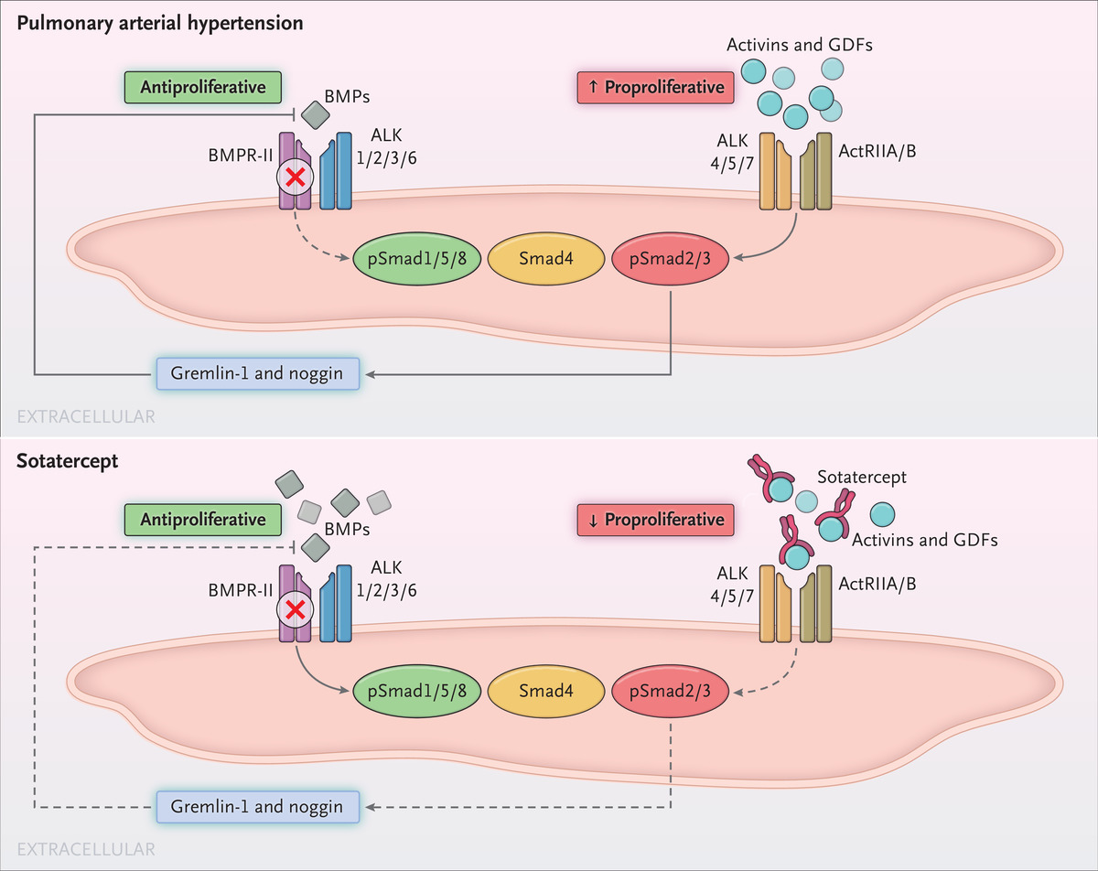
Background
Mutations in bone morphogenetic protein (BMP) receptor type 2 (BMPR2), a member of the TGF-β super-family, are a major cause of heritable PAH
Sotatercept acts as a ligand trap for TGF-β superfamily members, restoring balance between the growth promoting activin differentiation factor pathway and the growth-inhibiting BMP pathway^{1,2,3}
BMPR2 signaling pathway¹
Implicated in non-heritable PAH via maintaining endothelial integrity in pulmonary arteries
Mutations reducing signaling promote endothelial dysfunction, increase cellular proliferation, and aid pulmonary vascular remodeling
Sotatercept is a novel, first-in-class fusion protein of human activin receptor type IIA fused to the Fc domain of human IgG1²

Slide 6
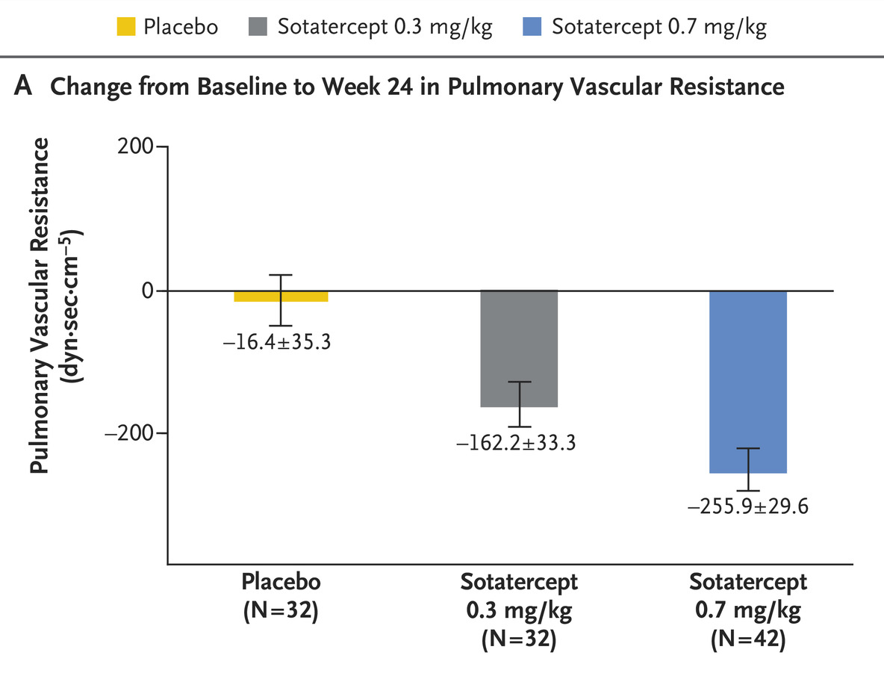
PULSAR Phase 2 Results
Least-squares Mean Change from Baseline to Week 24 in Pulmonary Vascular Resistance in Each Group
Reduction in PVR was driven by reduction in mean PA pressure with no significant difference in CO or PCWP
Similar findings when stratified by number of agents of background therapy and presence of prostacyclin infusion
⌶ bars indicate standard errors

Slide 7
Key Points from PULSAR Findings
No change in CO or TAPSE suggests direct effect on pulmonary circulation leading to treatment effect
Sotatercept reduced PVR, improved 6MWD and reduced NT-proBNP even in patients on background triple therapy¹
Adverse effects were largely manageable, including thrombocytopenia and increased hemoglobin
No bleeding events recorded in the trial
Continued sotatercept treatment for PAH suggests clinical efficacy is maintained for up to 48 weeks²
Placebo assignment did not affect the ability to respond after 24 weeks
Sotatercept was further evaluated in phase 3 programs¹⁻²
STELLAR (NCT04576988)
HYPERION (NCT04811092)

Slide 8
STELLAR: Study Design
A phase 3, randomized, double-blind, placebo-controlled, multicenter, parallel-group study (NCT04576988) to evaluate sotatercept on top of background PAH therapy* in adult participants with PAH with WHO FC II or III
Efficacy/safety data through treatment week 24; cumulative safety and time to death or clinical worsening as of Aug 26, 2022, are reported
Primary Endpoint: Change from baseline at week 24 in 6MWD
Inclusion Criteria:
WHO Group 1 PAH
WHO FC II or III
Adult ≥18 years
Baseline PVR ≥400 dynes·sec·cm⁻⁵ and PCWP or LVEDP ≤15 mmHg
6MWD 150 - 500 meters
Stable treatment with background PAH therapy*
Secondary Endpoints (Tested hierarchically to control type 1 error)
Change from baseline at week 24 in
Multicomponent clinical improvement
Increase ≥30 meters in 6MWD
NT-proBNP ≥30%↓ or maintenance/
achievement of NT-proBNP <300 pg/mL
Improvement in WHO FC or maintenance of WHO FC II
PVR, NT-proBNP, WHO FC
Time to death or first clinical worsening event though study completion (Aug 26, 2022)
French Risk Score
3 domains of PAH-SYMPACT®
Double-blind primary treatment period (24 weeks)
Double-blind extension
Randomization
1:1
Stratified by baseline WHO FC and background PAH therapy
Placebo every 3 weeks (N = 160)
Sotatercept 0.3 mg/kg starting dose to 0.7 mg/kg every three weeks (N = 163)
Total randomized: 323

Slide 9
STELLAR: Patient Characteristics
Characteristic | Placebo (N = 160) | Sotatercept (N = 163) | Total (N = 323)
Female sex — no. (%) | 127 (79.4) | 129 (79.1) | 256 (79.3)
Age — yr, mean ± SD | 48.3 ± 15.5 | 47.6 ± 14.1 | 47.9 ± 14.8
Race — no. (%)
White | 141 (88.1) | 147 (90.2) | 288 (89.2)
Black or African American | 5 (3.1) | 2 (1.2) | 7 (2.2)
Asian | 6 (3.8) | 1 (0.6) | 7 (2.2)
Other | 6 (3.8) | 7 (4.3) | 13 (4.0)
Missing | 2 (1.3) | 6 (3.7) | 8 (2.5)
Time since PAH diagnosis — yr, mean ± SD | 8.3 ± 6.7 | 9.2 ± 7.3 | 8.8 ± 7.0
WHO Group 1 PAH Classification — no. (%)
Idiopathic | 106 (66.3) | 83 (50.9) | 189 (58.5)
Heritable | 24 (15.0) | 35 (21.5) | 59 (18.3)
Associated with connective-tissue disease | 19 (11.9) | 29 (17.8) | 48 (14.9)
Drug-induced or toxin-induced | 4 (2.5) | 7 (4.3) | 11 (3.4)
Associated with corrected congenital shunts | 7 (4.4) | 9 (5.5) | 16 (5.0)
WHO FC — no. (%)
II | 78 (48.8) | 79 (48.5) | 157 (48.6)
III | 82 (51.3) | 84 (51.5) | 166 (51.4)
Background therapy for PAH — no. (%)
Prostacyclin infusion therapy | 64 (40.0) | 65 (39.9) | 129 (39.9)
Monotherapy | 4 (2.5) | 9 (5.5) | 13 (4.0)
Double therapy | 56 (35.0) | 56 (34.4) | 112 (34.7)
Triple therapy | 100 (62.5) | 98 (60.1) | 198 (61.3)
6MWD — meter, mean ± SD | 404.7 ± 80.6 | 397.6 ± 84.3 | 401.1 ± 82.4
NT-proBNP — pg/mL, mean ± SD | 1207.8 ± 2694.4 | 1037.5 ± 2498.6 | 1121.1 ± 2593.8
PVR — dyn·sec·cm⁻⁵, mean ± SD | 745.8 ± 313.5 | 781.3 ± 398.5 | 763.7 ± 358.8
Mean pulmonary artery pressure — mmHg, mean ± SD | 52.2 ± 13.0 | 53.0 ± 14.6 | 52.6 ± 13.8

Slide 10
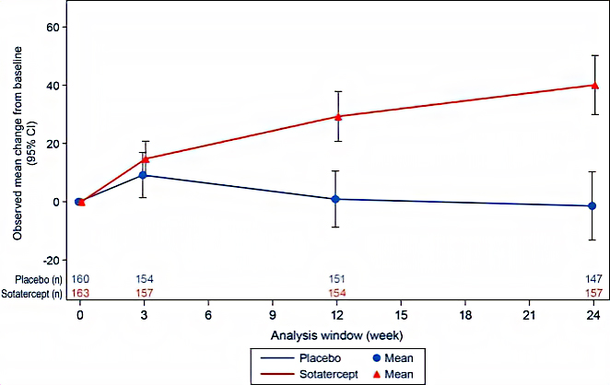
Primary Endpoint: Change from Baseline in 6MWD at Week 24
 | Placebo(N=160) | Sotatercept (N=163)
Observed mean change from baseline (95% CI)* | -1.4 (-13.2 to 10.3) | 40.1 (29.9 to 50.2)
Hodges-Lehmann location shift (95% CI)† |  | 40.8 (27.5 to 54.1)
Wilcoxon p-value‡ |  | < 0.001

Slide 11
Summary of Secondary Endpoints
8 of 9 secondary hypothesis tests also were significant (accounting for testing strategy)
 | Secondary Endpoint | Placebo (N = 160) | Sotatercept (N = 163) | Sotatercept versus Placebo
 |  |  |  | HL Location Shift (95% CI) | p-value*
1 | Multicomponent Improvement†, n/N (%) | 16 (10.1)‡ | 63 (38.9)‡ | -- | <0.001
2 | PVR – dyn·sec·cm⁻⁵ |  |  | -234.6 (-288.4 to -180.8) | <0.001
3 | NT-proBNP – pg/mL |  |  | -441.6 (-573.5 to -309.6) | <0.001
4 | WHO FC, n/N (%) | 22 (13.8)‡ | 48 (29.4)‡ | -- | <0.001
5 | TTCW or all-cause death |  |  | 0.16 (0.08 to 0.35)† | <0.001†
6 | French low-risk score, n/N (%) | 29 (18.2)‡ | 64 (39.5)‡ | -- | <0.001
7 | PAH-SYMPACT® Physical Impacts |  |  | -0.26 (-0.49 to -0.04) | 0.010
8 | PAH-SYMPACT® Cardiopulmonary |  |  | -0.13 (-0.26 to -0.01) | 0.028
9 | PAH-SYMPACT® Cognitive/Emotional |  |  | -0.16 (-0.40 to 0.08) | 0.156
The between-group reduction from baseline in least-squares mean pulmonary artery pressure (exploratory endpoint) at week 24 was -13.9 mmHg (95% CI: -16.0 to -11.8)

Slide 12
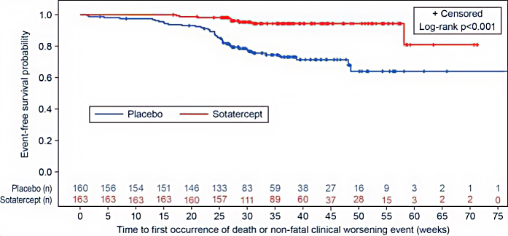
Time to First Occurrence of Death or Non-fatal Clinical Worsening Event (TTCW)
 | Placebo (N=160) | Sotatercept (N=163)
Total number of patients who died or experienced at least one clinical worsening event, n (%) | 42 (26.3) | 9 (5.5)
Assessment of first occurrence of death or non-fatal
clinical worsening event*:
Death as first event | 6 (3.8) | 2 (1.2)
Worsening-related listing for lung or heart-lung transplant | 1 (0.6) | 1 (0.6)
Need to initiate rescue therapy or need to increase dose of infusion prostacyclin by 10% or more | 17 (10.6) | 2 (1.2)
Need for atrial septostomy | 0 | 0
PAH-related hospitalization (≥24 hours) | 7 (4.4) | 0
Deterioration of PAH | 15 (9.4) | 4 (2.5)
After a median follow-up of 32.7 weeks across the treatment groups, the hazard ratio in the sotatercept group as compared with the placebo group was 0.16 (95% CI: 0.08 to 0.35).

Slide 13
Overall Summary of Safety
Cumulative results through data cut-off date*
Number of patients with any | Placebo (N=160) n (%) | Sotatercept (N=163) n (%)
TEAEs of interest† | 72 (45.0) | 97 (59.5)
Bleeding events | 25 (15.6) | 52 (31.9)
Telangiectasia | 6 (3.8) | 23 (14.1)
Increased hemoglobin (increased hematocrit, increased RBC count) | 0 | 10 (6.1)
Thrombocytopenia | 5 (3.1) | 14 (8.6)
Increased blood pressure | 1 (0.6) | 7 (4.3)
TEAEs with incidence ≥ 10% in one or more treatment groups
Epistaxis | 3 (1.9) | 33 (20.2)
Telangiectasia | 6 (3.8) | 23 (14.1)
Dizziness | 7 (4.4) | 24 (14.7)

Slide 14
Summary and Conclusions
STELLAR is the first phase 3 trial of sotatercept, an activin signaling inhibitor, in adults with PAH and WHO FC II-III
Sotatercept improved 6MWD (+40.8 m, 95% CI, 27.5 to 54.1; p < 0.001) and delivered broad clinical benefit across multiple domains including hemodynamics, WHO functional class, disease biomarkers, risk scores, and patient-reported outcomes
Sotatercept reduced the risk of death and non-fatal clinical worsening events by 84% versus placebo (HR: 0.16 [95% CI: 0.08 to 0.35])
Sotatercept was generally well tolerated
Adverse events more frequent with sotatercept versus placebo: minor bleeding events, telangiectasia, dizziness, increased hemoglobin levels, thrombocytopenia, and increased blood pressure
These results establish the clinical utility of sotatercept administered in combination with approved PAH therapies as a new treatment for PAH

Slide 15
Looking for more resources on this topic?
CME/CE in minutes
Congress highlights
Late-breaking data
Quizzes
Webinars
In-person events
Slides & resources
www.MedEdOTG.com

