Slide 1
Novel and Emerging Disease-Modifying Therapies for Mild Cognitive Impairment Due to AD: Efficacy and Safety of New DMTs for MCI
Sharon Cohen, MD, FRCPC
Medical Director
Toronto Memory Program
Toronto, Canada

Slide 2



Resource Information
About This Resource
These slides are one component of a continuing education program available online at MedEd On The Go titled Early-Stage Alzheimer’s Disease: New Therapies for Mild Cognitive Impairment
Program Learning Objectives:
Utilize clinically relevant tools to assess the subtle signs and symptoms of MCI to facilitate an earlier MCI diagnosis
Tailor communication strategies to each community of patients to overcome implicit bias and health disparities and to achieve optimal health outcomes and health equity
Provide clinicians with new and emerging data related to the pathophysiology of MCI in AD
Increase clinician awareness of the safety and efficacy of emerging DMT therapeutics used to manage MCI during the early stages of AD
MedEd On The Go®
www.mededonthego.com
This content or portions thereof may not be published, posted online or used in presentations without permission.
This content can be saved for personal use (non-commercial use only) with credit given to the resource authors.
To contact us regarding inaccuracies, omissions or permissions please email us at support@MedEdOTG.com

Slide 3
Disclaimer
The views and opinions expressed in this educational activity are those of the faculty and do not necessarily represent the views of Total CME, LLC, the CME providers, or the companies providing educational grants. This presentation is not intended to define an exclusive course of patient management; the participant should use their clinical judgment, knowledge, experience, and diagnostic skills in applying or adopting for professional use any of the information provided herein. Any procedures, medications, or other courses of diagnosis or treatment discussed or suggested in this activity should not be used by clinicians without evaluation of their patient's conditions and possible contraindications or dangers in use, review of any applicable manufacturer’s product information, and comparison with recommendations of other authorities. Links to other sites may be provided as additional sources of information.

Slide 4
Presentation Objective
To increase clinician awareness of the efficacy and safety of emerging disease modifying therapies (DMT), both for recently approved drugs and those underdevelopment for early Alzheimer disease (AD), with an emphasis on the mild cognitive impairment (MCI) stage of AD

Slide 5
Why MCI?
A major trend in AD drug development over the past decade has been to intervene at earlier stages of the clinical continuum when individuals are still relatively functional and have less neuronal loss
Early AD refers to MCI due to AD and mild AD dementia and is a common target stage for AD drug development
MCI represents the earliest symptomatic stage of AD and is a predementia state
In a time-to-event paradigm, delaying progression from MCI to dementia with a DMT represents prolongation of independence, avoidance of increased care partner burden, and avoidance of health care costs

Slide 6
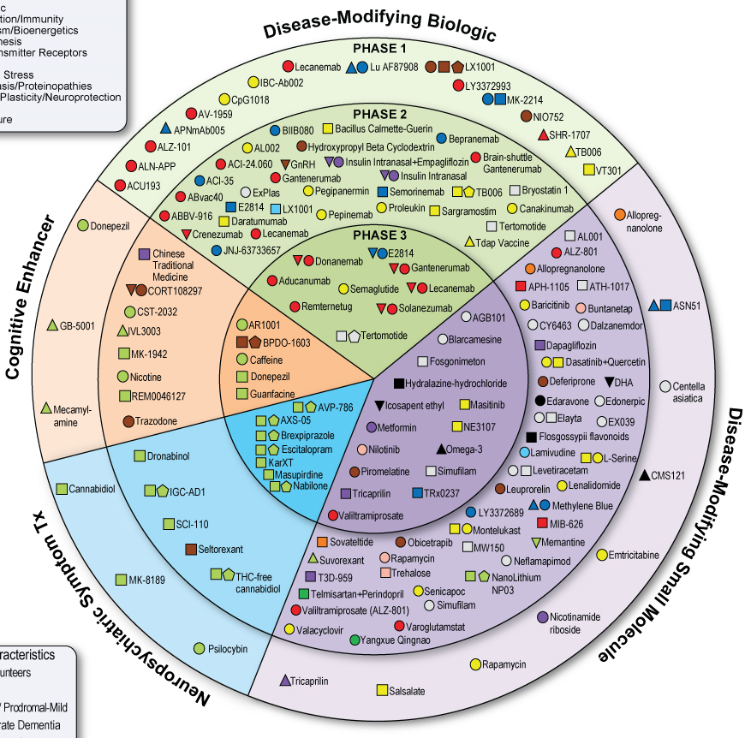
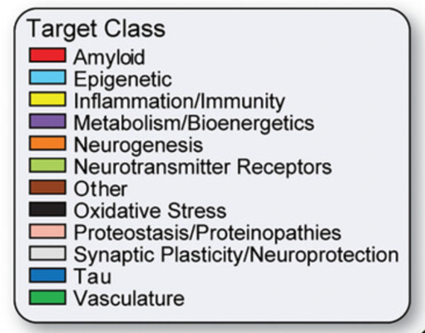
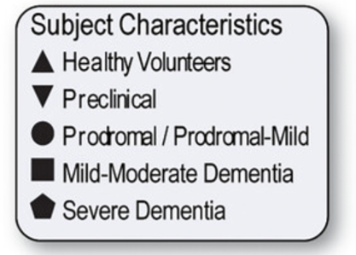
The Current AD Drug Development Pipeline
Fig. 1

Slide 7
Anti-Amyloid Monoclonal Antibodies in Early AD
Aducanumab: Granted FDA accelerated pathway approval in 2021 because amyloid lowering felt reasonably likely to lead to clinical benefit. Confirmatory trial ongoing
Lecanemab: Granted traditional FDA approval July 6, 2023, based on a confirmatory phase 3 trial Clarity AD; decline slowed on primary (CDR-SB), secondary (amyloid PET, ADAS-Cog 14, ADCS-MCI-ADL), and quality of life outcomes, as well as impact on amyloid, tau, and neurodegeneration
Donanemab: Topline results for Trailblazer-ALZ 2 showing positive results for primary (iADRS), secondary (CDR-SB, ADCS-iADL, ADAS-Cog 13), and biomarker endpoints
Gantenerumab: Failed to clear sufficient amyloid and did not meet clinical outcomes in the Graduate I and II studies recently reported

Slide 8
Lecanemab and Donanemab: Safety Profiles
Adverse Event | Lecanemab | Donanemab
ARIA-E | 12.5%; symptomatic 2.8% recurrence rate: 3.1% | 24% symptomatic 6.1%
ARIA-H | 17% symptomatic 0.7% | 31.4% (symptomatic not yet reported)
Infusion-related reactions | 26% (65% had only 1 event) | 8.7% (recurrence rate not yet reported)
AD, Alzheimer's disease.

Slide 9
Other Approaches to Early AD (Selected Examples)
Amyloid-targeted
Tau-targeted
RNAi targeting APP (eg, ALN-APP) in young onset AD
Preventing oligomers in apoE4 carriers (eg, valiltramiprosate)
ASO (eg, BIIB080); mid-domain mABs (eg, bepranemab)
Targeting neuroinflammation
Drugs with multiple targets
Tyrosine kinase inhibitor (eg, masitinib); enhance microglial activity (eg, AL002); inhibit soluble TNF (eg, XPro1595)
Impact on inflammation and BBB integrity (eg, semaglutide)

Slide 10



Looking for more resources on this topic?
CME/CE in minutes
Congress highlights
Late-breaking data
Quizzes
Webinars
In-person events
Slides & resources
www.MedEdOTG.com

