Slide 1
New Data on the Pathophysiology of MCI and Dementia
Richard S. Isaacson, MD
Institute for Neurodegenerative Diseases
Boca Raton, FL

Slide 2
Resource Information
About This Resource
These slides are one component of a continuing education program available online at MedEd On The Go titled Early-Stage Alzheimer’s Disease: New Therapies for Mild Cognitive Impairment
Program Learning Objectives:
Utilize clinically relevant tools to assess the subtle signs and symptoms of MCI to facilitate an earlier MCI diagnosis
Tailor communication strategies to each community of patients to overcome implicit bias and health disparities and to achieve optimal health outcomes and health equity
Provide clinicians with new and emerging data related to the pathophysiology of MCI in AD
Increase clinician awareness of the safety and efficacy of emerging DMT therapeutics used to manage MCI during the early stages of AD
MedEd On The Go®
www.mededonthego.com
This content or portions thereof may not be published, posted online or used in presentations without permission.
This content can be saved for personal use (non-commercial use only) with credit given to the resource authors.
To contact us regarding inaccuracies, omissions or permissions please email us at support@MedEdOTG.com

Slide 3
Disclaimer
The views and opinions expressed in this educational activity are those of the faculty and do not necessarily represent the views of Total CME, LLC, the CME providers, or the companies providing educational grants. This presentation is not intended to define an exclusive course of patient management; the participant should use their clinical judgment, knowledge, experience, and diagnostic skills in applying or adopting for professional use any of the information provided herein. Any procedures, medications, or other courses of diagnosis or treatment discussed or suggested in this activity should not be used by clinicians without evaluation of their patient's conditions and possible contraindications or dangers in use, review of any applicable manufacturer’s product information, and comparison with recommendations of other authorities. Links to other sites may be provided as additional sources of information.

Slide 4
New Data on the Pathophysiology of MCI and Dementia
Emerging science on the novel pathophysiological drivers of MCI in the early stages of AD

Slide 5
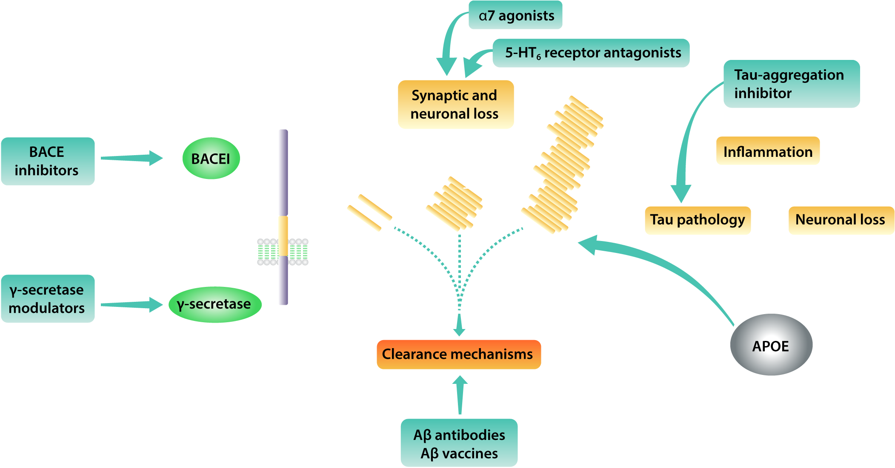
Multiple Therapeutic Targets Directed at AD Pathophysiology Are Under Investigation
Notes:
REF-0492:
Citron 2010
p389, Figure 1

Slide 6
Example of Therapeutic Targets: Beta Amyloid-Related Disease-Modifying Strategies
APP gene
Production
APP
Cu²⁺ Chelator
Aβ
Monomer
?
Antisense
Immunotherapy
Aβ Oligomer
Secretase inhibitors &
modulators
Aggregation
Aβ Fibril
Deposition
Diffuse
Plaque
Fibrillogenesis modulators
Senile
Plaque

Slide 7
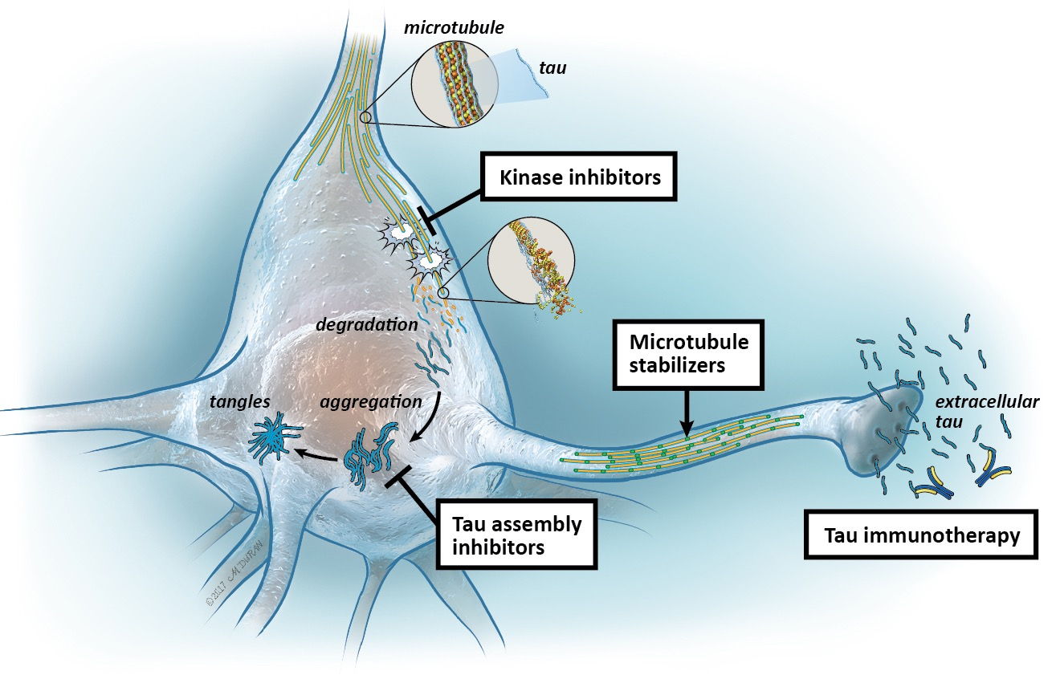
Disease-Modifying Therapies Directed Against Tau

Slide 8
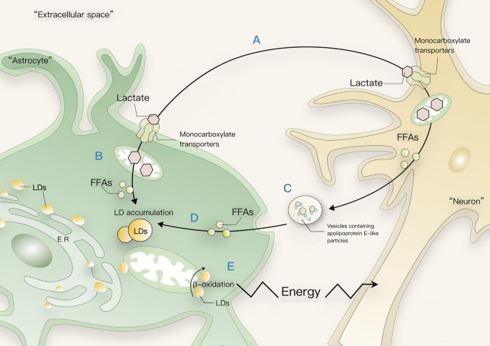
Both Peripheral and Central Cholesterol Metabolism Is Altered in AD
Pathologically in apoE4-related AD, smaller lipid droplets accumulate in astrocytes
ApoE4 aggregates
Higher levels of oxidative stress and lipid peroxidation
Neurons and astrocytes can eliminate excess lipids but need functional apoE-HDL particle for this to occur
Some of the effect of apoE4 on AD risk is likely mediated through elevated serum cholesterol
Elevated serum cholesterol is an independent risk factor for AD, even after controlling for apoE4 genotype (OR=3.1; 95% CI=1.2, 8.5)

Slide 9
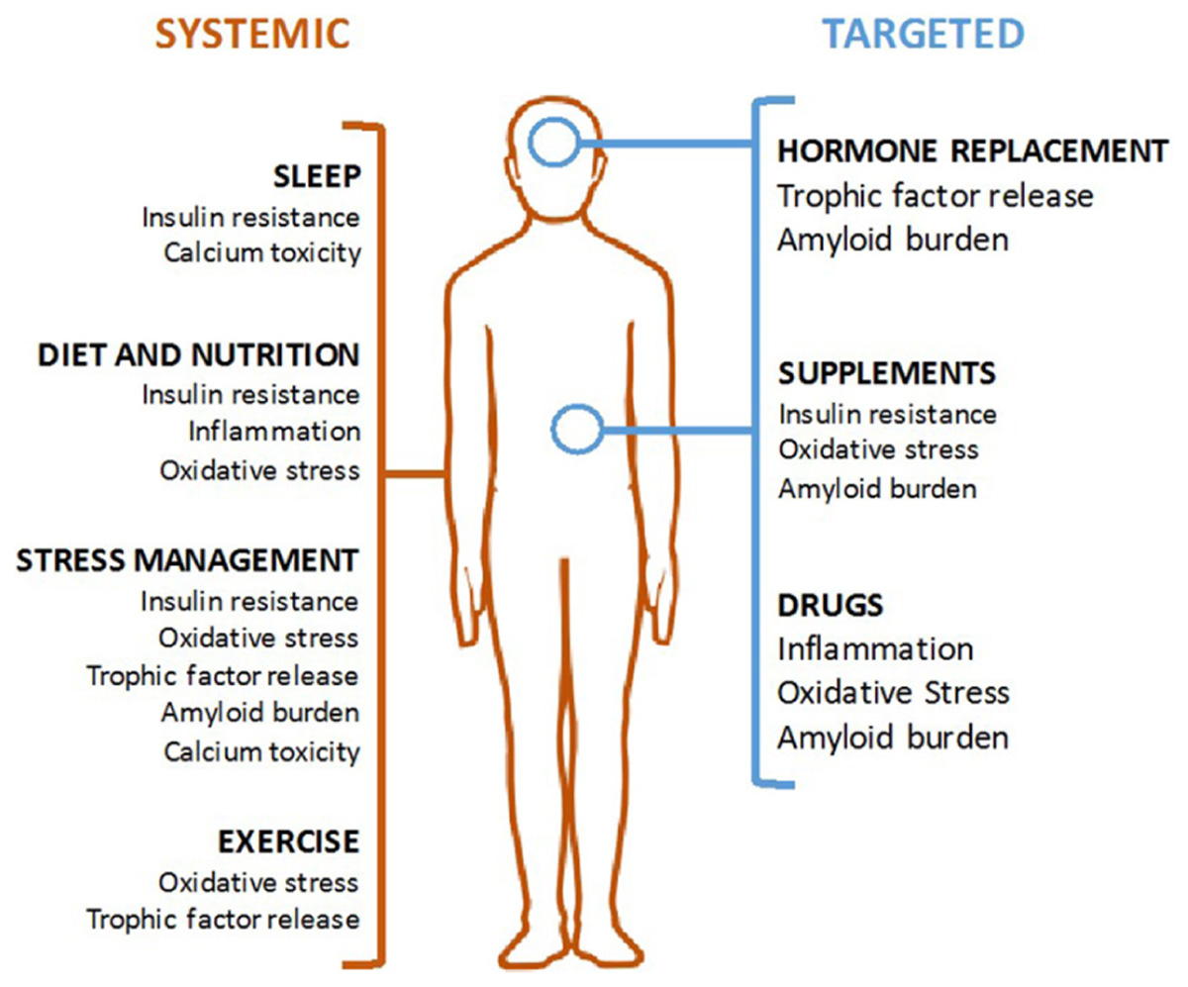
Modalities of AD Prevention
Systemic interventions (in orange, on left) should be the foundation of any AD prevention program and are aimed at correcting an unhealthy baseline
Targeted interventions (in blue, on right) can be used for patient with specific indications

Slide 10
Management of MCI Due to AD: Nonpharmacologic Interventions
Nonpharmacologic interventions have demonstrated small but significant improvements in cognition
Cognition-based intervention in MCI¹
Difference vs control in global cognitive function†:
0.37 (P=0.02)
Physical exercise in MCI¹
Difference vs control in global cognitive function†:
0.25 (P=0.003)
Physical/cognitive training in MCI²
Difference vs control in global cognitive function†:
2.17 (P<0.0001‡)
Multi-domain intervention in at-risk elderly people^{§3}
Difference vs control in cognition‖:
0.022 (P=0.03)

Slide 11
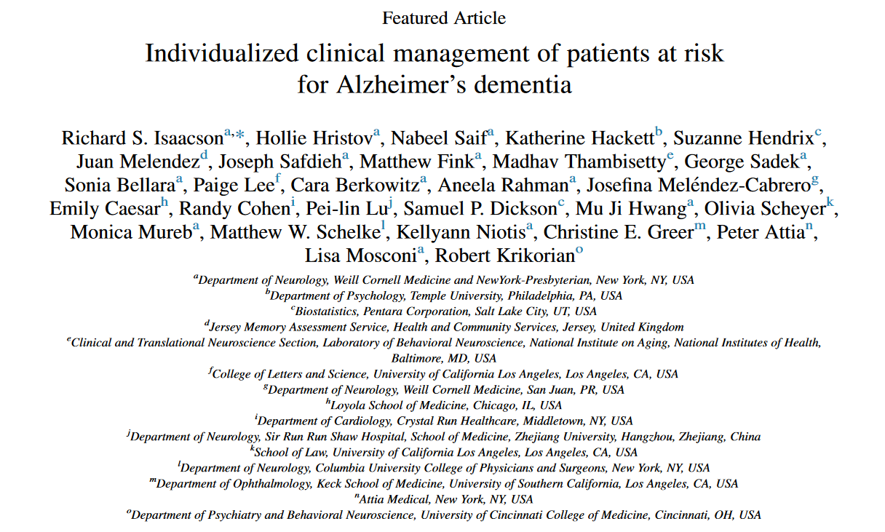

Slide 12
Multiple Components of AD Management
Initial evaluation
Early detection
Comprehensive history
Physical exam + labs
Mental status exam
Neuroimaging
Neuropsychiatric assessment
Ongoing Management
Tracking of symptoms
Cognitive enhancers
Treatment of psychiatric issues
Rapid assessment of mental screening changes
Proactive treatment of comorbidities
Patient
Caregiver
Doctor
Support System
Caregiver
Assessment for burden, depression, and other comorbidities
Disease education
Access to local resources
Individual and group therapy
Respite time
Psychosocial
Adequate supervision
Safety review of home and daily life
Advance directives
Financial planning
Meaningful activities
Physical exercise
Healthy diet
Social stimulation

Slide 13
Looking for more resources on this topic?
CME/CE in minutes
Congress highlights
Late-breaking data
Quizzes
Webinars
In-person events
Slides & resources
www.MedEdOTG.com

