Slide 1
Are There Other Novel Approaches or Targeted Therapies for Early Relapse Myeloma?
Noa Biran, MD
Associate Professor of Medicine
Hackensack Meridian Health
John Theurer Cancer Center, Multiple Myeloma Division
Hackensack, NJ

Slide 2



Resource Information
About This Resource
These slides are one component of a continuing education program available online at MedEd On The Go titled Early Relapse in Multiple Myeloma: Modern Management Strategies
Program Learning Objectives:
Distinguish between relapse and progression of disease in multiple myeloma
Compare the efficacy and safety of carfilzomib- and pomalidomide-based regimens in the treatment of relapsed multiple myeloma
Apply current and emerging treatment approaches to multiple myeloma patients in early relapse
Recognize common adverse events seen with combination regimens used to treat early relapsed multiple myeloma
MedEd On The Go®
www.mededonthego.com
This content or portions thereof may not be published, posted online or used in presentations without permission.
This content can be saved for personal use (non-commercial use only) with credit given to the resource authors.
To contact us regarding inaccuracies, omissions or permissions please email us at support@MedEdOTG.com

Slide 3
Disclaimer
The views and opinions expressed in this educational activity are those of the faculty and do not necessarily represent the views of Total CME, LLC, the CME providers, or the companies providing educational grants. This presentation is not intended to define an exclusive course of patient management; the participant should use their clinical judgment, knowledge, experience, and diagnostic skills in applying or adopting for professional use any of the information provided herein. Any procedures, medications, or other courses of diagnosis or treatment discussed or suggested in this activity should not be used by clinicians without evaluation of their patient's conditions and possible contraindications or dangers in use, review of any applicable manufacturer’s product information, and comparison with recommendations of other authorities. Links to other sites may be provided as additional sources of information.

Slide 4
Principles of Therapy in RRMM
Timing of Relapse
Biology of Relapse
  Hypercalcemia
  Renal failure
  Cytopenias
  NGS/High-risk FISH
Response to prior therapy
  Sensitive/refractory
Performance Status and Comorbidities
  Intolerance
  Diabetes/Peripheral neuropathy
  Support network

Slide 5
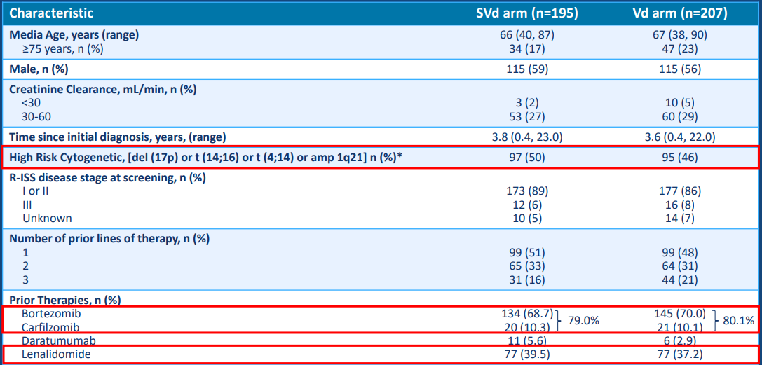
BOSTON Trial: Selinexor + Bortezomib + Dex in Early Relapsed Myeloma
Patient and Disease Characteristics Well Balanced Between Treatment Arms

Slide 6
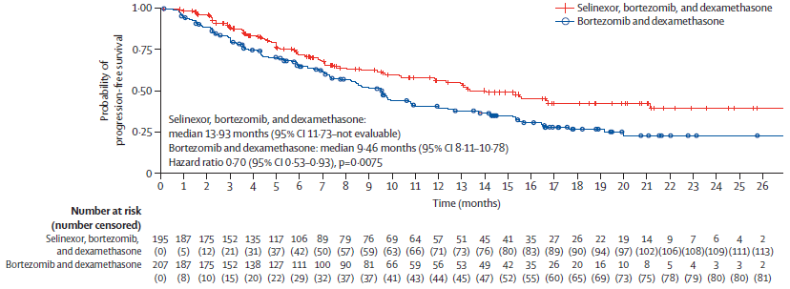
BOSTON Trial: Selinexor + Bortezomib + Dex in Early Relapsed Myeloma

Slide 7
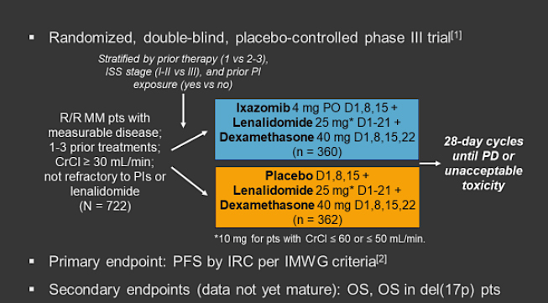
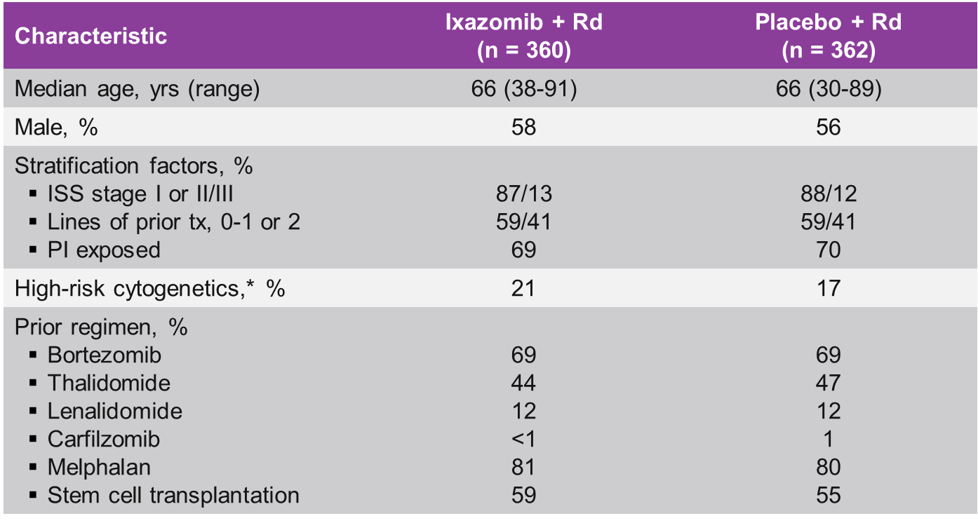
TOURMALINE-MM1: Study Design and Baseline Characteristics
*t(4;14), t(14;16), del(17p).

Slide 8
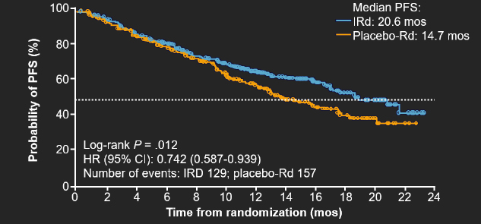
TOURMALINE-MM1: PFS
PFS benefit with ixazomib seen in all prespecified subgroups, including cytogenetic high risk, PI and IMiD exposed

Slide 9
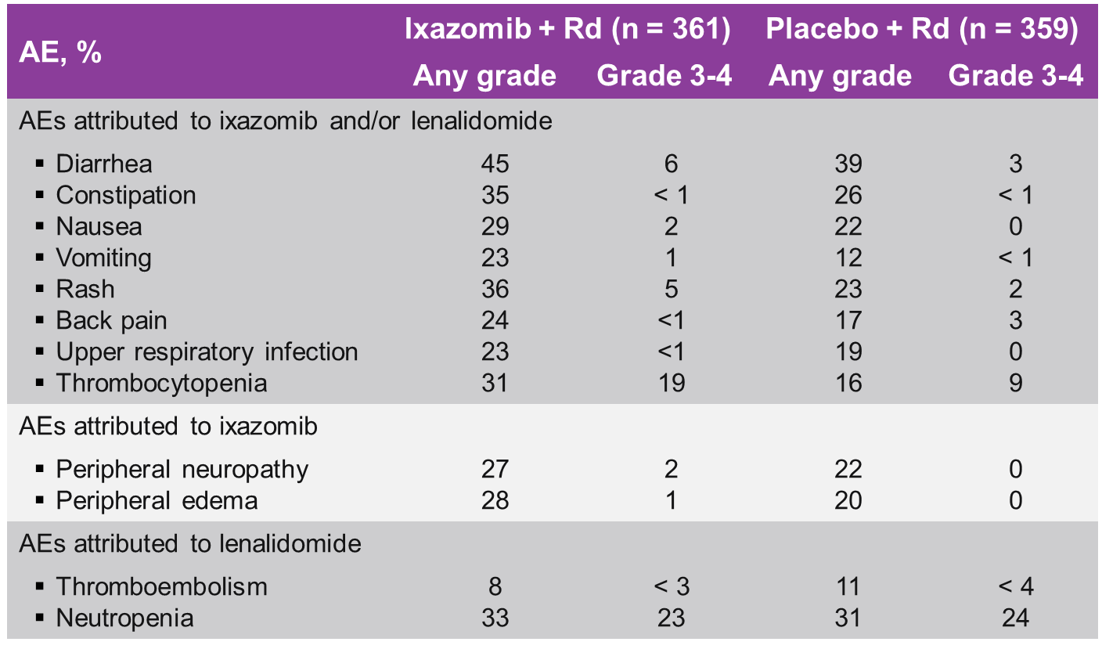
Addition of Ixazomib to Lenalidomide/Dexamethasone Significantly Prolonged PFS with Tolerable Safety Profile

Slide 10
Summary
The combination of selinexor with bortezomib and dexamethasone in patients with multiple myeloma who resulted in median PFS of 13.9 versus 9.4 months
A progression-free survival benefit was seen with ixazomib-lenalidomide-dex compared to lenalidomide-dex in patients with early relapsed myeloma of 20.4 versus 14.7 months

Slide 11



Looking for more resources
on this topic?
CME/CE in minutes
Congress highlights
Late-breaking data
Quizzes
Webinars
In-person events
Slides & resources
www.MedEdOTG.com

