Slide 1
Is There a Role for Novel BCMA-Directed Cellular Therapies in Early Relapsed Multiple Myeloma?
Joseph Mikhael, MD, MEd, FRCPC
Chief Medical Officer, International Myeloma Foundation
City of Hope Cancer Center
Phoenix, AZ

Slide 2



Resource Information
About This Resource
These slides are one component of a continuing education program available online at MedEd On The Go titled Early Relapse in Multiple Myeloma: Modern Management Strategies
Program Learning Objectives:
Distinguish between relapse and progression of disease in multiple myeloma
Compare the efficacy and safety of carfilzomib- and pomalidomide-based regimens in the treatment of relapsed multiple myeloma
Apply current and emerging treatment approaches to multiple myeloma patients in early relapse
Recognize common adverse events seen with combination regimens used to treat early relapsed multiple myeloma
MedEd On The Go®
www.mededonthego.com
This content or portions thereof may not be published, posted online or used in presentations without permission.
This content can be saved for personal use (non-commercial use only) with credit given to the resource authors.
To contact us regarding inaccuracies, omissions or permissions please email us at support@MedEdOTG.com

Slide 3
Disclaimer
The views and opinions expressed in this educational activity are those of the faculty and do not necessarily represent the views of Total CME, LLC, the CME providers, or the companies providing educational grants. This presentation is not intended to define an exclusive course of patient management; the participant should use their clinical judgment, knowledge, experience, and diagnostic skills in applying or adopting for professional use any of the information provided herein. Any procedures, medications, or other courses of diagnosis or treatment discussed or suggested in this activity should not be used by clinicians without evaluation of their patient's conditions and possible contraindications or dangers in use, review of any applicable manufacturer’s product information, and comparison with recommendations of other authorities. Links to other sites may be provided as additional sources of information.

Slide 4
KarMMa-3: Phase III Trial of Ide-Cel vs SoC in R/R MM
International, open-label, randomized phase III trial
Stratified by age (<65 vs ≥65), prior therapies
(2 lines vs 3-4 lines), and high-risk cytogenetics
(present or absent)
Lymphodepletion
CAR T-Cell Infusion (Day 0)
Patients with R/R MM after 2-4 prior
lines of therapy; including a PI, an IMiD, and daratumumab; disease progression in ≤60 days after last therapy
ECOG PS ≤1
(N = 386)
Cyclophosphamide 300 mg/m² +
Fludarabine 30 mg/m²
Idecabtagene Vicleucel
150-450 x 10⁶ CAR T-cells
(n = 254)
2:1
Investigators’ Choice SoC*
(n = 132)
PD or unacceptable toxicity
Key Pt Characteristics
Median PLT 3
HR cytogenetics ~45%
Extramedullary disease ~25%
Triple-Class-Refractory ~65%
Transplant ~85%
Primary endpoint: PFS
Key secondary endpoints: ORR, OS, DoR, MRD detection, safety

Slide 5
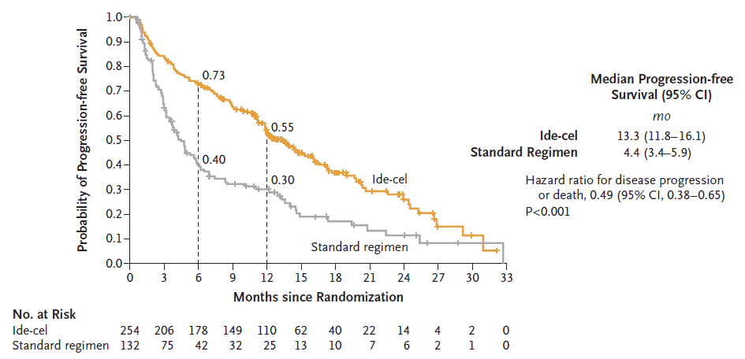
KarMMa 3 Study Results: PFS (Primary Endpoint)
Progression-free Survival (Intention-to-Treat Population)
PFS benefit consistently observed across prespecified subgroups including age, race, number of previous regimens, presence/absence
of high-risk cytogenetic abnormalities, extramedullary disease, high tumor burden, or triple-class-refractory status

Slide 6
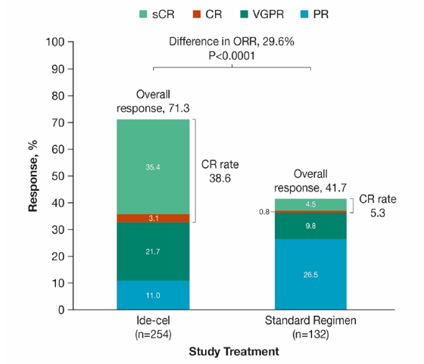
KarMMa 3 Study Results: Key Secondary Endpoints (ITT)
233/250
94/126
Percentage of Patients
Cytokine release syndrome Gr 3/4: 4% vs 0%
Neurotoxic event Gr 3/4: 3% vs 0%
Conclusions
Among adults with heavily pretreated relapsed and refractory multiple myeloma who had received 2 to 4 lines of therapy previously, the CAR T-cell therapy ide-cel led to significantly longer progression-free survival than standard regimens.

Slide 7
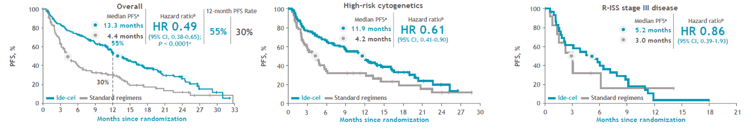
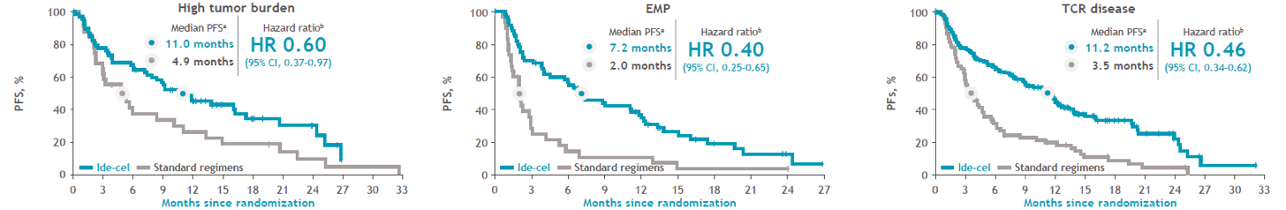
Progression-free Survival (ITT and High-risk Subgroups)
Median PFS was longer in patients treated with ide-cel vs standard regimens in the overall population and high-risk subgroups; interpretation in patients with R-ISS stage III disease was limited due to small subgroup size

Slide 8
CARTITUDE-4: Study Design and Endpoints
Screening
Key inclusion criteria:
Age ≥18 years
with MM
1–3 prior LOT (including PI + IMiD)
LEN-refractory
ECOG PS ≤1
Key exclusion criteria:
Prior CAR-T or
BCMA-targeting therapy
Randomization
1:1 randomization
Stratified by:
Choice of PVd/DPd
ISS stage
Number of prior LOT
PVd or DPd^{a,b}
Follow-up
SOC arm
Bridging
PVd or DPdª
≥1 cycle
Day 1:
Cilta-cel
infusion
(Target: 0.75×10⁶
CAR+ T cells/kg)
Day 1–112:
Collect safety, efficacy, PK/PD data
every 28 days
Lymphodepletion
Cilta-cel arm
Apheresis
(start of study treatment)
T-cell transduction and expansion
Primary endpoint
  PFS^{c}
Secondary endpoints
  Efficacy: ≥CR, ORR, MRD negativity, OS
  Safety
  PROs

Slide 9
CARTITUDE-4: Primary Endpoint – PFS (ITT Population)
Cilta-cel vs SOC
  12-month PFS rate: 76% vs 49%
  SOC performed
  as expected
Progression-free survivalª
Bridging phase, patients in cilta-cel arm were receiving the same treatment as the SOC arm
100
Week 8
Hazard ratio, 0.26 (95% CI, 0.18–0.38); P<0.0001^{b,c}
80
mPFS: not reached (95% CI, 22.8–NE)
60
Patients progression free and alive, %
40
20
mPFS: 11.8 months (95% CI, 9.7–13.8)
0
0
3
6
9
12
15
18
21
24
27
30
No. at risk
Progression-free survival, months
Cilta-cel arm
208
177
172
166
146
94
45
22
9
1
0
SOC arm
211
176
133
116
88
46
20
4
1
0
0
Cilta-cel arm
SOC arm

Slide 10
CARTITUDE-4: Secondary Endpoint (ITT) – Response
Cilta-cel had higher ORR vs SOC
Overall response rate^{a,b,c}
Outcome | Cilta-cel (N=208) | SOC (N=211)
12-month DOR rate, % (95% CI) | 84.7 (78.1–89.4) | 63.0 (54.2–70.6)
Duration of response, months median (95% CI) | NR | 16.6 (12.9–NE)
Odds ratio:
3.0 (1.8–5.0) P<0.0001
84.6
(176/208)
67.3
(142/211)
≥CR^{d}:
21.8
Patients, %
≥CR^{d}:
73.1
sCR
CR
VGPR
PR

Slide 11
CARTITUDE-4: CRS and CAR-T Cell-Related Neurotoxicity
In the cilta-cel as-treated population:
30 patients had non-ICANS neurotoxicities^{c}
  16 cranial nerve palsies (14 recovered)
  5 peripheral neuropathies
  1 MNT (grade 1)
Lower incidence and severity of CRS, ICANS, MNTs, and some cytopenias observed with CARTITUDE-4 vs CARTITUDE-1
  Cilta-cel may be better tolerated when used earlier in treatment
  Effective bridging therapy enables better control of tumor burden prior to CAR-T infusion
  MNTs were lower likely related to patient management strategies implemented to mitigate this risk
AEs, n (%) | As-treated patients (n=176)
AEs, n (%) | Any grade | Grade 3/4 | Median time to onset, days | Median duration, days | Resolved, n
CRS | 134 (76.1) | 2 (1.1) | 8 | 3 | 134
Neurotoxicityª | 36 (20.5) | 5 (2.8)
ICANS | 8 (4.5) | 0^{b} | 10 | 2 | 8
Other^{c} | 30 (17.0) | 4 (2.3)
Cranial nerve palsy^{d} | 16 (9.1) | 2 (1.1) | 21 | 77 | 14
Peripheral neuropathy | 5 (2.8) | 1 (0.6) | 63 | 201 | 3
MNT | 1 (0.6) | 0 | 85 | – | 0

Slide 12



MajesTEC-2: Teclistamab with Subcutaneous Daratumumab and Lenalidomide in MM
Key eligibility criteria
Measurable MM
1–3 prior lines of therapy, including an IMiD and a PI
Primary endpoints
Safetyª
Dose-limiting toxicities
Key secondary endpoints
ORR^{b}
Rate of ≥VGPR and ≥CR^{b}
Duration of response
Time to response
Tec-Dara-Len Dosing Schedule
Tec
Following step-up dosing
0.72 mg/kg or 1.5 mg/kg SC QW with transition to 3 mg/kg SC Q2W starting at cycle 3
Dara
1800 mg SC (per approved schedule)
  Cycles 1–2: QW
  Cycles 3–6: Q2W
  Cycles 7+: Q4W
Len
25 mg PO daily for 21 days of a
28-day cycle, starting at cycle 2
Cycles 2–4: dexamethasone
40 mg PO given QW

Slide 13
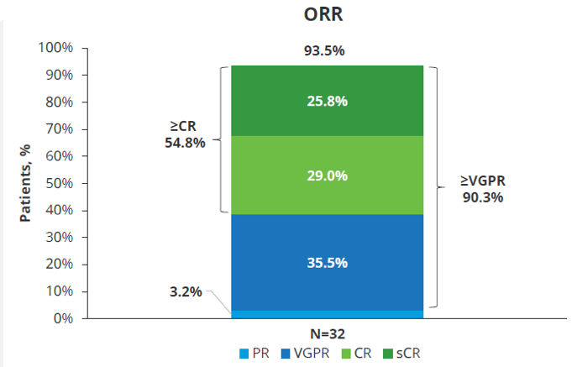
MajesTEC-2: Overall Response Rate with Tec-Dara-Len
Variable | Median (range)
Follow-up, months | 8.4 (1.1–12.9)
Time to first response, months | 1.0 (0.7–3.3)
Time to ≥CR, months | 3.0 (1.0–10.4)
Time to first response was quick and responses deepened over time

Slide 14
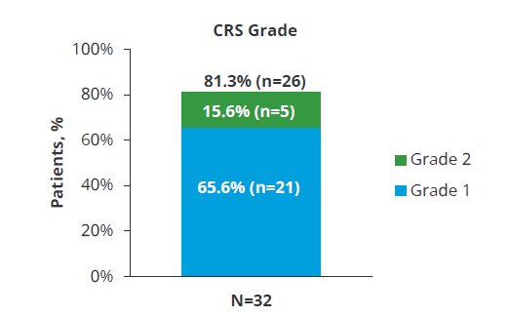
MajesTEC-2: Toxicities with Tec-Dara-Len
All CRS events were low grade; no grade ≥3 events reported
97% (37/38) of CRS events occurred during cycle 1
Infections were common but majority were low-grade
Most common infections were COVID-19, upper respiratory infection, and pneumonia
  4 (33.3% of 12 patients who had COVID-19 were unvaccinated
  2 (6.3%) patients discontinued due to an AE (COVID-19)
2 fatal AEs were reported
  COVID-19 (77 days after last dose)
  Multiorgan failure due to sepsis

Slide 15
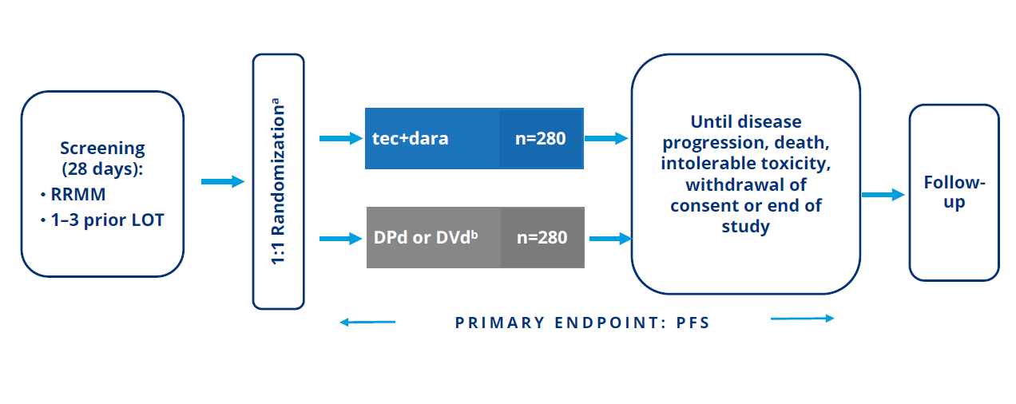
MajesTEC-3: Teclistamab Plus Daratumumab Vs. Investigator’s Choice of DPd or DVd in Patients with Relapsed/Refractory MM and 1-3 Prior LOT

Slide 16
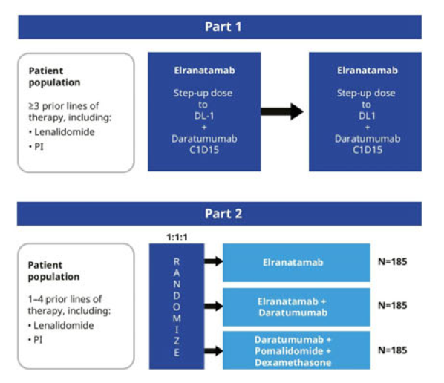
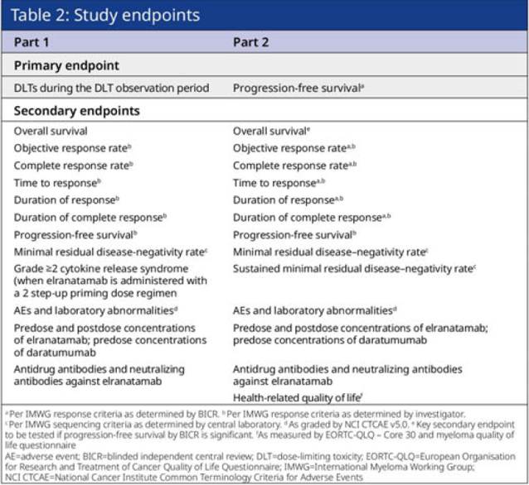
MagnetisMM-5: An Open-Label, Multicenter, Randomized Phase 3 Study of Elranatamab as Monotherapy and in Combination with Daratumumab in Patients with Relapsed/Refractory MM

Slide 17
Conclusions
Theoretically one would expect CAR T-cell therapy to be more effective in earlier lines of therapy due to “earlier” engagement of
T cells
This now has been proven with BOTH ide-cel and cilta-cel
There is also a signal that CAR T-cell therapy may be less toxic
We very likely will be using CAR T-cell agents in earlier lines of therapy soon
The same investigation is now being done with bispecific antibodies…

Slide 18



Looking for more resources
on this topic?
CME/CE in minutes
Congress highlights
Late-breaking data
Quizzes
Webinars
In-person events
Slides & resources
www.MedEdOTG.com

