Slide 1
Pomalidomide-Based Regimens in Early Relapse Multiple Myeloma
Joseph Mikhael, MD, MEd, FRCPC
Chief Medical Officer, International Myeloma Foundation
Professor, Translational Genomics Research Institute (TGen)
City of Hope Cancer Center
Phoenix, AZ

Slide 2



Resource Information
About This Resource
These slides are one component of a continuing education program available online at MedEd On The Go titled Early Relapse in Multiple Myeloma: Modern Management Strategies
Program Learning Objectives:
Distinguish between relapse and progression of disease in multiple myeloma
Compare the efficacy and safety of carfilzomib- and pomalidomide-based regimens in the treatment of relapsed multiple myeloma
Apply current and emerging treatment approaches to multiple myeloma patients in early relapse
Recognize common adverse events seen with combination regimens used to treat early relapsed multiple myeloma
MedEd On The Go®
www.mededonthego.com
This content or portions thereof may not be published, posted online or used in presentations without permission.
This content can be saved for personal use (non-commercial use only) with credit given to the resource authors.
To contact us regarding inaccuracies, omissions or permissions please email us at support@MedEdOTG.com

Slide 3
Disclaimer
The views and opinions expressed in this educational activity are those of the faculty and do not necessarily represent the views of Total CME, LLC, the CME providers, or the companies providing educational grants. This presentation is not intended to define an exclusive course of patient management; the participant should use their clinical judgment, knowledge, experience, and diagnostic skills in applying or adopting for professional use any of the information provided herein. Any procedures, medications, or other courses of diagnosis or treatment discussed or suggested in this activity should not be used by clinicians without evaluation of their patient's conditions and possible contraindications or dangers in use, review of any applicable manufacturer’s product information, and comparison with recommendations of other authorities. Links to other sites may be provided as additional sources of information.

Slide 4
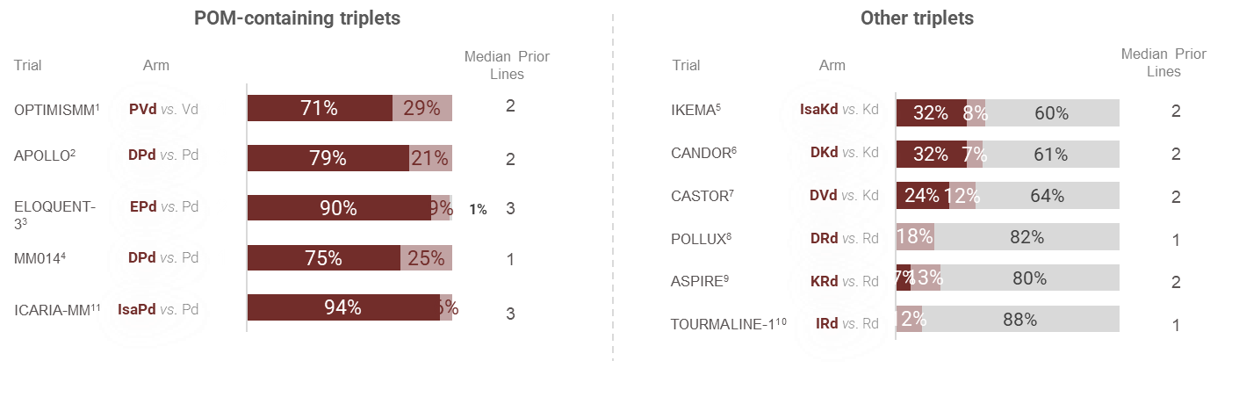
Key Trials in Relapsed Disease
Listed by degree of LEN-refractoriness¹⁻¹¹
LEN refractory
LEN exposed (not refractory)
Non LEN exposed
Note: Charts provided for ease of viewing information from multiple trials. Direct comparison is not intended and should not be inferred.

Slide 5
Phase 3 OPTIMISMM Study Design¹
21-day cycles
RRMM
1-3 prior regimens, ≥ 2 cycles of LEN
ECOG PS ≤ 2
Prior BORT allowed (PD with 1.3 mg/m² twice weekly dose excluded)
N = 559
PVd (n = 281)
POM 4 mg D 1-14
BORT 1.3 mg/m² sc
cycles 1-8: D 1, 4, 8, 11
cycles 9+: D 1 and 8
LoDEX 20 mg (≤ 75 y) or 10 mg
(> 75 y) day of and day after BORT
Follow-up visit
28 days after Tx discontinuation
LT follow-up
PD, subsequent antimyeloma Tx, and survival
PD or unacceptable toxicity
Vd (n = 278)
BORT 1.3 mg/m² sc
cycles 1-8: D 1, 4, 8, 11
cycle 9+: D 1 and 8
LoDEX 20 mg (≤ 75 y) or 10 mg
(> 75 y) day of and day after BORT
Enter PFS
follow-up period
Stratification
  Age (≤75 y vs >75 y)
  Prior regimens (1 vs > 1)
  β2-microglobulin at screening (<3.5 mg/L vs ≥3.5 to ≤5.5 mg/L vs >5.5 mg/L)

Slide 6

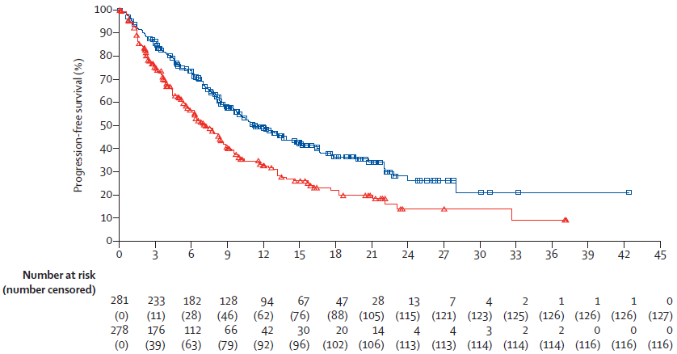
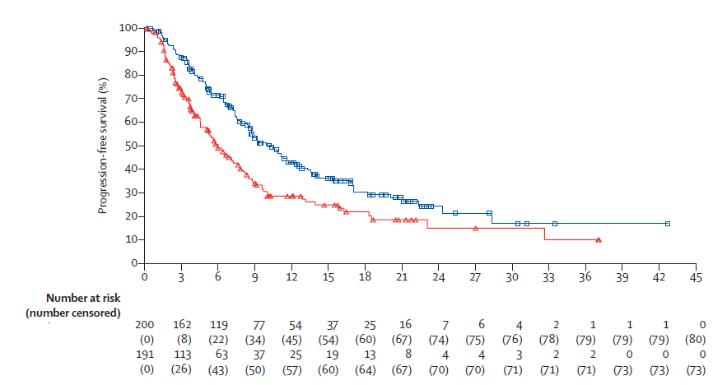

OPTIMISMM: Progression-Free Survival¹
ITT
(PVd)
(Vd)
LEN-refractory
70% (n=391) LEN-refractory
(PVd)
(Vd)
(PVd)
(Vd)
Gr 3/4 AE: neutropenia 42%, thrombocytopenia 27%, infections 31%, peripheral sensory neuropathy 8%

Slide 7
APOLLO - Study Design¹
Phase 3 study of D-Pd versus Pd in RRMM conducted in collaboration between EMN and Janssen¹
Key eligibility criteria:
RRMM
≥1 prior line with both lenalidomide and a PI
ECOG PS ≤2
CrCl ≥30 mL/min
D-Pd
D: 1,800 mg SCª QW Cycles 1-2,
Q2W Cycles 3-6, Q4W Cycles 7+
P: 4 mg PO Days 1-21
d: 40 mg^{b} PO Days 1, 8, 15, 22
Post-treatment follow-up Q4W for patients who discontinued treatment^{c}
Survival follow-up every 12 weeks following PD or start of subsequent therapy
Primary endpoint:
PFS
Secondary endpoints:
ORR, ≥VGPR, ≥CR^{d}
MRDe
OS
Time to response
Duration of response
Time to next therapy
Safety
HRQoL
1:1 randomization
Pd
P: 4 mg PO Days 1-21
d: 40 mg^{b} PO Days 1, 8, 15, 22
Stratification factors
Number of lines of prior therapy
(1 vs 2-3 vs ≥4)
ISS disease stage (I vs II vs III)
Cycle duration: 28 days
Treatment until PD or
unacceptable toxicity

Slide 8
APOLLO: PFS at a Median Follow-Up of 16.9 Months^{a1}
100
12-month PFS rate^{b}
80
60
52%
% surviving without progression
40
35%
D-Pd median: 12.4 months
20
HR, 0.63; 95% CI, 0.47-0.85;
P = 0.0018
Pd median: 6.9 months
0
0
2
4
6
8
10
12
14
16
18
20
22
24
26
28
30
32
34
36
No. at risk
Months
Gr 3/4 AE: neutropenia 68%, anemia 17%, thrombocytopenia 17%, infections 70%
Pd
D-Pd
153
151
121
135
93
111
79
100
61
87
52
80
46
74
36
66
27
48
17
30
12
20
5
12
5
8
1
5
0
3
0
2
0
2
0
2
0
1
Median PFS among patients refractory to lenalidomide was 9.9 months for D-Pd and 6.5 months for Pd
Addition of DARA SC to Pd improved PFS, with a 37% reduction
in the risk of progression or death

Slide 9
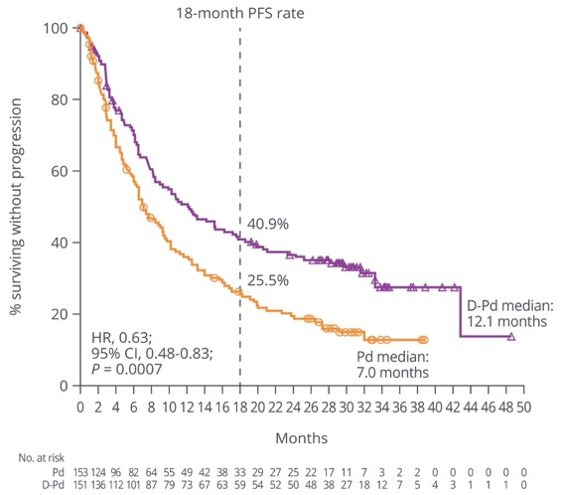
APOLLO: PFS – Updated at ASH 2021¹
FIGURE 2. PFS in the ITT population.
With a median follow-up of 30.7 months, D-Pd provided a PFS benefit over Pd in the ITT population
Among patients who were refractory to lenalidomide, the median PFS was 9.9 months in the D-Pd group and 6.5 months in the Pd group (HR, 0.64; 95% CI, 0.48-0.86)
Among patients who were refractory to lenalidomide and last received a lenalidomide dose of 5 to 10 mg, the median PFS was 10.3 months in the D-Pd group and 8.5 months in the Pd group
(HR, 0.83; 95% CI, 0.47-1.45; P = 0.5030)
  The estimated 18-month PFS rates were 27.6% and 24.1%, respectively
Among patients who were refractory to lenalidomide and last received a lenalidomide dose of 15 to 25 mg, the median PFS was 10.7 months in the D-Pd group and 6.5 months in the Pd group
(HR, 0.56; 95% CI, 0.39-0.80; P = 0.0011)
  The estimated 18-month PFS rates were 39.5% and 22.0%, respectively
7

Slide 10
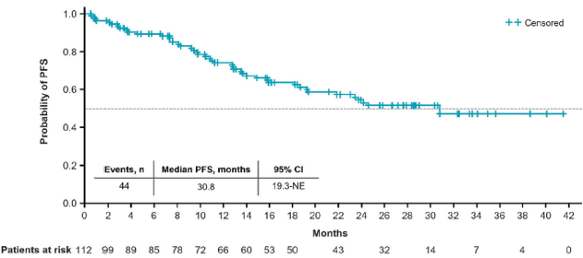
MM-014: DPd in RRMM^{1,2}
MM-014 (Cohort B), phase 2 study, nonrandomized, n = 112, DPd Pomalidomide 4 mg, orally, days 1 to 21 (28 days) Daratumumab 16 mg/kg, intravenously, days 1, 8, 15, and 22 of cycles 1 and 2; days 1 and 15 for cycles 3 through 6; and day 1 for cycle 7 and beyond Dexamethasone 40 mg, orally, days 1, 8, 15, and 22 | CASSIOPEIA study: D-VTd versus VTd
RRMM; measurable disease; 1–2 prior regimens, patients who relapsed after or were refractory to lenalidomide. Median age: 66.5 years | Prior lines 1 (1-2) 1 (62,5%) | Lenalidomide-exposed: 100% Lenalidomide-refractory: 75% | Median follow-up: 28.4 months
Outcomes:
ORR (ITT population): 77.7% ORR (LEN Refractory): 76.2%
CR (ITT population): 26.8% CR (LEN Refractory): 21.4%
VGPR (ITT population): 25.9% VGPR (LEN Refractory): 26.2%
Grade ≥ 3 TEAEs, % | DPd
Neutropenia | 64.3
Anemia | 17.9
Thrombocytopenia | 14.3
Infections and infestations | 36.6
Back pain | 6.3
Insomnia | 5.4
Outcomes:
mPFS (ITT population): 30.8 months
mPFS (one prior line): NR
mPFS (refractory to LEN): 23.7 months

Slide 11

ICARIA: Isa-Pd vs Pd - Study Design¹
Isa-Pd n=154
Disease progression,
unacceptable toxicities,
patient withdrawal
1:1
RRMM
Randomization
Pd n=153
Sample size calculation: ~300 patients required to detect an HR of 0.6 with 90% power and 1-sided type 1 error of 2.5%
Cycle 1:
Week 1
Week 2
Week 3
Week 4
Subsequent cycles:
Week 1
Week 2
Week 3
Week 4
↑
D1
↑
D8
↑
D15
↑
D22
↑
D1
↑
D15
Isatuximab 10 mg/kg
Isatuximab 10 mg/kg
Pomalidomide 4 mg
Days 1–21
Pomalidomide 4 mg
Days 1–21
↑
D1
↑
D8
↑
D15
↑
D22
↑
D1
↑
D8
↑
D15
↑
D22
Dexamethasone 40 mg*
Dexamethasone 40 mg*

Slide 12
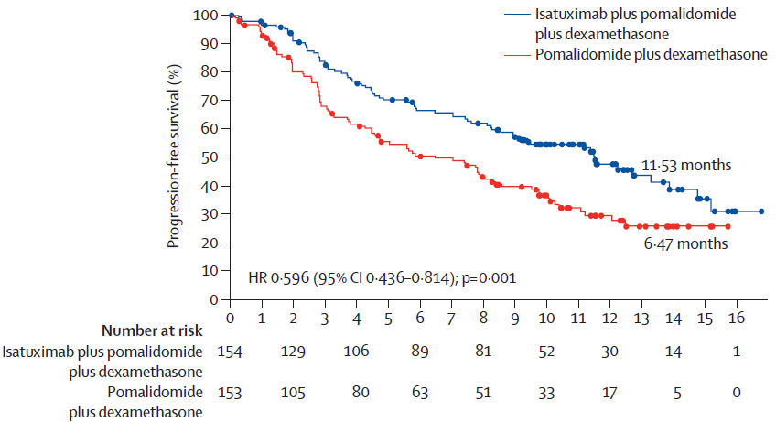
ICARIA-MM: Median PFS (By IRC)¹
ITT population
93% LEN-refractory

Slide 13
ICARIA-MM: Final OS Analysis¹
220 OS events: 106 (68.8%) in Isa-Pd; 114 (74.5%) in Pd*
100
Isa-Pd
Pd
Censor
90
80
70
Isa-Pd:
mOS: 24.57 months
(95% CI: 20.304–31.310)
60
50
Overall survival (%)
40
Pd:
mOS: 17.71 months
(95% CI: 14.390–26.218)
30
20
10
0
HR = 0.776 (95% CI: 0.594–1.1015); log-rank p=0.0319†
0
3
6
9
12
15
18
21
24
27
30
33
36
39
42
45
48
51
54
Time (Months)
Number at Risk
Isa-Pd
154
145
127
119
109
102
91
84
75
68
63
61
54
50
48
45
44
23
8
Pd
153
137
116
103
93
82
72
66
65
58
49
44
42
39
36
36
33
18
3
Clinically meaningful OS benefit, with 6.9-month improvement in median OS

Slide 14
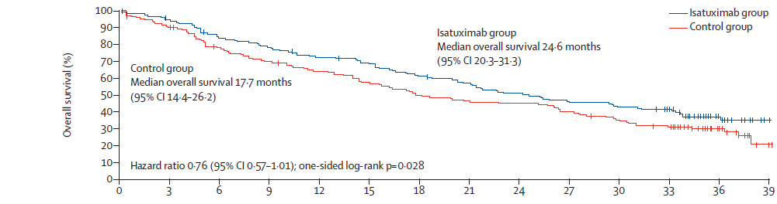
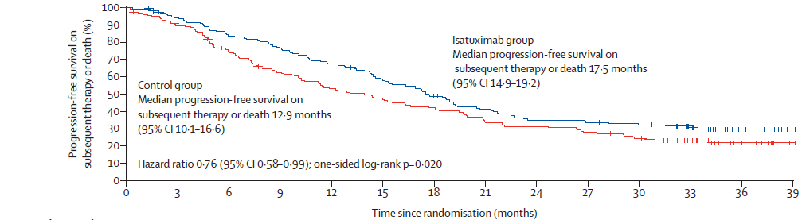
ICARIA-MM: Extended Follow-Up Analysis¹
Gr ≥3 AE: neutropenia 50%, pneumonia 23%, thrombocytopenia 13%

Slide 15
ELOQUENT-3: Addition of Elotuzumab to Pomalidomide/Dexamethasone Backbone¹
Elotuzumab + pomalidomide + dexamethasone (n=60)
Open-label, randomized phase 2 trial
ORR: 53% for elotuzumab group vs 26% for control group; odds ratio: 3.25 (95% CI, 1.49-7.11)
Elotuzumab 10 mg/kg IV every week in cycles
1-2 and 20 mg/kg IV every 4 weeks thereafter
Pomalidomide 4 mg PO on d 1-21 of each cycle
Dexamethasone 40- or 20-mg equivalent every week for patients aged ≤75 or >75 y, respectively
Primary endpoint: PFS
Secondary endpoint: ORR
Patients with R/R MM who received ≥2 prior lines and are refractory or R/R to lenalidomide and a PI
(N = 117)
R
28-d cycles
Pomalidomide + dexamethasone (n=57)

Slide 16
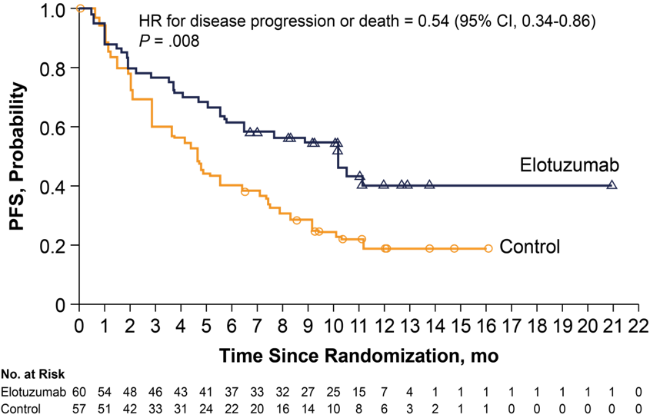
ELOQUENT-3: PFS¹
Gr 3/4 AE: neutropenia 13%, anemia 10%, infections 13%
In this population of lenalidomide- and PI-refractory patients, risk of progression or death was significantly lower among those who received elotuzumab + pomalidomide/dexamethasone vs pomalidomide + dexamethasone alone

Slide 17
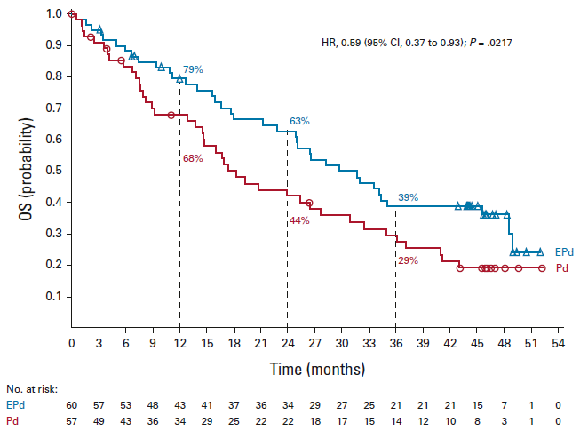
ELOQUENT-3: Final Analysis of OS¹
In this population of lenalidomide- and PI-refractory patients, median OS was prolonged by over 12 months, and the risk of death reduced by 41% with EPd vs Pd alone
No new safety signals were detected
Minimum follow-up of
45 months

Slide 18
Conclusions – Pomalidomide-Based Regimens in Early Relapse
Evidence supports the long-term use of therapy in MM, especially with immunomodulatory agents
We can divide relapsed patients into those not refractory to lenalidomide, and those refractory to lenalidomide
Multiple options exist for LEN-sensitive patients including DRd, KRd, and IRd
Multiple options exist for LEN-refractory patients, including PVd, DVd, DPd, Isa-Pd, DKd and Isa-Kd
Managing patients on pomalidomide is similar to managing those on lenalidomide

Slide 19



Looking for more resources
on this topic?
CME/CE in minutes
Congress highlights
Late-breaking data
Quizzes
Webinars
In-person events
Slides & resources
www.MedEdOTG.com

