Slide 1
Multiple Myeloma At First Relapse: Is My Patient Refractory to Lenalidomide?
Noa Biran, MD
Associate Professor of Medicine
Hackensack Meridian Health
John Theurer Cancer Center, Multiple Myeloma Division
Hackensack, NJ

Slide 2



Resource Information
About This Resource
These slides are one component of a continuing education program available online at MedEd On The Go titled Early Relapse in Multiple Myeloma: Modern Management Strategies
Program Learning Objectives:
Distinguish between relapse and progression of disease in multiple myeloma
Compare the efficacy and safety of carfilzomib- and pomalidomide-based regimens in the treatment of relapsed multiple myeloma
Apply current and emerging treatment approaches to multiple myeloma patients in early relapse
Recognize common adverse events seen with combination regimens used to treat early relapsed multiple myeloma
MedEd On The Go®
www.mededonthego.com
This content or portions thereof may not be published, posted online or used in presentations without permission.
This content can be saved for personal use (non-commercial use only) with credit given to the resource authors.
To contact us regarding inaccuracies, omissions or permissions please email us at support@MedEdOTG.com

Slide 3
Disclaimer
The views and opinions expressed in this educational activity are those of the faculty and do not necessarily represent the views of Total CME, LLC, the CME providers, or the companies providing educational grants. This presentation is not intended to define an exclusive course of patient management; the participant should use their clinical judgment, knowledge, experience, and diagnostic skills in applying or adopting for professional use any of the information provided herein. Any procedures, medications, or other courses of diagnosis or treatment discussed or suggested in this activity should not be used by clinicians without evaluation of their patient's conditions and possible contraindications or dangers in use, review of any applicable manufacturer’s product information, and comparison with recommendations of other authorities. Links to other sites may be provided as additional sources of information.

Slide 4
What Is the Difference Between Relapse and Refractory?
Patients with relapsed/refractory multiple myeloma (RRMM) are a diverse group.
  Relapse while NOT on
  active therapy
  Relapse WHILE on active therapy
  Primary refractory MM (disease that is nonresponsive to treatment in patients who never achieve a minimal response or better)
Relapsed disease: Previously
treated myeloma that has progressed after prior therapy and requires
new therapy
Refractory disease: Disease that becomes non-responsive or progressive on therapy within 60 days of the last treatment
Disease progression: Disease that progresses by serum or urine laboratory tests or by imaging studies. (Meets the IMWG definition of PD)

Slide 5
IMWG Definition of Relapse
Clinical relapse²
Any one or more of the following criteria:
Direct indicators of increasing disease and/or end organ dysfunction (CRAB features) related to the underlying clonal plasma-cell proliferative disorder: it is not used in the calculation of time to progression or progression-free survival but is listed as something that can be reported optionally or for use in clinical practice
Development of new soft tissue plasmacytomas or bone lesions (osteoporotic fractures do not constitute progression)
﻿﻿Definite increase in the size of existing plasmacytomas or bone lesions; a definite increase is defined as a 50% (and ≥1cm) increase as measured serially by the SPD of the measurable lesion
﻿﻿Hypercalcemia (>11 mg/dL)
﻿﻿Decrease in hemoglobin of ≥2 g/dL not related to therapy or other non-myeloma-related conditions
﻿﻿Rise in serum creatinine by ≥2 mg/dL from
the start of the therapy and attributable to myeloma
﻿﻿Hyperviscosity related to serum paraprotein

Slide 6
IMWG Definition of Relapse
Biochemical relapse³
≥25% increase from the lowest confirmed response of the monoclonal protein (M protein) in the serum (absolute increase, ≥0.5 g/dL) or in the urine (absolute increase, ≥200 mg/d)
≥25% increase from the lowest confirmed response between involved and uninvolved serum-free light chains (absolute increase, >10 mg/dL)
﻿﻿≥10% increase of the absolute percentage of BM plasma cells
New soft tissue plasmacytomas or bone lesions
≥50% (and ≥1 cm) increase in existing plasmacytomas or bone lesions, as measured serially according to the SPD of the measured lesions

Slide 7
IMWG Definition of Relapse
Relapse from CR² (to be used only if the endpoint is disease-free survival)
Any one or more of the following criteria:
Reappearance of serum or urine M protein by immunofixation or electrophoresis
Development of ≥5% plasma cells in the BM
Appearance of any other sign of progression (i.e., new plasmacytoma, lytic bone lesion, or hypercalcemia, see above)

Slide 8
IMWG Definition of Relapse
Relapse from MRD negativity² (to be used only if the endpoint is disease-free survival)
Any one or more of the following criteria:
﻿﻿Loss of MRD-negative state (evidence of clonal plasma cells on NGF or NGS, or positive imaging study for recurrence of myeloma)
﻿﻿Reappearance of serum or urine M protein by immunofixation or electrophoresis
Development of ≥5% clonal plasma cells in the BM
Appearance of any other sign of progression (i.e., new plasmacytoma, lytic bone lesion, or hypercalcemia)

Slide 9
IMWG Definition of Progression
Progressive disease⁴
Any one or more of the following criteria:
Increase of 25% from lowest confirmed response value in one or more of the following criteria:
  ﻿﻿Serum M protein (absolute increase must be ≥0.5 g/dL)
  ﻿﻿Urine M protein (absolute increase must be
  ≥200 mg/24 hours)
  In patients without measurable serum and urine M protein levels, the difference between involved and uninvolved FLC levels (absolute increase must be >10 mg/dL)
  In patients without measurable serum and urine M protein levels and without measurable involved FLC levels, BM plasma cell percentage irrespective of baseline status (absolute increase must be ≥10%)
Serum M protein increase ≥1 g/dL, if the lowest M component was ≥5 g/dL
Appearance of a new lesion(s), ≥50% increase from nadir in SPD* of >1 lesion, or ≥50% increase in the longest diameter of a previous lesion >1 cm in short axis
≥50% increase in circulating plasma cells (minimum of 200 cells/μL) if this is the only measure of disease

Slide 10
IMWG Definition of Progression
Refractory⁵
Disease that becomes non-responsive or progressive on therapy or within 60 days of the last treatment in patients who had achieved an MR† or better on prior therapy

Slide 11
IMWG Definition of Progression
Primary refractory³
Refractory disease in patients who have never achieved an MR with any therapy. These include patients who never achieve an MR or better, for whom there is no significant change in the M protein concentration and no evidence of clinical progression.

Slide 12
Myeloma Refractory to Lenalidomide
Add weekly dexamethasone
The major definition for lenalidomide-refractory disease is progression or
<PR on FULL-DOSE of lenalidomide
Increase lenalidomide dose
Switch to a pomalidomide (or mo-Ab/PI-based regimen)
Progression on lenalidomide maintenance

Slide 13
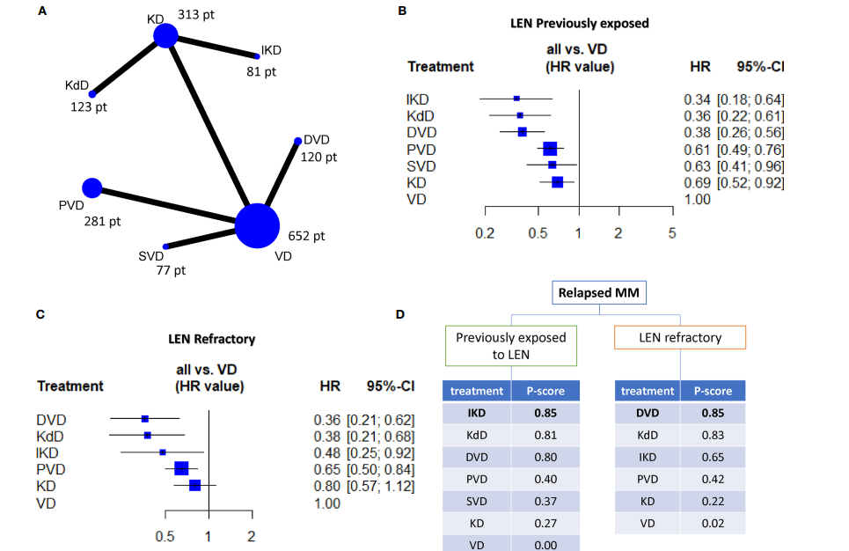
Treatment of LEN-exposed versus LEN-refractory
The efficacy of seven different lenalidomide-sparing regimens was compared in LEN-exposed and LEN-refractory patients

Slide 14
Summary
Relapsed myeloma is previously treated myeloma that has progressed after prior therapy and requires new therapy
The definition of disease progression is a 25% increase in paraprotein burden from the lowest documented value. For M-spike it requires a 0.5 g/dL or above increase from the nadir
The response rates for regimens in the relapsed setting are significantly reduced for lenalidomide-refractory myeloma compared to lenalidomide-sensitive myeloma

Slide 15



Looking for more resources
on this topic?
CME/CE in minutes
Congress highlights
Late-breaking data
Quizzes
Webinars
In-person events
Slides & resources
www.MedEdOTG.com

