Slide 1
Case Discussion: How Do I Manage Patients with TNBC?
Aditya Bardia, MD, MPH
Director
Breast Cancer Research
Associate Professor
Harvard Medical School
Attending Physician
Massachusetts General Hospital
Boston, MA

Slide 2
Disclaimer
The views and opinions expressed in this educational activity are those of the faculty and do not necessarily represent the views of TotalCME, Inc., the CME providers, or the companies providing educational grants. This presentation is not intended to define an exclusive course of patient management; the participant should use their clinical judgment, knowledge, experience, and diagnostic skills in applying or adopting for professional use any of the information provided herein. Any procedures, medications, or other courses of diagnosis or treatment discussed or suggested in this activity should not be used by clinicians without evaluation of their patient's conditions and possible contraindications or dangers in use, review of any applicable manufacturer’s product information, and comparison with recommendations of other authorities. Links to other sites may be provided as additional sources of information.

Slide 3
Objectives
First line therapy
Second line (and plus) therapy

Slide 4
Patient Story: 44F
Noticed increase in shortness of breath, which prompted restaging scans that revealed pulmonary and liver lesions; CT guided biopsy revealed breast adenocarcinoma, ER-/PR-/HER2-
How would you treat this patient?
(BRCA testing negative)
Carboplatin
Eribulin
Paclitaxel
Capecitabine
It depends…

Slide 5
Patient Story: 44F
Noticed increase in shortness of breath, which prompted restaging scans that revealed pulmonary and liver lesions; CT guided biopsy revealed breast adenocarcinoma, ER-/PR-/HER2-
How would you treat this patient?
(BRCA testing negative)
Carboplatin
Eribulin
Paclitaxel
Capecitabine
It depends…

Slide 6
Patient Story: 44F
Noticed increase in shortness of breath, which prompted restaging scans that revealed pulmonary and liver lesions; CT guided biopsy revealed breast adenocarcinoma, ER-/PR-/HER2-
How would you treat this patient?
(BRCA testing negative)
Carboplatin
Eribulin
Paclitaxel
Capecitabine
It depends…

Slide 7
Patient Story: 44F
Noticed increase in shortness of breath, which prompted restaging scans that revealed pulmonary and liver lesions; CT guided biopsy revealed breast adenocarcinoma, ER-/PR-/HER2-
How would you treat this patient?
BRCA testing negative
PD-L1 positive

Slide 8
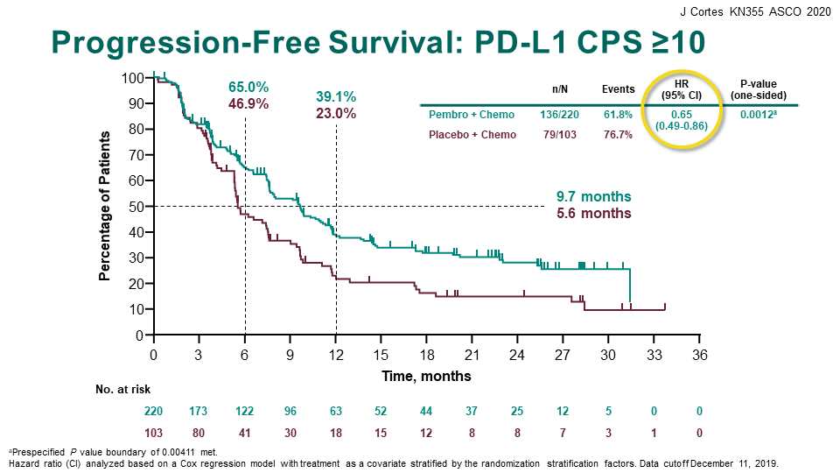
Metastatic TNBC (Keynote 355)
Nov 2020: FDA Approved Pembrolizumab for PD-L1+ mTNBC

Slide 9
Atezolizumab Indication Withdrawn
Atezolizumab TNBC indication was withdrawn by the manufacturer in August 2021 after talks with the FDA
Atezolizumab + nab-paclitaxel received accelerated approval in 2019 based on the IMpassion130 trial
Continued approval was based on the results of IMpassion131, which did not meet its primary endpoint

Slide 10
What If a Patient Has a Known Germline BRCA Mutation?

Slide 11
HER2- MBC with gBRCA Mutation: Olaparib and Talazoparib
Both Olaparib and Talazoparib FDA approved for pts with HER2 – MBC and germline BRCA mutations

Slide 12
Patient Story: 35F
2017: Underwent lumpectomy with radiotherapy for pT2N0, invasive breast cancer, ER-/PR-/HER2-
2018: Received AC-T chemotherapy
2018: Pulmonary metastasis → mTNBC, PD-L1 positive
2018: Received carboplatin and pembrolizumab (clinical trial). Disease progression after nine months. Received capecitabine. Disease progression after three months.
Which therapy would you choose next?

Slide 13
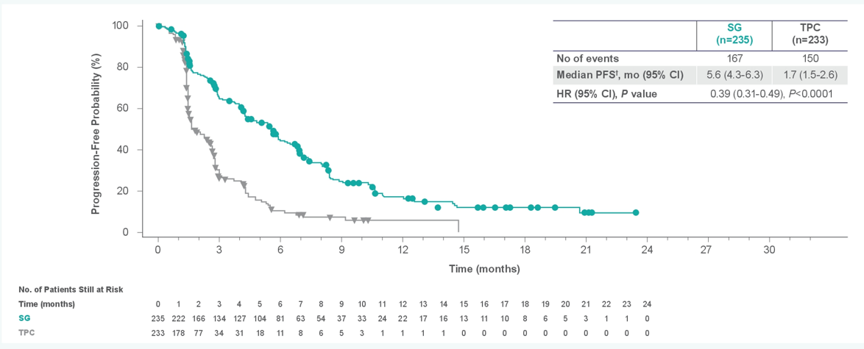
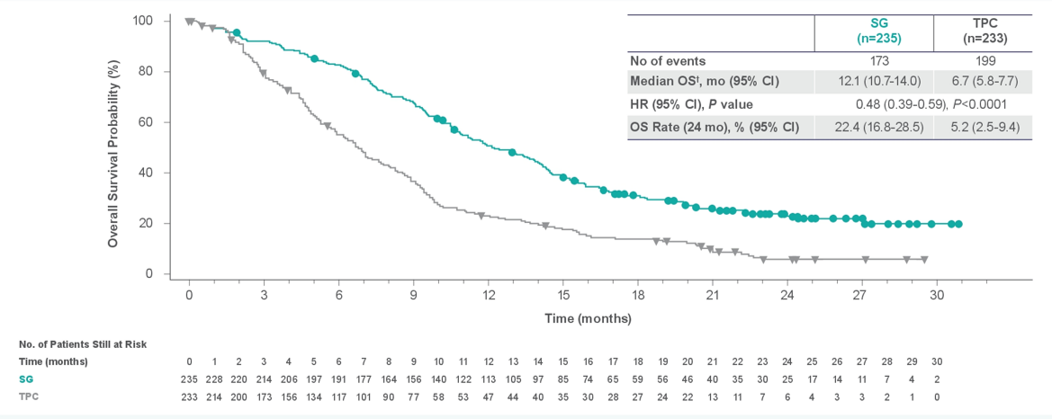
Pre-treated mTNBC: Sacituzumab Govitecan
Progression-Free Survival Among Patients Without Brain Metastases
Overall Survival Among Patients Without Brain Metastases
FDA approved for pts with pre-treated mTNBC
(at least 1 prior therapy for MBC)

Slide 14
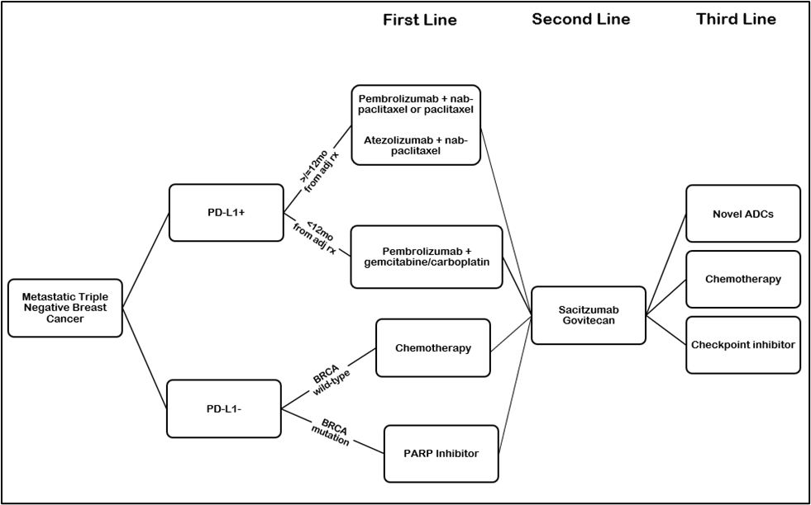
Management of Metastatic TNBC: Treatment Algorithm

Slide 15
Conclusion
First Line:
Chemotherapy + pembrolizumab preferred first line therapy for metastatic TNBC that is PD-L1 positive
Second, Third, and Plus Line:
PARP inhibitor (olaparib, talazoparib) standard for BRCA-mutant metastatic TNBC
Sacituzumab govitecan preferred second line (and beyond) therapy for metastatic TNBC
Chemotherapy (such as capecitabine, eribulin) currently standard of care for third line (and beyond) metastatic TNBC

