Slide 1
What Is the Evidence Supporting TROP-2 Directed Therapy in Current Clinical Practice of Patients With TNBC?
Aditya Bardia, MD, MPH
Director
Breast Cancer Research
Associate Professor
Harvard Medical School
Mass General Hospital Cancer Center
Boston, MA

Slide 2
Disclaimer
The views and opinions expressed in this educational activity are those of the faculty and do not necessarily represent the views of TotalCME, Inc., the CME providers, or the companies providing educational grants. This presentation is not intended to define an exclusive course of patient management; the participant should use their clinical judgment, knowledge, experience, and diagnostic skills in applying or adopting for professional use any of the information provided herein. Any procedures, medications, or other courses of diagnosis or treatment discussed or suggested in this activity should not be used by clinicians without evaluation of their patient's conditions and possible contraindications or dangers in use, review of any applicable manufacturer’s product information, and comparison with recommendations of other authorities. Links to other sites may be provided as additional sources of information.

Slide 3
Trop-2 as Therapeutic Target
Trop-2/EGP-1 is a pan-epithelial cancer antigen
Related to but distinct from EGP-2 (aka EpCAM)
Less expression on normal tissues
Overexpressed in multiple tumor types
Excellent target for ADC

Slide 4
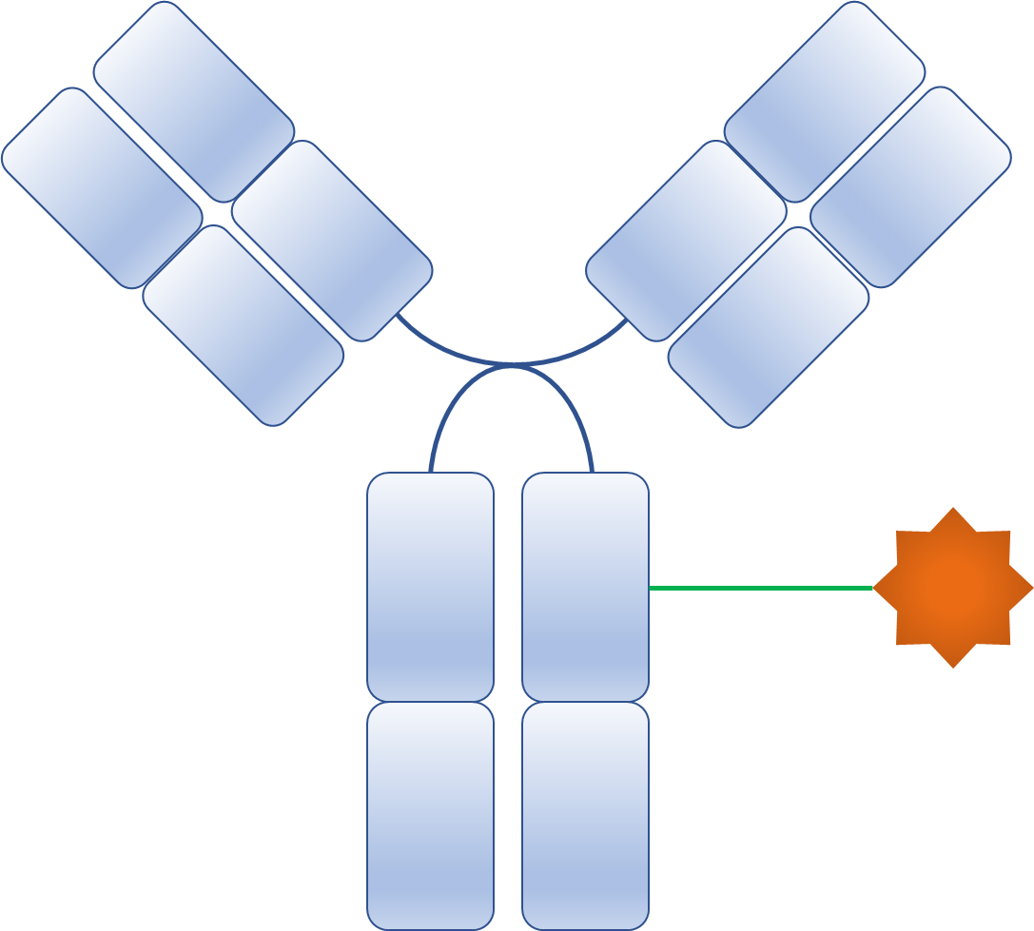
Antibody-Drug Conjugates: Targeted Payload Delivery
1. Binding of an ADC to antigen
2. Internalization to the early endosome
Trop-2
Trop-2
Clathrin
5. Apoptosis of the cancer cell
H⁺
Lysosomes
H⁺
3. Degradation of ADCs in the lysosome
4. Release and action of payload

Slide 5
Antibody-Drug Conjugates: Targeted Payload Delivery
1. Binding of an ADC to antigen
2. Internalization to the early endosome
Trop-2
Trop-2
6. Bystander Effect
Clathrin
5. Apoptosis of the cancer cell
H⁺
Lysosomes
H⁺
3. Degradation of ADCs in the lysosome
4. Release and action of payload

Slide 6
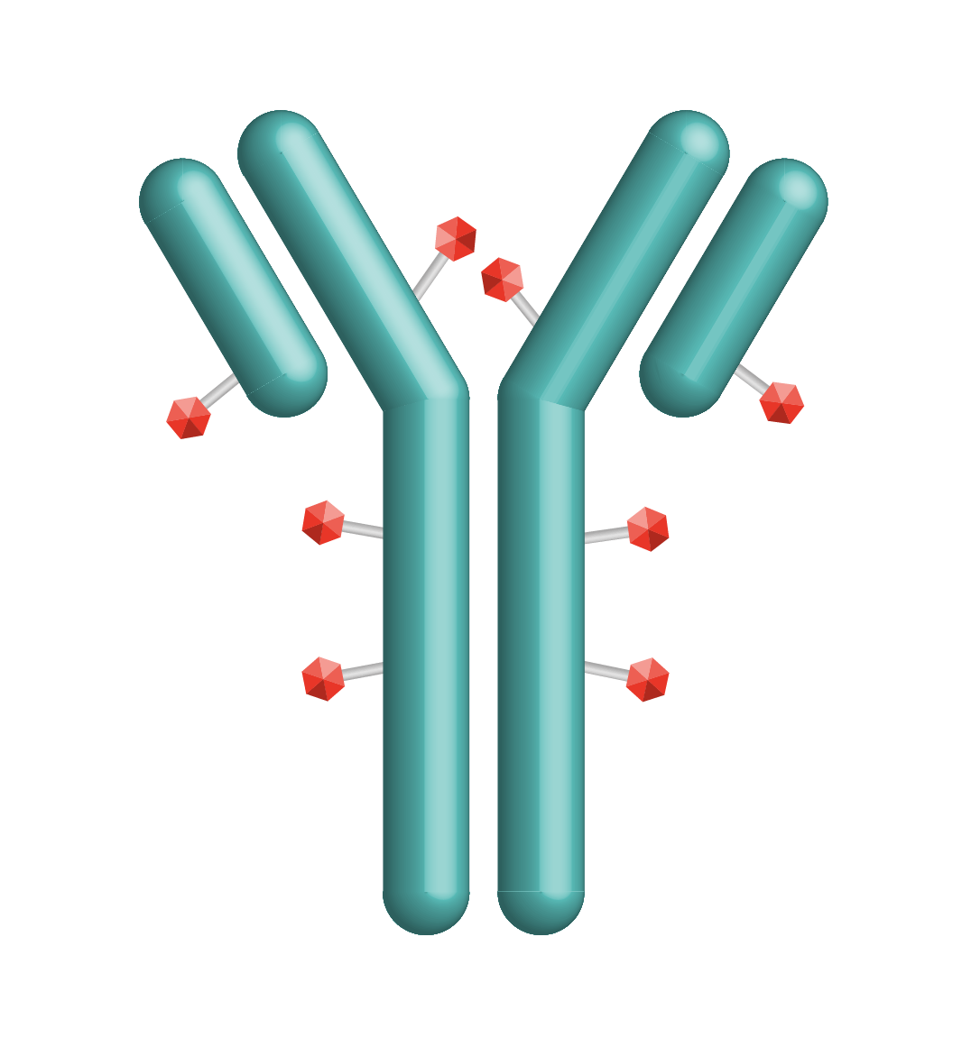
Sacituzumab Govitecan: First-In-Class Trop-2 ADC
Trop-2 is expressed in all subtypes of breast cancer and linked to poor prognosis^{1,2}
SG is distinct from other ADCs³⁻⁶
Antibody highly specific for Trop-2
High drug-to-antibody ratio (7.6:1)
Internalization and enzymatic cleavage by tumor cell not required for the liberation of SN-38 from the antibody
Hydrolysis of the linker also extracellularly releases the SN-38 cytotoxic in the tumor microenvironment, providing a bystander effect
Linker for SN-38
Hydrolyzable linker for payload release
High drug-to-antibody ratio (7.6:1)⁶
Humanized anti‒Trop-2 antibody
Directed toward Trop-2, an epithelial antigen expressed on many solid cancers
SN-38 payload
SN-38 more potent than parent compound irinotecan
ADC: antibody−drug conjugate
Trop-2: trophoblast cell surface antigen 2

Slide 7
ASCENT Phase III Study of Sacituzumab Govitecan: Overview
Metastatic TNBC
(per ASCO/CAP)
≥ 2 chemotherapies for advanced disease
(no upper limit; one of the required prior regimens could be from progression that occurred within a 12-month period after completion of [neo]adjuvant therapy)
N = 529
Sacituzumab Govitecan (SG)
10 mg/kg IV days 1 & 8, every 21-day cycle
(n = 267)
Endpoints
Primary
PFS†
Secondary
PFS for the full population‡
OS, ORR, DOR, TTR, safety
Continue treatment until progression or unacceptable toxicity
R 1:1
Treatment of Physician’s Choice (TPC)* (n = 262)
Data cutoff: February 25, 2021
NCT02574455
*TPC: eribulin, vinorelbine, gemcitabine, or capecitabine. †PFS measured by an independent, centralized, and blinded group of radiology experts who assessed tumor response using RECIST 1.1 criteria in patients without brain metastasis. ‡The full population includes all randomized patients (with and without brain metastases). Baseline brain MRI only required for patients with known brain metastasis.
ASCO/CAP, American Society of Clinical Oncology/College of American Pathologists; DOR, duration of response; DSMC, Data Safety Monitoring Committee; IV, intravenous; mTNBC, metastatic triple-negative breast cancer; ORR, objective response rate; OS, overall survival; PFS, progression-free survival; R, randomization; RECIST, Response Evaluation Criteria in Solid Tumors; TTR, time to response. National Institutes of Health. https://clinicaltrials.gov/ct2/show/NCT02574455.

Slide 8
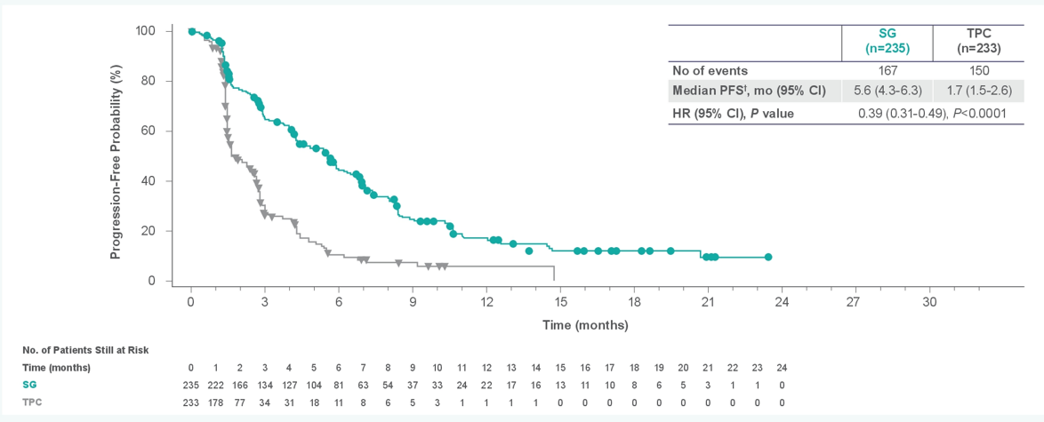
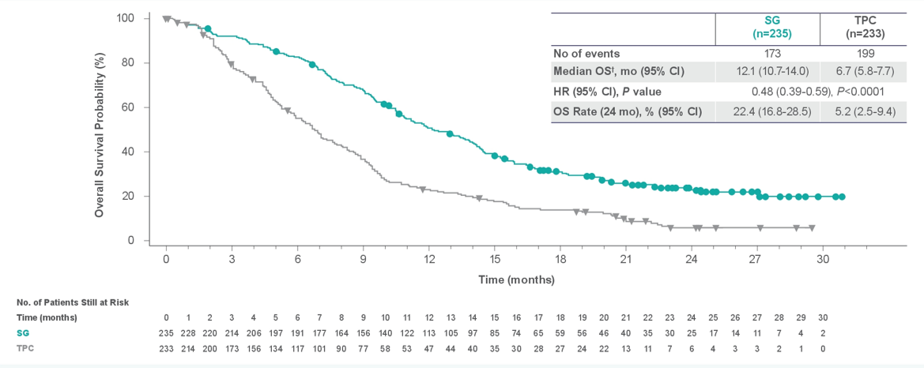
Progression-Free Survival and Overall Survival
Similar results noted with additional follow up on final database lock*
Progression-Free Survival Among Patients Without Brain Metastases
Overall Survival Among Patients Without Brain Metastases

Slide 9
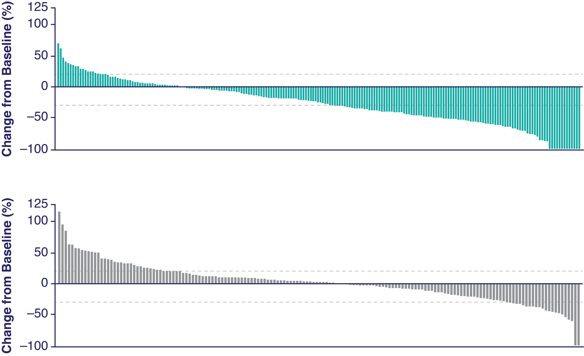
Overall Response Rate: Sacituzumab Govitecan (vs TPC)
 | SG (n=235) | TPC (n=233)
ORR—no. (%) | 82 (35) | 11 (5)
P-value | <0.0001
CR | 10 (4) | 2 (1)
PR | 72 (31) | 9 (4)
CBR—no. (%) | 105 (45) | 20 (9)
P-value | <0.0001
Median DOR —mo (95%CI) | 6.3 (5.5−9.0) | 3.6 (2.8−NE)
P-value | 0.057
SG
***
TPC
****
Assessed by independent central review in brain metastases-negative population. *Denotes patients who had a 0% change from baseline in tumor size. BICR, blind independent central review; CBR, clinical benefit rate (CR + PR + SD ≥6 mo); CR, complete response; DOR, duration of response; ORR, objective response rate; PR, partial response; SG, sacituzumab govitecan; TPC, treatment of physician’s choice; TTR, time to response.
Similar results noted with additional follow up on final database lock*

Slide 10
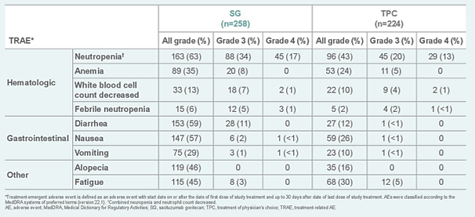
Treatment Related Adverse Effects: Sacituzumab Govitecan (vs TPC)
Key grade ≥ 3 TRAEs (SG vs TPC): neutropenia (51% vs 33%), diarrhea (10% vs < 1%), leukopenia (10% vs 5%), anemia (8% vs 5%), and febrile neutropenia (6% vs 2%)
No severe cardiovascular toxicity; no grade > 2 neuropathy or grade > 3 interstitial lung disease with SG

Slide 11
What About Biomarkers?
Objective Response Rate by Trop-2 Expression
Trop-2
Trop-2

Slide 12
What About Biomarkers?
Objective Response Rate by Trop-2 Expression
Bystander Effect
Trop-2
Trop-2

Slide 13
What About Other Drugs?
Humanized
Anti-TROP2 IgG1 mAb
Patients with relapsed/refractory advanced or metastatic TNBC have poor clinical outcomes¹
Dato-DXd is a differentiated TROP2-directed ADC designed with three components^{2,3}:
A humanized anti-TROP2 IgG1⁴ mAb
A topoisomerase I inhibitor payload (exatecan derivative, DXd)
A tetrapeptide-based cleavable linker
Dato-DXd has demonstrated highly encouraging antitumor activity and manageable AEs in the NSCLC cohort⁵
6 mg/kg has been selected as the dose for expansion into other advanced tumor types
Deruxtecan^{6,a}
Cleavable Tetrapeptide-Based Linker
Topoisomerase I Inhibitor Payload (DXd)
ADC, antibody drug conjugate; AE, adverse event; IgG1, immunoglobulin G1; mAB, monoclonal antibody; NSCLC, non-small cell lung cancer; TNBC, triple negative breast cancer; TROP2, trophoblast cell surface antigen. ª Actual drug positions may vary.
1. Bardia A, et al. NEJM.2021; 2. Okajima D, et al. AACR-NCI-EORTC 2019 [Abstract C026]; 3. Nakada T, et al. Chem Pharm Bull (Tokyo). 2019;67(3):173-185; 4. Daiichi Sankyo Co. Ltd. Accessed October 6, 2020. https://www.daiichisankyo.com/media_investors/investor_relations/ir_calendar/files/005438/DS-1062%20Seminar%20Slides_EN.pdf7; 5. Spira A et al. WCLC 2020 [Abstract 3407]; 6. Krop I, et al. SABCS 2019 [Abstract GS1-03].

Slide 14
Clinical Efficacy in mTNBC: Datopotamab Deruxtecan
Patients, n (%)ª | All Patients (n=44)
ORR | 15 (34)
CR/PR (confirmed) | 14 (32)
CR/PR (pending confirmation)^{b} | 1 (2)
Non-CR/non-PD | 3 (7)
Stable disease | 17 (39)
Not evaluable | 2 (5)
Disease control rate | 34 (77)
PD | 8 (18)
100
80
60
40
20
Best Percent Change in SoD From Baseline by BICR (n=39), %
Median follow-up: 7.6 months (range, 4-13 months)
0
†
*
*
*
-20
*
†
*
*
*
-40
Dose level:
†
*
8 mg/kg
*
*
-60
6 mg/kg
-80
Prior sacituzumab govitecan
Prior DXd-based ADC
*
-100
†
Similarly, enrollment in TROPION-PanTumor01: Dato-DXd HR+ Breast Cancer Cohort

Slide 15
Treatment-Emergent Adverse Events: Datopotamab Deruxtecan
Most common adverse events observed were nausea and stomatitis (predominantly grade 1-2)
Low frequency of hematologic toxicity and diarrhea
No cases of ILD
Different from Sacituzumab Govitecan and Trastuzumab Deruxetcan!
Grade
1-2
≥3
0
10
20
30
40
50
60
70
Patients, %ª

Slide 16
ADCs to Target MBC: Multiple Agents in Development
Drug | Target
Ado-trastuzumab emtansine (T-DM1) | HER2
Trastuzumab deruxtecan (DS-8201a) | HER2
Sacituzumab govitecan (IMMU-132) | Trop-2
Ladiratuzumab vedotin (SGN-LIV1a) | LIV-1
Patritumab deruxtecan (U3-1402) | HER3
Datopotamab deruxtecan (DS-1062) | Trop-2
AVID100 | EGFR
BA3021 | ROR2
SAR6658 | CA6
SAR408701 | CEA-CAM5

Slide 17
Summary
Sacituzumab govitecan (SG), first-in-class trop-2 ADC, is the preferred treatment for patients with metastatic TNBC (2nd line and beyond)
Ongoing studies are evaluating SG in HR+ breast cancer, in combination with targeted therapies and immunotherapy, as well as neo/adjuvant therapy in early breast cancer
Datopotamab deruxtecan (Dato-DxD) is another trop-2 ADC that has demonstrated impressive clinical activity in pre-treated mTNBC
Additionally, there are multiple targeted therapies in development to target key genomic pathways and antigens overexpressed in breast cancer

