Slide 1
How Can You Recognize and Manage the Common Adverse Events Seen With ADCs?
Kevin Kalinsky, MD, MS
Director, Glenn Family Breast Center
Winship Cancer Institute at Emory University
Atlanta, GA

Slide 2
ASCENT Phase III Study of Sacituzumab Govitecan: Overview
Metastatic TNBC
(per ASCO/CAP)
≥2 chemotherapies for advanced disease
[no upper limit; one of the required prior regimens could be from progression that occurred within a 12-month period after completion of (neo)adjuvant therapy]
(n=529)
Sacituzumab Govitecan (SG)
10 mg/kg IV
Days 1 and 8, every 21-day cycle
(n=267)
Endpoints
Primary
PFS†
Secondary
PFS for the full population‡
OS, ORR, DOR, TTR, safety
Continue treatment until progression or unacceptable toxicity
R 1:1
Treatment of Physician’s Choice (TPC)*
(n=262)
Stratification factors
Number of prior chemotherapies (2-3 vs >3)
Geographic region (North America vs Europe)
Presence/absence of known brain metastases (yes/no)
NCT02574455
ASCENT was halted early due to compelling evidence of efficacy per unanimous DSMC recommendation.
*TPC: eribulin, vinorelbine, gemcitabine, or capecitabine. †PFS measured by an independent, centralized, and blinded group of radiology experts who assessed tumor response using RECIST 1.1 criteria in patients without brain metastasis. ‡The full population includes all randomized patients (with and without brain metastases). Baseline brain MRI only required for patients with known brain metastasis.
ASCO/CAP, American Society of Clinical Oncology/College of American Pathologists; DOR, duration of response; DSMC, Data Safety Monitoring Committee; IV, intravenous; mTNBC, metastatic triple-negative breast cancer; ORR, objective response rate; OS, overall survival; PFS, progression-free survival; R, randomization; RECIST, Response Evaluation Criteria in Solid Tumors; TTR, time to response.
National Institutes of Health. https://clinicaltrials.gov/ct2/show/NCT02574455.

Slide 3
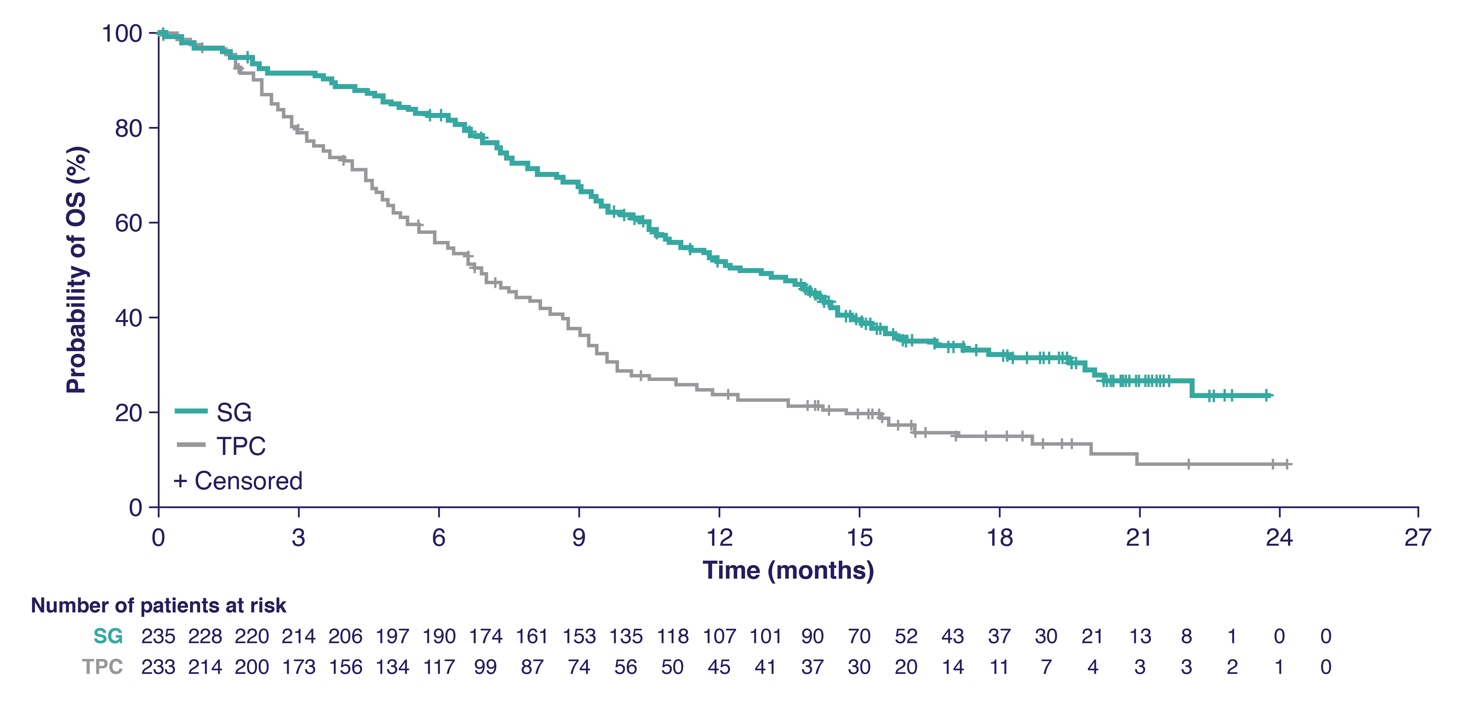
ASCENT: Overall Survival
 | SG (n=235) | TPC (n=233)
No. of events | 155 | 185
Median OS—mo (95% CI) | 12.1 (10.7-14.0) | 6.7 (5.8-7.7)
HR (95% CI), P-value | 0.48 (0.38-0.59), P<0.0001
Assessed by independent central review in the brain metastases-negative population.
OS, overall survival; SG, sacituzumab govitecan; TPC, treatment of physician’s choice.

Slide 4
ASCENT: TRAEs (All Grade, >20%;Grade 3/4, >5% of Patients)
 |  |  | SG (n=258) |  |  | TPC (n=224)
TRAE* |  |  | All grade % | Grade 3, % | Grade 4, % | All grade, % | Grade 3, % | Grade 4, %
Hematologic | Neutropenia† | Neutropenia Febrile neutropenia Anemia Leukopenia | 63 | 46 | 17 | 43 | 27 | 13
 | Anemia‡ |  | 34 | 8 | 0 | 24 | 5 | 0
 | Leukopenia§ |  | 16 | 10 | 1 | 11 | 5 | 1
 | Febrile neutropenia |  | 6 | 5 | 1 | 2 | 2 | <1
Gastrointestinal | Diarrhea |  | 59 | 10 | 0 | 12 | <1 | 0
 | Nausea |  | 57 | 2 | <1 | 26 | <1 | 0
 | Vomiting |  | 29 | 1 | <1 | 10 | <1 | 0
Other | Fatigue | Fatigue Alopecia Decreased appetite Hyperglycemia Hypomagnesemia Hypophosphatemia | 45 | 3 | 0 | 30 | 5 | 0
 | Alopecia |  | 46 | 0 | 0 | 16 | 0 | 0
Key grade ≥3 TRAEs (SG vs TPC): neutropenia (51% vs 33%), diarrhea (10% vs <1%), leukopenia (10% vs 5%), anemia (8% vs 5%), and
febrile neutropenia (6% vs 2%)
  G-CSF usage was 49% in the SG arm vs 23% in the TPC arm
  Dose reductions due to TRAEs were similar (22% SG vs 26% TPC)
No severe cardiovascular toxicity, no grade >2 neuropathy or grade >3 interstitial lung disease with SG
No treatment-related deaths with SG; one treatment-related death (neutropenic sepsis) with TPC
AEs leading to treatment discontinuation were low for SG and TPC: 4.7% and 5.4%, respectively
Patients received a median of seven treatment cycles of SG with a median treatment duration of 4.4 months (range, 0.03-22.9)
*Patients may report more than one event per preferred term. AEs were classified according to the MedDRA systems of preferred terms and system organ class and according to severity by NCI CTCAE v4.03. †Combined preferred terms of ‘neutropenia’ and ‘decreased neutrophil count’. ‡Combined preferred terms of ‘anemia’ and ‘decreased hemoglobin’. §Combined preferred terms of ‘leukopenia’ and ‘decreased white blood cell count’.
G-CSF, granulocyte-colony stimulating factor; SG, sacituzumab govitecan; TPC, treatment of physician’s choice; TRAE, treatment-related AE.

Slide 5
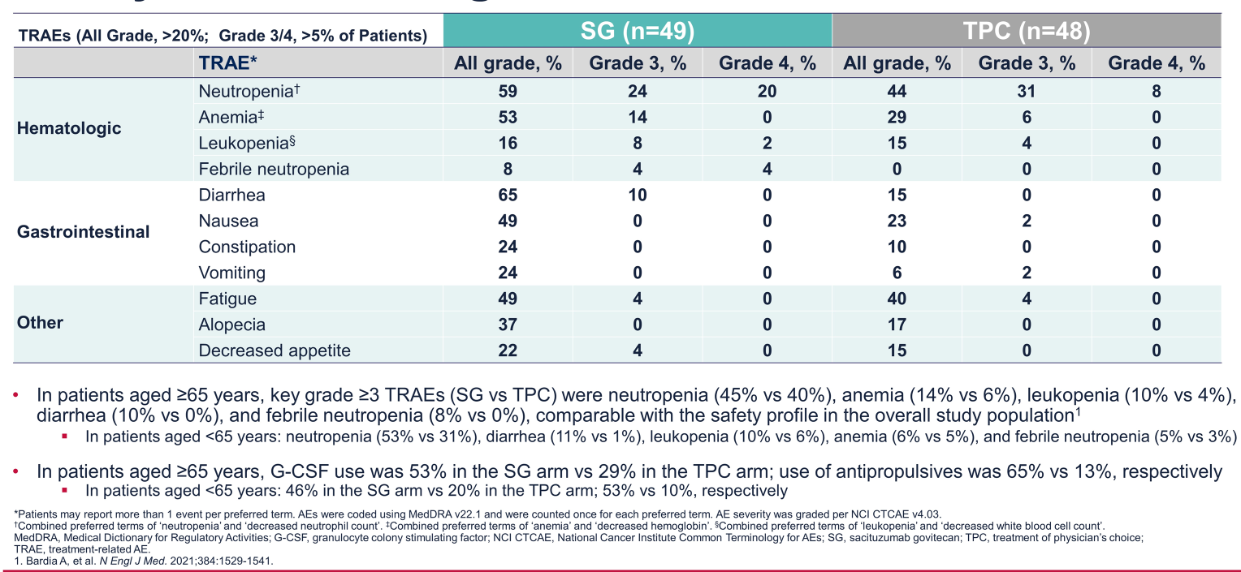
Phase 3 ASCENT: Safety in Patients ≥65 Years

Slide 6
TROPION-PanTumor01 (NCT03401385)
Phase 1 Study of Datopotamab Deruxtecan in Relapsed/Refractory Metastatic Solid Tumors
Relapsed/refractory advanced/metastatic solid tumors
Unselected for TROP2 expressionª
Age ≥18 (US) or ≥20 (Japan) years
ECOG PS 0-1
Measurable disease per RECIST version 1.1
Stable, treated brain metastases allowed
NSCLC^{b}
(0.27 to 10 mg/kg IV Q3W)
Primary objectives
Safety
Tolerability
Secondary objectives^{e}
Efficacy^{f}
Pharmacokinetics
Antidrug antibodies
TNBC^{c}
8 mg/kg (n=2); 6 mg/kg (n=42)
HR+/HER2− breast cancer^{d}
Other tumor types
(including SCLC, bladder, gastric, esophageal)
Data cutoff: July 30, 2021
ECOG PS, Eastern Cooperative Oncology Group performance status; Q3W, every 3 weeks; RECIST, Response Evaluation Criteria in Solid Tumors.
ª Pretreatment tumor tissue was required for retrospective analysis of TROP2 expression. ^{b} Results from the NSCLC cohort have been previously reported.^{1,2} ^{c} Includes patients treated in the dose-escalation and dose-expansion portions. ^{d} Enrollment in the HR+/HER2− cohort is now complete and data will be forthcoming. ^{e} Exploratory objectives include analyses of biomarkers associated with response. ^{f} Response assessments are based on RECIST 1.1.

Slide 7
Treatment-Emergent Adverse Events in ≥15% of Patients
TNBC Cohort
Most common adverse events observed were nausea and stomatitis (predominantly grade 1-2)
Low frequency of hematologic toxicity and diarrhea
No cases adjudicated as drug-related ILD
Grade
1-2
≥3
0
10
20
30
40
50
60
70
Patients, %ª
Data cutoff: July 30, 2021
ILD, interstitial lung disease.
ª n=44 patients.

Slide 8
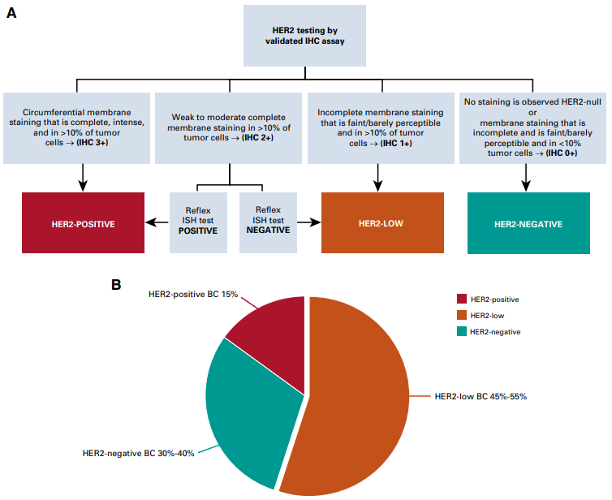
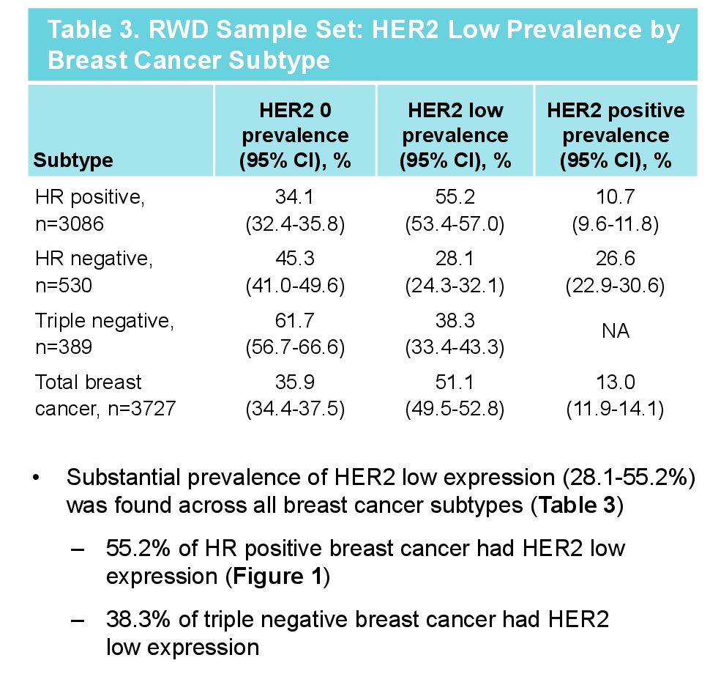
HER2-Low Breast Cancer
IHC 1+ or IHC 2+ with a negative ISH test
  Approximately 50% of patients with breast cancer
RWD Sample Set: HER2 Low Prevalence by
Breast Cancer Subtype

Slide 9
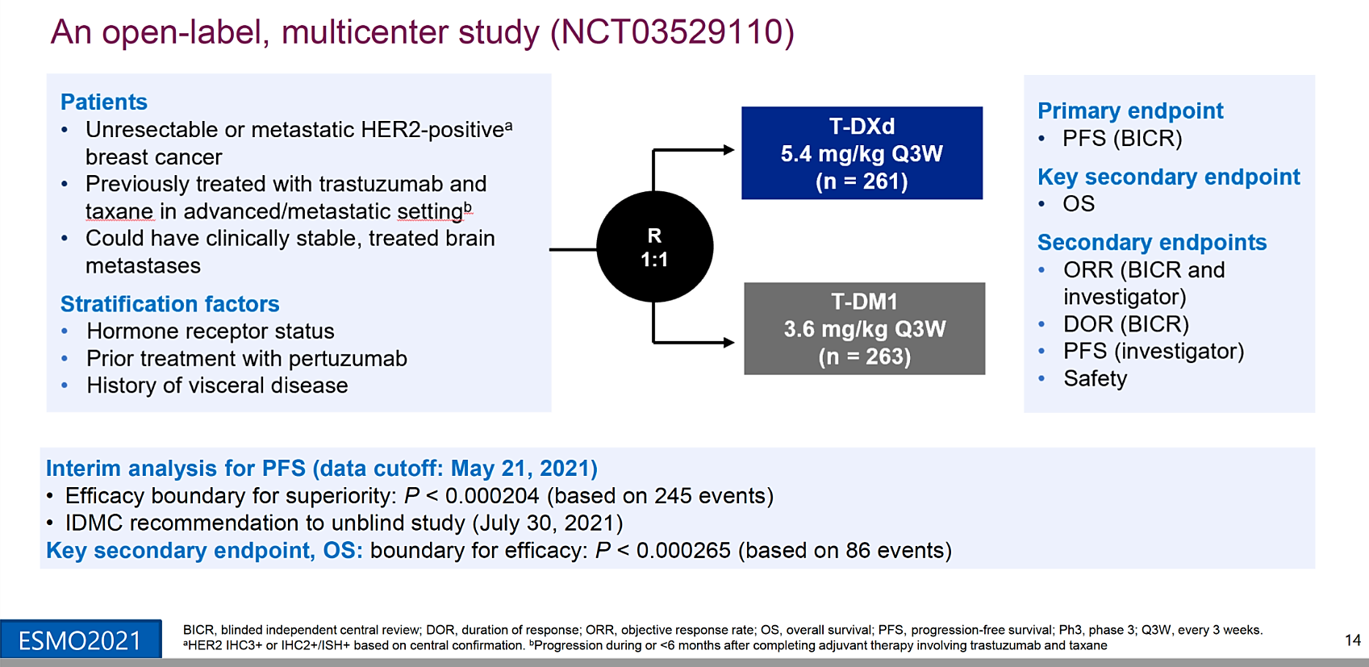
DESTINY-Breast03: First Randomized Ph3 Study of T-DXd

Slide 10
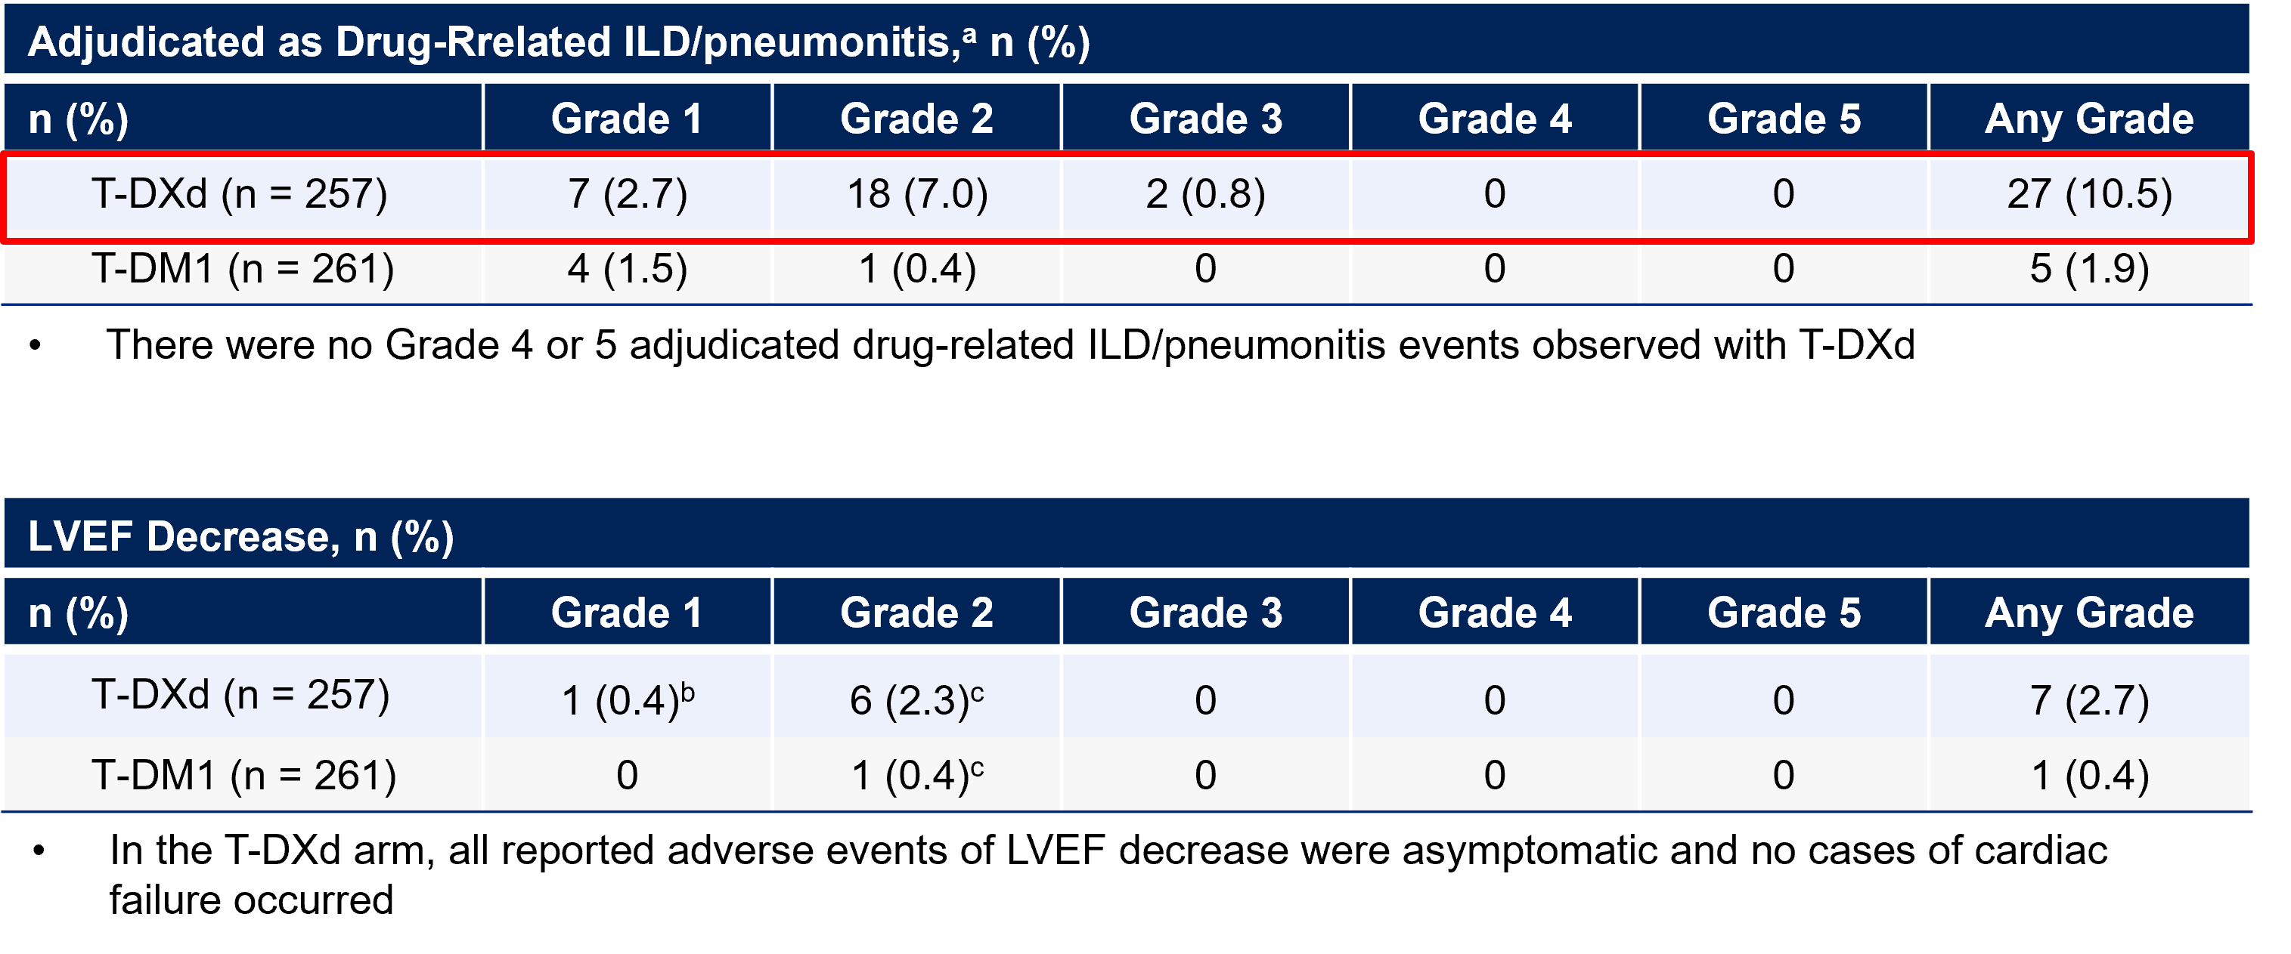
Adverse Events of Special Interest
ªPatients with prior history of ILD/pneumonitis requiring steroids were excluded. ^{b}Left ventricular dysfunction. ^{c}Decreased ejection fraction.
ILD, interstitial lung disease; LVEF, left-ventricular ejection fraction.

Slide 11
Summary
Not all ADCs are the same; adverse effect profiles differ between agents
Key adverse effects seen with sacituzumab govitecan include neutropenia, anemia, diarrhea, nausea, fatigue, and alopecia
Datopotamab deruxtecan causes nausea and stomatitis, but has a decreased risk of myelosuppression and diarrhea with no cases of interstitial lung disease
Decreases in left ventricular ejection fraction and drug related-interstitial lung disease/pneumonitis have been seen with trastuzumab deruxtecan and ado-trastuzumab emtansine

