Slide 1
What Is the Therapeutic Rationale for ADCs in Cancer?
Sara A. Hurvitz, MD, FACP
Professor of Medicine
Director, Breast Cancer Clinical Trials Program, Division of Hematology-Oncology
David Geffen School of Medicine, UCLA
Medical Director, Clinical Research Unit, Jonsson Comprehensive Cancer Center
Santa Monica, CA

Slide 2
Components of an Antibody Drug Conjugate (ADC)
Antibody
  High affinity and specificity to tumor antigen
  Efficient internalization
  Reduced immunogenicity
  ADCC/CDC
Fab
Fc

Slide 3
Components of an Antibody Drug Conjugate (ADC)
Payload
  Highly potent
  Microtubule inhibitors
    Auristatins
    Maytansines
  DNA damaging agents
    Calicheamicin
    Duocarmycins
    Topoisomerase I inhibitors
Antibody
  High affinity and specificity to tumor antigen
  Efficient internalization
  Reduced immunogenicity
  ADCC/CDC
Fab
Fc

Slide 4
Components of an Antibody Drug Conjugate (ADC)
Payload
  Highly potent
  Microtubule inhibitors
    Auristatins
    Maytansines
  DNA damaging agents
    Calicheamicin
    Duocarmycins
    Topoisomerase I inhibitors
Antibody
  High affinity and specificity to tumor antigen
  Efficient internalization
  Reduced immunogenicity
  ADCC/CDC
Fab
Fc
Linker
  Stable in the blood stream
  Capable of releasing payload
  once internalized
  Cleavable linker
  Non-cleavable linker

Slide 5
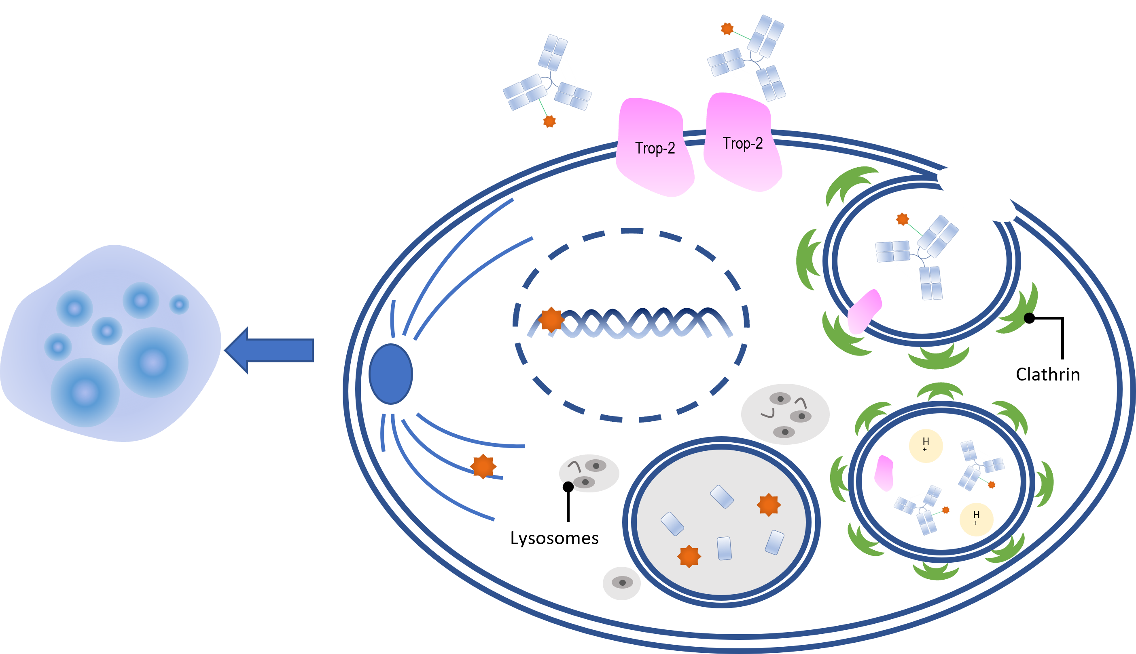
Selective Delivery of Toxic Payload
1. Binding of an ADC to antigen
2. Internalization to the early endosome
5. Apoptosis of the cancer cell
3. Degradation of ADCs in the lysosome
4. Release and action of payload

Slide 6
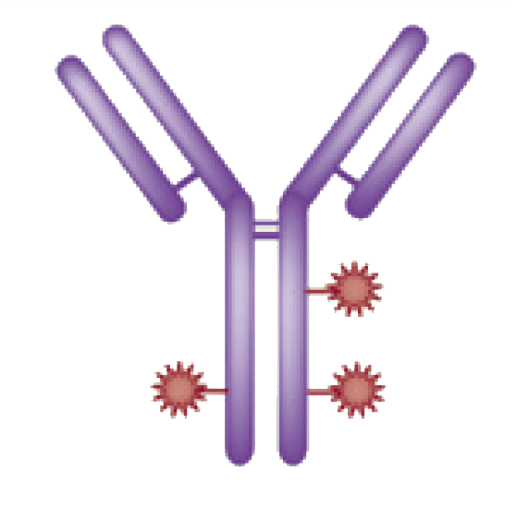




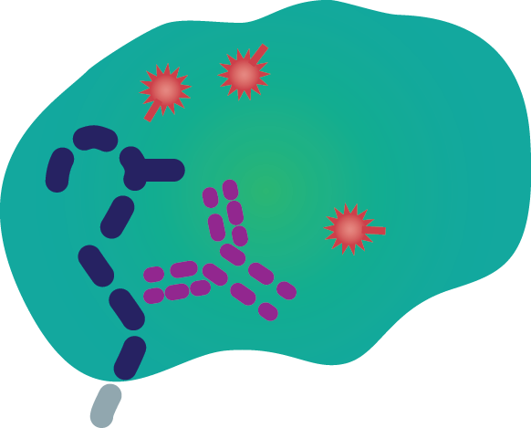
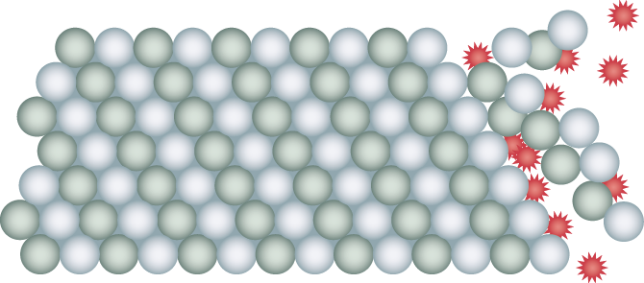


HER2 Targeted ADC: T-DM1 (trastuzumab emtansine)
HER2
T-DM1
Cytotoxic payload release
P
P
P
Lysosome
Internalization
Nucleus
Notes:
6

Slide 7
EMILIA: Led to T-DM1 Approval in Patients with HER2+ Locally Advanced or mBC in Feb 2013^{1,2}
ANTITUMOR ACTIVITY
Overall Survival
1.0
85.2%
 | Median (mo) | No. of events
Cap + Lap | 25.1 | 182
T-DM1 | 30.9 | 149
Stratified HR=0.682 (95% CI, 0.55-0.85); P = 0.0006 Efficacy stopping boundary P = 0.0037 or HR=0.727
0.8
78.4%
64.7%
0.6
PROPORTION SURVIVING
0.4
51.8%
Cap + Lap
0.2
T-DM1
Data cut-off July 31, 2012
Unstratified HR=0.70 (P = 0.0012)
0
0
2
4
6
8
10
12
14
16
18
20
22
24
26
28
30
32
34
36
Time (mo)

Slide 8
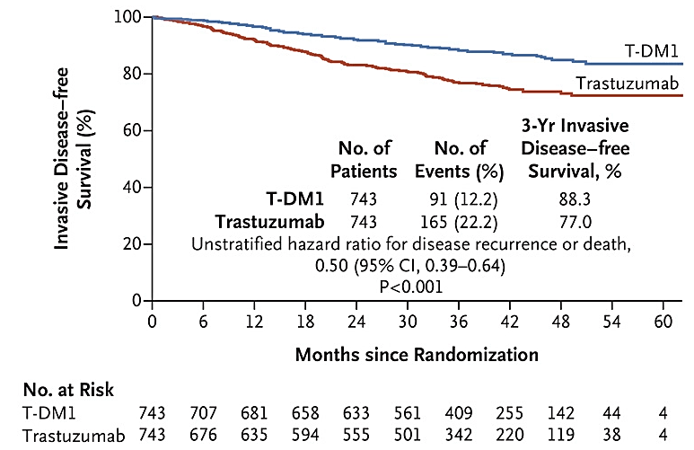
KATHERINE: Led to FDA Approval of T-DM1 for Patients with Residual Disease After Neoadjuvant Trastuzumab/Chemotherapy Based on Significantly Improved Invasive Disease-Free Survival

Slide 9
ADCs with Bystander Effect
1. Binding of an ADC to antigen
2. Internalization to the early endosome
5. Apoptosis of the cancer cell
3. Degradation of ADCs in the lysosome
4. Release and action of payload

Slide 10
ADCs with Bystander Effect
6. Bystander Effect
1. Binding of an ADC to antigen
2. Internalization to the early endosome
5. Apoptosis of the cancer cell
3. Degradation of ADCs in the lysosome
4. Release and action of payload

Slide 11
Trastuzumab Deruxtecan (DS-8201):
ADC Targeting HER2
DS-8201a Structure and Mechanism of Action

Slide 12
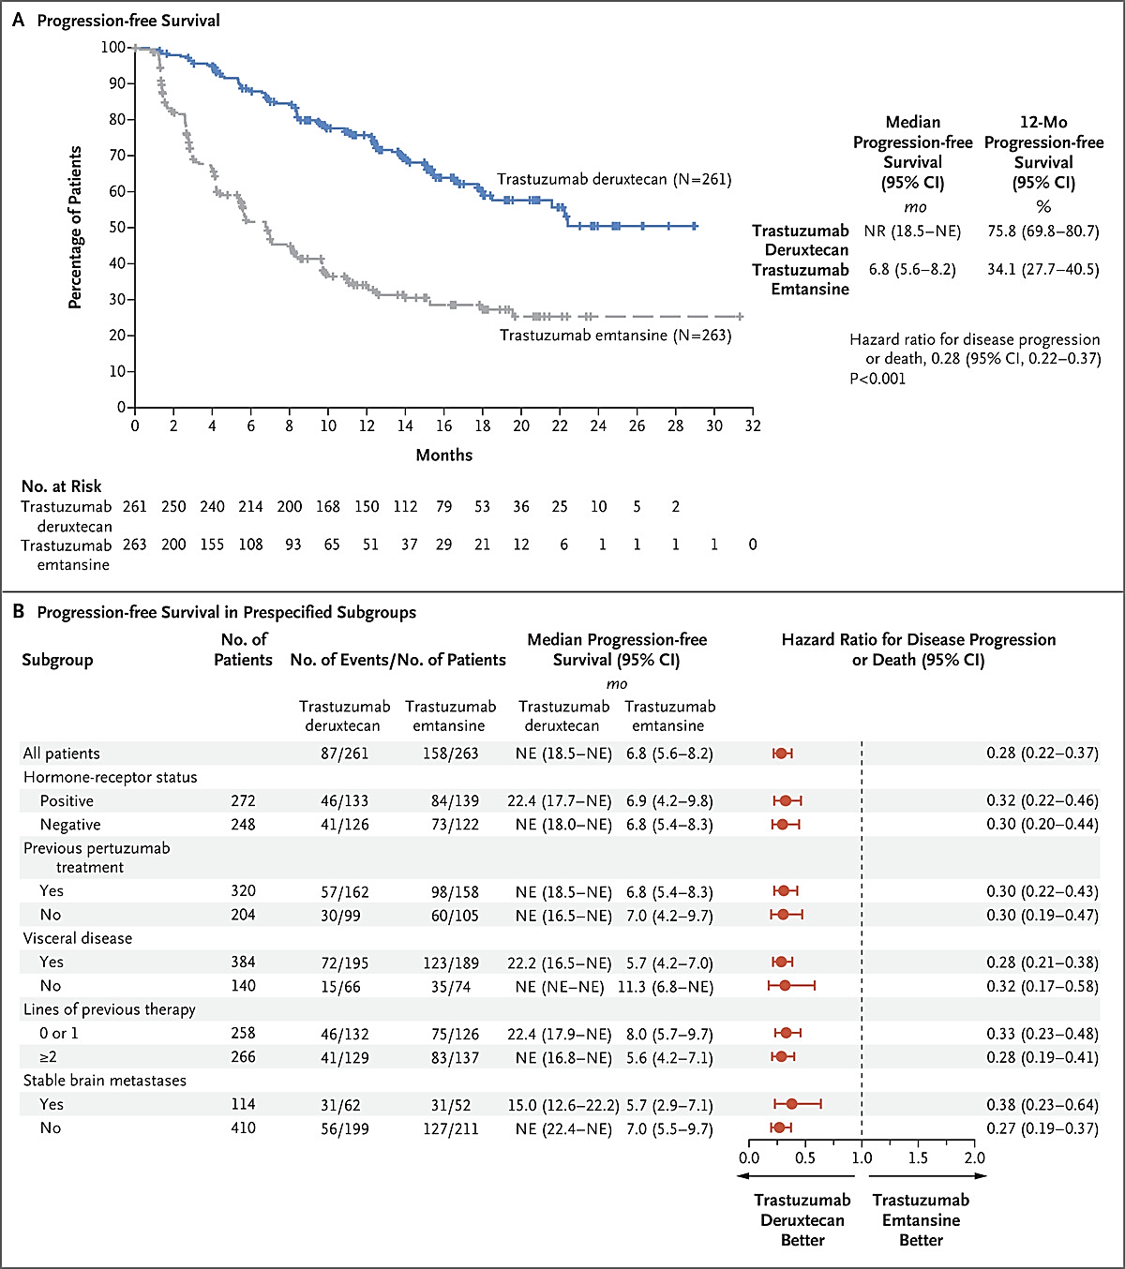
T-DXd Improves PFS Compared to T-DM1 for HER2+ Metastatic Breast Cancer (DESTINY-Breast-04)

Slide 13
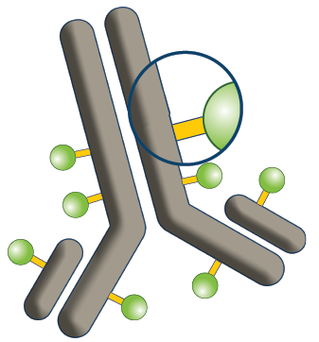
Sacituzumab Govitecan: ADC
Humanized Anti-Trop-2 Antibody
Targets Trop-2—an epithelial antigen expressed on many solid cancers including mTNBC
Linker for SN-38
Hydrolysable linker for payload release
High drug-to-antibody ratio (7.5:1)
SN-38 Payload
SN-38 more potent than parent compound irinotecan
ADC delivers up to
136-fold more SN-38 than irinotecan in vivo

Slide 14
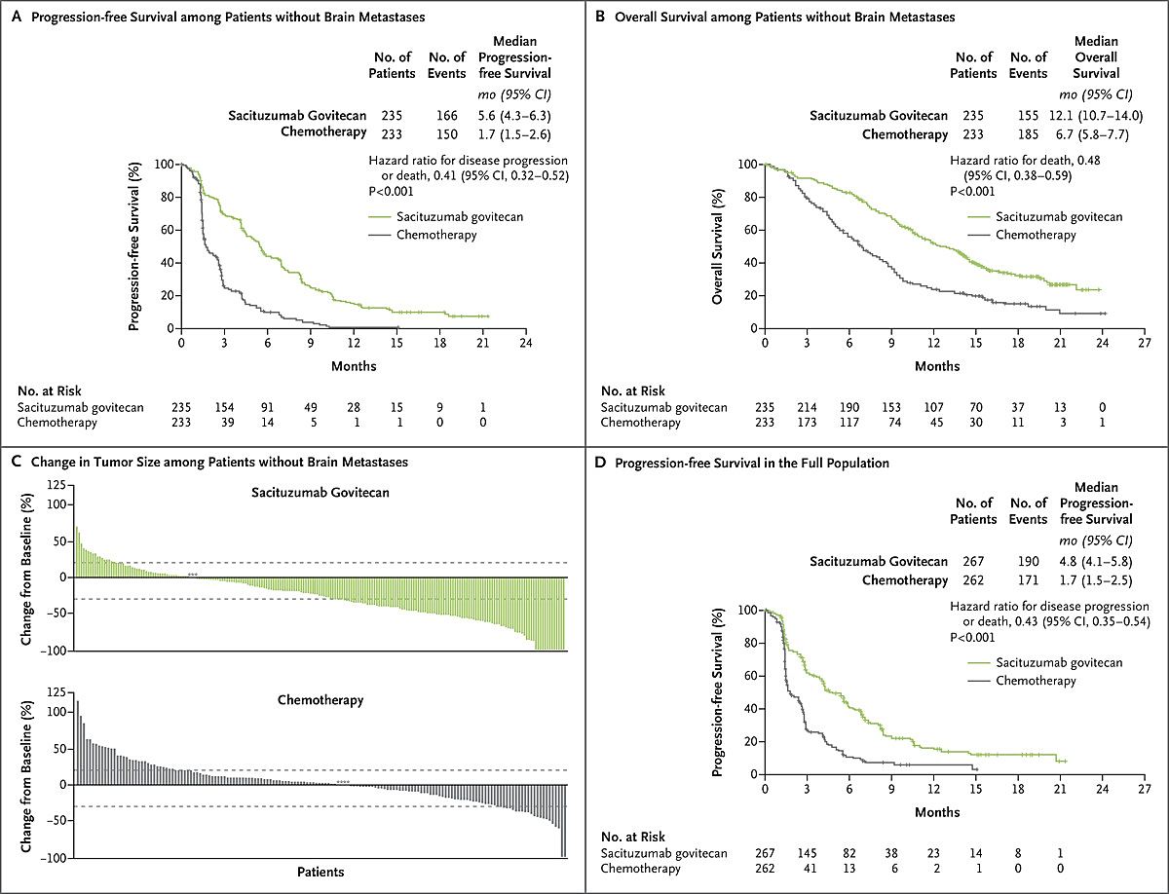
Sacituzumab Govitecan for Metastatic TNBC
Improves PFS and OS (ASCENT)

Slide 15
Summary
The field of ADCs has significantly altered the treatment landscape for those diagnosed with cancer
This allows patients to be treated with high doses of very potent chemotherapies with greater efficacy and without the same level of toxicity as would be seen if the chemotherapy was given alone

