Slide 1
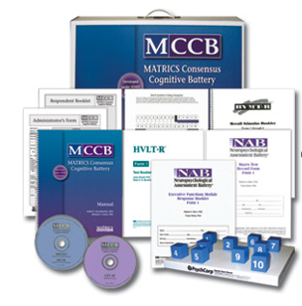
MATRICS Consensus Cognitive Battery (MCCB)¹
Speed of processing
Category fluency
Trail Making Test, Part A
Symbol coding
Attention/vigilance
Continuous Performance Test, identical pairs (CPT-IP)
Working memory
Letter-number span
Spatial span
Verbal learning
Hopkins Verbal Learning Test – revised (HVLT-R)
Visual learning
Brief Visuospatial Memory Test – revised (BVMT-R)
Reasoning and problem solving
Mazes
Uses mean of t-scores for an estimate of global neuropsychological performance

Slide 2
Interview-Based Assessments of Cognitive Performance
Effective if you have an informant (family member/caregiver) who can tell you about the patient
Important to assess the person's ability to perform cognitively demanding relevant tasks
Structured assessments of functional capacity include:
Can the patient carry on a conversation?
Does the patient frequently get lost?
Is the person able to get their laundry done or cook a meal?
If you ask the right person the right question, you get an answer that's valid

Slide 3
Quote by Philip Harvey, PhD
“One of the really important functional skills appears to be organizing everyday activities.”
“If a patient can organize a shopping list, go out, shop, and then prepare a meal, that avoids having them eating their food at 7-Eleven. So I think it's important to think about organized elements of sequential activities, which can be assessed by asking relatives.”

