Slide 1
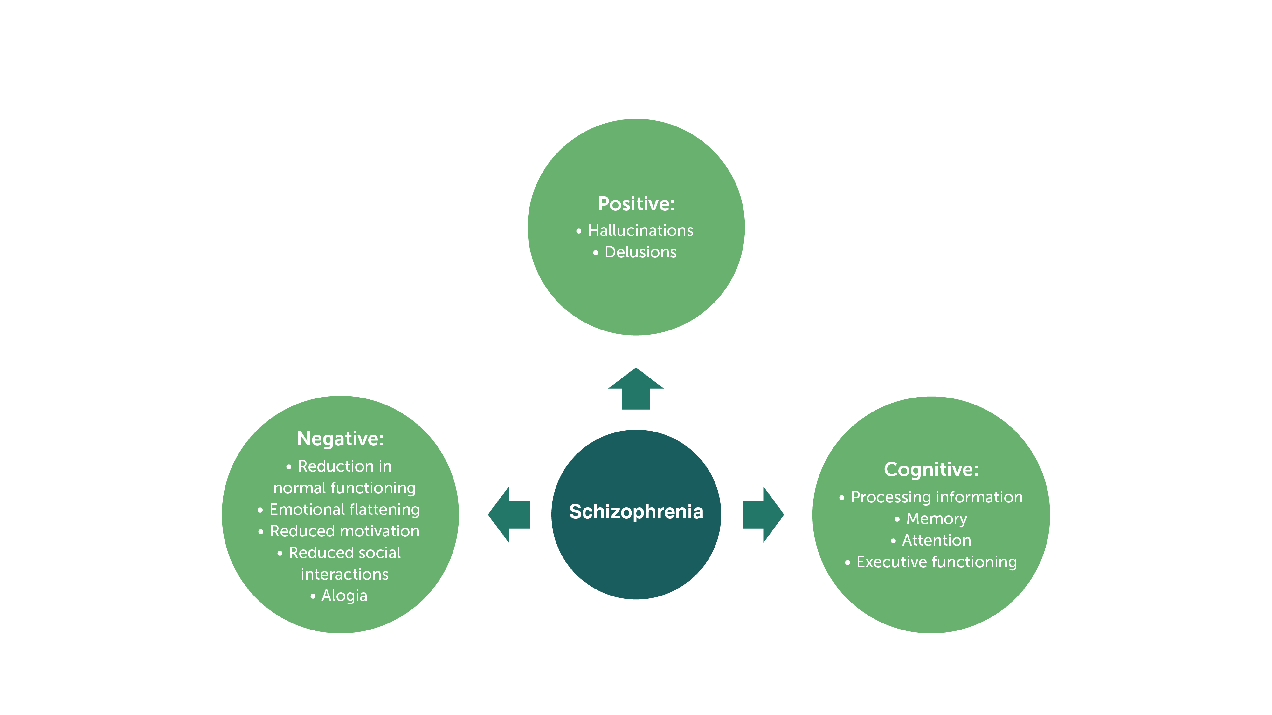
Triad of Symptoms in Schizophrenia

Slide 2
Interaction Between Negative and Cognitive Symptoms
Interaction between negative and cognitive symptoms affects everyday activities
Negative and cognitive symptoms are different
Negative symptoms predict social outcomes more than vocational functioning or everyday activities
Cognition predicts vocational functioning and everyday activities but not social outcomes
You need to ask: What are you actually trying to treat?

Slide 3
Subdomains of Negative Symptoms
Reduced emotional experience
Interferes with interest in doing the things they can do
Reduced emotional expression
Blunted affect, monotone voices
Reduced emotional experience, avolition, and amotivation are more strongly related to poor outcomes than reduced emotional expressions

