Slide 1
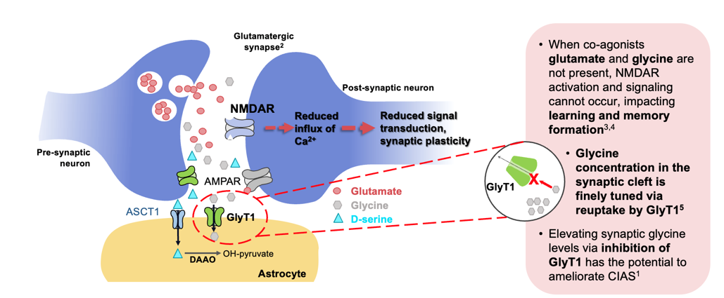
Glycine Is an Obligator Co-Transmitter at NMDAR

Slide 2
NMDA Receptor Activity
Glycine and glycine transport are ways to manipulate the NMDA receptor
  Previous efforts in increasing NMDA activity in NMDA have not worked
More naturalistic manipulation of the receptor system by inhibiting transport with the GlyT1 inhibitor
  Pushing more glycine into the system
Regulates the receptor system and allows it to function more normally

