Slide 1
CIAS: Characteristics
Occurs before the onset of psychotic symptoms
Affects different cognitive abilities
Attention
Processing speed
Working memory
Executive functioning
Episodic memory

Slide 2
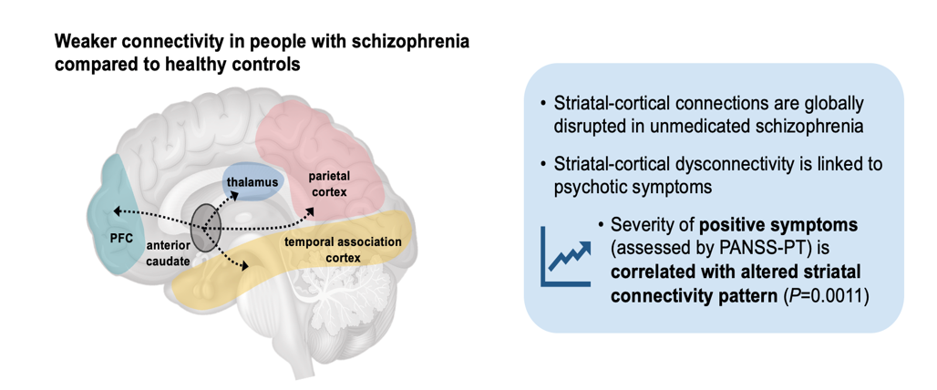
Altered Striatal Connectivity to Frontal Regions

Slide 3
CIAS Prevalence
Is Up To
85%

Slide 4
Quote by Martin Strassnig, MD
“That concept of NMDA hypofrontality that is in the frontal lobe, there is basically a deficit, often GABAergic neuronal input, that kind of slows the brain processing down. It basically causes impaired cognitive function.”

